Slide 1
Lending Club Case Study
Santosh Talluri
Samarjeet Saurabh

Slide 2

Objective
Objective: The aim of this case study is to apply Exploratory Data Analysis (EDA) techniques to a real-world problem, uncover meaningful insights, and present them in a business-focused manner through a presentation.
Benefits of the Case Study:
Provides an understanding of how EDA is utilized in addressing real-world business challenges.
Develops a foundational knowledge of risk analytics within the banking and financial services sectors.
Demonstrates how data is leveraged to minimize financial losses when lending to clients.
Enhances comprehension of data visualization and the appropriate use of charts for real-world data analysis.

Slide 3
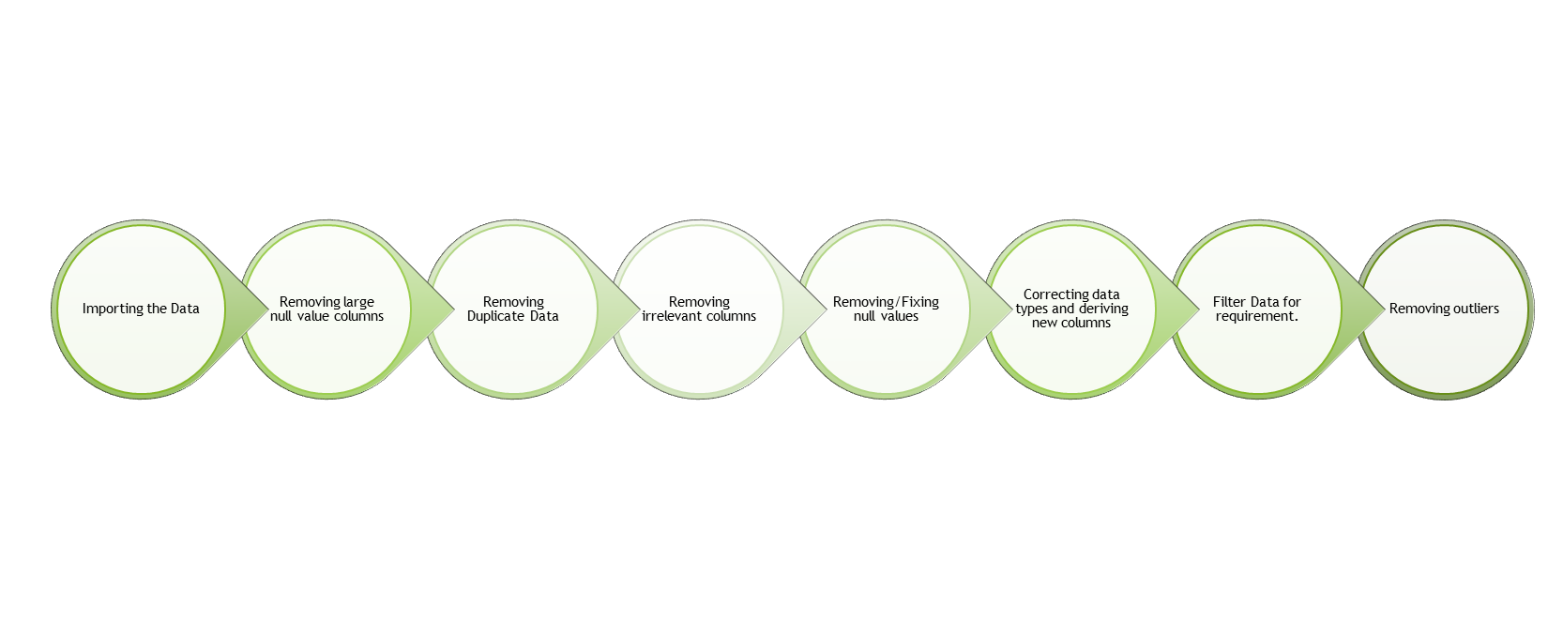
Business Understanding
Business Objective: The goal is to make informed decisions on whether to approve or reject loan applications based on specific variables.
Dataset Details:
The dataset provided includes information on past loan applicants, indicating whether they defaulted or not. The data pertains only to approved loans and does not include rejected applications. The loan status is categorized into three types: Fully Paid, Current, and Charged-Off.
Data Clean-up and preparation process:

Slide 4
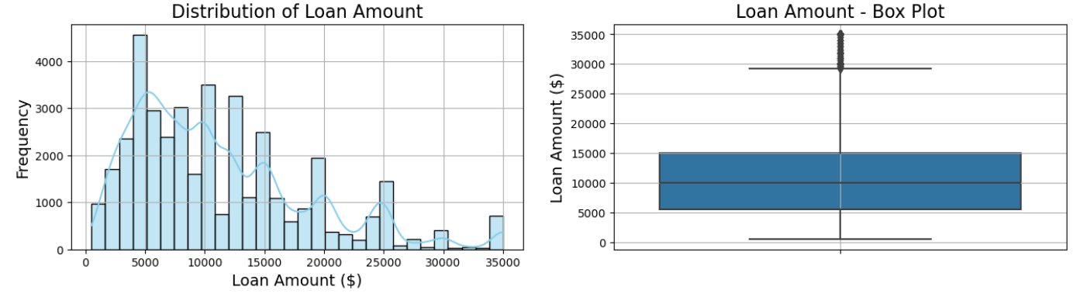
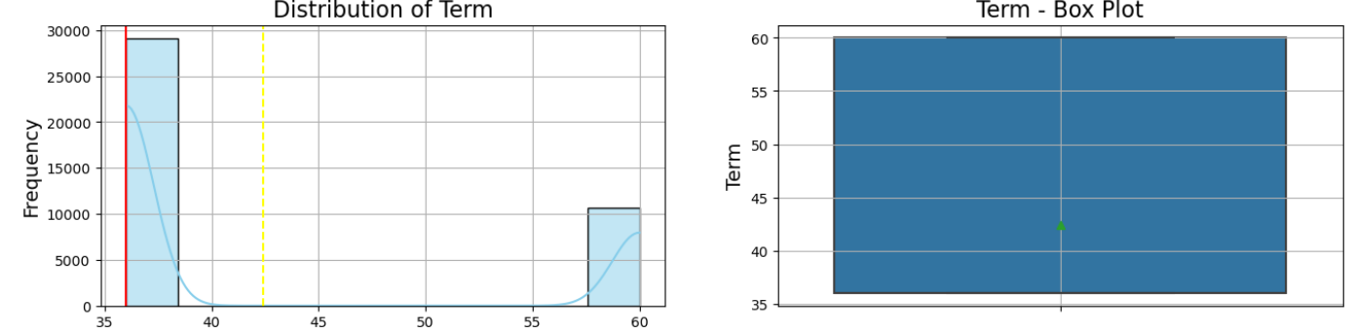
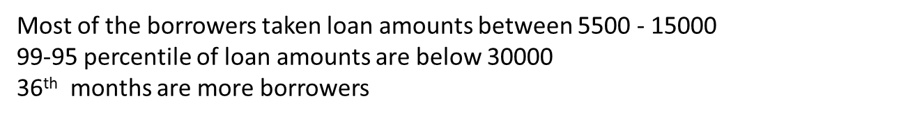
Distribution of Loan Amount & Term

Slide 5
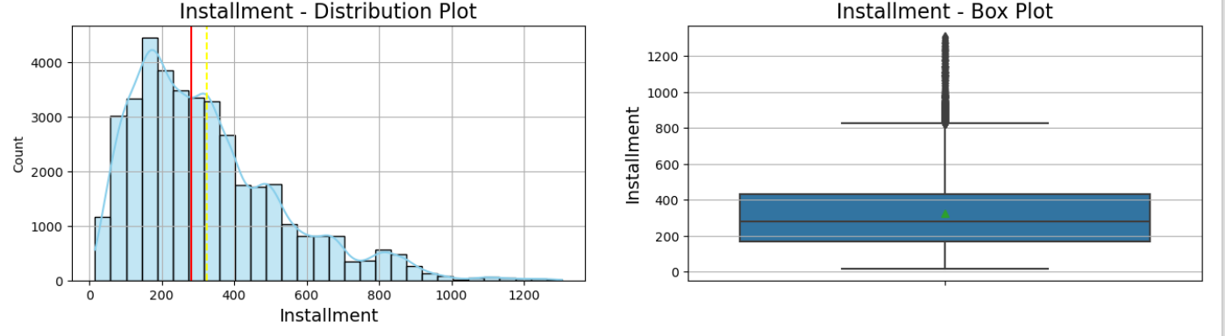
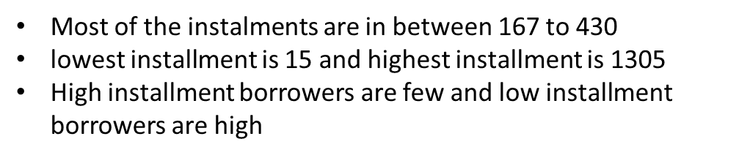
Installment

Slide 6
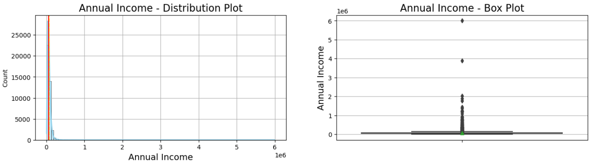
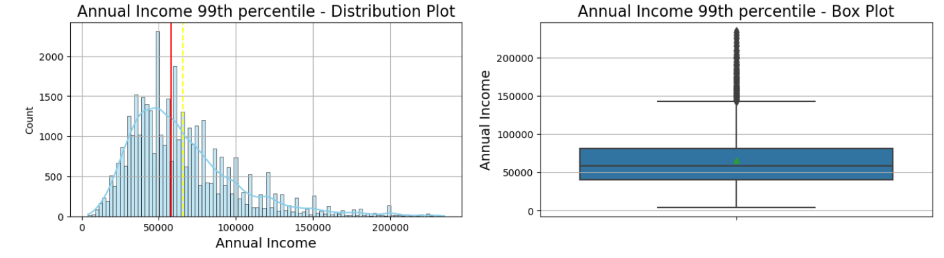
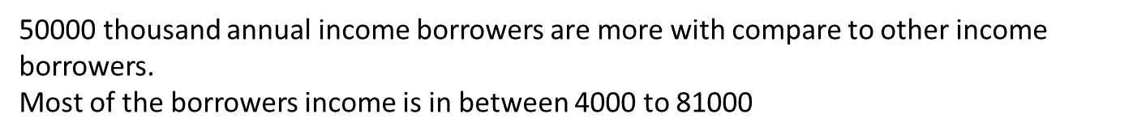
Annual Income

Slide 7
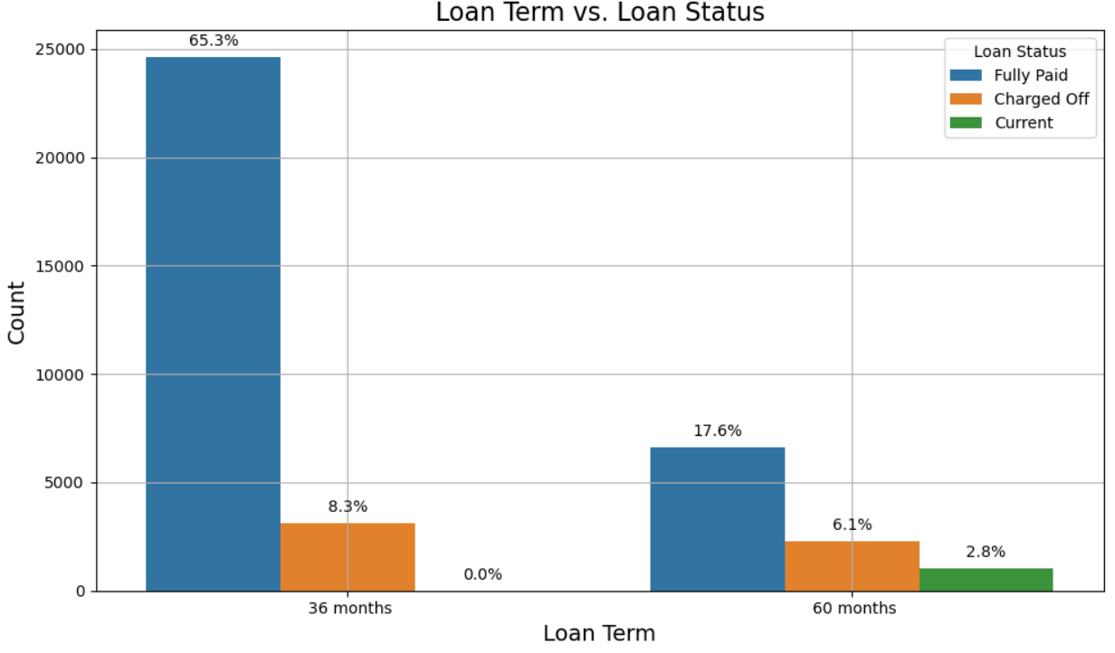
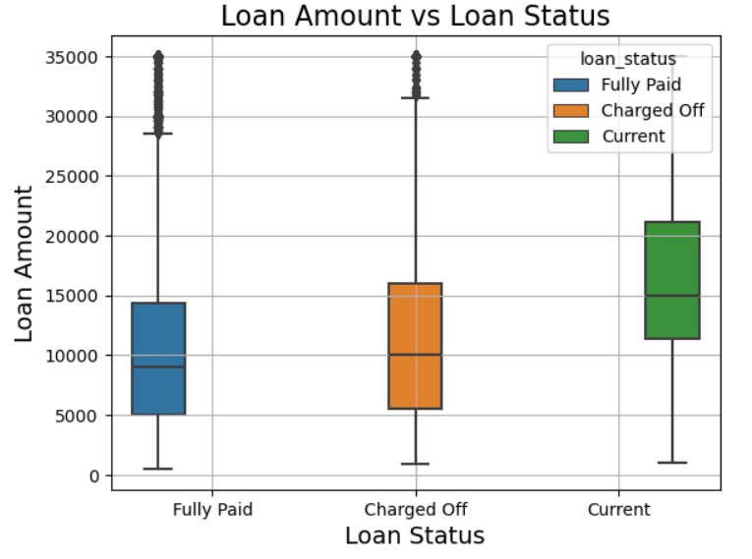
Loan Status and Amount
Loan Status: The number of charged off loan is much smaller(14.5%) compared to total count.
Loan Amount: It varies from 500 to 35000 with a median of 10000. Loan amount is majorly small and very few clients have taken large loans and larger it goes we have higher chance of defaulting.

Slide 8
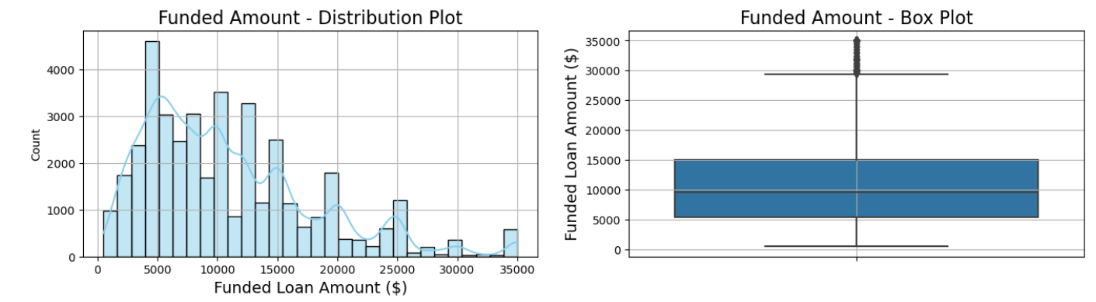

Funded Loan

Slide 9
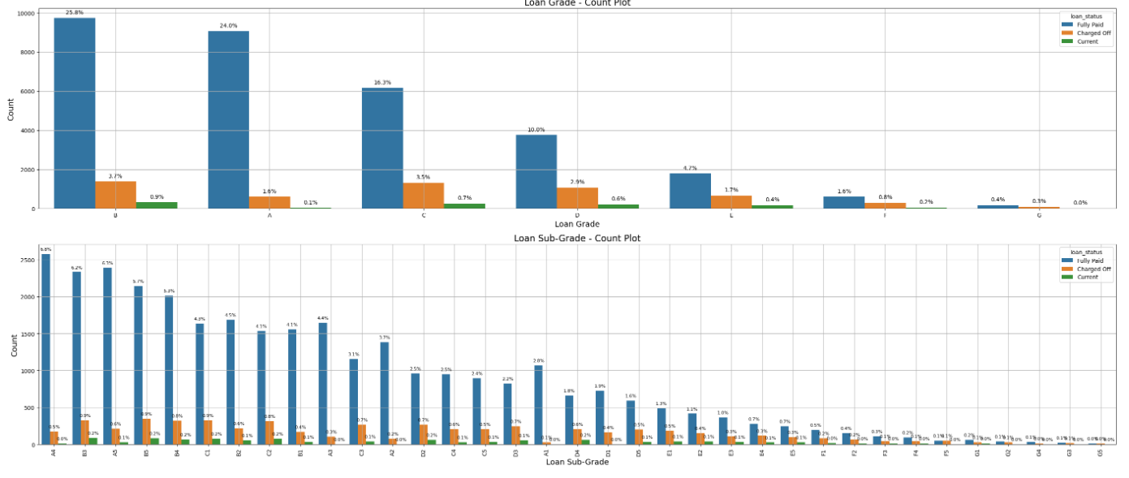
Grade and Sub-Grade
Grade: The loan approved are majorly of higher grade as they are of low risk thus low chance of defaulting. 60 month term loans have larger number of lower grade loans with high risk.
Sub Grade: This provides more insight that the loans within grade are more skewed towards lowered sub grades.

Slide 10
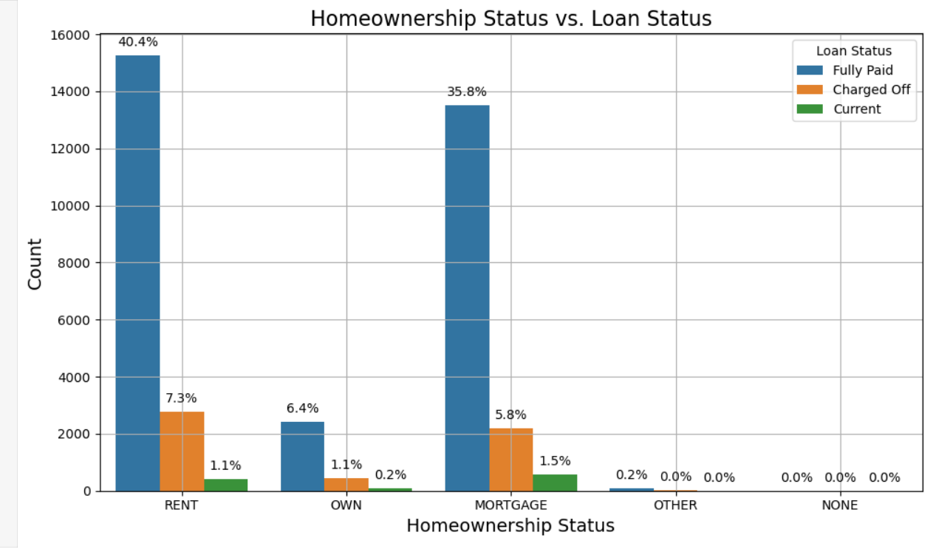
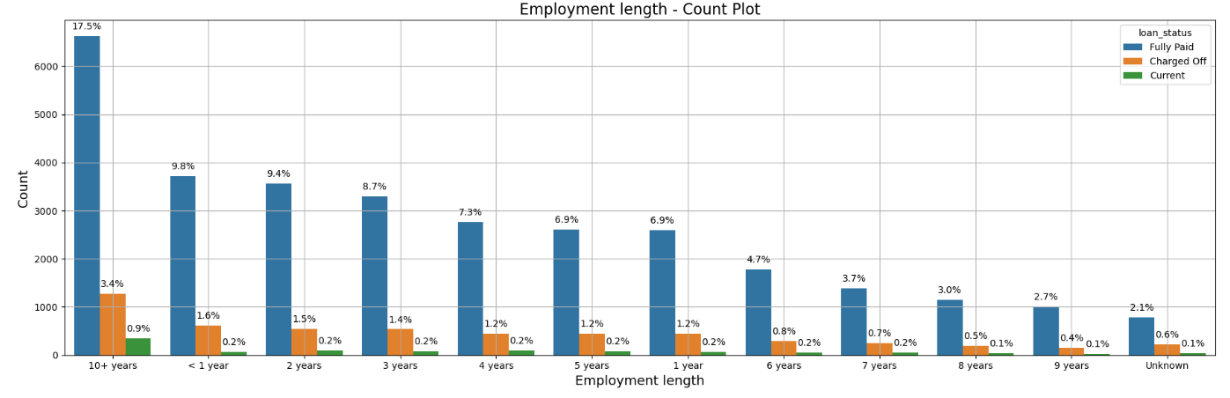
Employment Length & Homeownership
Employment Length: Majority of clients have 10+ years of experience and has highest number of defaulted loan.
Home Ownership: Majority of clients are lacking ownership of any property and are on rent or mortgage and have a higher chance of defaulting.

Slide 11
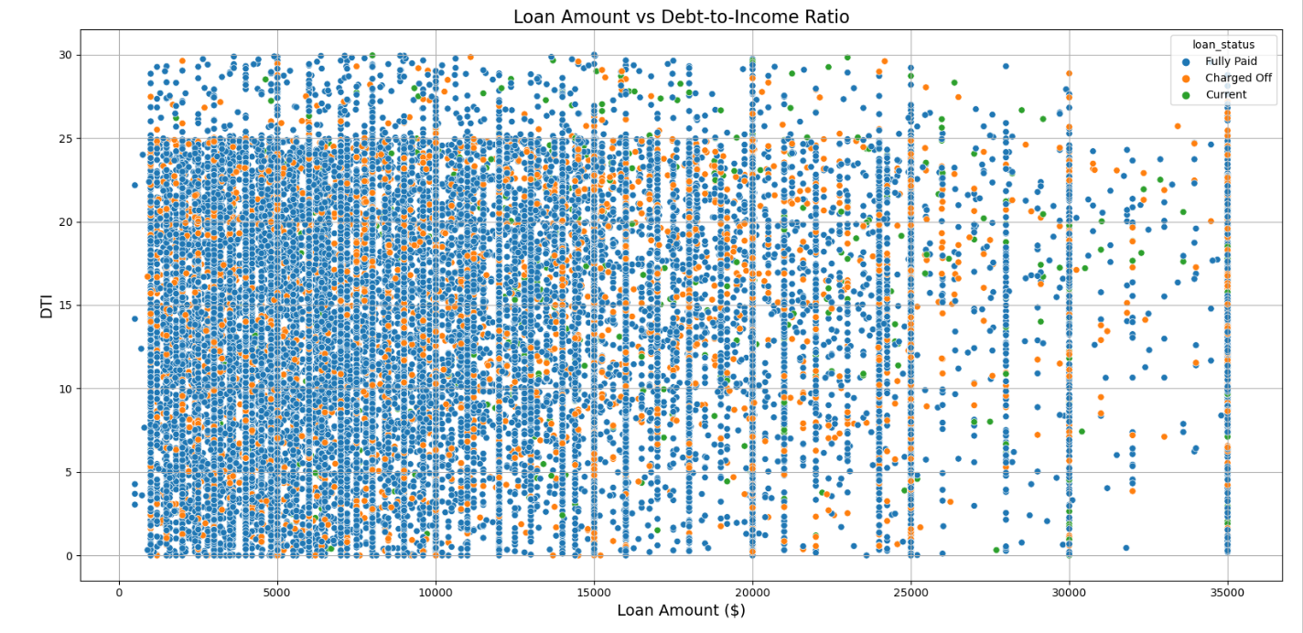
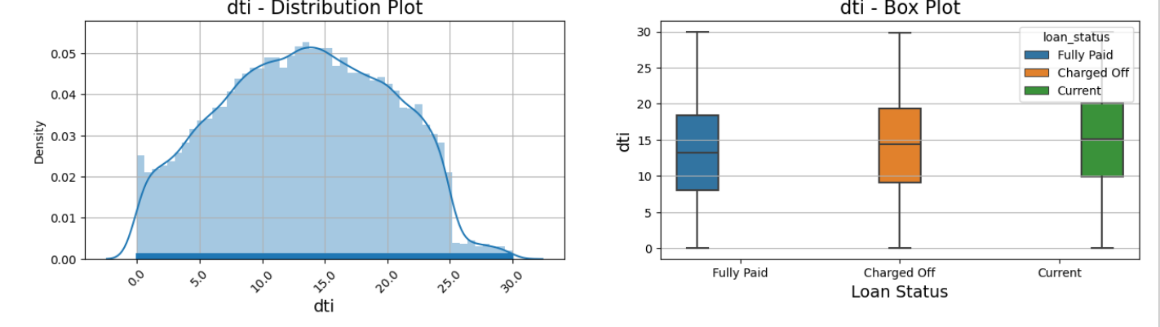
DTI & Loan status
DTI: The large percentage of Clients have a large Debt to Income ratio which shows that lending to such clients can be very risky.

Slide 12
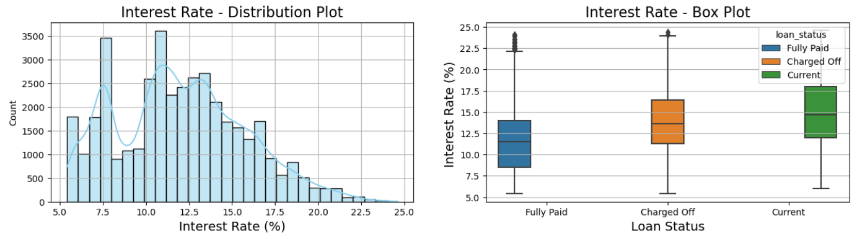
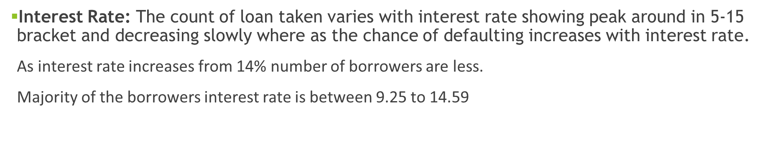

Interest Rate

Slide 13
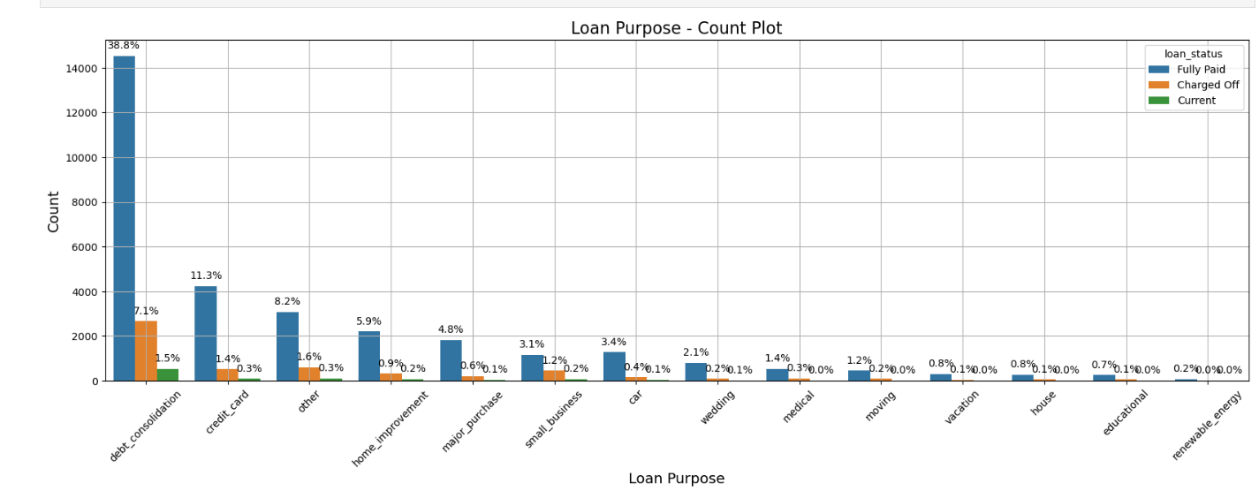
Loan Purpose

Slide 14
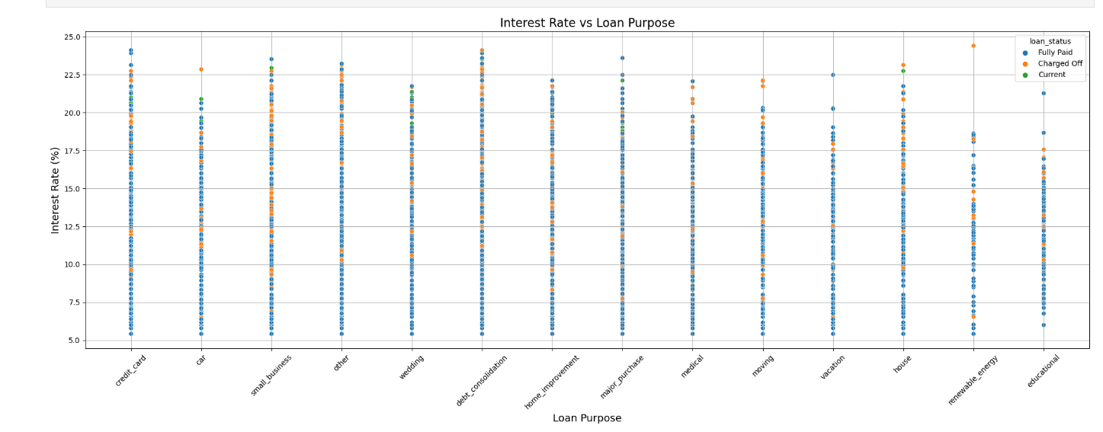
Interest Rate Vs Loan Purpose

Slide 15
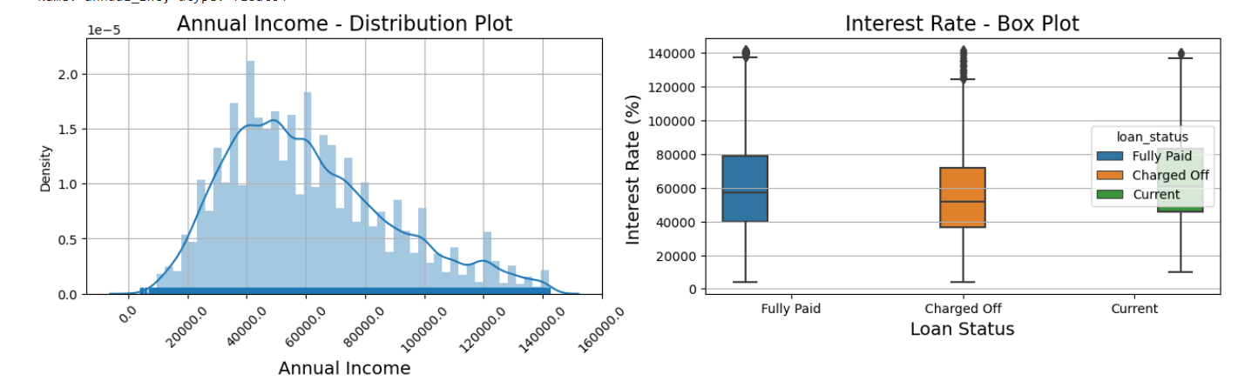
Annual Income & Purpose
Annual Income : The Majority of clients have low annual income compared to rest and income lower than 50k has higher chance of defaulting.
Purpose: Loans are taken mostly for debt consolidation followed by credit card payment. Whereas the debt consolidation has highest fully paid loan but also has highest defaulted loans as well.

Slide 16
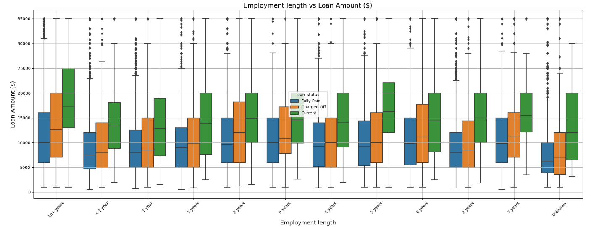
Employee Vs Loan Amount

Slide 17
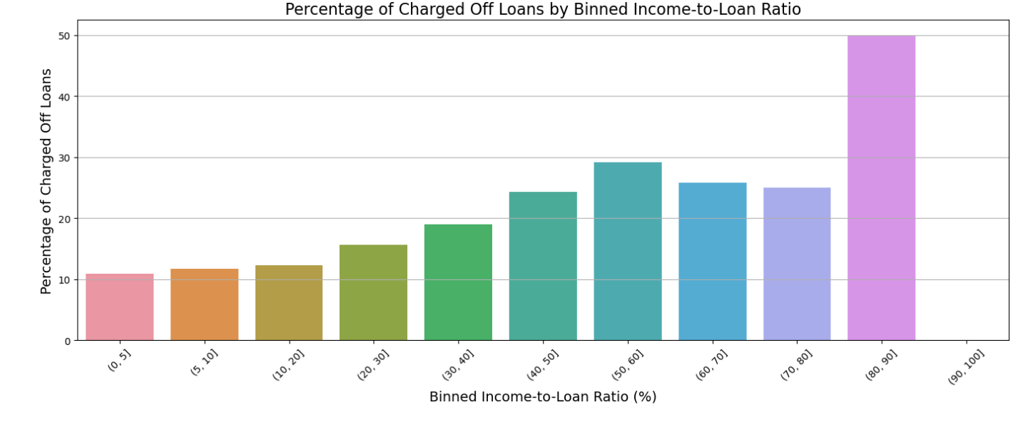
Binned Income to Loan Ratio

Slide 18
Recommendations
Recommendations
Major Driving factor which can be used to predict the chance of defaulting and avoiding Credit Loss:
1. DTI
2. Grades
3. Verification Status
4. Annual income
Other considerations for 'defaults’ :
Burrowers having annual income in the range 50000-100000.
Burrowers having Public Recorded Bankruptcy.
Burrowers with least grades like E,F,G which indicates high risk.
Burrowers with very high Debt to Income value.
Burrowers with working experience 10+ years.

