Slide 1



Driving
Alumni
Engagement
3 year Strategy using power of Analytics
Prepared By: Team 10
Gopesh Dwivedi, Indu Arya, Rubi Saini, Saurabh Semwal
Institute of System Science, National University of Singapore

Slide 2
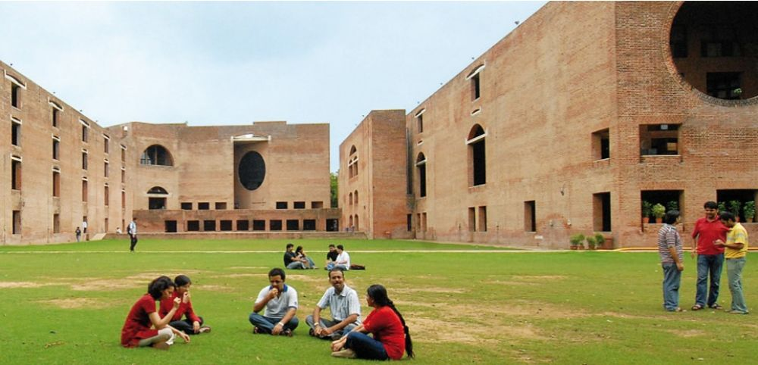
Agenda
Current Scenario
Overview: Proposed Solution
Phase 1: Targeting, Outreach & Acquisition
Phase 2: Retention and Engagement
Phase 3: Growth & Loyalty
Year 1: Timeline & Execution
Infrastructure Requirement & Budget
Personalization & Challenges
Success Metrics & Evaluation
Appendix & Research

Slide 3







Current Scenario: Problems & Missed Opportunities
Lack of Data
No Digital CRM Platform
No Tracking
Feedback Unavailable
Limited Outreach
Low Awareness

Slide 4
Roadmap: Proposed Solution
2018
Phase 1
Create Awareness, reach potential members
Build tracking, run marketing campaigns
2019
Phase 2
Build retention strategies, prevent attrition, increase engagement
Phase 3
Destination
2020
2021
Continue growing into stronger community
Introduce Awards & Recognitions, promote loyalty
400+ Active Memberships

Slide 5

Overview: Proposed Solution
1
2
3
Year – 1
Targeting & Acquisition
Year – 2
Retention & Engagement
Year – 3
Growth & Gamification
Performance
& Review
Process :
Target Existing130+ Members for Renewal
Outreach remaining Alumni via Campaigns
Use multiple channels for targeting like LinkedIn, official IIMA Alumni Website etc.
Process :
Use Year 1 interaction data for Attrition Model
Run Campaigns to increase Retention
Acquire new Alumni with targeted Marketing & outreach
Process :
Continue targeting new Alumni
Use referral strategy to promote word of mouth
Use Rewards & Recognition to improve loyalty
Process :
Evaluate Success metrics
Did we achieve them?
Are Alumni more engaged?
Did we grow as expected?
Deliverables :
Enriched Database
Tracking Mechanism
Deliverables :
Attrition Scorecard
Retention Strategy
Deliverables :
Gamification Strategy
Referral Program
Deliverables :
Performance Report
Suggest Improvement

Slide 6



Year 1: Targeting New Members
Marketing
Response
Registration
Members
mailchimp
620+ Profiles
250+ Responded
90+
New Sign-ups
Leads
Success
Mail relevant details and terms
Collect Sign Up fee of SG$100 using e-payment methods
Assumed 30-35* % success rate of conversion
Use Short Survey to record the interest in Membership
Collect Personal & Contact Information
Expecting 40* % response rate (Click through)
Sponsored InMail
Run sponsored InMail Campaign on LinkedIn
Personalized & relevant
Target 620+ IIMA Alumni in Singapore

Slide 7



Year 1: Data Collection & Segmentation
Feedback
Engagement
Young Alumni
Interests
0-10 years Experience
Energetic, Need Networking
Work
Mid-Level
10-25 years Experience
Busy, need fun & meet-up
Personal Info
Achievers, C-suites, 25+ Exp.
Give back, inspiration, Enjoy
Torch Bearer

Slide 8





Year 1: Timeline and Execution
Performance Months
July
August
September
October
November
December
January
February
March
April
May
June
Renewals
Scoring Month
Reminder
Direct Mail Campaign for Existing Members
60-75%
Feedback
Induction
Ceremony
Events
100-105
Members
Renewed
Events
Events
New Acquisitions
Events
Sponsored
InMail to 600+ prospects
10$/day
15-17%
Event Creation | Accept Invitation |Track Attendance
90-95
Members
Renewed

Slide 9



Year 2: Retention & Increased Engagement
Retention
Personalization
Multiple Touchpoints
Based on the Feedback data, predict members likely to attire.
Take proactive measures to prevent attrition using member’s behavioral data.
Create personalized campaigns for different segments.
Friend to Friend Mapping to send campaigns for events
Keeping the members engaged by informing them about future events, taking polls, sending them greetings on their birthday’s.

Slide 10



Year 3: Growth & Loyalty
Advocacy
Recognition
Badges & Leaderboard
Encourage existing members to recommend other alumni to join.
Awarding members who very active in the events with some goody bags, exiting offers.
Award members who have been active through out the year with badges.

Slide 11





Data-driven CRM: Infrastructure & Budget
Platforms
Events
Value
Proposition
Relationships
Segments
Free
Paid
1+ Events
Family
Multiple digital touchpoints
Volunteering
Recognition
Meet Industry leaders
Networking
Job prospects
Volunteering
Leisure & Fun
Discover your interests
Stay in touch
Highly Engaged
Engaged
Disengaged
Actively Disengaged
Demographic
Behavioral
Functional
Interest-based
Resources
Channels
Data Scientist or Business Analyst
Application Developer
Social Media like FB, IN, Instagram
Slack, WhatsApp
Emails
Cost Structure
Primary: Sign up fee of SG$100 per membership
Secondary: Donations, Paid Events, Partnerships
Expected collection 20K (Year 1), 28K (2), 40K (3)
Revenue Streams
Year 1: Most services/platforms – SGD 600 For LinkedIn
Year 2: Branding, Marketing, Paid CRM – SGD 2300
Year 3: Customized Solution with Sophistication, Rewards and gifts – SGD 8000

Slide 12
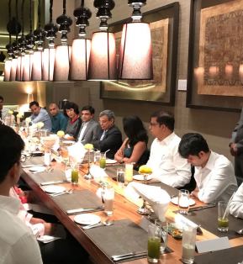
Proposed Events:
Sports Events
Restaurant Get-Together
Picnics
Plan a Professional Development Seminar
Themed costume parties
The purpose of alumni events is to get people together, communicate, forge new relationships, and maintain existing connections.

Slide 13
Success Metrics & Expectations
Attrition rate
# New Sign ups
Average Footfall
Campaign response rate
Satisfaction (Survey)
05
400+ Active Members in 2021, stronger community
04
Reduced Involuntary Attrition, long term relation
03
YoY Increased Membership while lowering marketing
02
Increased Engagement by relevant events & tracking
01
Up to date and Accurate Data Insights about Alumni

Slide 14
Alumni Management & Challenges
Creating Value for each segment
Multi-vendor Environment- No single platform serves all
Database Management
Survey Response Rate
Limited Revenue sources
Thank you
Questions?
Prepared By: Team 10
Gopesh Dwivedi, Indu Arya, Rubi Saini, Saurabh Semwal
Institute of System Science, National University of Singapore

Slide 15
Appendix
About IIM Ahmedabad
Research- IIMA Alumni in Singapore
LinkedIn Research
Lead Generation- Targeting Non-Member Alumni
Outbound Channel Comparison
CRM Platforms for Alumni Engagement
Target Marketing
Budget Estimations
Year-wise Projections
Surveys and Feedback
Engagement Strategy
Retention Strategy
Events Summary and Suggestions
References and Case Studies

