Slide 1
AZURE ENVIRONMENT ASSESSMENT
Contoso
Inventory, Well-Architected findings and remediation roadmap
September 2026

Slide 2
Agenda
1
Executive summary
2
Scope & methodology
3
Inventory overview
4
Assessment scorecard
5
Key findings
6
Remediation roadmap
7
Next steps
Contoso · Azure Environment Assessment · Confidential
2

Slide 3
Executive summary
Overall posture score 75/100 — Fair
133
3
4
75
17
74%
Resources
Subscriptions
Regions
Posture score
High findings
Tag coverage
• 133 resources were assessed across 3 subscription(s), 19 resource groups and 4 region(s).
• 106 finding(s) were raised: 17 high, 73 medium and 16 low severity, affecting 78 resources.
• Security is the weakest area (score 65/100); Governance is the strongest (84/100).
• 74% of resources carry all required tags (environment, owner, costCenter).
• Priority high-severity issues: Storage account permits HTTP (4); Storage account allows anonymous blob access (4); VM stopped but not deallocated (4).
Contoso · Azure Environment Assessment · Confidential
3

Slide 4
Scope & methodology
• Based on the inventory export supplied by Contoso
• Every resource evaluated against rules aligned to the Azure Well-Architected Framework
• Pillars: Security, Reliability, Cost Optimization, Operational Excellence, Governance
• Scores = severity-weighted pass rate (High 5 · Medium 3 · Low 1)
• Rating: Good ≥ 80 · Fair 60–79 · Poor < 60
Subscription | Resources
Contoso-Production | 66
Contoso-NonProduction | 52
Contoso-Connectivity | 15
Contoso · Azure Environment Assessment · Confidential
4

Slide 5
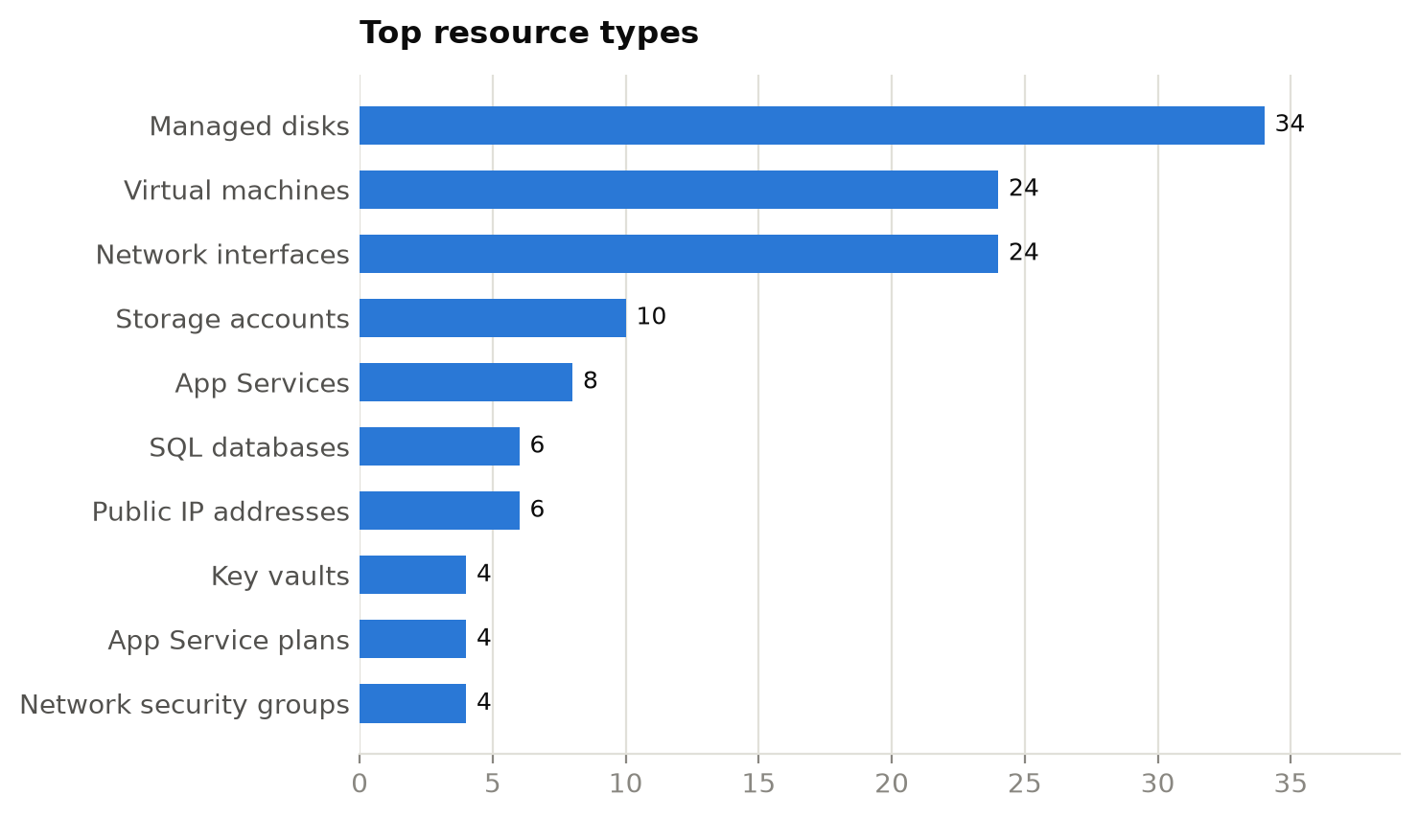
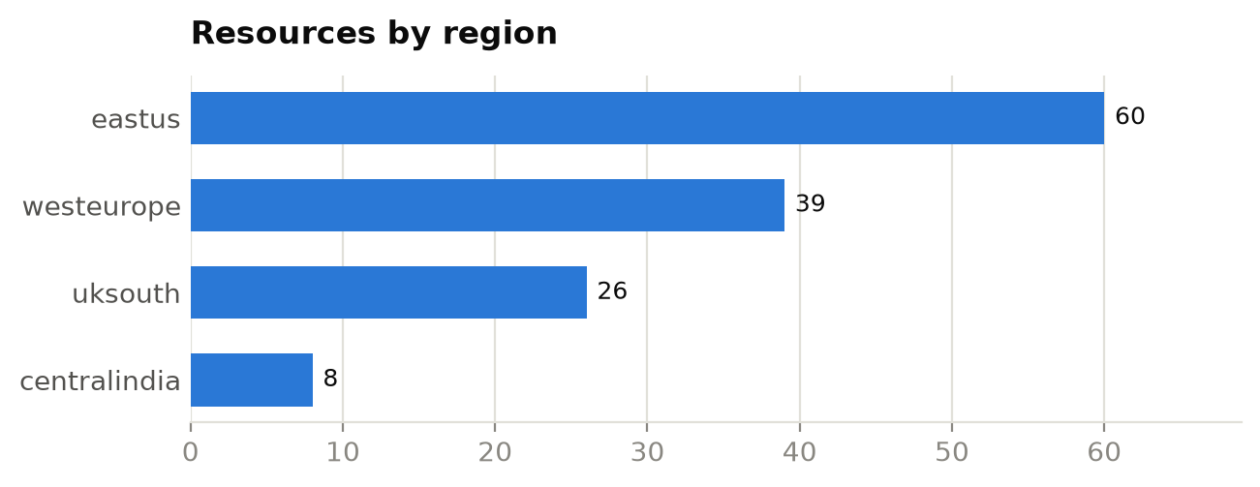
Inventory overview
133 resources · 19 resource groups
Contoso · Azure Environment Assessment · Confidential
5

Slide 6
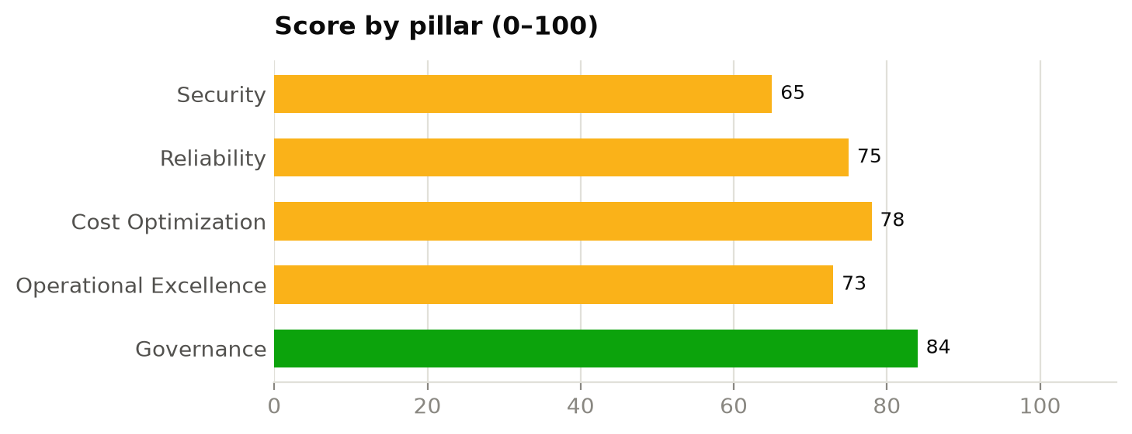
Assessment scorecard
Severity-weighted pass rate per pillar
Pillar | Score | Rating | High | Med | Low
Security | 65 | Fair | 12 | 4 | 0
Reliability | 75 | Fair | 0 | 15 | 6
Cost Optimization | 78 | Fair | 4 | 12 | 3
Operational Excellence | 73 | Fair | 0 | 0 | 7
Governance | 84 | Good | 1 | 42 | 0
Contoso · Azure Environment Assessment · Confidential
6

Slide 7
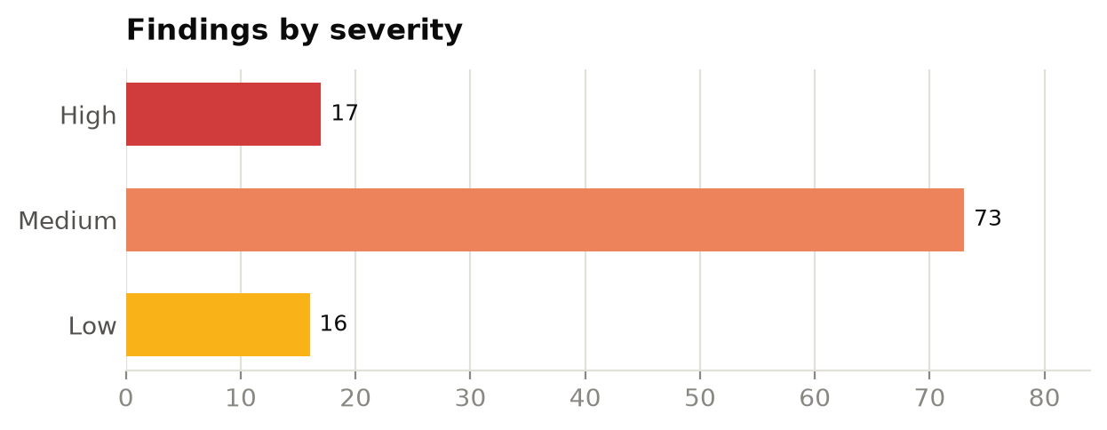
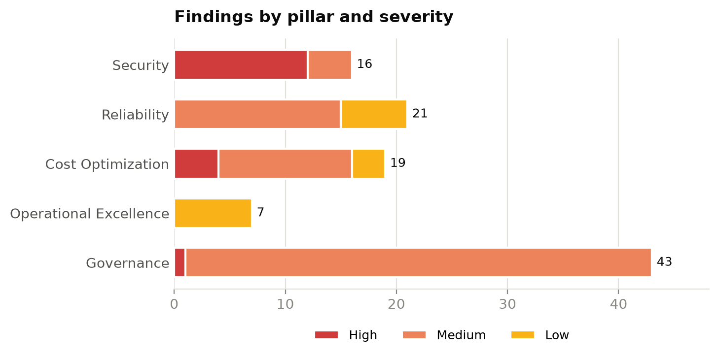
Findings distribution
106 findings across 78 resources
Contoso · Azure Environment Assessment · Confidential
7

Slide 8
Key findings
Ranked by severity, then number of resources affected
ID | Finding | Severity | Pillar | Affected
SEC-001 | Storage account permits HTTP | High | Security | 4
SEC-002 | Storage account allows anonymous blob access | High | Security | 4
COST-003 | VM stopped but not deallocated | High | Cost Optimization | 4
SEC-006 | Web app does not enforce HTTPS | High | Security | 2
SEC-007 | NSG exposes management ports to the Internet | High | Security | 2
GOV-003 | Classic (ASM) resource in use | High | Governance | 1
GOV-001 | Required tags missing | Medium | Governance | 34
REL-001 | VM has no zone or availability set | Medium | Reliability | 15
Contoso · Azure Environment Assessment · Confidential
8

Slide 9
Key findings (cont.)
Ranked by severity, then number of resources affected
ID | Finding | Severity | Pillar | Affected
COST-001 | Unattached managed disk | Medium | Cost Optimization | 10
GOV-002 | Resource outside approved regions | Medium | Governance | 8
SEC-003 | Storage account accepts TLS < 1.2 | Medium | Security | 2
COST-005 | Empty App Service plan | Medium | Cost Optimization | 2
SEC-004 | Key Vault purge protection disabled | Medium | Security | 1
SEC-005 | SQL server reachable from public networks | Medium | Security | 1
OPS-001 | Previous-generation VM size | Low | Operational Excellence | 5
REL-003 | Storage account uses locally redundant replication | Low | Reliability | 3
Contoso · Azure Environment Assessment · Confidential
9

Slide 10
Remediation roadmap
Sequenced by risk and effort
0-30 days (quick wins & critical risk)
30-60 days
60-90 days
• Storage account permits HTTP (4)
• Storage account allows anonymous blob access (4)
• VM stopped but not deallocated (4)
• Web app does not enforce HTTPS (2)
• NSG exposes management ports to the Internet (2)
• Classic (ASM) resource in use (1)
• Unattached managed disk (10)
• Empty App Service plan (2)
• Unassociated public IP address (2)
…and 1 more
• Required tags missing (34)
• VM has no zone or availability set (15)
• Resource outside approved regions (8)
• Storage account accepts TLS < 1.2 (2)
• Key Vault purge protection disabled (1)
• SQL server reachable from public networks (1)
• Previous-generation VM size (5)
• Storage account uses locally redundant replication (3)
• SQL database not zone redundant (3)
• Log Analytics retention below target (2)
Contoso · Azure Environment Assessment · Confidential
10

Slide 11
Recommended next steps
1. Remediate high-severity security exposures (public access, HTTP, open management ports)
2. Reclaim idle spend: orphaned disks, unused public IPs, stopped VMs and empty plans
3. Enforce tagging and allowed regions through Azure Policy at management-group scope
4. Design zone-redundant patterns for production workloads
5. Re-run this assessment monthly to track posture trend
Contoso · Azure Environment Assessment · Confidential
11

