Slide 1

AI Chatbot for Banking Application
Symbiosis Institute of Technology

Slide 2
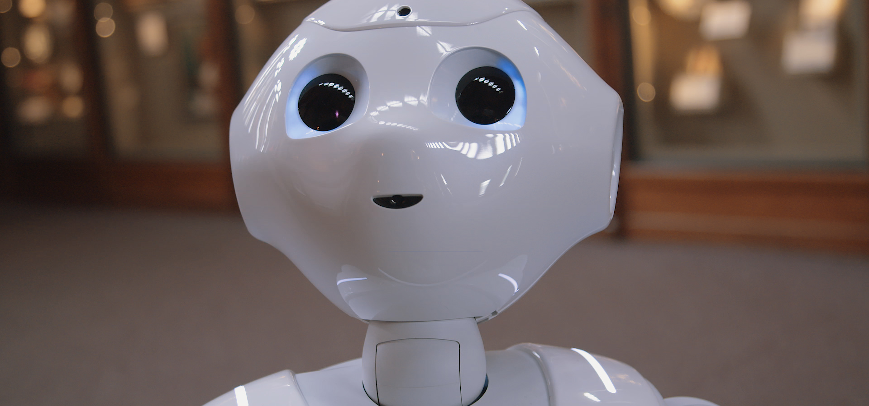
What is a Chatbot?
Chat robot is a computer program that simulates human conversation or chat, through artificial intelligence. Typically a chatbot will communicate with a real person.

Slide 3










Uses of a Chatbot
Customer Service
Sales marketing and Branding
FAQ
Handless Operations
Personal Finance Assistant
When trained, a chatbot can also provide service when the call centre is closed, or eventually even act as an independent agent,
Chatbots can be used for sales qualification, ecommerce, promotional campaigns, or as a branding vehicle.
An HR chatbot can help with frequently asked questions and can act as an on boarding assistant.
A speech to text enabled and vice versa can be used for various operation like reading out news and asking weather.
Chatbots make it easy to make trades, get notifications about stock market trends, track your personal finances, or even get help finding a mortgage.

Slide 4

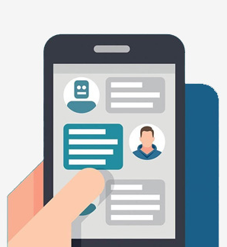


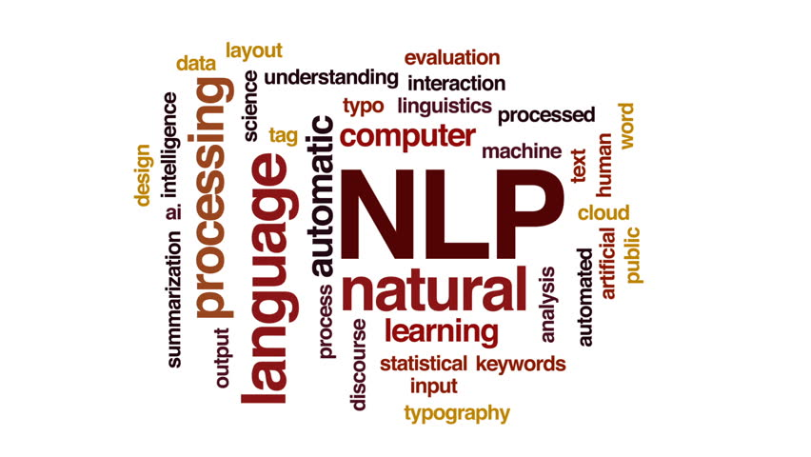
What are we doing?
We are intending to develop an AI based Chatbot which will answer queries of the bank employees. The chatbot will be integrated in an app built in Android studio.
Dialogflow
Android Studio
Natural Language Processing

Slide 5
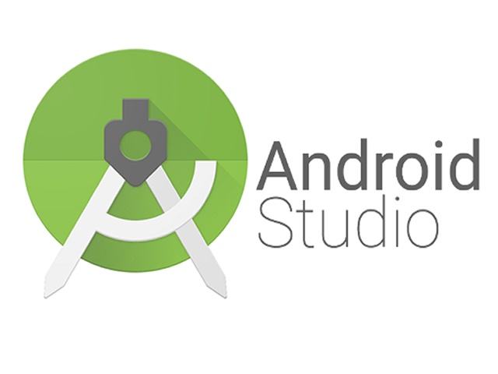





Technology used

Slide 6
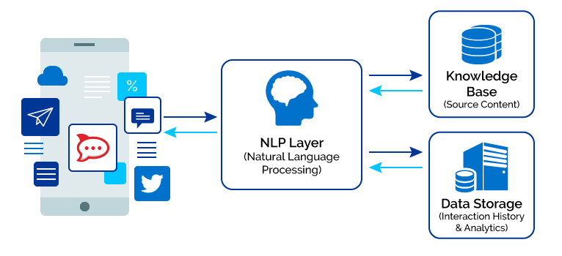
System Architecture

Slide 7
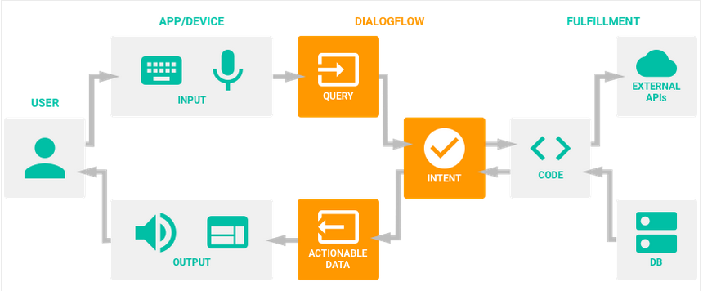
Dialog flow

Slide 8
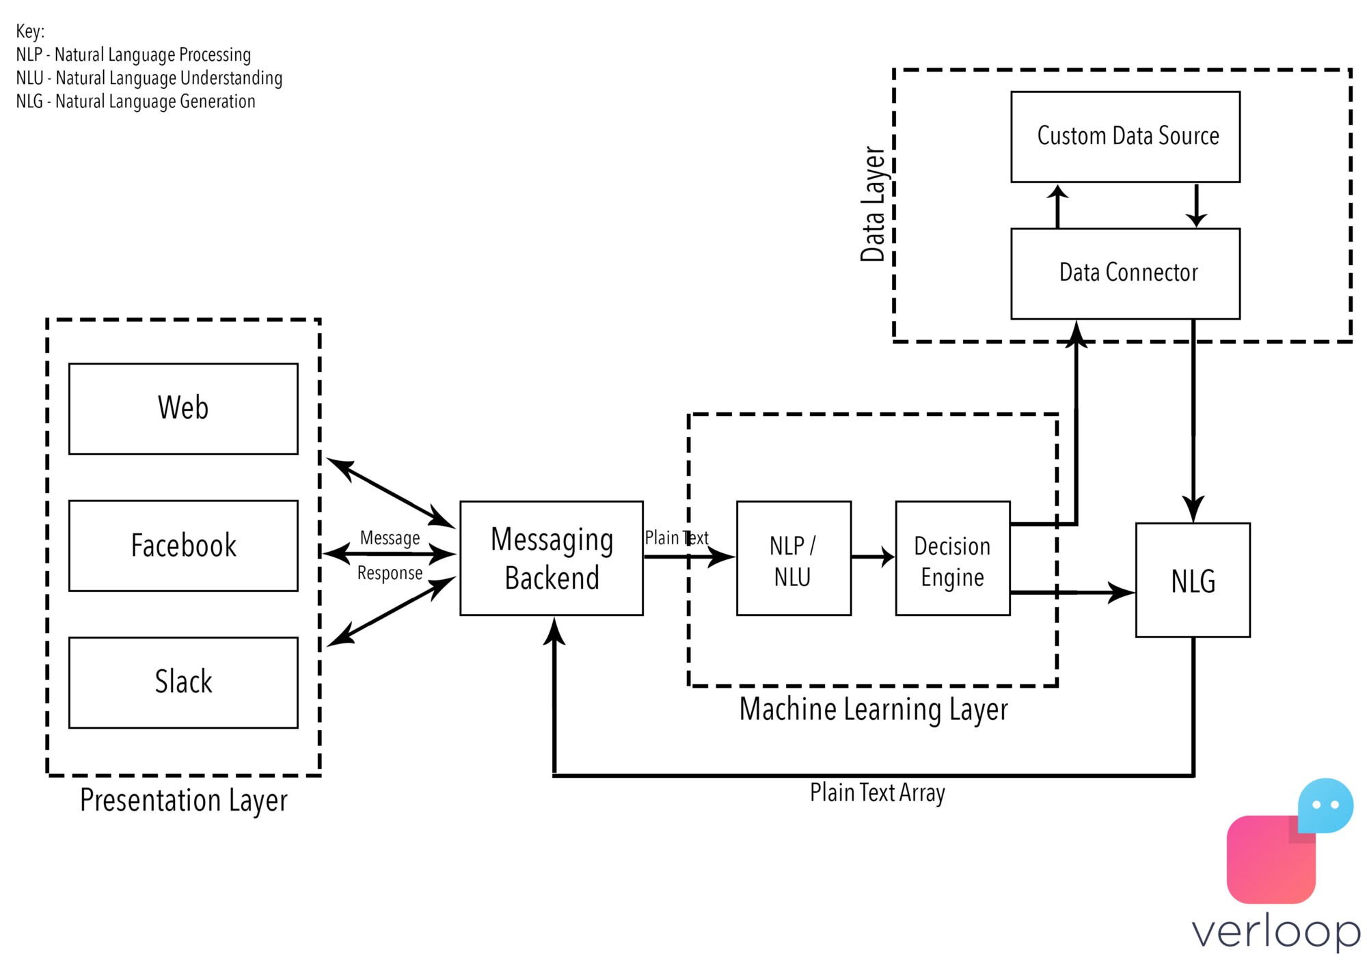
Chatbot
A chatbot follows the same process, with two fundamental differences, the channel of communication and what you’re talking to.

Slide 9
You find a product on Facebook’s Messenger and for the sake of consistency, let’s say it’s the same bottle of Tropicana. You only ever see the presentation layer and send the bot a message that is picked up by the backend saying you want some Tropicana.
Using Natural Language Processing (what happens when computers read language. NLP processes turn text into structured data), the machine converts this plain text request into codified commands for itself.
Now the chatbot throw this data into a decision engine, since in the bots mind it has certain criteria to meet to exit the conversational loop, notably, the quantity of Tropicana you want.
Using Natural Language Generation (what happens when computers write language. NLG processes turn structured data into text), much like you did with your mother the bot asks you how much of said Tropicana you wanted.

Slide 10
This array of responses goes back into the messaging backend and is presented to you in the form of a question. You tell the bot you want 1 litre and we go back through NLP into the decision engine.
The bot now analyzes pre-fed data about the product, stores, their locations and their proximity to your location. It identifies the closest store that has this product in stock and tells you what it costs.
It then directs you to a payment portal and after it receives confirmation from gateway, it places your order for you, and voila in one to two business days, you have 1 litre of Tropicana 100% Orange Juice.
The biggest difference between chatbots and humans at this point of time though, is what the industry calls empathy understanding. Chatbots simply aren’t as adept as humans at understanding conversational undertones.

Slide 11
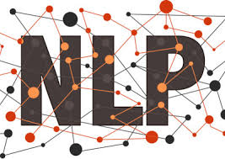
Natural Language Processing
Natural language processing (NLP) is the ability of a computer program to understand human speech as it is spoken. NLP is a component of artificial intelligence .
It makes computer to perform useful tasks with the natural languages humans use.
Current approaches to NLP are based on machine learning
The input and output of an NLP system can be −
Speech.
Written Text.

Slide 12

Knowledge Base (BETA)
Knowledge connectors complement defined intents. They parse documents (for example, FAQs or articles) to find automated responses. To configure them, you define one or more knowledge bases, which are collections of documents.
You can enable knowledge bases for your agent, so all detect intent requests may find automated responses using your knowledge bases. Alternatively, you can specify one or more knowledge bases in your individual detect intent requests.

Slide 13
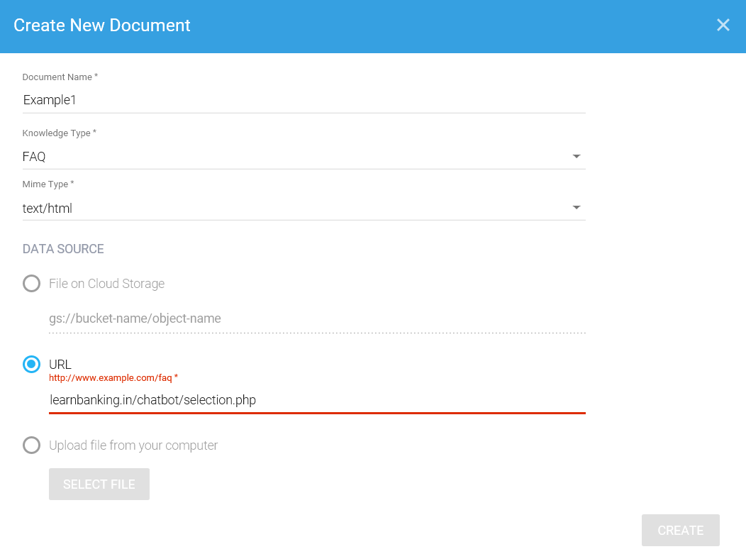
Knowledge Base

Slide 14
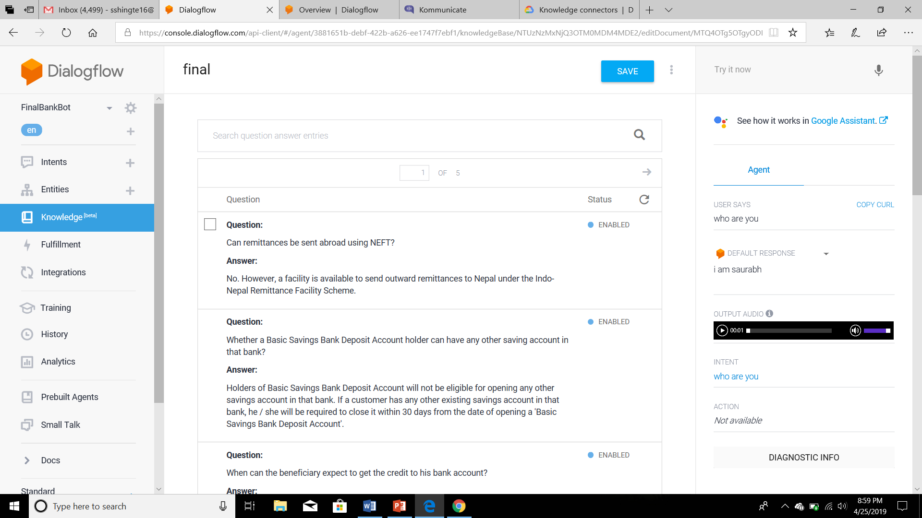

Slide 15
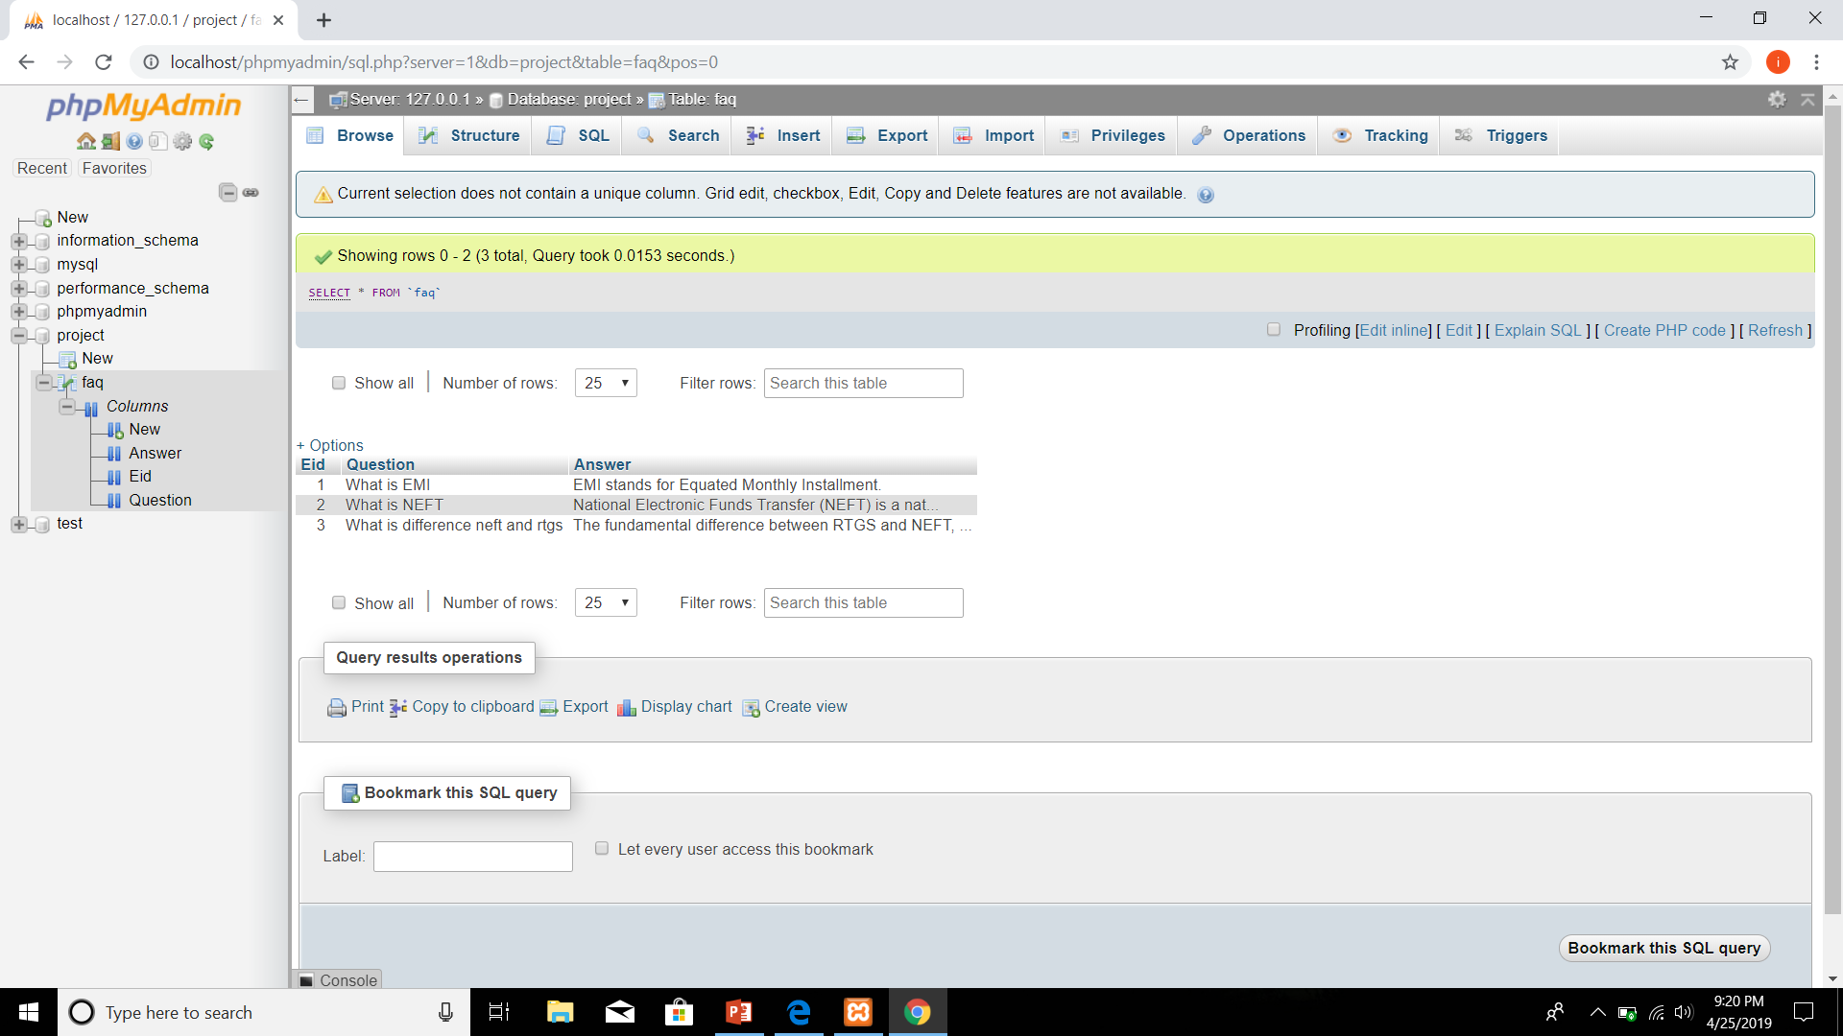
Database Used
We have used MySQL for storing the data.

Slide 16
About Google Indexing and Web SEO
Indexing is the process of adding web pages into Google search.
When crawling is done then after the results get put into Google index.
A good idea for increase high rank in search engines is to let only vital parts of your blog/website be indexed.
The main reason why we need indexing is because Knowledge base performs crawling on a html page.

Slide 17
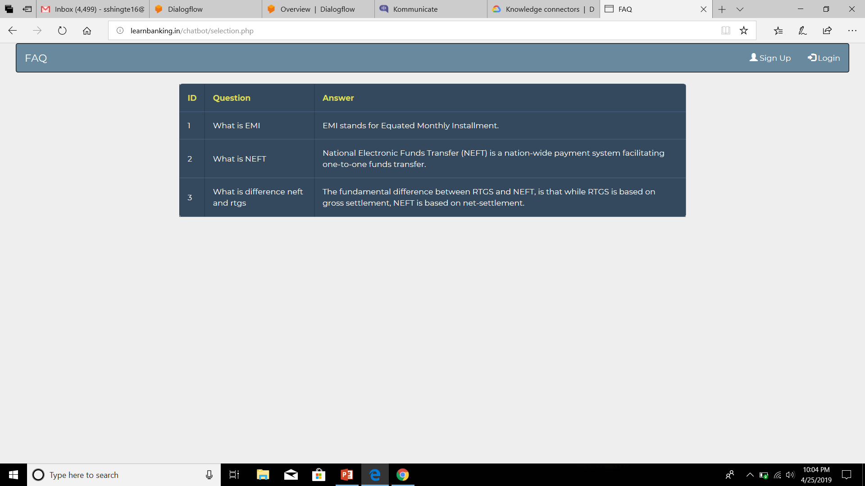
IMAGES

Slide 18
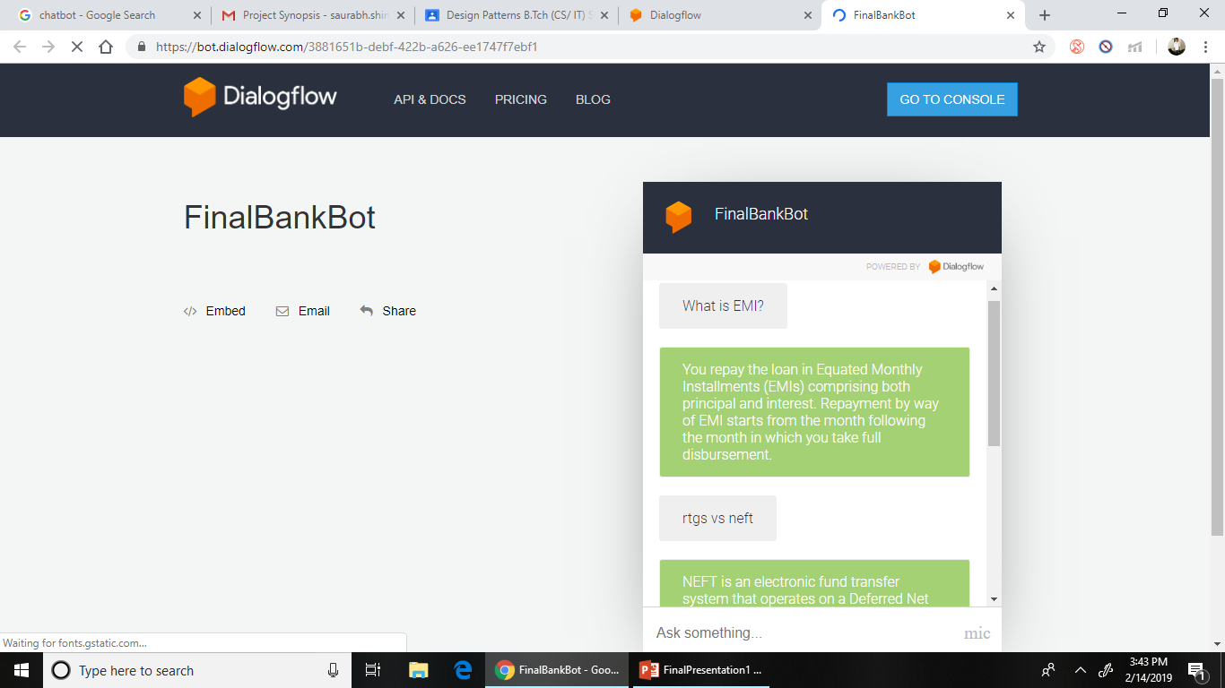
Implementation

Slide 19
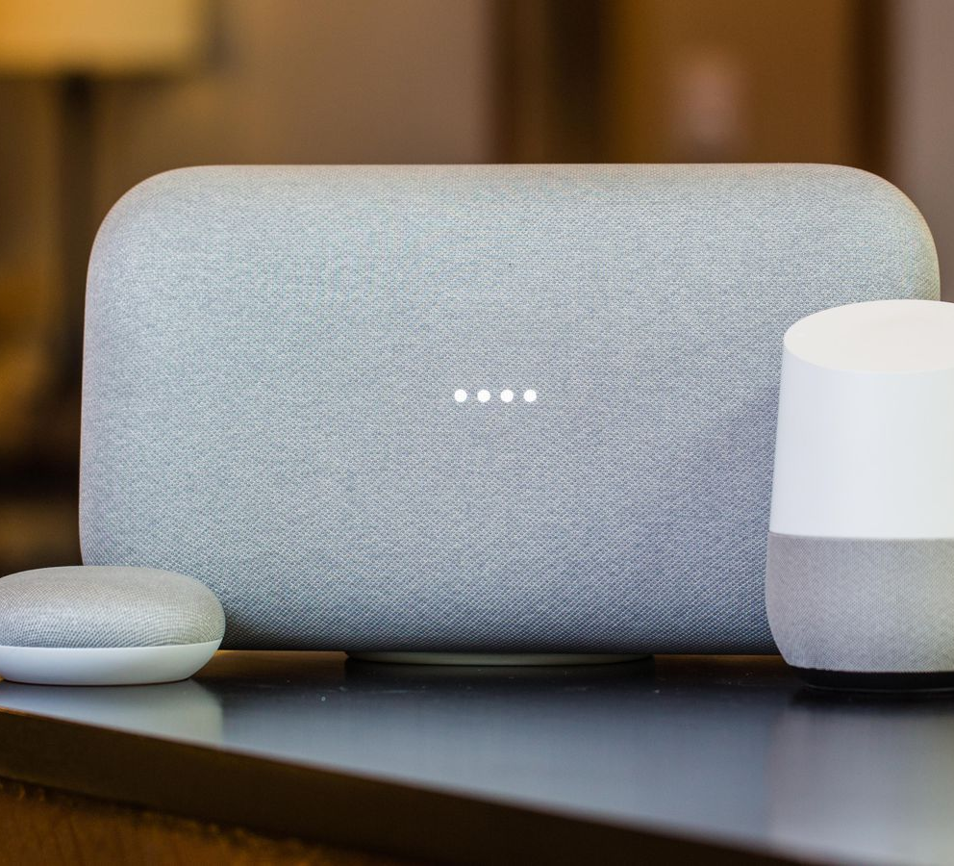
Google Home
Google Home is a voice-activated home product that allows you and your family to get answers from Google, stream music, and manage everyday tasks.

Slide 20
Timeline
Four month action plan.
Finalizing Topic
First Presentation
Complete Chatbot Integration with the app
1st JAN
15th JAN
1st FEB
15th FEB
1st MAR
15th MAR
1st APR
15th APR
20th APR
2019
2019
Complete Chatbot Implementation
Final Project Submission
Month, 20YY
First report submission

Slide 21

Thank You
Final year project
Dhruv Patel
Ishan Yadav
Prashant Mall
Saurabh Shingte

