Slide 1
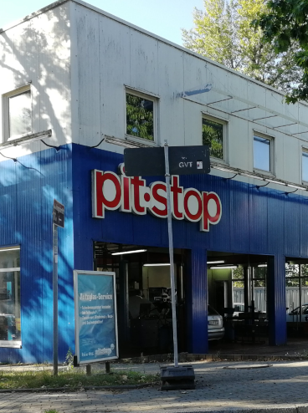
AI-Driven Chaos Engineering
TEAM 28
Cloud-native resilience demo using Pitstop, Docker Compose, Ollama and a live dashboard
Team No. 28
Build an AI system that introduces controlled local failures, observes impact, verifies recovery and reports ranked findings.
Sandbox only: no production systems
Model: qwen2.5:1.5b via local Ollama
Application: Pitstop microservices garage

Slide 2
Problem Statement
TEAM 28
What the challenge asked us to build
Team solution should
Accepted failure types
Out of scope
Select and map a cloud-native sample app
Plan failures intelligently
Inject controlled failures with safety limits
Observe errors, slowdowns and recovery time
Analyze and report ranked weaknesses
Service/container crash
Slow or lossy network responses
Failed shared dependency
Traffic spike / combined scenario
Production or shared infrastructure
Unbounded destructive faults
Unverified model-generated commands
Claims of write durability without tests

Slide 3
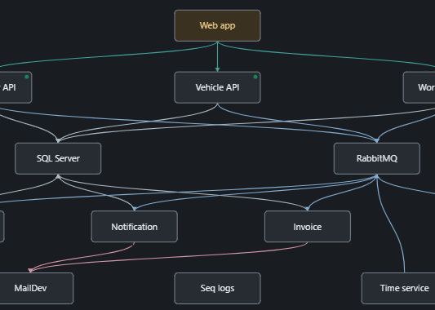
Day-1 Baseline And Safety
TEAM 28
Foundation before running AI-selected experiments
Pitstop running end-to-end in Docker Compose
Mapped services, dependencies and data flows
Captured baseline latency and health
Implemented manual STOP and automatic rollback
Verified no arbitrary model shell commands
Day-1 minimum: running app + dependency map + safe failure + kill switch

Slide 4
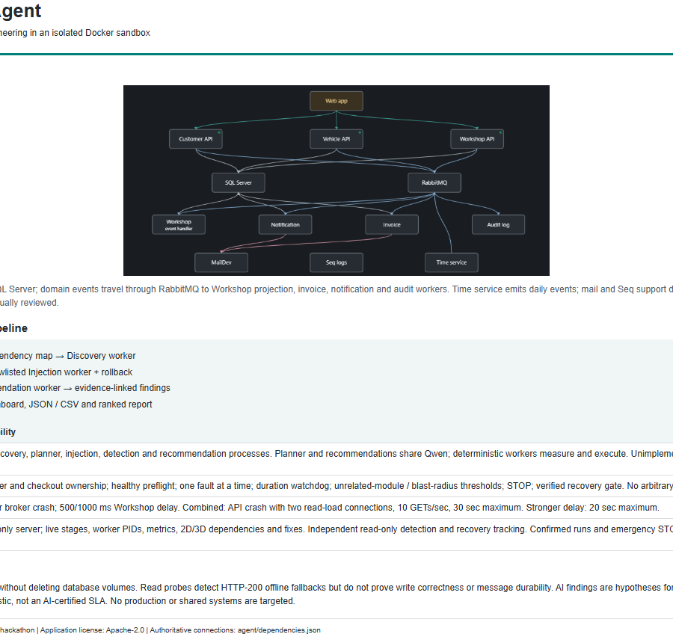
Solution Architecture
TEAM 28
AI planning is separated from deterministic execution
Planner
Ranks registered experiments from dependency map, baseline and discovery evidence.
Injection worker
Runs only code-owned, bounded tools; one fault at a time; rollback watchdog active.
Detection + recommendation
Measures availability/latency and produces evidence-linked findings with caveats.

Slide 5
AI Agent Workflow
TEAM 28
From healthy baseline to ranked recommendations
Stage
What happens
Safety gate
Baseline
Probe Customer, Vehicle, Workshop pages
Unhealthy baseline blocks injection
Plan
AI ranks allowed experiment catalog
Schema + ID validation
Inject
Crash or delay selected target
Duration + blast-radius thresholds
Recover
Restore target and verify pages
All three module pages must recover
Analyze
Rank anomalies and recommend fixes
Evidence only; no root-cause certainty
The AI chooses among registered experiments; it never invents a target or command.
Reports retain model caveats when explanations are uncertain.

Slide 6
Experiments Executed
TEAM 28
Three required scenarios plus a combined stretch scenario
Experiment
Fault
Observed impact
Recovery
workshop-crash
Workshop API crash
Workshop offline; Customer/Vehicle stable
0.74 sec
database-crash
SQL dependency outage
Two modules impacted; safety rollback
30.29 sec
workshop-delay
500 ms network delay
Workshop latency / timeouts
1.07 sec
crash + traffic
Workshop crash under read load
Combined failure stretch
4.55 sec
What this proves
What we do not claim
Controlled faults, measured degradation, automatic restoration and recorded evidence.
Read probes do not prove write correctness or message durability.

Slide 7
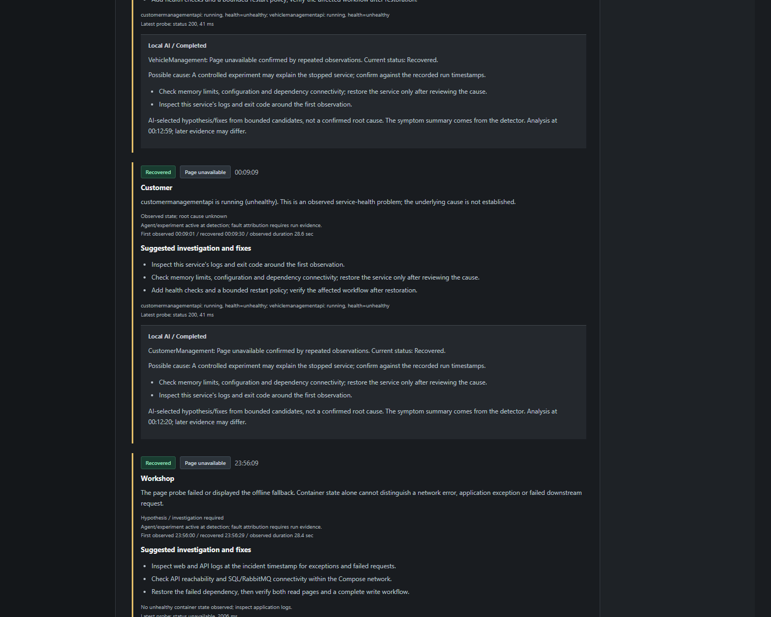
Live Dashboard
TEAM 28
Operator view for experiments, monitor, topology and evidence
Agent lifecycle and worker status
Live module health probes
Failure monitor with incident-specific AI recommendations
3D topology and dependency map
Downloadable evidence and findings
Stretch goal: live dashboard / simple UI

Slide 8
Findings And Scores
TEAM 28
AI-ranked findings grounded in measured evidence
High severity
Recommended fixes
Score method
Workshop crash caused repeated Workshop page failures.
SQL outage affected multiple modules.
Workshop delay produced severe latency/availability anomalies.
Inspect service logs and dependency errors.
Use bounded timeouts and safer fallback behavior.
Rerun matched experiments after changes.
Transparent read-probe heuristic, not an SLA.
Recovery and healthy fault probes improve score.
Unequal sampling is reported, not hidden.

Slide 9
Applied Fix And Retest
TEAM 28
Timeout/fallback behavior improved responsiveness, with a reported tradeoff
Module
Before p95
After p95
Interpretation
Customer
5044 ms
165 ms
Faster fallback path
Vehicle
23 ms
113 ms
Stable reads
Workshop
4555 ms
2064 ms
Fails fast under delay
We do not present the fix as universally better: it improves responsiveness while exposing an availability tradeoff.
This is a matched retest, not a statistical proof.

Slide 10
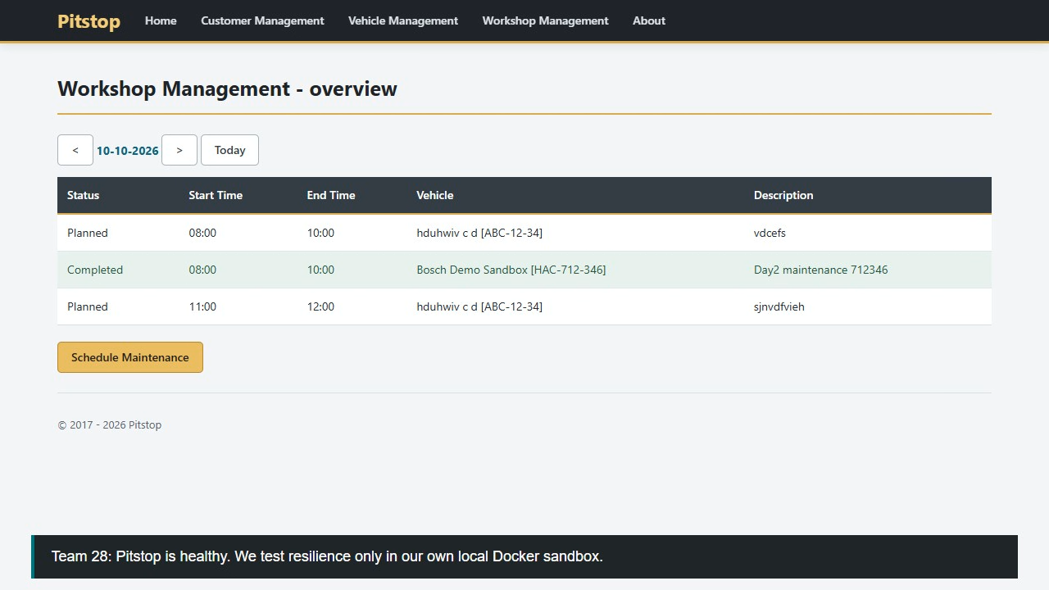
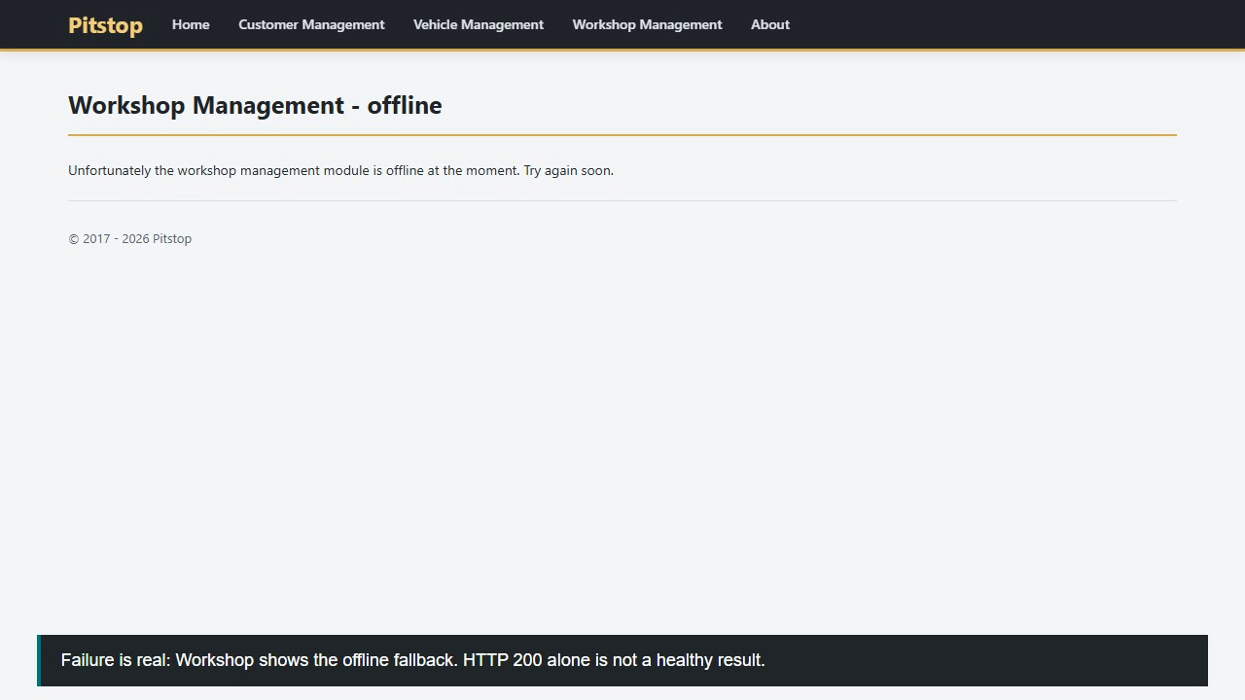
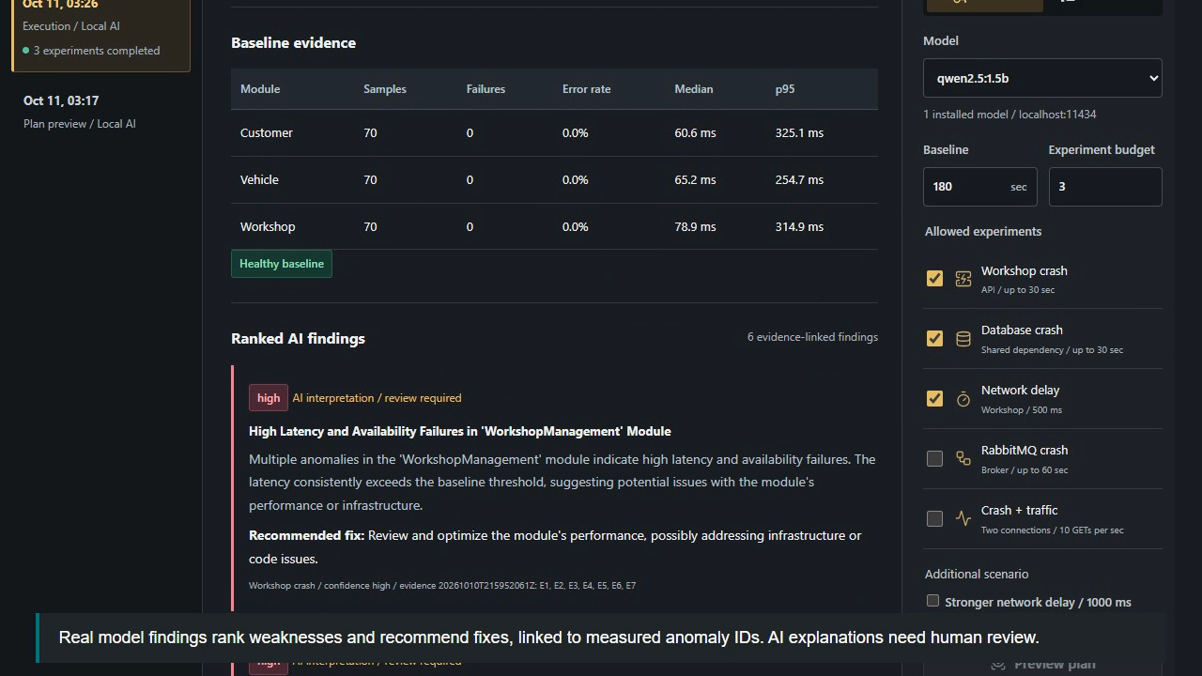
Demo And Deliverables
TEAM 28
All required submission materials prepared
Deliverable
File
Source code + README
GitHub branch / README.md
Demo video
submission/demo.webm (88.4 sec)
Architecture overview
submission/architecture.pdf
Findings report
submission/findings.md
Team form
submission/team-form.json

Slide 11
Final Demo Flow
TEAM 28
What we will show the instructor
Open Pitstop and show Customer, Vehicle, Workshop are healthy
Open dashboard Overview and explain worker lifecycle
Show Dependencies and 3D topology
Show Evidence & findings with ranked AI report
Play the under-3-minute demo video
Live rerun defaults
Use Workshop crash, Database crash and Workshop delay; keep RabbitMQ unchecked for the final live run.
Safety message
All faults are local, bounded, reversible, and blocked by STOP / recovery gates.
Close
AI helps prioritize experiments and summarize evidence; humans still review findings.

