Slide 1
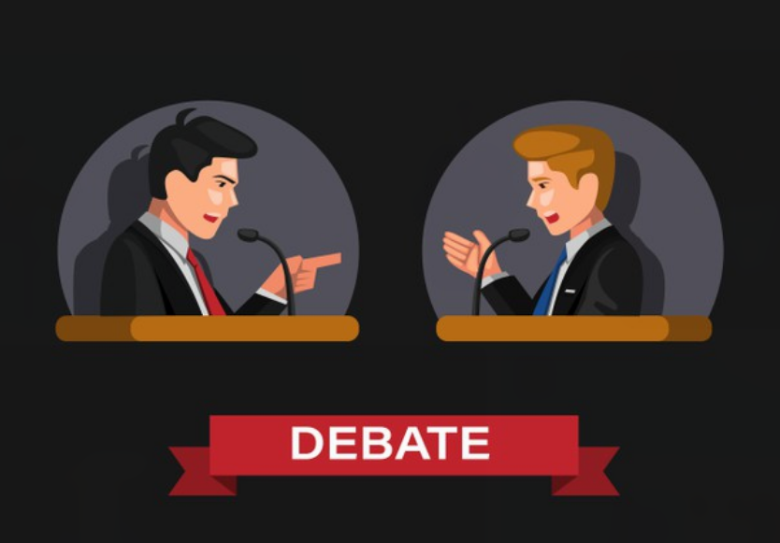
"In business, you don't get what you deserve, you get what you negotiate."
BUISNESS BATTLE

Slide 2

Description of the event
Each participating team will be assigned the role of an infrastructure company (details provided in the document sent after registration).
The participating teams will be paired of and will compete against each other in the form of a debate.
The 2 companies will compete against each other for a construction tender released by us.
Basic details of the tender will be enclosed within a doc file.
The debate will be conducted based on a set of guidelines given.

Slide 3
Flow of event
Mode of conduct- ZOOM
Total time of debate 8-10 min
first 2 min; the two teams will present their proposal within 1 min.
next 3-5 min; the two teams will then debate. (giving the advantages of their company and pointing out the drawback of their opponent)
last 2 min will be given for them to deliver their closing statements.

Slide 4
Instructions to be followed
Each pair will be put into a breakout room, and the negotiation will be monitored by the event organizers.
read your company background carefully so that you understand the facts before you begin biding/negotiating
you have to abide by the facts provided
you can add additional points to strengthen your argument and gain points

Slide 5
Judging criteria
Teams with innovative ideas and new points will gain more points
There is separate marking will be done for introduction and conclusion
teams that put the best technical arguments and make the most profitable deal wins
Top 3 teams will win the prizes

Slide 6
Event by
Shreya
Vaishnavi
Aditya
Prakhar
Deep

