Slide 1
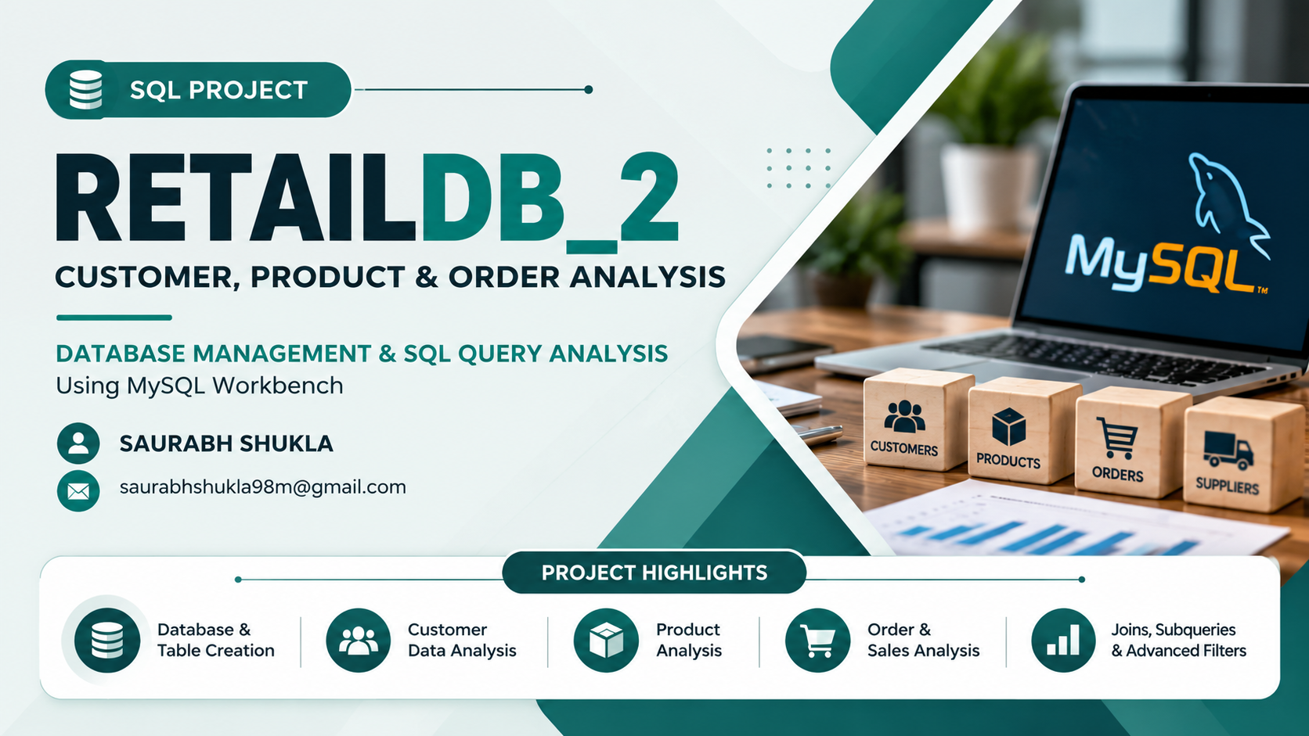

Slide 2
SQL Assignment – Medium
Customers
Orders
Order_Items
RetailDB_2: joins, aggregations, subqueries and filters, with output and insight for all 20 queries
Products
Suppliers
MySQL Workbench · 5 tables · 20 queries

Slide 3
Database Schema
Suppliers
supplier_id | PK
supplier_name
contact_email
city
Products
product_id | PK
product_name
category
price
stock_qty
supplier_id | FK
Order_Items
order_item_id | PK
order_id | FK
product_id | FK
quantity
price_each
Orders
order_id | PK
customer_id | FK
order_date
total_amount
payment_mode
Customers
customer_id | PK
name
email
city
signup_date
Suppliers → Products
Products → Order_Items
Orders → Order_Items
Customers → Orders
One supplier can supply many products (supplier_id).
One product can appear in many order lines (product_id).
One order contains many order lines (order_id).
One customer can place many orders (customer_id).
PK = primary key FK = foreign key Arrows point from the parent table to the child table

Slide 4
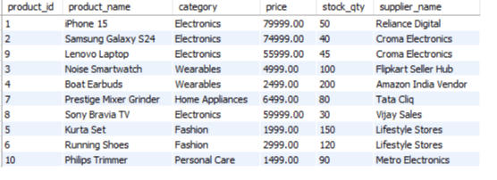
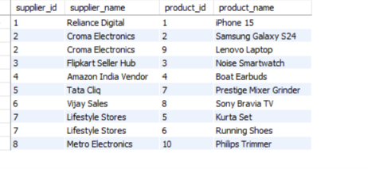
Q1 & Q3 – INNER and RIGHT JOIN
A · NORMAL QUERIES
Q1
Products with their supplier name (INNER JOIN)
Q3
All suppliers and their products (RIGHT JOIN)
SELECT p.product_id, p.product_name, p.category,
p.price, p.stock_qty, s.supplier_name
FROM Products p
INNER JOIN Suppliers s
ON p.supplier_id = s.supplier_id;
SELECT s.supplier_id, s.supplier_name,
p.product_id, p.product_name
FROM Products p
RIGHT JOIN Suppliers s
ON p.supplier_id = s.supplier_id;
OUTPUT
OUTPUT
INSIGHT
INSIGHT
All 8 suppliers are listed and none has a NULL product, so every supplier has at least one product.
Croma Electronics and Lifestyle Stores have 2 products each; the other six have 1.
The result matches Q1 (10 rows) because no supplier is without products.
All 10 products are listed with a supplier, so every product is linked to a supplier.
Croma Electronics and Lifestyle Stores supply 2 products each.
Electronics is the largest category with 4 products.

Slide 5
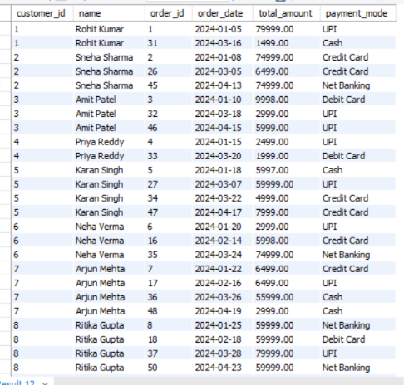
Q2 – LEFT JOIN
A · NORMAL QUERIES
Q2
All customers and their orders (LEFT JOIN)
OUTPUT
SELECT c.customer_id, c.name, o.order_id,
o.order_date, o.total_amount, o.payment_mode
FROM Customers c
LEFT JOIN Orders o
ON c.customer_id = o.customer_id;
INSIGHT
All 15 customers appear and no row has a NULL order, so every customer has placed at least one order.
The result has 50 rows, which means 50 orders in total.
Vikram Joshi has the most orders (5); Rohit Kumar and Priya Reddy have the fewest (2 each).
Five payment modes are used: UPI, Cash, Credit Card, Debit Card and Net Banking.

Slide 6
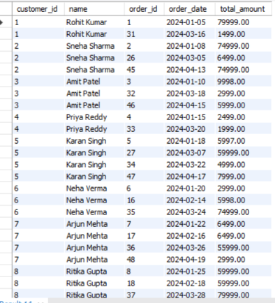
Q4 – FULL OUTER JOIN Simulation
A · NORMAL QUERIES
Q4
All customers and all orders (FULL OUTER JOIN using UNION)
OUTPUT
SELECT c.customer_id, c.name, o.order_id,
o.order_date, o.total_amount
FROM Customers c
LEFT JOIN Orders o ON c.customer_id = o.customer_id
UNION
SELECT c.customer_id, c.name, o.order_id,
o.order_date, o.total_amount
FROM Customers c
RIGHT JOIN Orders o ON c.customer_id = o.customer_id;
INSIGHT
MySQL has no FULL OUTER JOIN, so a LEFT JOIN and a RIGHT JOIN are combined with UNION.
The result has 50 rows, the same as Q2, with no NULLs.
Every customer has orders and every order belongs to a customer, so the RIGHT JOIN adds nothing new.
UNION removes duplicates, so matching rows appear only once.

Slide 7
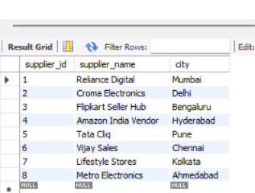
Q5 – Joins with Filters
A · NORMAL QUERIES
Q5
Products priced ₹5,000–₹50,000 from Mumbai suppliers
OUTPUT (EMPTY RESULT)
product_id | product_name | price | supplier_name | city
0 row(s) returned
SELECT p.product_id, p.product_name, p.price,
s.supplier_name, s.city
FROM Products p
INNER JOIN Suppliers s ON p.supplier_id = s.supplier_id
WHERE p.price BETWEEN 5000 AND 50000
AND s.city = 'Mumbai';
CHECK: SUPPLIERS TABLE
INSIGHT
The query returns 0 rows, which is the correct result for this data.
Only one product is in the price range: Prestige Mixer Grinder (₹6,499), supplied by Tata Cliq, which is in Pune.
The only Mumbai supplier, Reliance Digital, sells the iPhone 15 at ₹79,999, above the range.
No product satisfies both conditions together.

Slide 8
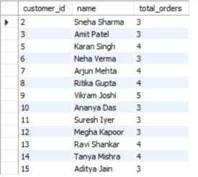
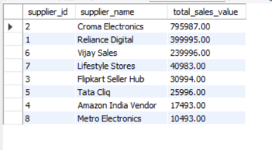
Q6 & Q7 – Order Counts and Supplier Sales
B · AGGREGATIONS & GROUP BY
Q6
Customers with more than 2 orders (GROUP BY + HAVING)
Q7
Total sales value per supplier (quantity × price_each)
SELECT c.customer_id, c.name,
COUNT(o.order_id) AS total_orders
FROM Customers c
INNER JOIN Orders o ON c.customer_id = o.customer_id
GROUP BY c.customer_id, c.name
HAVING COUNT(o.order_id) > 2;
SELECT s.supplier_id, s.supplier_name,
SUM(oi.quantity * oi.price_each) AS total_sales_value
FROM Suppliers s
INNER JOIN Products p ON s.supplier_id = p.supplier_id
INNER JOIN Order_Items oi ON p.product_id = oi.product_id
GROUP BY s.supplier_id, s.supplier_name
ORDER BY total_sales_value DESC;
INSIGHT
OUTPUT
13 of 15 customers have more than 2 orders.
Vikram Joshi leads with 5 orders; five customers have 4 and seven have 3.
Rohit Kumar and Priya Reddy (2 orders each) are filtered out by HAVING.
INSIGHT
OUTPUT
Croma Electronics leads with ₹7,95,987, about half of all supplier sales.
Reliance Digital (₹3,99,995) and Vijay Sales (₹2,39,996) come next.
Metro Electronics is lowest at ₹10,493 (only the Philips Trimmer).

Slide 9
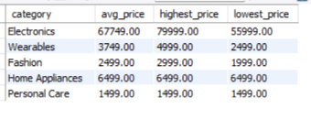
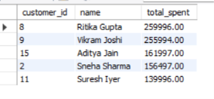
Q8 & Q9 – Category Prices and Top Spenders
B · AGGREGATIONS & GROUP BY
Q8
Average, highest and lowest price per category
Q9
Top 5 customers by total spending
SELECT category,
ROUND(AVG(price), 2) AS avg_price,
MAX(price) AS highest_price,
MIN(price) AS lowest_price
FROM Products
GROUP BY category;
SELECT c.customer_id, c.name,
SUM(o.total_amount) AS total_spent
FROM Customers c
INNER JOIN Orders o ON c.customer_id = o.customer_id
GROUP BY c.customer_id, c.name
ORDER BY total_spent DESC
LIMIT 5;
OUTPUT
OUTPUT
INSIGHT
INSIGHT
Electronics has the highest average price, ₹67,749, ranging from ₹55,999 to ₹79,999.
Personal Care has the lowest average at ₹1,499.
Home Appliances and Personal Care have one product each, so their average, highest and lowest are equal.
Ritika Gupta is the top spender at ₹2,59,996, just ahead of Vikram Joshi (₹2,55,994).
Vikram placed more orders (5 vs 4) but spent less, so order value matters more than order count.
Aditya Jain, Sneha Sharma and Suresh Iyer complete the top 5.

Slide 10
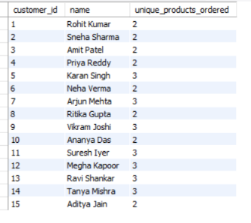
Q10 – Unique Products per Customer
B · AGGREGATIONS & GROUP BY
Q10
Unique products ordered by each customer
OUTPUT
SELECT c.customer_id, c.name,
COUNT(DISTINCT oi.product_id) AS unique_products_ordered
FROM Customers c
INNER JOIN Orders o ON c.customer_id = o.customer_id
INNER JOIN Order_Items oi ON o.order_id = oi.order_id
GROUP BY c.customer_id, c.name;
INSIGHT
Every customer ordered 2 or 3 different products; nobody ordered more than 3.
Seven customers bought 3 unique products and the other eight bought 2.
Vikram Joshi has 5 orders but only 3 unique products, so he re-ordered some items.
DISTINCT is needed because the same product can appear in several orders.

Slide 11
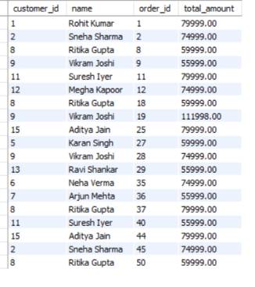
Q11 – Orders Above the Average
C · SUBQUERIES
Q11
Customers with an order above the average amount
OUTPUT
SELECT DISTINCT c.customer_id, c.name,
o.order_id, o.total_amount
FROM Customers c
INNER JOIN Orders o ON c.customer_id = o.customer_id
WHERE o.total_amount > (SELECT AVG(total_amount)
FROM Orders);
INSIGHT
The average order value is ₹29,849, and 19 of the 50 orders are above it.
These 19 orders come from 11 different customers; Ritika Gupta has 4 of them.
The largest order is #19 by Vikram Joshi (₹1,11,998).
The subquery runs once and returns a single average that is compared with every order.

Slide 12

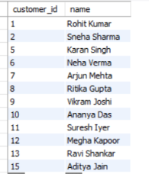
Q12 & Q13 – Subqueries with NOT IN and IN
C · SUBQUERIES
Q12
Products that have never been ordered (NOT IN)
Q13
Customers who ordered an Electronics product
SELECT product_id, product_name, category, price
FROM Products
WHERE product_id NOT IN (
SELECT product_id FROM Order_Items
WHERE product_id IS NOT NULL);
SELECT customer_id, name
FROM Customers
WHERE customer_id IN (
SELECT o.customer_id
FROM Orders o
INNER JOIN Order_Items oi ON o.order_id = oi.order_id
INNER JOIN Products p ON oi.product_id = p.product_id
WHERE p.category = 'Electronics');
OUTPUT (EMPTY RESULT)
INSIGHT
OUTPUT
12 of 15 customers ordered at least one Electronics product.
Amit Patel, Priya Reddy and Tanya Mishra never ordered Electronics.
The subquery returns customer ids; the outer query fetches their names.
INSIGHT
The query returns 0 rows, so all 10 products have been ordered at least once.
The IS NOT NULL filter in the subquery avoids the NOT IN trap, where a single NULL would hide every row.

Slide 13

Q14 & Q15 – Nested Subquery and MAX()
C · SUBQUERIES
Q14
Suppliers whose products were ordered over 100 times
Q15
Most expensive product (subquery with MAX)
SELECT supplier_id, supplier_name
FROM Suppliers
WHERE supplier_id IN (
SELECT p.supplier_id
FROM Products p
INNER JOIN Order_Items oi ON p.product_id = oi.product_id
GROUP BY p.product_id, p.supplier_id
HAVING SUM(oi.quantity) > 100);
SELECT product_id, product_name, category, price
FROM Products
WHERE price = (SELECT MAX(price) FROM Products);
OUTPUT
OUTPUT (EMPTY RESULT)
supplier_id | supplier_name
0 row(s) returned
INSIGHT
INSIGHT
The iPhone 15 (Electronics, ₹79,999) is the most expensive product.
The subquery returns one value, the maximum price, which is compared with each product.
If two products shared the top price, both would be returned.
The query returns 0 rows: no product reaches 100 units in total.
With only 50 orders the volumes are small. Boat Earbuds, for example, sold about 7 units (₹17,493 of sales at ₹2,499 each).
Here "ordered more than 100 times" is read as total quantity per product.

Slide 14
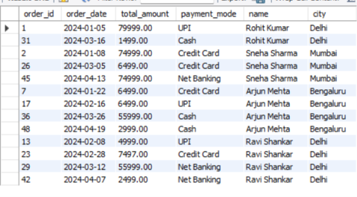
Q16 – The IN Operator
D · ADVANCED FILTERS
Q16
Orders from customers in Mumbai, Delhi or Bengaluru (IN)
OUTPUT
SELECT o.order_id, o.order_date, o.total_amount,
o.payment_mode, c.name, c.city
FROM Orders o
INNER JOIN Customers c ON o.customer_id = c.customer_id
WHERE c.city IN ('Mumbai', 'Delhi', 'Bengaluru');
INSIGHT
The orders shown belong to customers in Delhi (Rohit Kumar, Ravi Shankar), Mumbai (Sneha Sharma) and Bengaluru (Arjun Mehta).
The data spells the city as "Bengaluru", which matches the filter.
IN is a shorter way to write three city = ... conditions joined with OR.

Slide 15
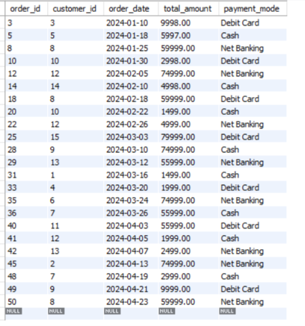
Q17 – The NOT IN Operator
D · ADVANCED FILTERS
Q17
Orders not paid by UPI or Credit Card (NOT IN)
OUTPUT
SELECT *
FROM Orders
WHERE payment_mode NOT IN ('UPI', 'Credit Card');
INSIGHT
23 of 50 orders were paid by Cash (8), Net Banking (8) or Debit Card (7).
The other 27 orders used UPI (16) or Credit Card (11).
Both modes are excluded in a single condition, instead of two separate <> checks.

Slide 16

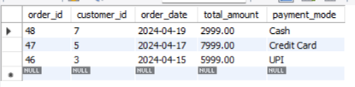

Q18, Q19 & Q20 – IS NULL, NOT IN and OFFSET
D · ADVANCED FILTERS
Q18
Customers with no email recorded (IS NULL)
Q19
Suppliers not in any customer city (NOT IN)
Q20
Latest 3 orders after skipping 2 (LIMIT + OFFSET)
SELECT customer_id, name, city
FROM Customers
WHERE email IS NULL
OR TRIM(email) = '';
SELECT supplier_id, supplier_name,
city
FROM Suppliers
WHERE city NOT IN (
SELECT city FROM Customers
WHERE city IS NOT NULL);
SELECT *
FROM Orders
ORDER BY order_date DESC,
order_id DESC
LIMIT 3 OFFSET 2;
OUTPUT (EMPTY RESULT)
OUTPUT
OUTPUT (EMPTY RESULT)
INSIGHT
INSIGHT
INSIGHT
0 rows: every customer has an email recorded.
IS NULL is used because = NULL never matches. TRIM also catches empty strings.
0 rows: every supplier city also has at least one customer.
The IS NOT NULL filter keeps NULL cities from emptying the result.
Orders are sorted newest first and the two latest (#50, #49) are skipped.
The result is orders #48, #47 and #46, dated 19, 17 and 15 April 2024.
order_id is a tie-breaker, so the order stays stable when dates match.

Slide 17
Key Findings
50 orders
₹7,95,987
₹2,59,996
23 of 50
from 15 customers; every customer has ordered at least once (Q2, Q4)
in sales for Croma Electronics, about half of all supplier sales (Q7)
spent by the top customer, Ritika Gupta (Q9)
orders were paid with Cash, Debit Card or Net Banking instead of UPI or Credit Card (Q17)
Empty results
Q5, Q12, Q14, Q18 and Q19 return 0 rows. The queries are correct; the data simply has no matching records.
Thank you

