Slide 1
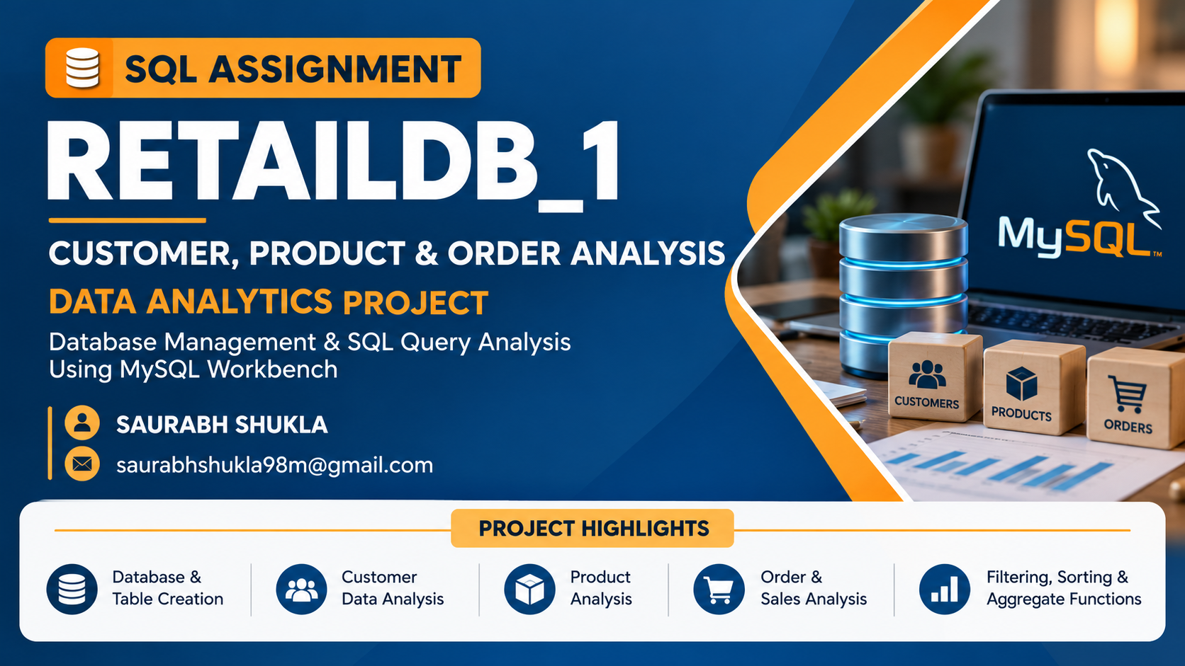

Slide 2
Database Overview: RetailDB_1
Customers
Products
Orders
Who our customers are
What we sell
What was purchased
customer_id (PK)
name
email
city
signup_date
product_id (PK)
product_name
category
price
order_id (PK)
customer_id (FK)
product_id (FK)
order_date
quantity
total_amount
payment_mode
Orders links Customers and Products through customer_id and product_id (foreign keys).

Slide 3
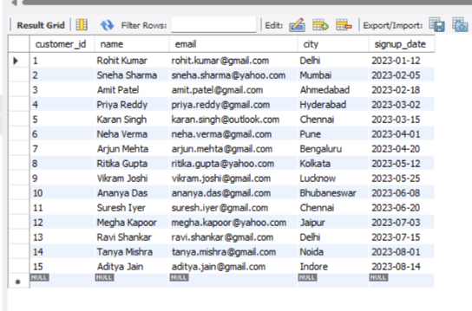
Customers Table (Q1: Fetch all customers)
QUERY
OUTPUT
SELECT * FROM customers;
INSIGHTS
The platform has 15 registered customers, spread across 13 different cities.
Delhi and Chennai each have 2 customers, every other city has 1. No single city dominates.
All signups happened between Jan and Aug 2023, roughly 2 new customers per month.
Gmail is the most used email provider (11 of 15), followed by Yahoo (3) and Outlook (1).
15 rows returned

Slide 4
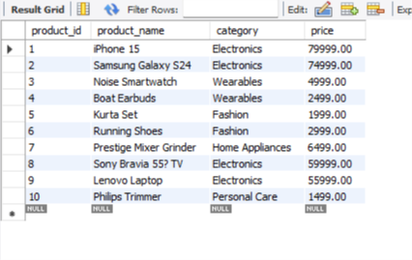
Products Table
QUERY
OUTPUT
SELECT * FROM products;
INSIGHTS
The catalogue has 10 products in 5 categories: Electronics, Wearables, Fashion, Home Appliances and Personal Care.
Electronics is the largest category with 4 products (iPhone 15, Galaxy S24, Sony TV, Lenovo Laptop).
Prices range from ₹1,499 (Philips Trimmer) to ₹79,999 (iPhone 15).
5 of 10 products cost more than ₹5,000, and 4 of those 5 are Electronics.
10 rows returned

Slide 5
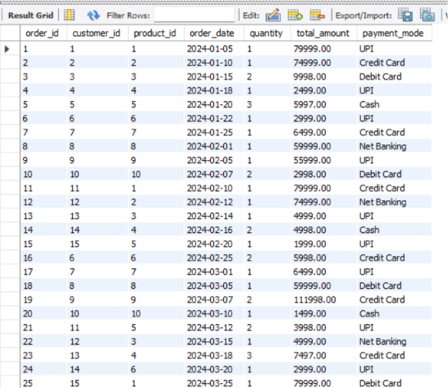
Orders Table
QUERY
OUTPUT
SELECT * FROM orders;
INSIGHTS
In these 25 orders, UPI is the favourite payment mode (9 orders, 36%), then Credit Card (6) and Debit Card (4).
Electronics drive revenue: 9 of 25 orders but about 90% of the total value (₹6.78 lakh of ₹7.54 lakh).
Order 19 is the biggest at ₹1,11,998 (2 Lenovo Laptops). Average order value is about ₹30,179.
Customers 6 to 15 all placed a second order in Feb and Mar, which shows good repeat buying.
First 25 orders (Jan to Mar 2024)

Slide 6
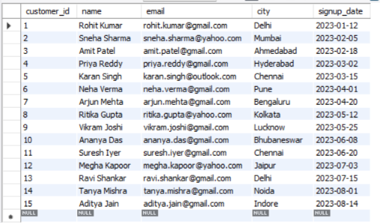
Q1. Fetch all customers from the database
QUERY
OUTPUT
SELECT * FROM customers;
INSIGHTS
The Customers table contains customer details, including customer ID, name, email, city, and signup date.
Each customer has a unique customer ID, which helps identify individual customers.
Customers have registered from multiple cities, showing the geographical distribution of the customer base.
The signup dates help track customer registration trends over time.
First 25 orders (Jan to Mar 2024)

Slide 7
Q2. Customer names and their cities
QUERY
OUTPUT
SELECT name, city FROM customers;
name | city
Rohit Kumar | Delhi
Sneha Sharma | Mumbai
Amit Patel | Ahmedabad
Priya Reddy | Hyderabad
Karan Singh | Chennai
Neha Verma | Pune
Arjun Mehta | Bengaluru
Ritika Gupta | Kolkata
Vikram Joshi | Lucknow
Ananya Das | Bhubaneswar
Suresh Iyer | Chennai
Megha Kapoor | Jaipur
Ravi Shankar | Delhi
Tanya Mishra | Noida
Aditya Jain | Indore
INSIGHTS
Instead of SELECT *, only the 2 needed columns are fetched. This keeps the result small and focused.
Delhi (Rohit Kumar, Ravi Shankar) and Chennai (Karan Singh, Suresh Iyer) have 2 customers each.
8 of 15 customers live in the 6 big metros (Delhi, Mumbai, Chennai, Bengaluru, Hyderabad, Kolkata), the other 7 are in smaller cities.
15 rows returned

Slide 8
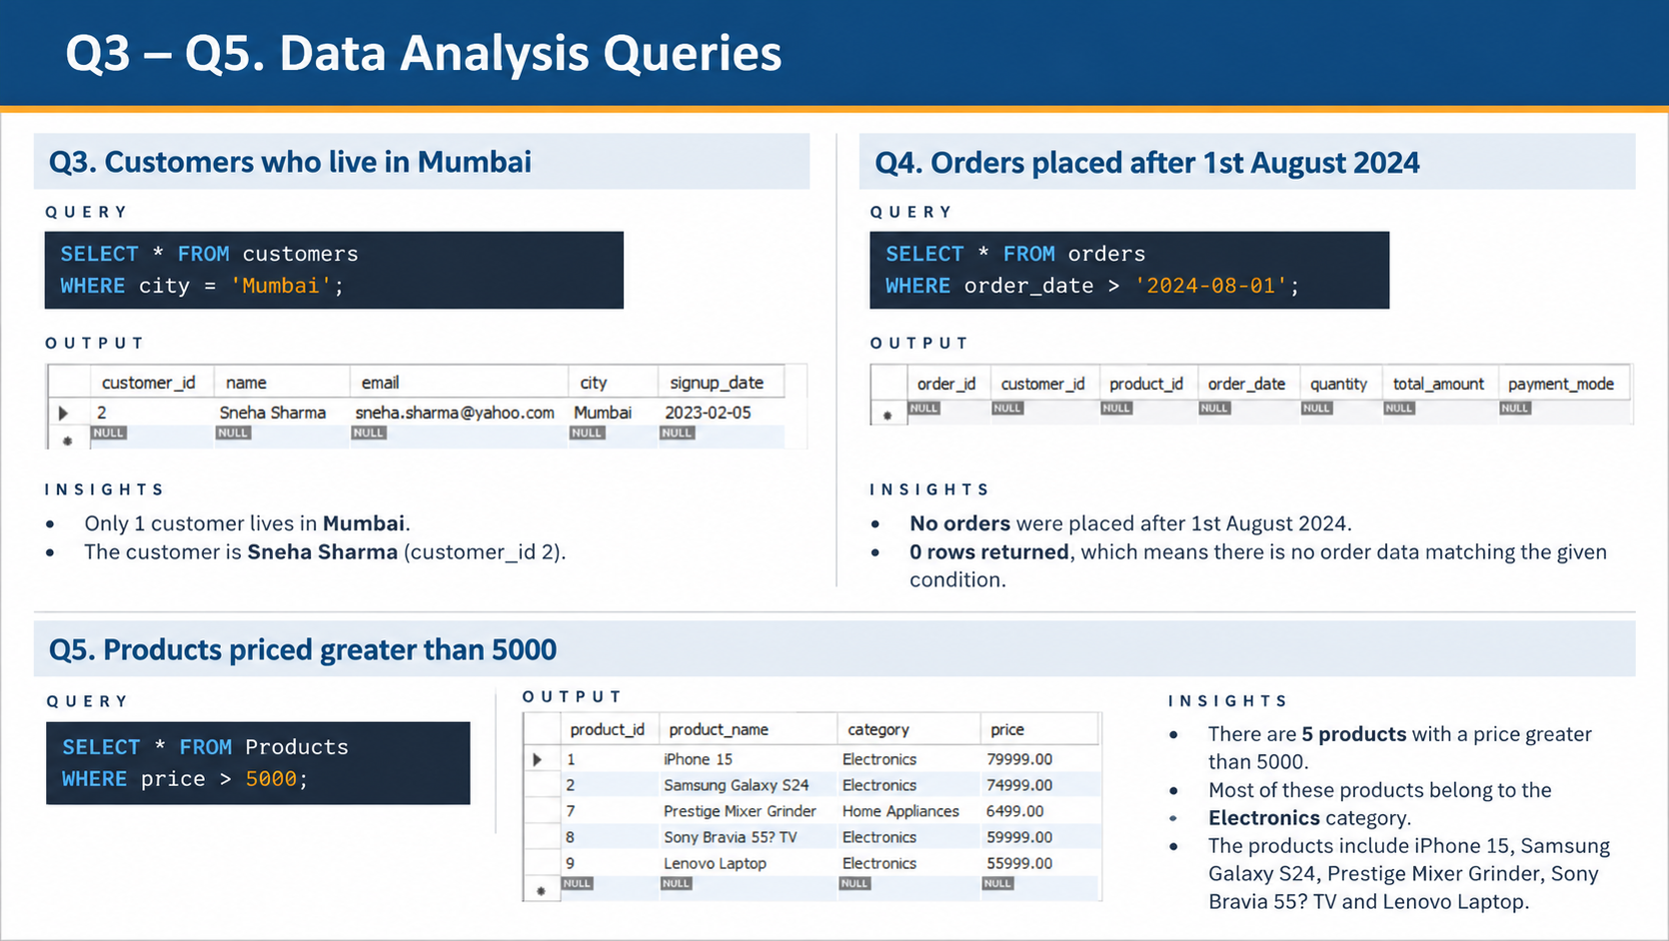

Slide 9

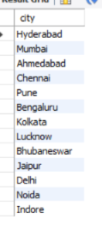
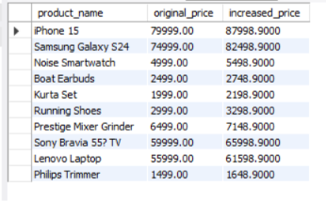
Q6–Q10. Customer & Product Analysis
Q6. Total number of customers
Q7. Update Rohit Kumar’s city
QUERY
QUERY
SELECT COUNT(*) AS total_customers
FROM Customers;
UPDATE Customers
SET city = 'Hyderabad'
WHERE name = 'Rohit Kumar';
OUTPUT
INSIGHTS
• The database contains 15 customers.
• COUNT(*) counts all rows in the Customers table.
INSIGHTS
• Updates Rohit Kumar’s city to Hyderabad.
• Run a SELECT query to verify the updated record.
Q8. Delete order with ID = 5
Q9. Products with 10% price increase
Q10. Unique customer cities
QUERY
QUERY
QUERY
DELETE FROM Orders
WHERE order_id = 5;
SELECT product_name,
price AS original_price,
price * 1.10 AS increased_price
FROM Products;
SELECT DISTINCT city
FROM Customers;
OUTPUT
INSIGHTS
INSIGHTS
OUTPUT
• DISTINCT returns each city once.
• The list includes Mumbai, Delhi, Hyderabad and other cities.
• Deletes the order whose order_id is 5.
• Confirm the deletion by checking the Orders table.
Note: DELETE statements may not return a result grid.
Calculated price = original price × 1.10.

Slide 10




Q17–Q20. Summary Statistics with SQL
Q17. Average order amount
Q18. Highest order amount
QUERY
QUERY
SELECT AVG(total_amount) AS
avg_order_amount FROM Orders;
SELECT MAX(total_amount) AS
highest_order_amount FROM Orders;
OUTPUT
INSIGHTS
OUTPUT
INSIGHTS
Average order amount: 32,722.83.
AVG() calculates the mean order value.
Highest order amount: 111,998.00.
MAX() returns the largest order value.
Q19. Lowest product price
Q20. Total money spent
QUERY
QUERY
SELECT MIN(price) AS lowest_price
FROM Products;
SELECT SUM(total_amount) AS
total_spent FROM Orders;
OUTPUT
INSIGHTS
OUTPUT
INSIGHTS
Lowest product price: 1,499.00.
MIN() returns the smallest product price.
Total spent across all orders: 948,962.00.
SUM() adds all order amounts.

Slide 11
Project Conclusion & Learning Outcomes
CONCLUSION
LEARNING OUTCOMES
This project demonstrates the use of basic SQL queries to manage and analyze customer, product, and order data.
Key concepts covered:
• Database and table creation
• Retrieving data using SELECT
• Filtering data using WHERE
• Sorting and limiting records
• Aggregate functions: COUNT, AVG, MAX, MIN and SUM
• Updating customer information and deleting specific orders
• Calculating increased product prices
• Identifying unique cities and filtering payment modes
This project helped me understand basic SQL operations and how to use MySQL Workbench for data analysis.
Key learning outcomes:
• Writing and executing SQL queries
• Retrieving and filtering relevant records
• Sorting results and limiting output
• Summarizing data with aggregate functions
• Modifying records using UPDATE and DELETE
• Interpreting query results to draw useful insights
END OF PROJECT • THANK YOU

