Slide 1

Predicting Success of Kickstarter Campaigns
Saurabh Pundir
Data Science Intensive Capstone Project, June 1, 2018 Cohort
Thanks to Springboard Mentor
AJ Sanchez

Slide 2
Introduction
Kickstarter is a global crowdfunding platform which helps creative projects to raise funding from backers
Project owners choose a deadline, set the rewards level and minimum funding goal
If people like the project/idea, they can pledge money to make it happen. Projects must reach their funding goal, otherwise no money will be collected
There is no guarantee that Project Owner will deliver on their project, use the money to implement their project, or that the completed project will meet backers' expectations
Each project had a status of either failed, successful, live, suspended or canceled.
We considered dataset of projects with success and failed status
Since its launch in April 2009, 15 million people have backed a Kickstarter project

Slide 3
Kickstarter platform has raised $3.71 billion for 300,000 projects Successfully funded projects: 144,770 Unsuccessful projects: 255,775 But, are all projects worth the clients and audience investments? This project aims to find out the best algorithm to predict the probability of success of newly launched crowdfunding project. The project should be launched in last twenty-four hours because the project which has passed more time might have received some pledge amount which is not a variable in this model.
The Problem
Can we predict the success or failure of newly launched
Kickstarter Campaigns?

Slide 4
Who are our Clients?
Success of the newly launched Project
Project Owner
Project Backer
Crowdfunding Facilitator

Slide 5
Data Summary
Data Wrangling
Data Cleaning
Data Storage
Pickle object sterilization is utilized to store each month data frame
Data Extraction
Data acquired for the period: March 2016 – Jan 2018
Number of records: 172892
Number of Fields: 32
3 Step process
Data can be downloaded for one month at a time
File size: 140 MB
File format : csv (40 csv files)
Each CSV file has 4000 project information
Consolidate files from all months into one
Data fields are converted using date time conversion from Unix time to UTC date (“%Y-%m-%d %H:%M:%S”) format
Data fields related to location, user and category are subfields which were extracted from JSON Column
Missing data values were neglected
If Project data is available for multiple months then only recent data was considered which made project ID unique within the data
All International amounts were converted to USD
Additional fields like pledge count ratio etc were created for further analysis and visualization
JSON data is further extracted using JSON normalize
Source: webrobots.com
After all monthly files are available, as individual files, a single pickle file is created with all data appended
All the final models are saved in a Pickle file
Intermediate pickle file was created to save a state of data wherever process was time consuming

Slide 6
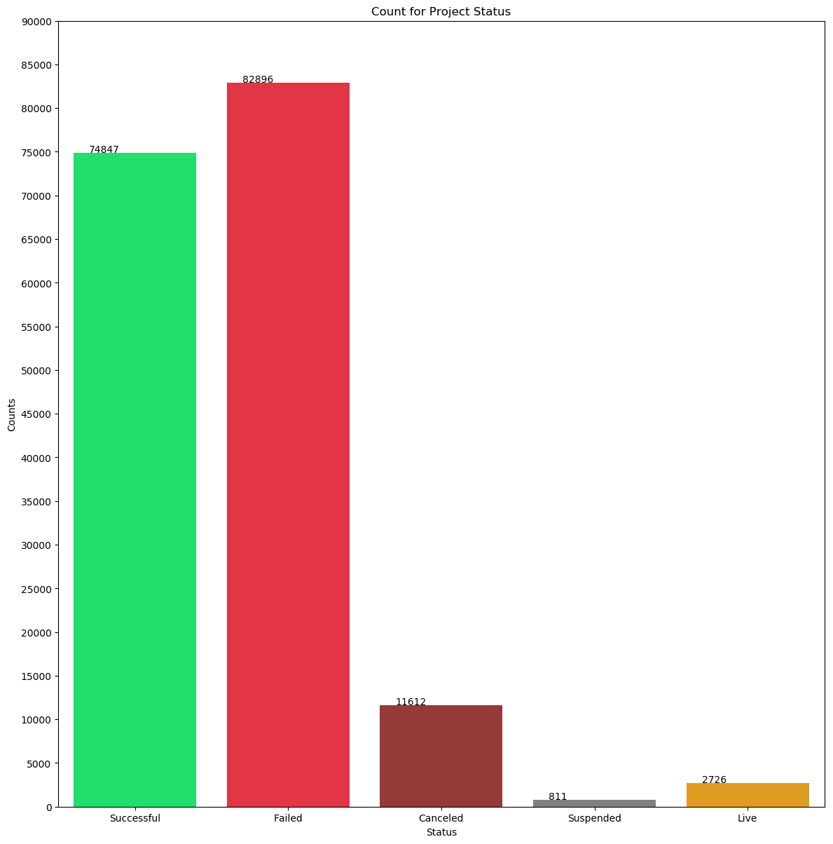
Project Count vs Project Status

Slide 7
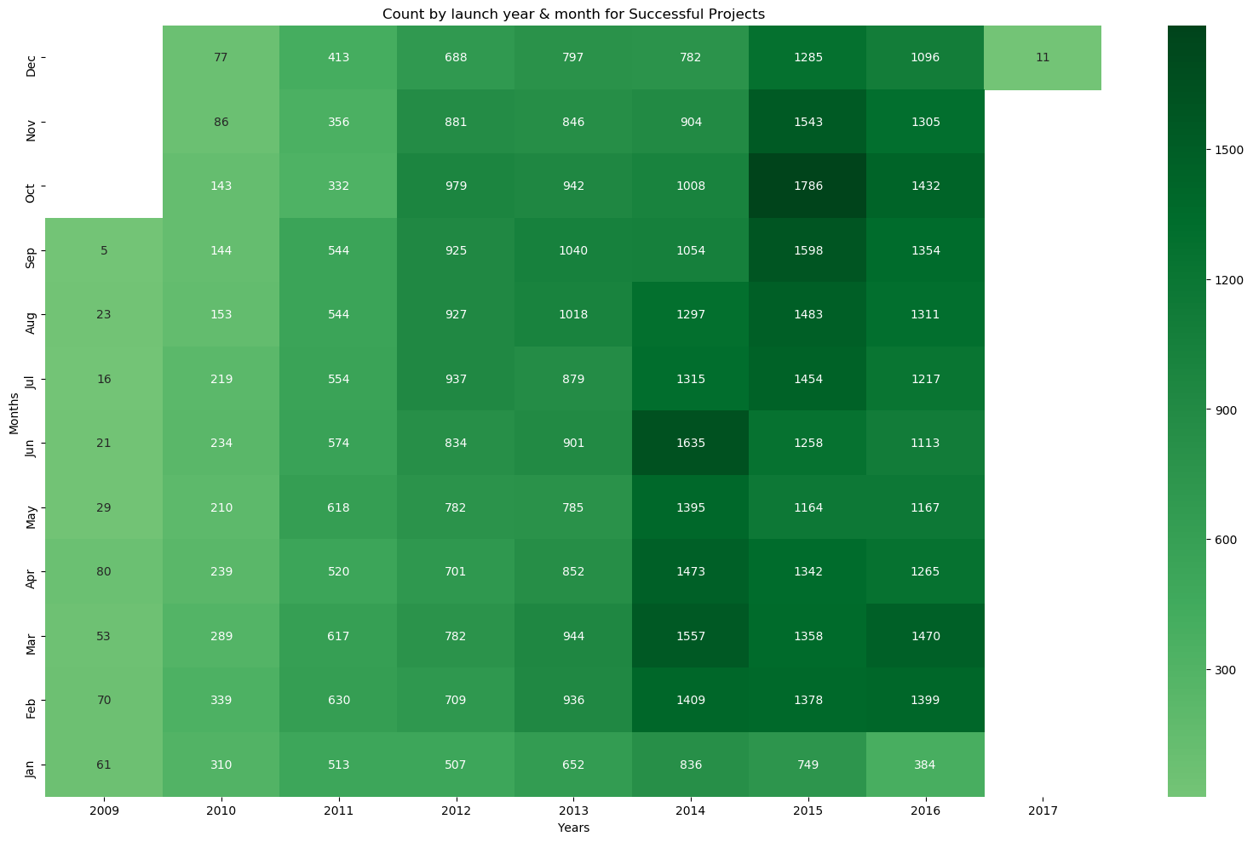
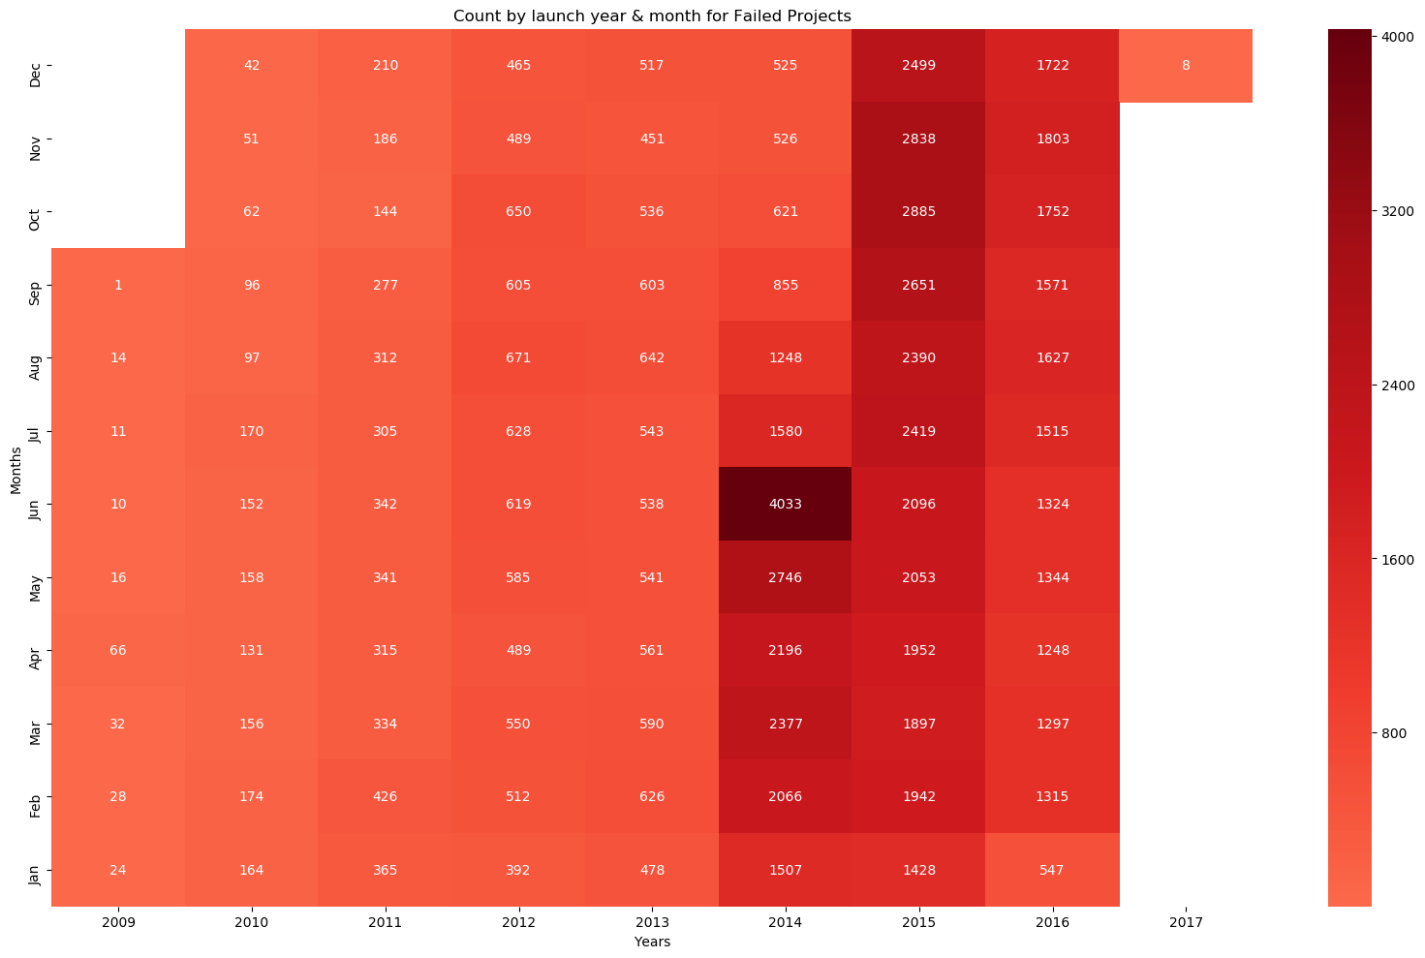
Relationship between launch Year/Month date with Success or Failure of the project
Heat Map for Year and Month
For Successful projects
Heat Map for Year and Month
For Failed projects

Slide 8
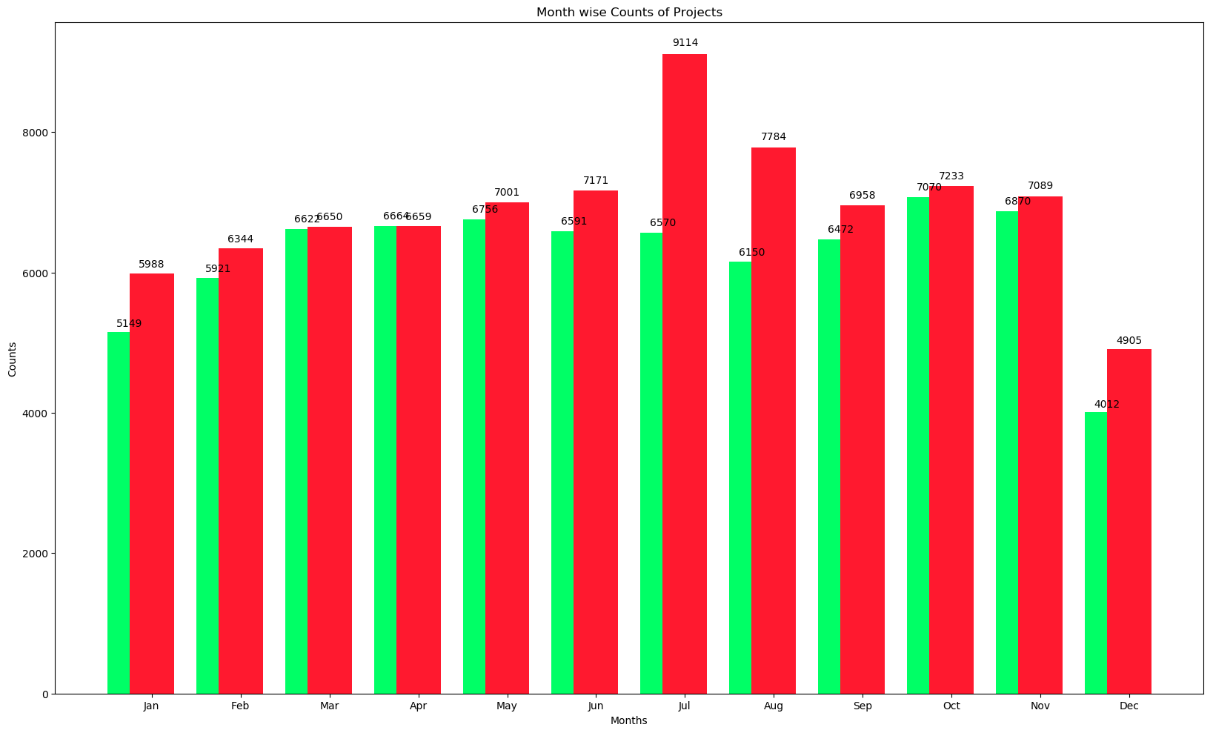
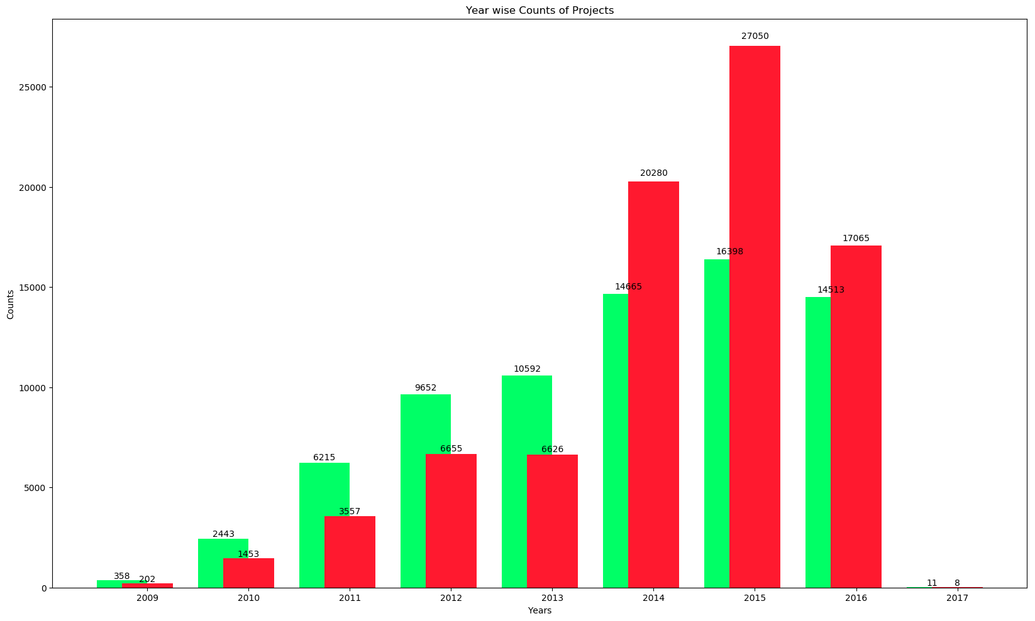
• Projects are launched evenly all months around with few months showing spike in numbers • Every month more projects failed but still, the counts are close • Kickstarter was launched in 2009. There was steady growth in a number of projects started till 2015 • Insufficient data available from 2017 and onward • There is an indication that more project failed as year’s progress. This may be due to decline in popularity or insufficient data
Month-wise Successful and Failed projects
Year-wise Successful and Failed projects

Slide 9
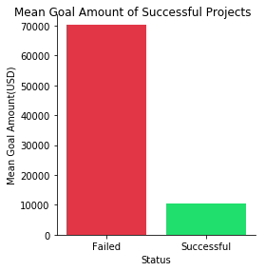
Goal Amount of Successful Projects

Slide 10
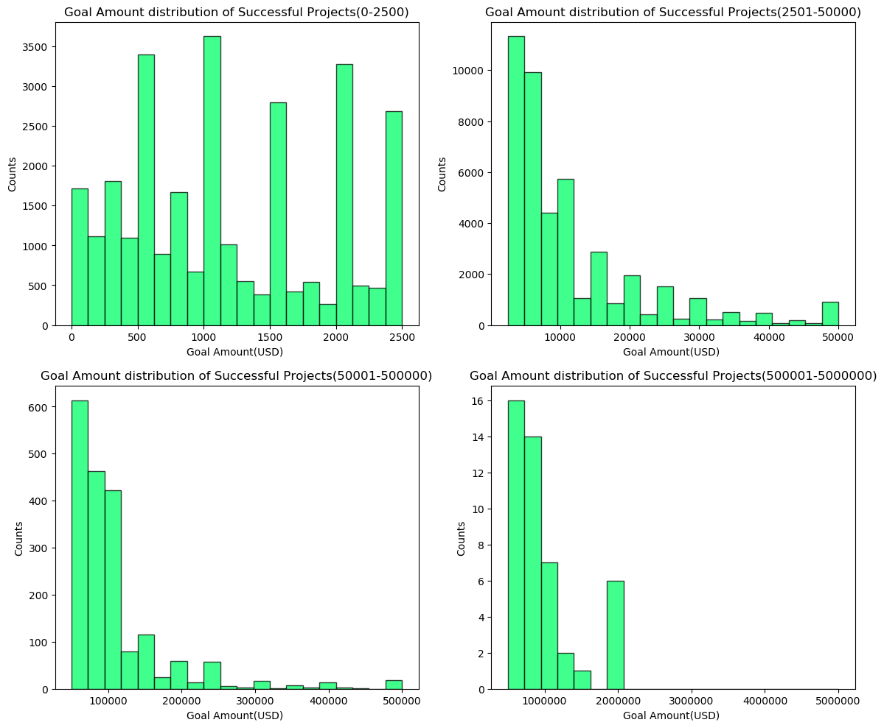
Goal Amount Distribution of Successful Projects
Most successful projects have goal amount in the range of 2500-5000 USD
For goal amounts from 0 - 4000 USD the difference between the number of failed and successful projects is very similar
If goal amount is more than 4000 USD the effect of goal amount can be seen on the success /failure of the project

Slide 11
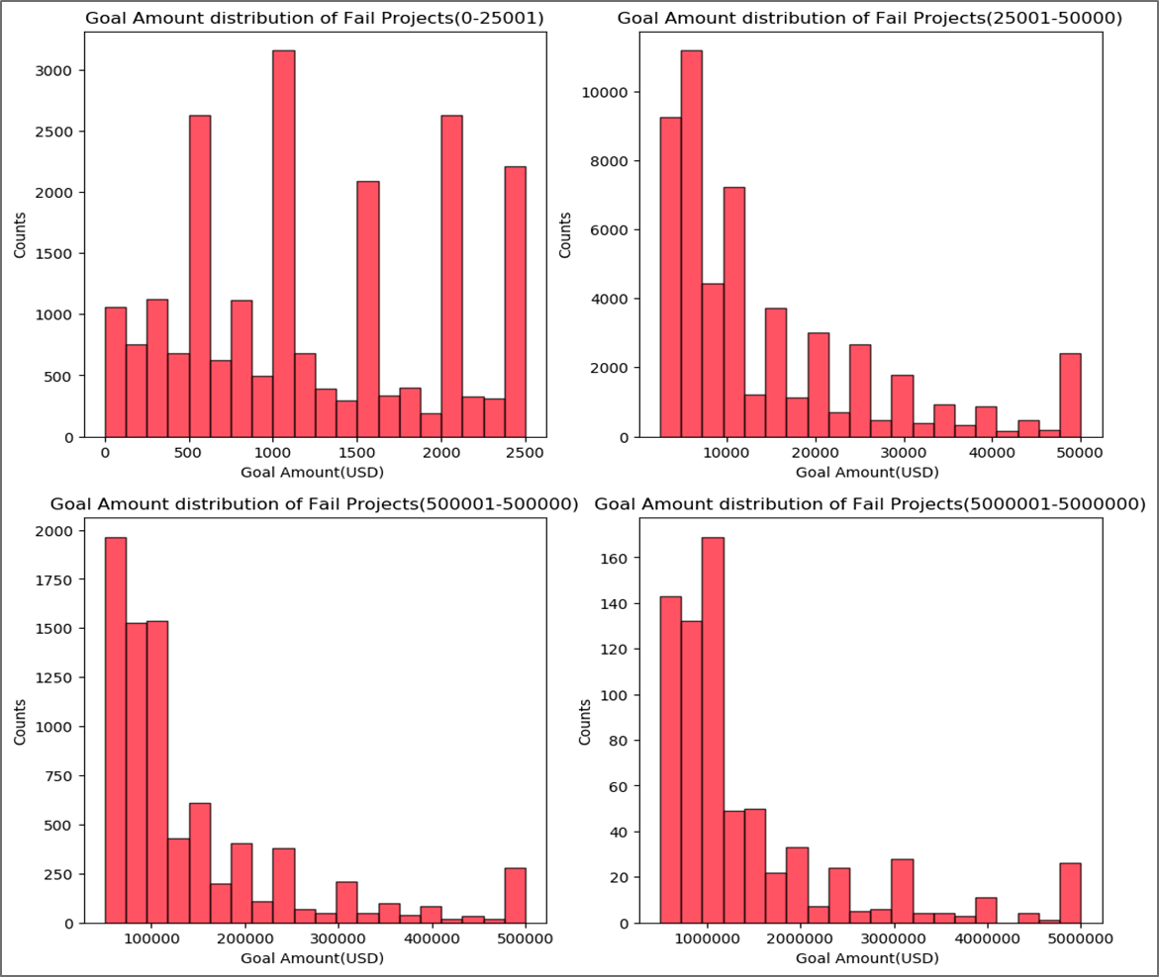
Goal Amount Distribution of Failed Projects
Most failed projects have goal amount in the range of 5000-7000 USD
The average goal amount of failed project is seven times higher. It indicates project with higher amount ask fail more.
If goal amount is more than 4000 USD the effect of goal amount can be seen on the success /failure of the project

Slide 12
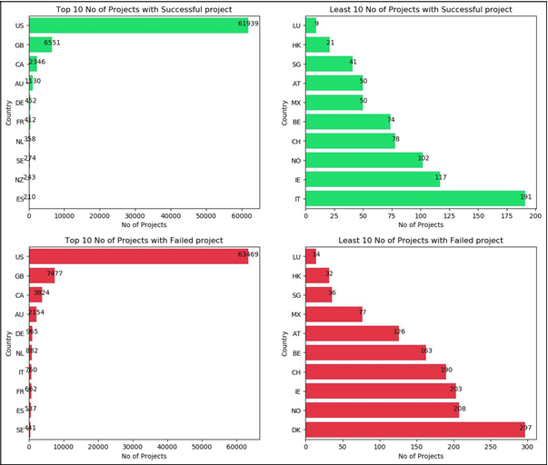

Country-wise Distribution of Successful and Failed Projects
Most number of projects launched were from USA
Most number of Successful and Failed projects - USA
Most countries in Top 10 and bottom 10 are same. It means these are most and least participating countries

Slide 13
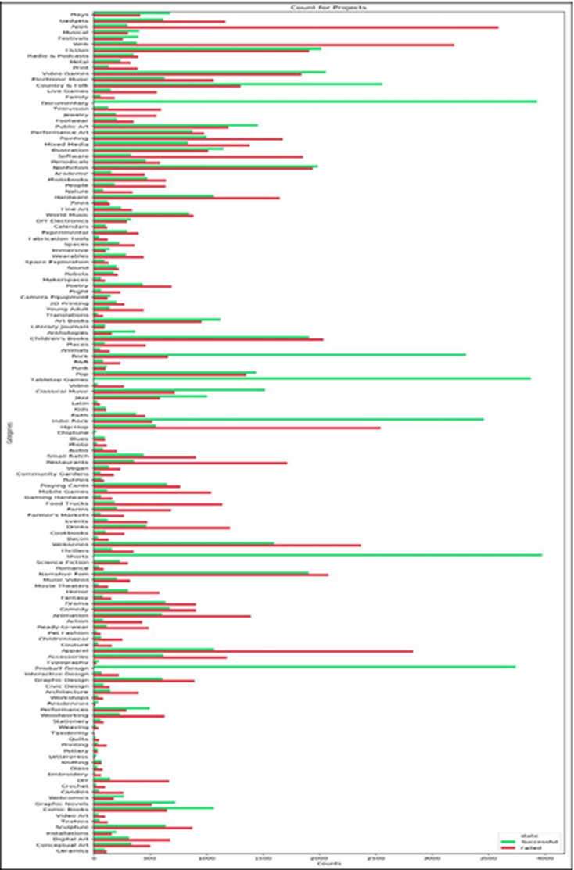
Categories with Most and Least Successful /Failed Projects

Slide 14
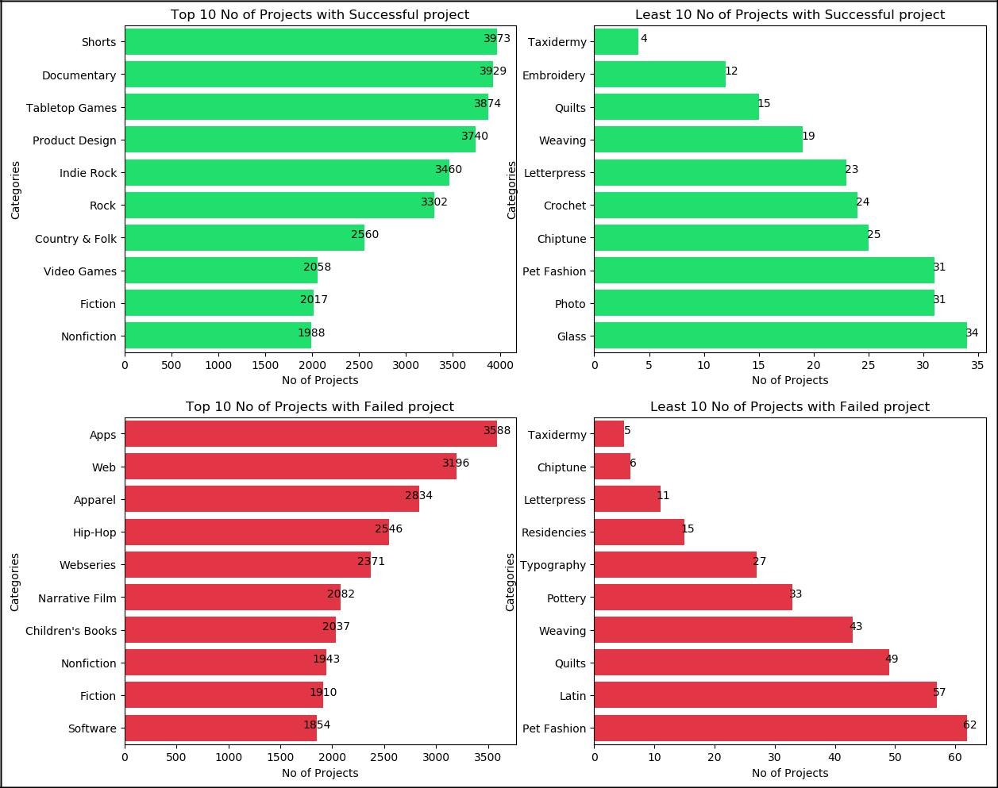
150+ distinct categories of projects
Categories like Apps, Web have high failing ratio
Categories like Product design and Shorts have high success ratio
No Top 10 or bottom 10 categories are common, which means categories have the impact on the success or failure of the project

Slide 15
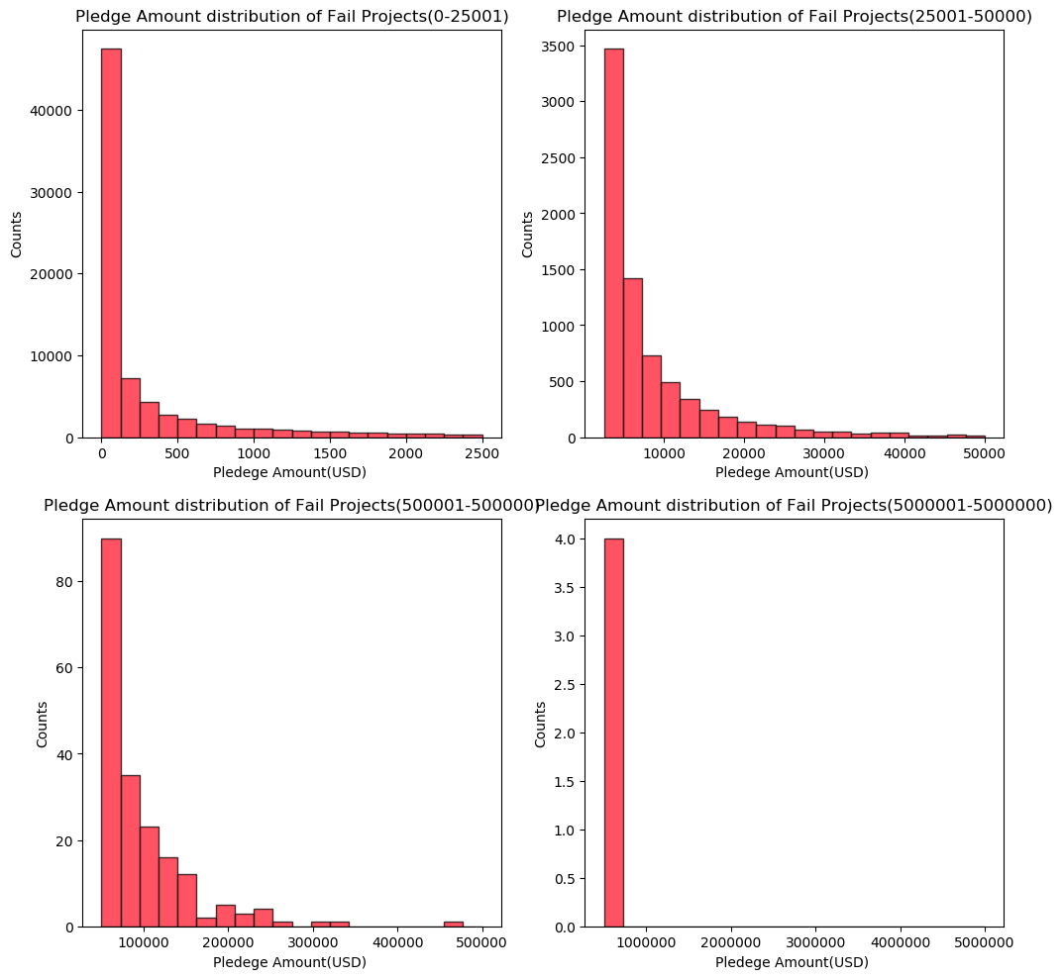
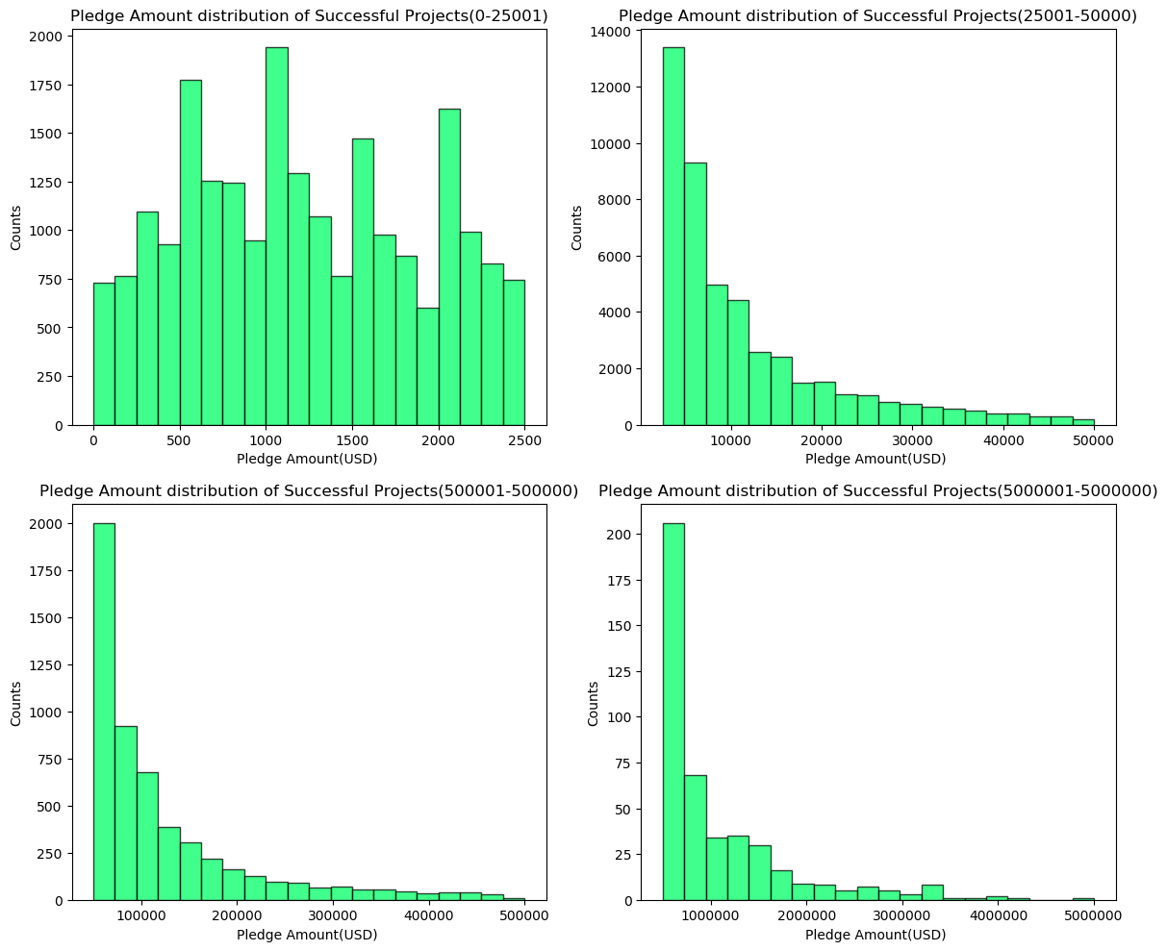
Pledge Amount - Success and Failure of Projects

Slide 16
Machine Learning Modeling

Slide 17
Logistic Regression Model
Baseline Analysis is performed by applying Logistic Regression Machine Learning Model
Logistic Regression algorithm is used to create model [0.01, 0.1, 1, 10, 100]
Setting hyperparameter: The [0.01, 0.1, 1, 10, 100] are used for the hyperparameter to find the best estimator using grid search from the model selection.
Splitting train and test size: The train and test split are 80-20. The train_test_split is used to get the two sets.
Fitting data: The training data obtain by above split and the model return by grid search is used to fit the data and obtain the model.
Finding accuracy: The accuracy score is calculated on training and test data using score method of the model for L1 and L2 regularization parameter. The L2(default) provides more accuracy on test data as compared to L1.
Table 1: Logistic Regression Accuracy comparison
Regularization parameter | accuracy of training data | accuracy of test data
L2(Default) | 0.82 | 0.83
L1 | 0.78 | 0.78

Slide 18
Logistic Regression Model
Classification report provides information about various parameter like precision, recall f1-score and support.
These figures tell about model performance based on how good the real fit is between test and train data based on true expected vs predicted
The report for L1 and L2 regularization parameter is shown below. The L2 (default) is having better recall and precision as compared to L1
Model Features
yTrain length | y_predict_training | ytestlr length | y_predict_test
126194 | 126194 | 31549 | 31549
Table 2: Logistic Regression Model features
Regularization parameter L2
Classification Report (Training)
 | Precision | recall | f1-score | support
0 | 0.78 | 0.92 | 0.85 | 66280
1 | 0.89 | 0.71 | 0.79 | 59914
Avg/total | 0.83 | 0.82 | 0.82 | 126194
Table 3: Logistic Regression (L2) Training Classification Report
Classification Report (Test)
 | Precision | recall | f1-score | support
0 | 0.78 | 0.92 | 0.85 | 16616
1 | 0.89 | 0.2 | 0.80 | 14933
Avg/total | 0.84 | 0.72 | 0.80 | 31549
Table 4: Logistic Regression (L2) Test Classification Report

Slide 19
Logistic Regression Model
Regularization parameter L1
Classification Report (Training)
Classification Report (Test)
 | Precision | recall | f1-score | support
0 | 0.74 | 0.89 | 0.81 | 66280
1 | 0.84 | 0.65 | 0.73 | 59914
Avg/total | 0.79 | 0.78 | 0.77 | 126194
 | Precision | recall | f1-score | support
0 | 0.74 | 0.89 | 0.81 | 16616
1 | 0.84 | 0.66 | 0.74 | 14933
Avg/total | 0.79 | 0.78 | 0.78 | 31549
Table 5: Logistic Regression (L1) Training Classification Report
Table 6: Logistic Regression (L1) Test Classification Report
Confusion Matrix
Regularization parameter L2
Regularization parameter L1
 | Predicted False | Predicted True
Actual False | 15336 | 1280
Actual True | 4236 | 10697
 | Predicted False | Predicted True
Actual False | 14811 | 1805
Actual True | 5123 | 9810
Table 7: Logistic Regression (L2) Confusion Matrix
Table 8: Logistic Regression (L1) Confusion Matrix

Slide 20
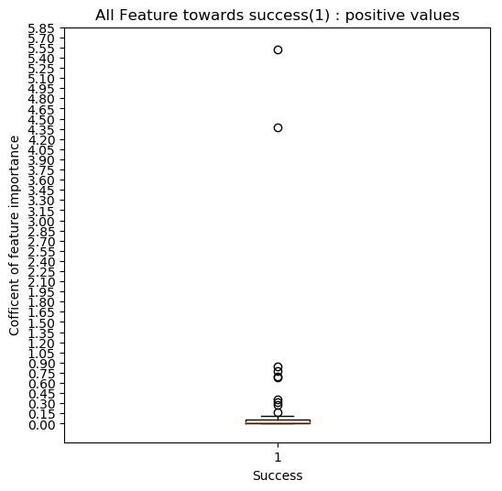
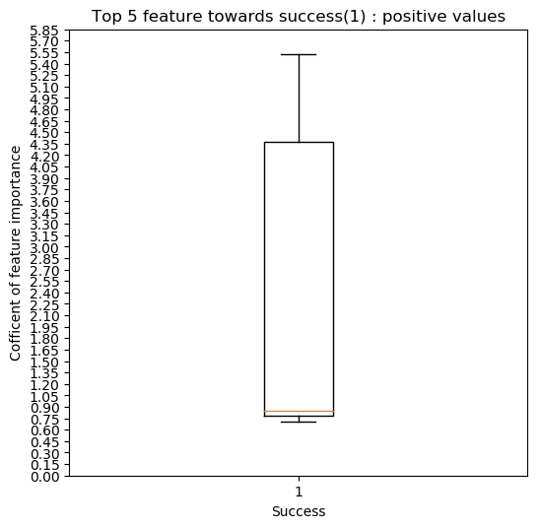
Top features influencing success of a campaign (1): positive values • The spread of top positive feature is large due to top 2 value(5.55 & 4.50) being relatively very high numbers • Most value resides in lower range providing nearly same feature importance coefficient
Regression Model – Feature importance with regularization L1

Slide 21
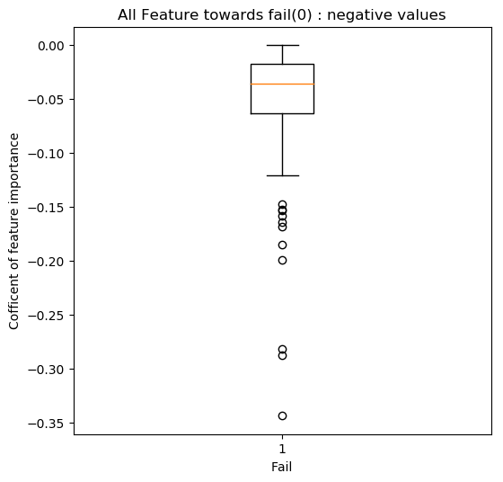
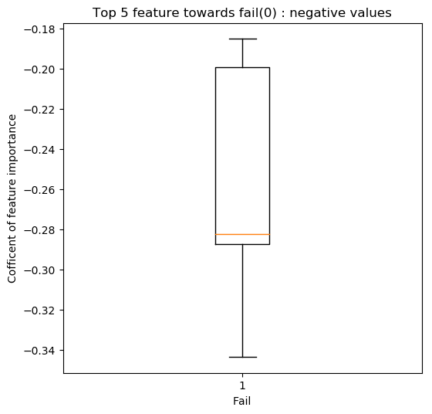
Top features influencing failure of a campaign (0): negative values • The spread of top negative feature is large due to top 2 value (0.35 & 0.30) being relatively very high numbers. • Most value resides in higher (absolute number) range providing, unlike success coefficient • The absolute value of fail is comparatively very small to success top most coefficient.
Regression Model – Feature importance with regularization L1

Slide 22
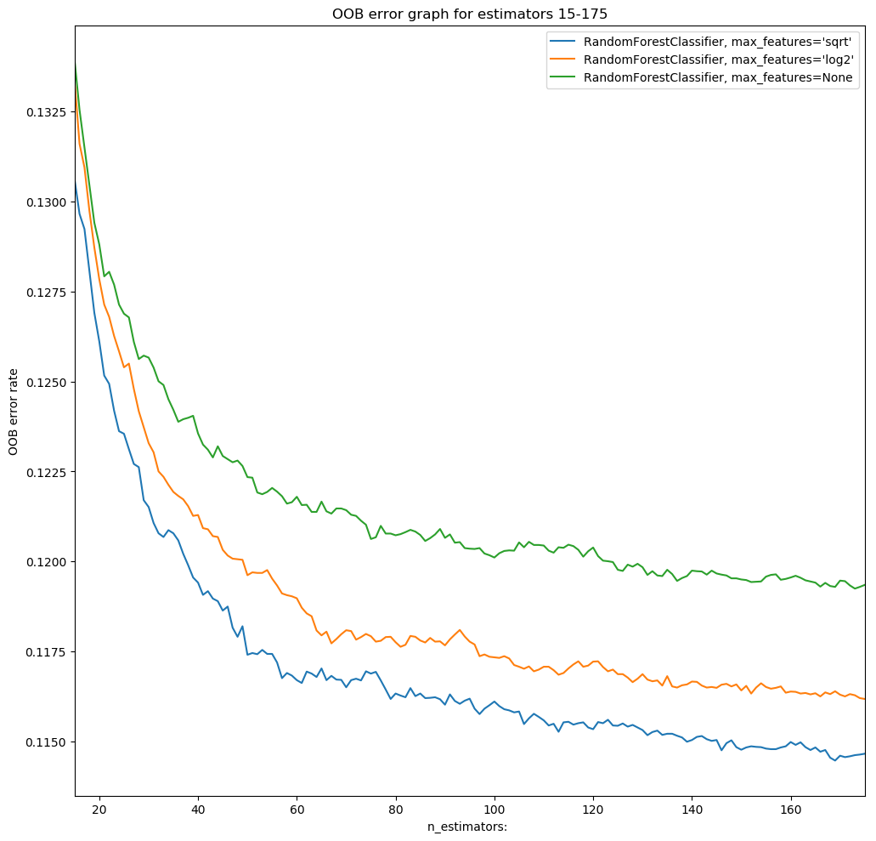
Random Forest Classifier Model
Random Forest Classifier (15-175)

Slide 23
Random Forest Classifier Model
Random Forest Classifier (15-175)
Top 5 feature with towards success (1): positive values
OOB Error rate | Estimator | Max Feature
0.11446661489452747 | 169 | 'sqrt'
0.11617826521070729 | 175 | 'log2'
0.1192449720271962 | 173 | None
Sr. No | Feature | Coefficient
1 | usd_pledged | 0.363263
2 | backers_count | 0.342628
3 | deadline_days | 0.058642
4 | staff_pick | 0.029299
5 | Shorts | 0.015465
The model created with the highlighted least OOB error rate with estimator 169.
Model features
Accuracy of test data | oob error on model | yTrain length | y_predict_ training | ytestlr length | y_predict_test
0.89 | 0.11 | 126194 | 126194 | 31549 | 31549
Top 5 feature with towards fail (0): negative values
Sr. No | Feature | Coefficient
1 | Taxidermy | 1.944475e-05
2 | Letterpress | 1.605715e-05
3 | Miscellaneous | 1.065033e-05
4 | Country | 8.956387e-07
5 | Estate | 5.096736e-07
Classification Report
 | Precision | recall | f1-score | support
0 | 0.91 | 0.87 | 0.89 | 16616
1 | 0.87 | 0.90 | 0.88 | 14933
Avg/total | 0.89 | 0.89 | 0.89 | 31549
Confusion Matrix
 | Predicted False | Predicted True
Actual False | 14533 | 2083
Actual True | 1498 | 13435

Slide 24
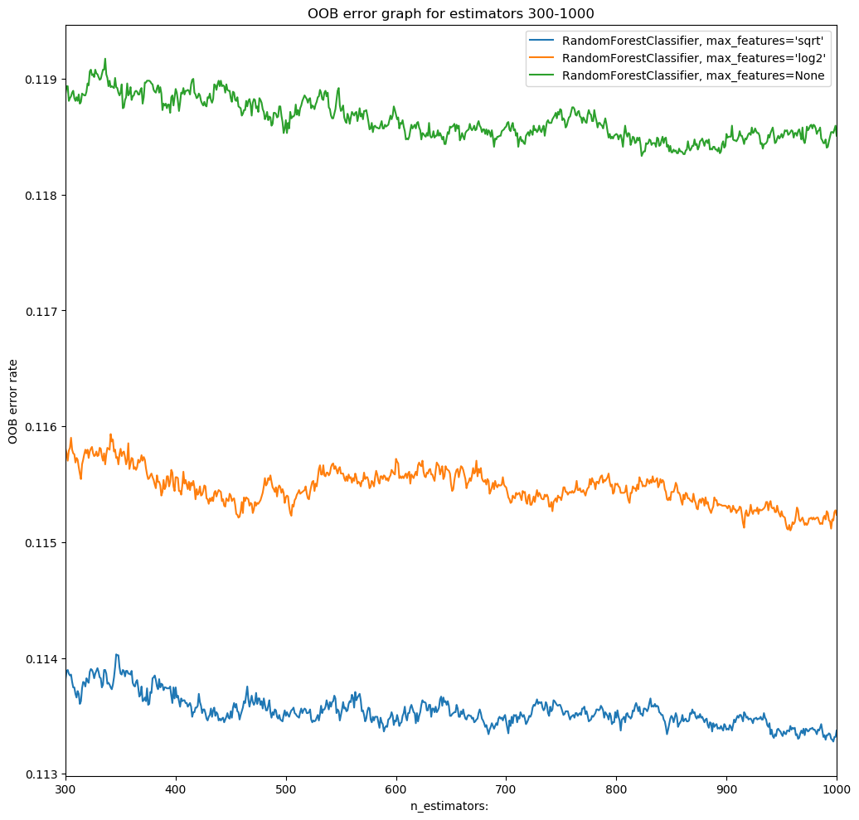
Random Forest Classifier Model
Random Forest Classifier (300-1000)

Slide 25
Random Forest Classifier Model
Random Forest Classifier (300-1000)
Top 5 feature with towards success (1): positive values
OOB Error rate | Estimator | Max Feature
0.11327796884162478 | 997 | 'sqrt'
0.11510055945607556 | 958 | 'log2'
0.11833367671997086 | 823 | None
Sr. No | Feature | Coefficient
1 | usd_pledged | 0.363263
2 | backers_count | 0.342628
3 | deadline_days | 0.058642
4 | staff_pick | 0.029299
5 | Shorts | 0.015465
The model created with the highlighted least OOB error rate with estimator 997
Model features
Model features | oob error on model | yTrain length | y_predict_ training | ytestlr length | y_predict_test
Model features | 0.11 | 126194 | 126194 | 31549 | 31549
Top 5 feature with towards fail (0): negative values
Sr. No | Feature | Coefficient
1 | Taxidermy | 1.944475e-05
2 | Letterpress | 1.605715e-05
3 | Miscellaneous | 1.065033e-05
4 | Country | 8.956387e-07
5 | Estate | 5.096736e-07
Classification Report
 | Precision | recall | f1-score | support
0 | 0.91 | 0.87 | 0.89 | 16616
1 | 0.87 | 0.90 | 0.88 | 14933
Avg/total | 0.89 | 0.89 | 0.89 | 31549
Confusion Matrix
 | Predicted False | Predicted True
Actual False | 14533 | 2083
Actual True | 1498 | 13435
The code related to this part is in Capstone_ML_LogisticRegression_RandomForestClassifier.ipynb file

Slide 26
Model Comparison
Model features Test Data
 | Random Forest Classifier 169 | Random Forest Classifier -199 | Random Forest Classifier -444 | Random Forest Classifier-997 | Linear Regression -L2 | Linear Regression -L1
Accuracy | 0.89 | 0.89 | 0.89 | 0.89 | 0.83 | 0.78
Precision(1) | 0.87 | 0.87 | 0.87 | 0.87 | 0.89 | 0.84
recall(1) | 0.90 | 0.90 | 0.90 | 0.90 | 0.71 | 0.66
f1-score(1) | 0.88 | 0.88 | 0.88 | 0.88 | 0.80 | 0.74
support(1) | 14933 | 14933 | 14933 | 14933 | 14933 | 14933
Precision(0) | 0.91 | 0.91 | 0.91 | 0.91 | 0.78 | 0.74
recall(0) | 0.87 | 0.87 | 0.87 | 0.87 | 0.92 | 0.89
f1-score(0) | 0.89 | 0.89 | 0.89 | 0.89 | 0.85 | 0.81
support(0) | 16616 | 16616 | 16616 | 16616 | 16616 | 16616
False(Actual/Predicted) | 14533 | 14533 | 14533 | 14533 | 15336 | 14811
True(Actual/Predicted) | 13435 | 13435 | 13435 | 13435 | 10697 | 9810

Slide 27
Conclusion - Model Comparison
The two machine learning algorithm Random Forest Classifier and Logistic Regression were compared with each other and also with some variation of parameters within the same algorithm
The Random forest with estimator 169-997 provides insight that model work similar and hence increasing estimator does not provide any significant improvement on the model
In Linear regression with L1 an L2 as regularization parameter, the L2 provides little better performance
Between two machine algorithm, the random forest classifier performed well over logistic regression on many parameters.
The accuracy improved with random forest classifier. The recall & f-1 score for positive(1) improved significantly with random forest but logistic regression did perform well for some false(0) data too

Slide 28
More Ideas to improve the Model in Future
There can be various crowdfunding sources, however this Project will be limited to campaigns funded using a website called Kickstarter
In future we can include data from multiple companies like GoFundMe, Indiegogo etc
Launch Period: Study the restriction related to this model based on the age of the Kickstarter project
Currently, the files are processed using code running in a Jupiter notebook on the local computer. The process like data wrangling, data cleaning and modeling took hours to finish on a local machine. Cloud technologies like AWS, Azure, and Cloudera etc. can be used to speed-up the processing
We can use batch processing for getting new data every month and update the model
Create a web application for visualization

Slide 29
Conclusion and Recommendations
All sources of datasets contributed to the predictive power of the model
Out of supervised classification models, the Random Forest Classifier provided the best results
Out of 32 features, we have performed feature importance analysis and identified features strongly contributing to the success and failure of the campaign
Kickstarter can add value to their current process of staff pick selection. They can use this model and understand if staff pick feature can take this project through the finish line
Through our model the Project Owner and Project backer can estimate the success or the failure of the campaign before launching or investing respectively

Slide 30
Thank You!
Saurabh Pundir Email: saurabhpundir.data@gmail.com www.linkedin.com/in/saurabhspundir https://github.com/saurabhspundir/KickstarterSuccessPredication

