Slide 1

Customer Segmentation in Mortgage Industry Saurabh Pundir Data Science Intensive Capstone Project, July 25, 2018
Thanks to Springboard Mentor AJ Sanchez

Slide 2
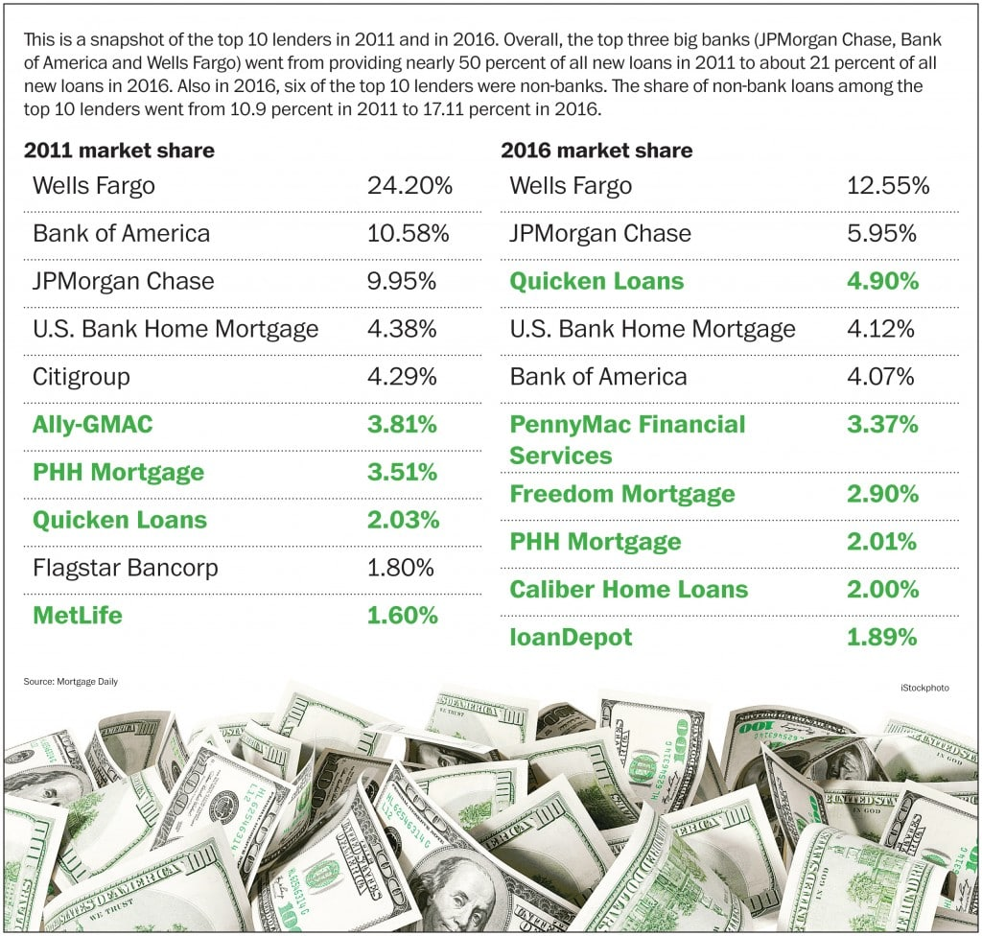
Introduction
The overall mortgage market is huge, with $ 10 trillion-plus in outstanding mortgages and projections of $2 trillion for this year
In 2011, 50 percent of all new mortgage money was loaned by the three biggest banks in the United States: JPMorgan Chase, Bank of America and Wells Fargo
By September 2016, the share of loans by these three big banks dropped to 21 percent
Six of the top 10 largest lenders by volume were non-banks, such as Quicken Loans, Loan Depot, and PHH Mortgage, compared with just two of the top 10 in 2011
In such a competitive and dynamic market its critical to obtain a deep understanding of consumer needs and behaviors to quickly find and close high-quality loans

Slide 3
The Problem
The top three lenders have a total share of $150 million, with the leader having a share of $80 million. Rest of the pie is distributed amongst 400 small and medium-sized lenders
Mortgage companies want to increase their market share and for doing so they need to understand their customers better
As per a recent study conducted by J.D. Powers, 63% of customers would leave their mortgage servicer for better customer service. The same study shows that 27% of first-time buyers and 21% of all borrowers regret their choice of lender
Can we identify the segment of mortgage customer based on the loans provided to the customer in the last three years?

Slide 4











Clients
Mortgage Firms
Banks
Real Estate Companies

Slide 5
Data Summary
Data acquired for the period: 2015 – 2017
Number of records and Fields: 1-2 million loans and 36 Fields
Data Wrangling – 3 STEP PROCESS
Data Extraction
Source: Home Mortgage Disclosure Act (HMDA)
Data Cleaning
Merged with FIPS database for county information
Data Storage
Pickle object sterilization is utilized to store each month data frame
Data can be downloaded for one year at a time 2015-2017
File size: 140 MB
File format : csv (3 csv files)
Each CSV file has loan records in millions
Total 2,51,794,02 records
Clean data without loan amount
Clean data without loan status
Clean data without county
Created column for approval rejection based on status
All the final models are saved in a Pickle file
Intermediate pickle file was created to save a state of data wherever process was time consuming

Slide 6
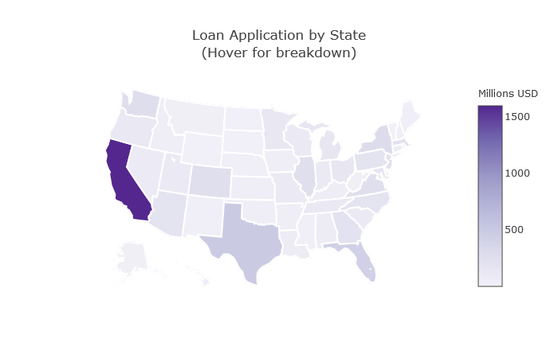
Loan Distribution in USA by State

Slide 7
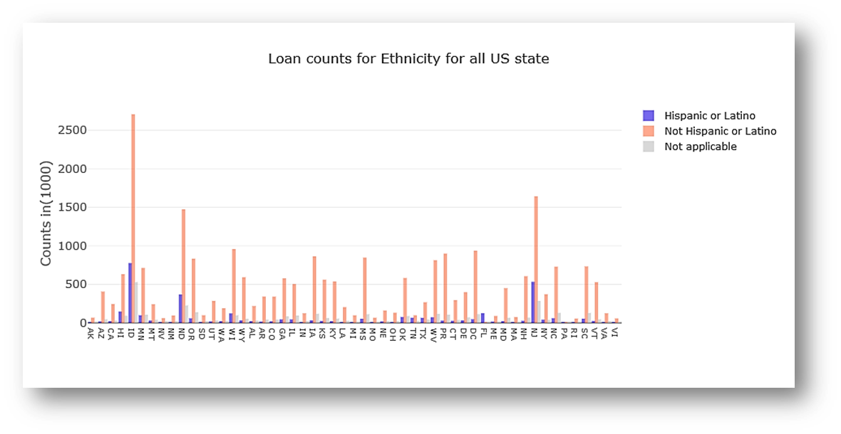
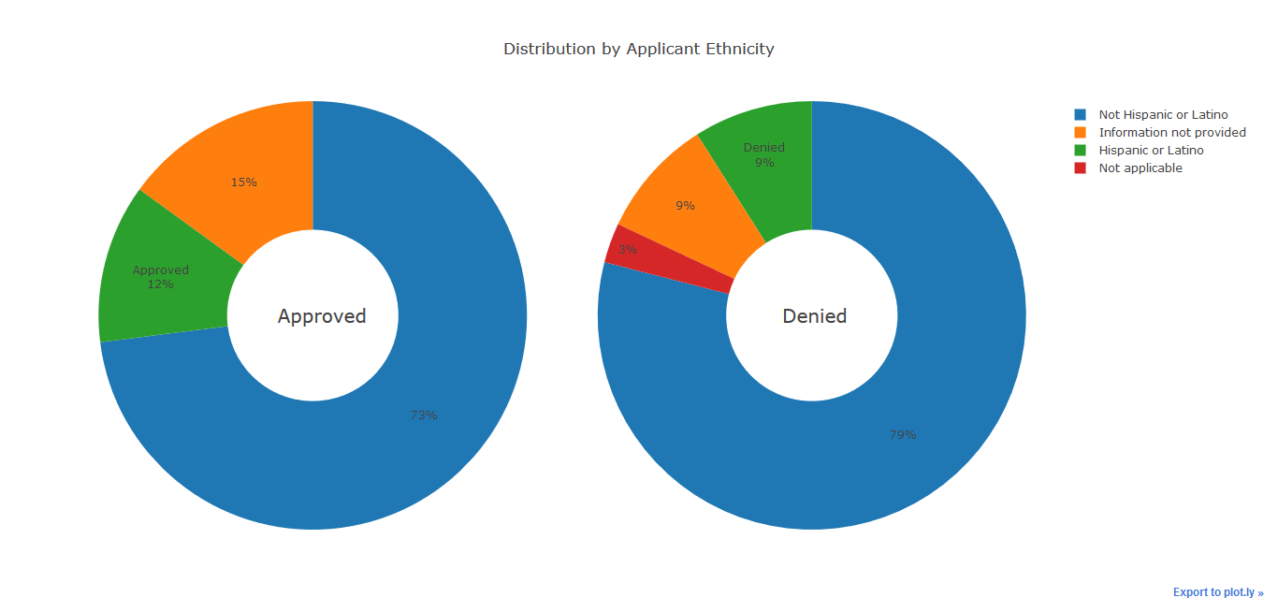
Loan Count – Applicant Ethnicity
Most states show non-Hispanic applicant more than Hispanic, but this can be due to fact that non-Hispanic covers a lot of other ethnicities
The 3 % of the application without ethnicity get rejected. But the application without ethnicity do not have a significant effect on approval
The ratio of approval for Hispanic applicants is 7% less than non-Hispanic. The ratio of approval for Hispanic and not providing information is almost similar.

Slide 8
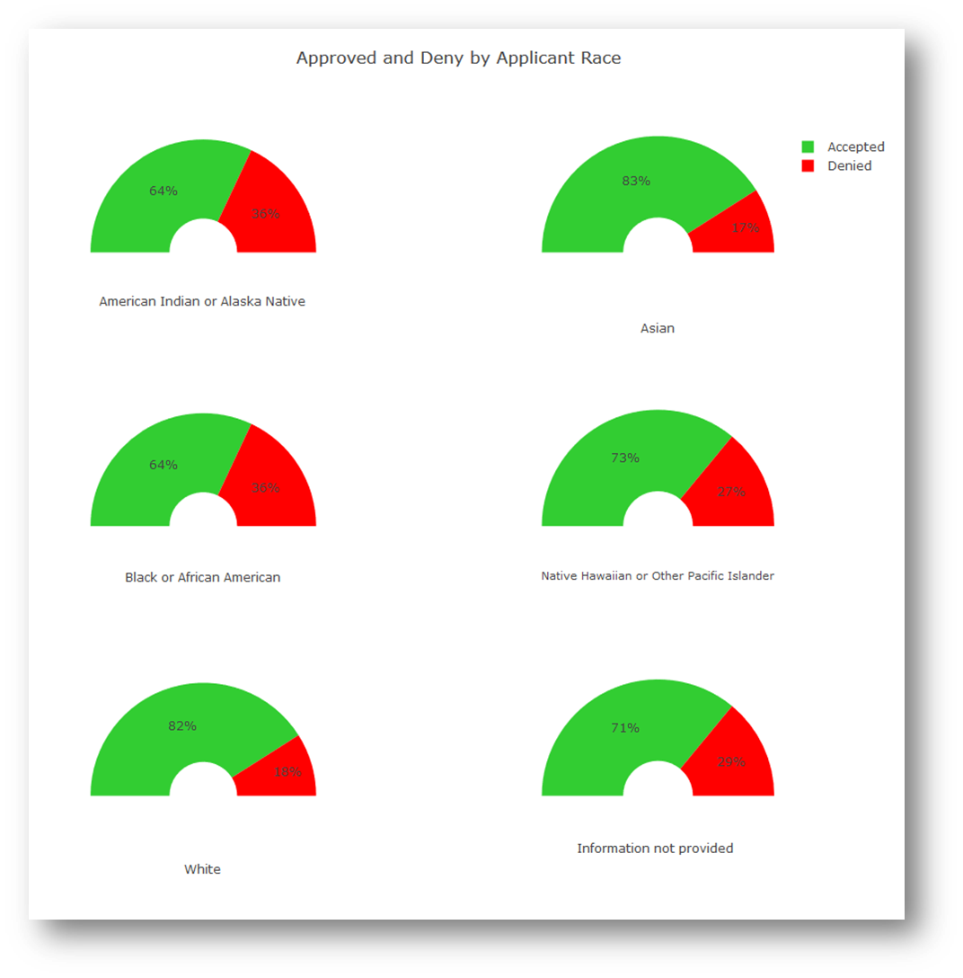
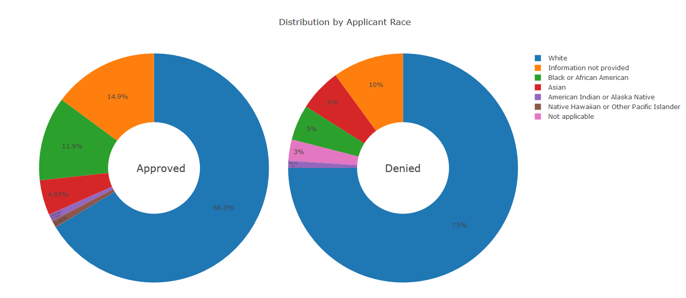
Loan Status – Applicant Race
In most states, the number of white applicants is higher as compared to other races. This might be also due to fact that there are more white people in the USA
A number of applications for loan denials are higher for Black or African American race followed by Asian race.
Number of approvals for loans are highest - 82% and denials are at 18% as per the data study

Slide 9
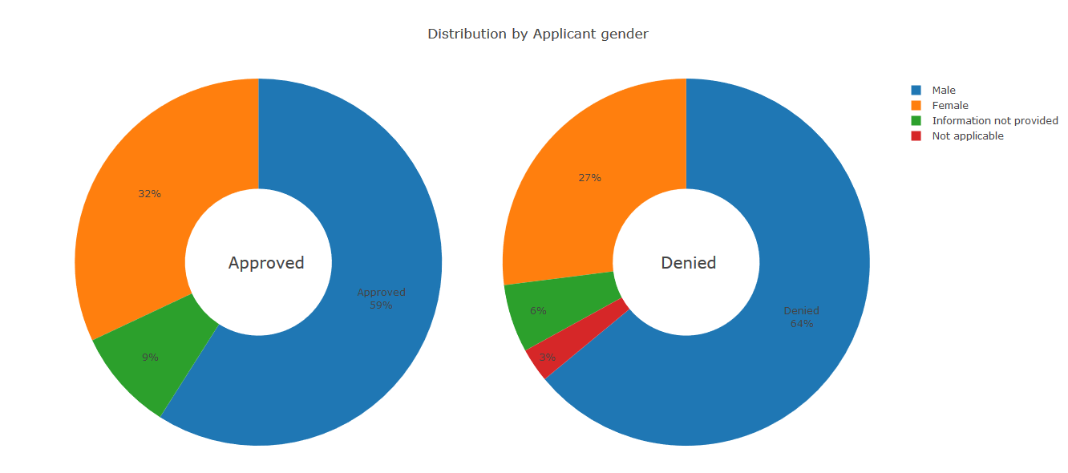
Loan Status – Applicant Gender
The number of male applicants is higher as compared to female applicants for all of US states. This could be due to the reason that a lower number of female applicants have applied for loans
81% of male applications were accepted and 19% denied visa-via 77% of female applications were accepted and 23% denied
A number of Approved Male applicants are higher and the rate of denial for male applicants is also on the higher side

Slide 10
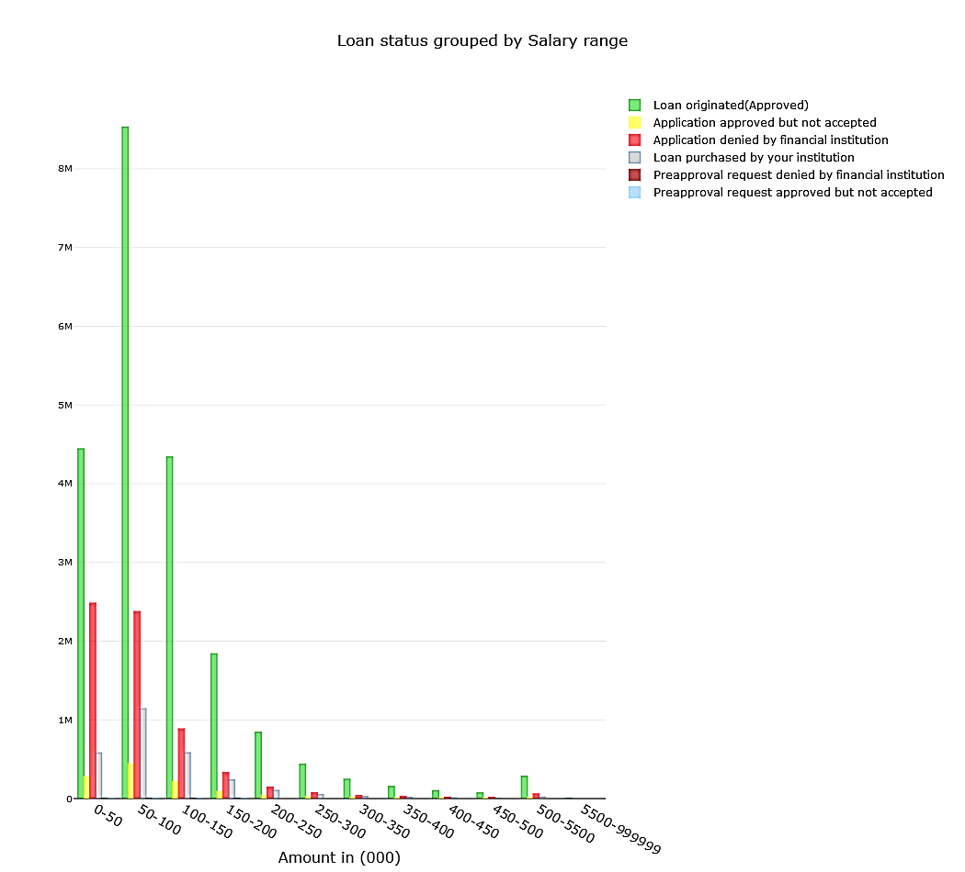
Loan Status – Applicant Income

Slide 11
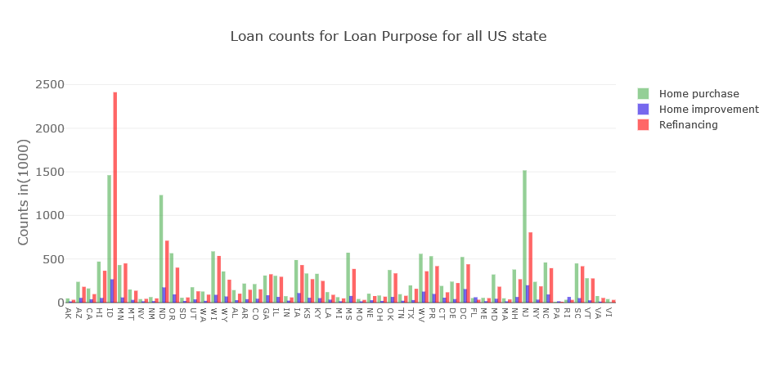
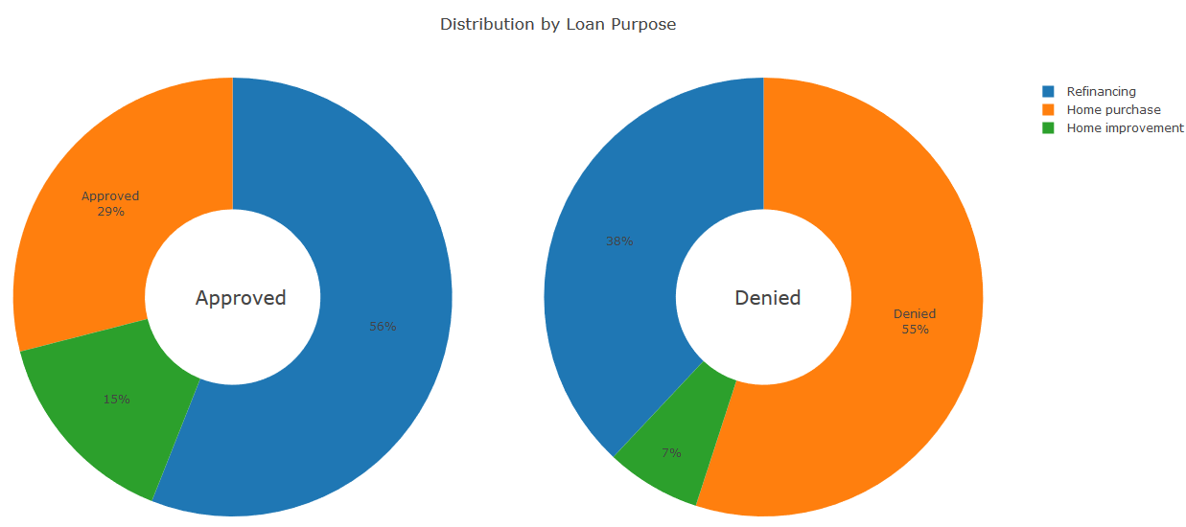
Loan Count – Loan Purpose for all US states
Loan counts for Refinancing is higher as compared to Home Purchase
56% of applicants received approval for refinancing 29% for new home purchase and 15% for home improvement
There are some areas where refinances are higher than a new home loan
Data indicates that 55% loan purpose requests for new home purchase faced denials followed by 38% for refinancing and 7% denial rate for home improvement loans

Slide 12
Machine Learning Algorithm

Slide 13
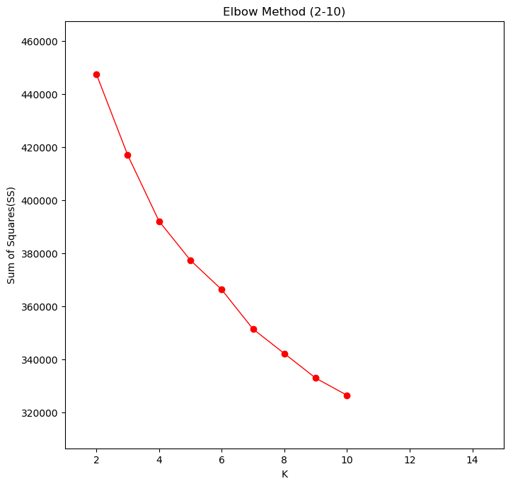
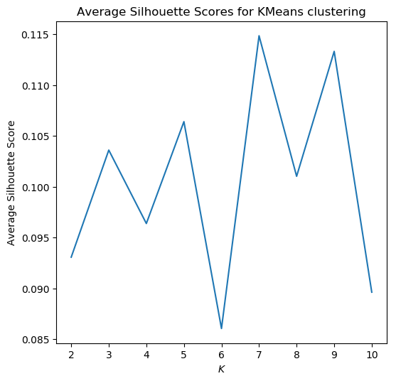
Base Analysis – K Means
The elbow method uses value inertia_ to determine the elbow visually. The idea is to visualize the graph for all possible value of K and observe the sudden change in the sum of the square of values
The silhouette method is based on the silhouette score for each cluster in K mean. The strong silhouette score helps in choosing the desired cluster value

Slide 14
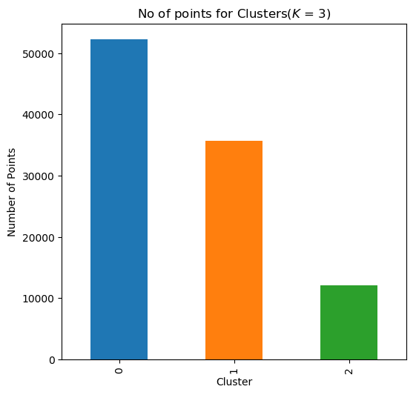
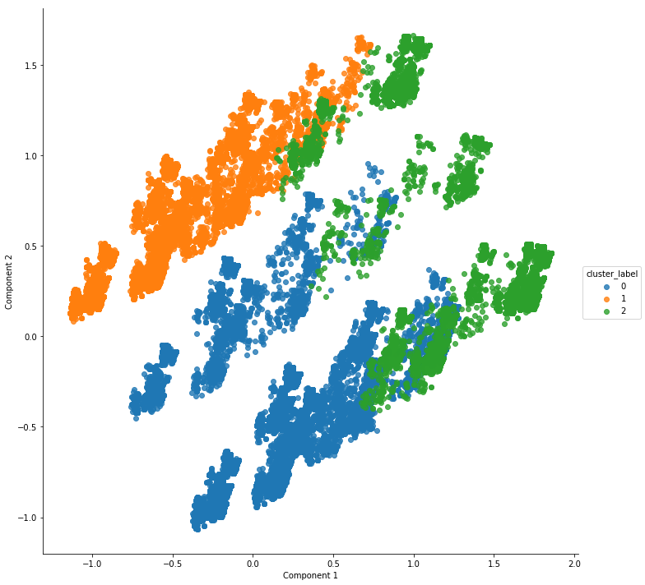
Base Analysis – K Means

Slide 15
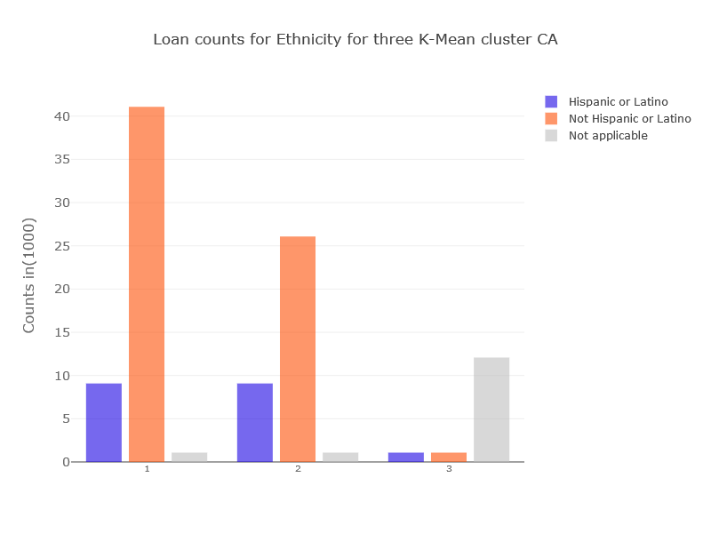
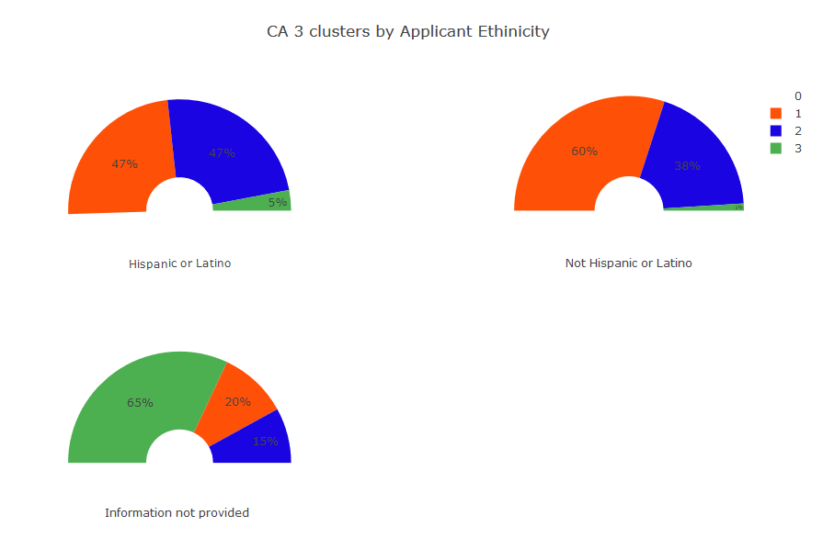
Clustering - Applicants Ethnicity
Loan Counts for Ethnicity for three K Mean Cluster
CA 3 Clusters by Applicant Ethnicity

Slide 16
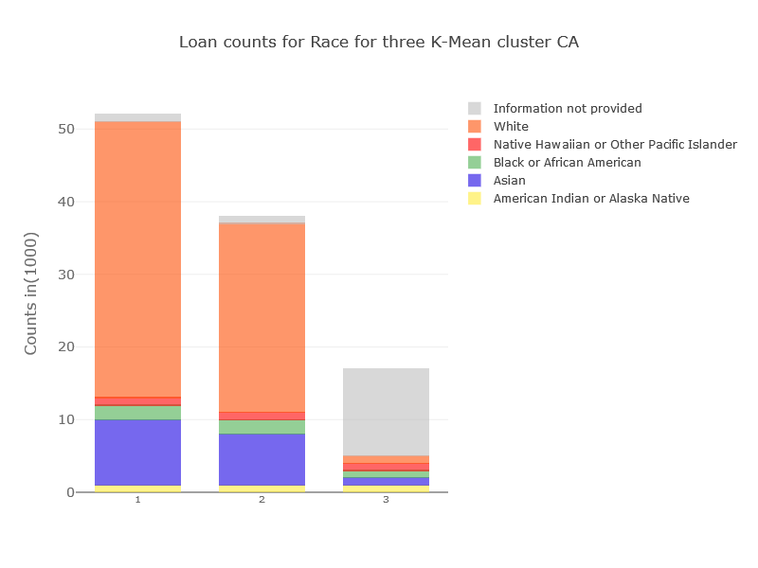
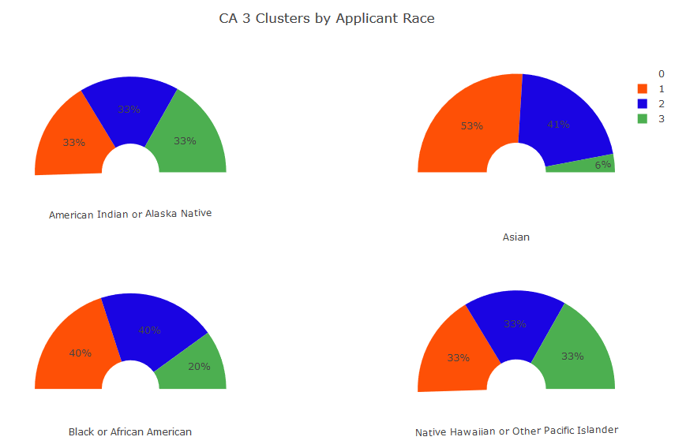
Applicants Race

Slide 17
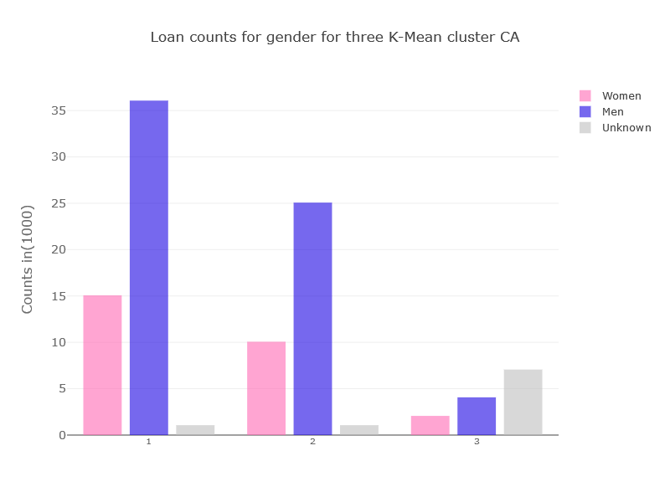
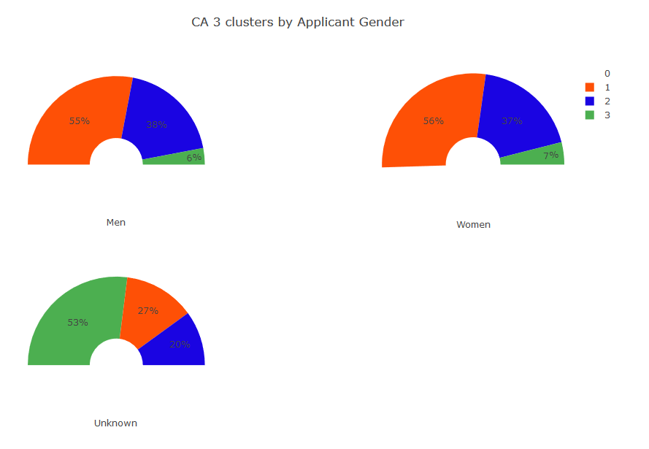
Applicants Gender
Loan Counts for gender for three K-Mean Cluster
CA 3 Clusters by Applicant Gender

Slide 18
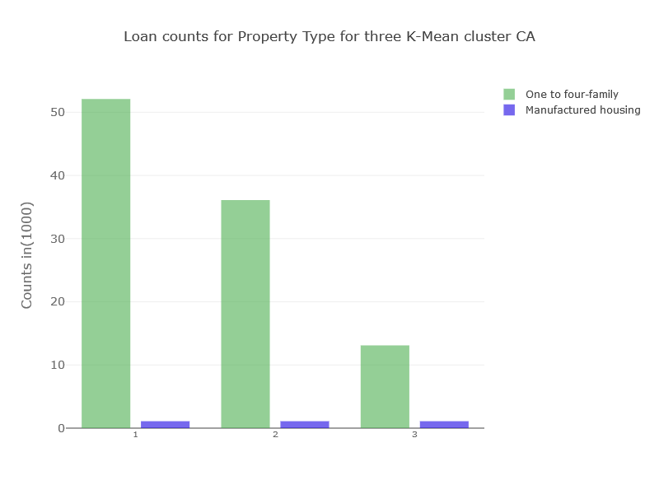
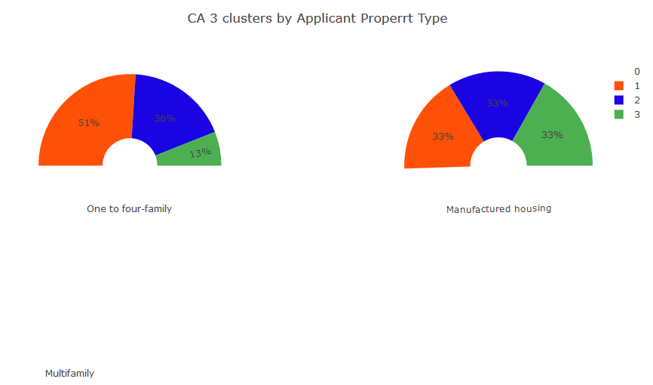
Clustering - Property Type

Slide 19
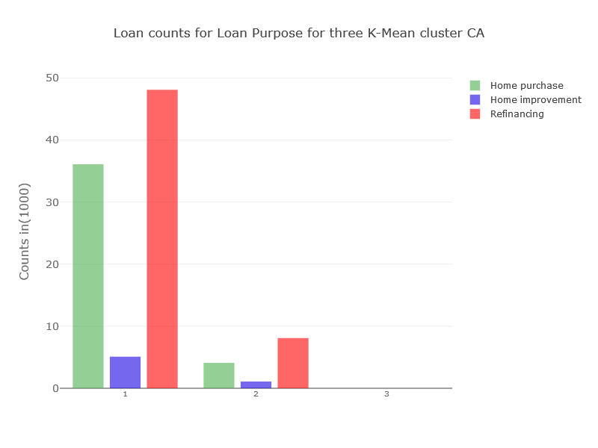
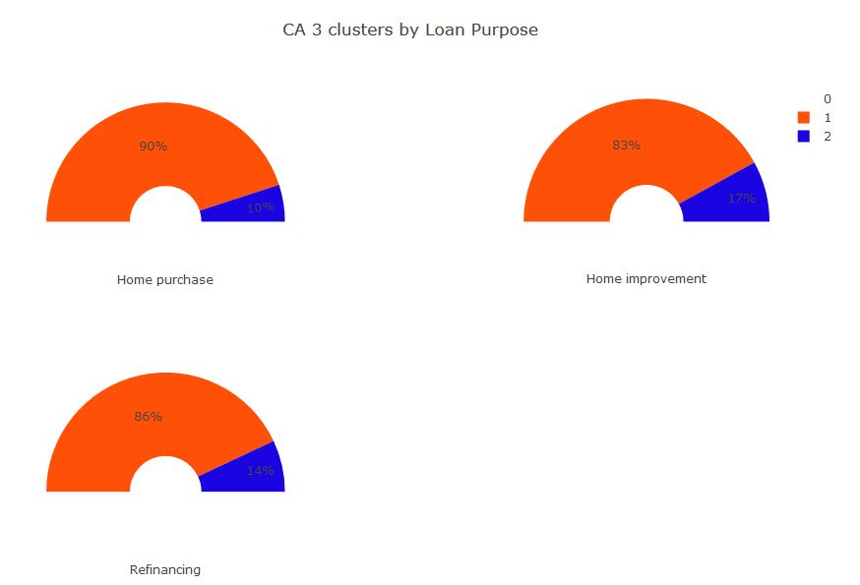
Loan Purpose

Slide 20
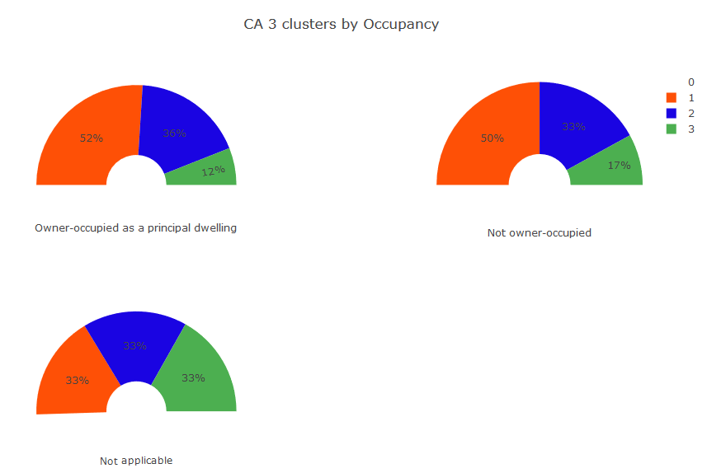
Clustering - Owner Occupancy

Slide 21
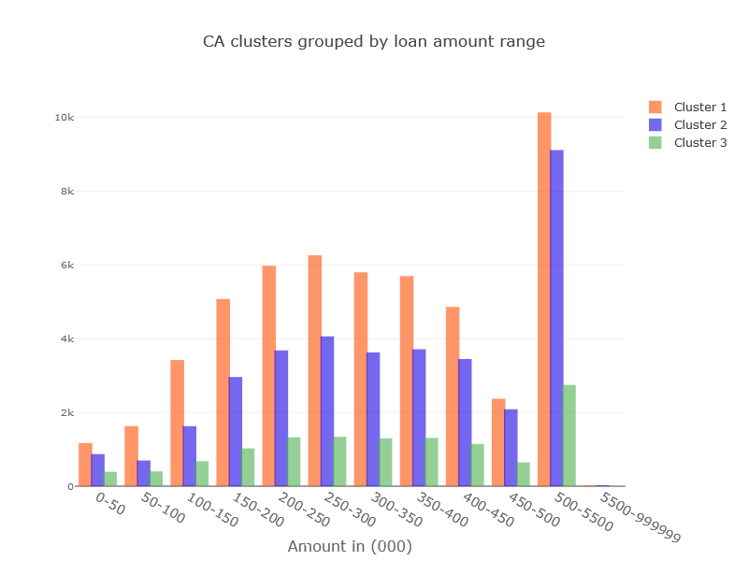
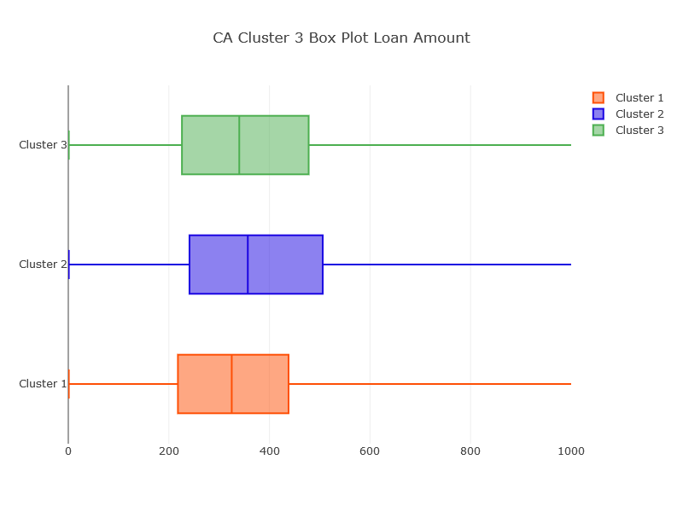
Clustering - Loan Amount

Slide 22
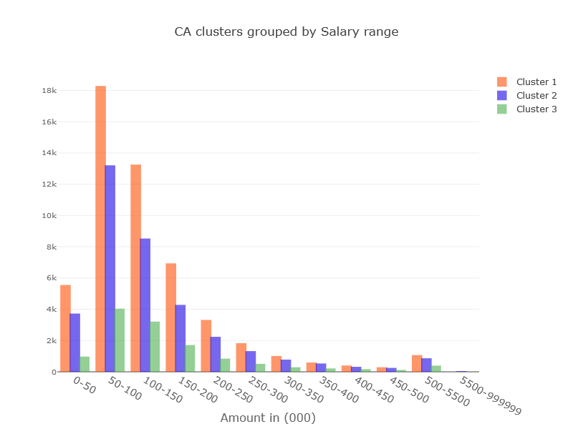
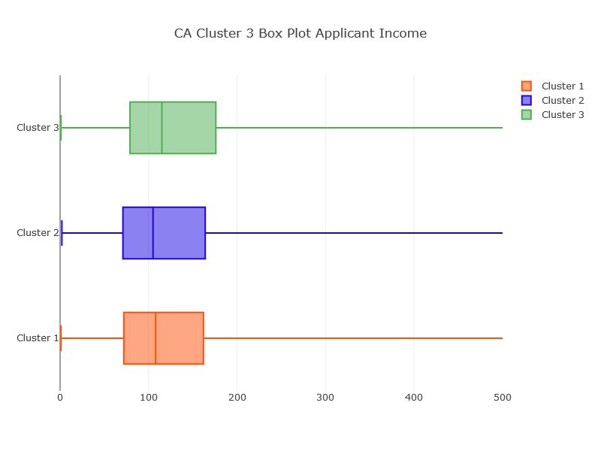
Clustering - Applicant Income

Slide 23
Insights and Recommendations
Specific products for Home Improvement Loan: Home improvement is in high demand in customers of all ethnicity, race, and genders. The number of the home improvement loans compare to purchase. Specific products for home improvement can attract more customer base or interest current customer base
Refinance Request of homes is very close to the new home loan request. There are some areas where refinances are higher than a new home loan
Hispanic Vs Non-Hispanic: The non-Hispanic ethnicity people are the majority of customer base but assuming a non-Hispanic included vast number of races, the number of Hispanic customers are insignificant numbers
Home for a Single Family in Demand: The 98% of the market is for single-family houses as compare to multi-family or manufactured home
70% of the applicant are Males: The most primary applicant for getting loan is male. Targeted advertising and brand placements can be done in male-centric magazines and websites
Middle-class spending more on Home Loans: Most numbers of people in all cluster are in the salary range of 50-100 thousand. The most number of new home improvement and purchase are dominated by these salary ranges.
White, Asian & African American: The race should not be considered as criteria for discrimination but there can be things like the language of advertisement material which help target customers. The majority of the client base belongs race white. But Asian and African American are respectively two races with the most customer based.

Slide 24
Conclusion and Future Recommendations
Customer Segmentation is based on three clusters of K means. After performing Machine Learning and visual analysis of data the following are conclusion and recommendation:
The mortgage customer in the state of California is a very good sample space to understand overall behavior as the visualization of CA and all state data are very similar
This analysis is done using 100,000 sample out of millions of loans in CA.
Most of the features available are significant in contributing towards the clustering.
The ML used is K means for clustering.
The data should be at least explored state wise to create better understanding instead of all state as one big data set
The similar exercise should be performed for all other states to create better understanding as per state
The code is usable and can be very well utilized in running for any state, county or area based on the requirement
The visualization created can be presented to the business team to generate more insights from their perspective

Slide 25
Thank You!!!
Future Work
Exploring more States: The clustering is done on state of CA. The work can be extended to include data from all 50 states
Bringing more Features in customer data: Clustering is done on data available to the public via govt agency. There can be better insights based on more features related to clients available within the company
Other Clustering Algorithms: Due to computation work restriction, the other algorithms like Agglomerative clustering and DBScan cannot be performed. The single computer laptop is unable to process the request. The python scripts are created (available with the code on GitHub) to run without Juypter notebook but unable to run on server level configuration machine. There are more algorithm that can be explored to compare clusters
Technology: Currently, the files are processed using code running in a Jupiter notebook on the local computer. Cloud technologies like AWS, Azure, and Cloudera etc. can be used to speed up the processing. The clustering is done on the only state of CA for only 100, 000 records. The work can be extended to include all 50 states with more data on these technologies.

