Slide 1
Saurabh Shrestha Data Visualization DSC 640

Slide 2
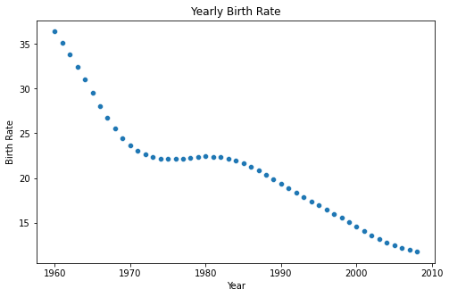
Python – Scatter Plot

Slide 3
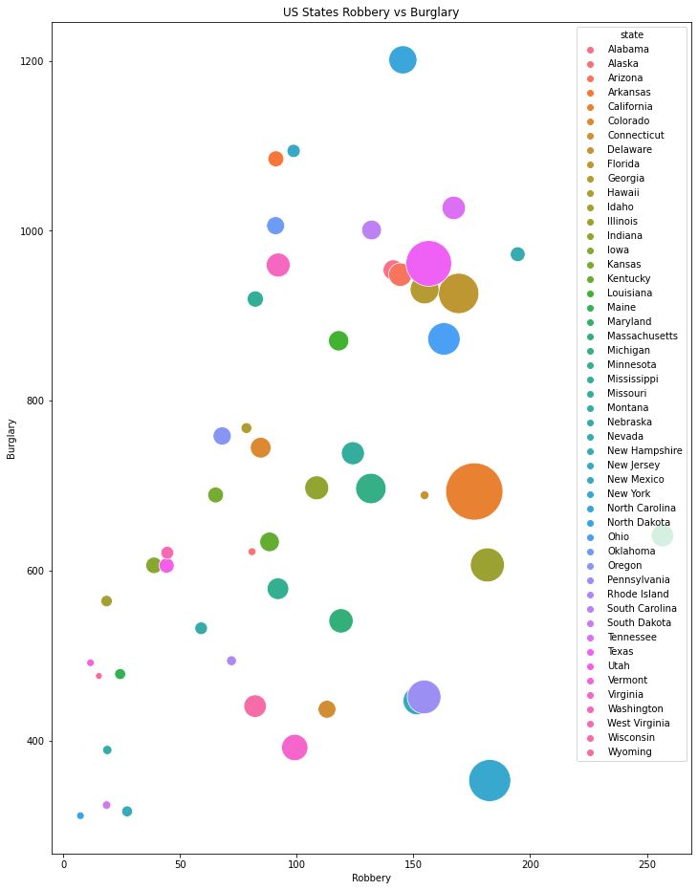
Python – Bubble Chart

Slide 4
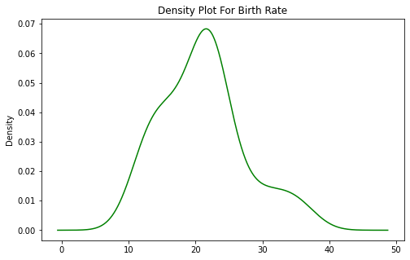
Python – Density Plot

Slide 5
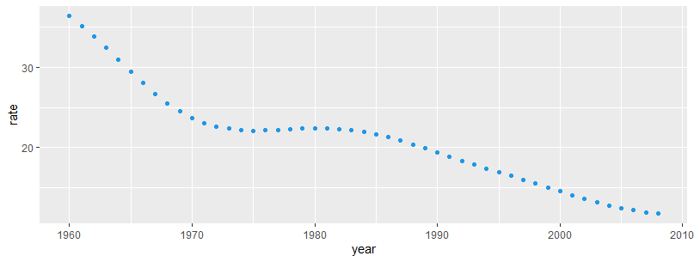
R – Scatter Plot

Slide 6
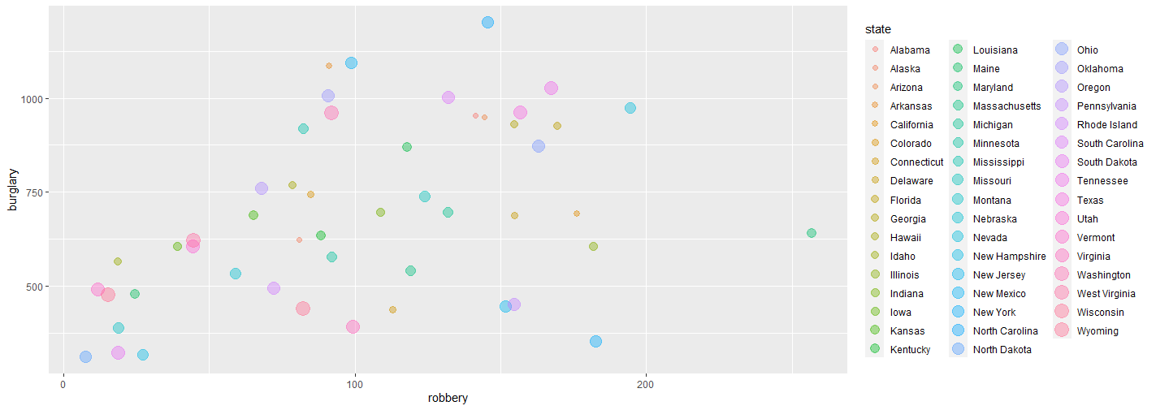
R – Bubble Chart

Slide 7
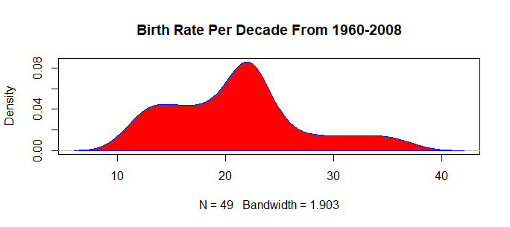
R – Density Plot

Slide 8
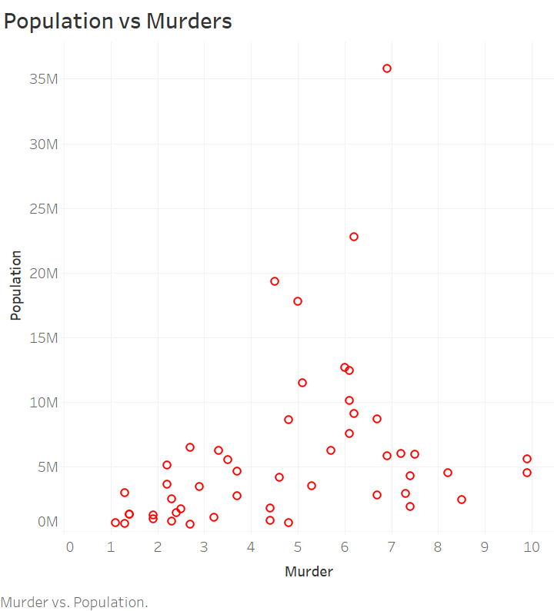
Tableau – Scatter Plot

Slide 9
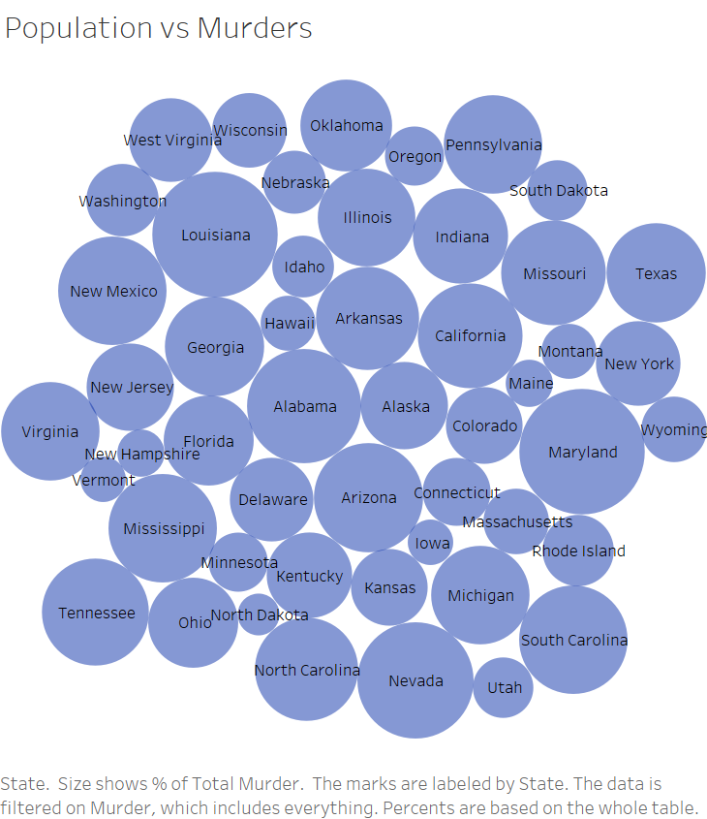
Tableau – Bubble Chart

Slide 10
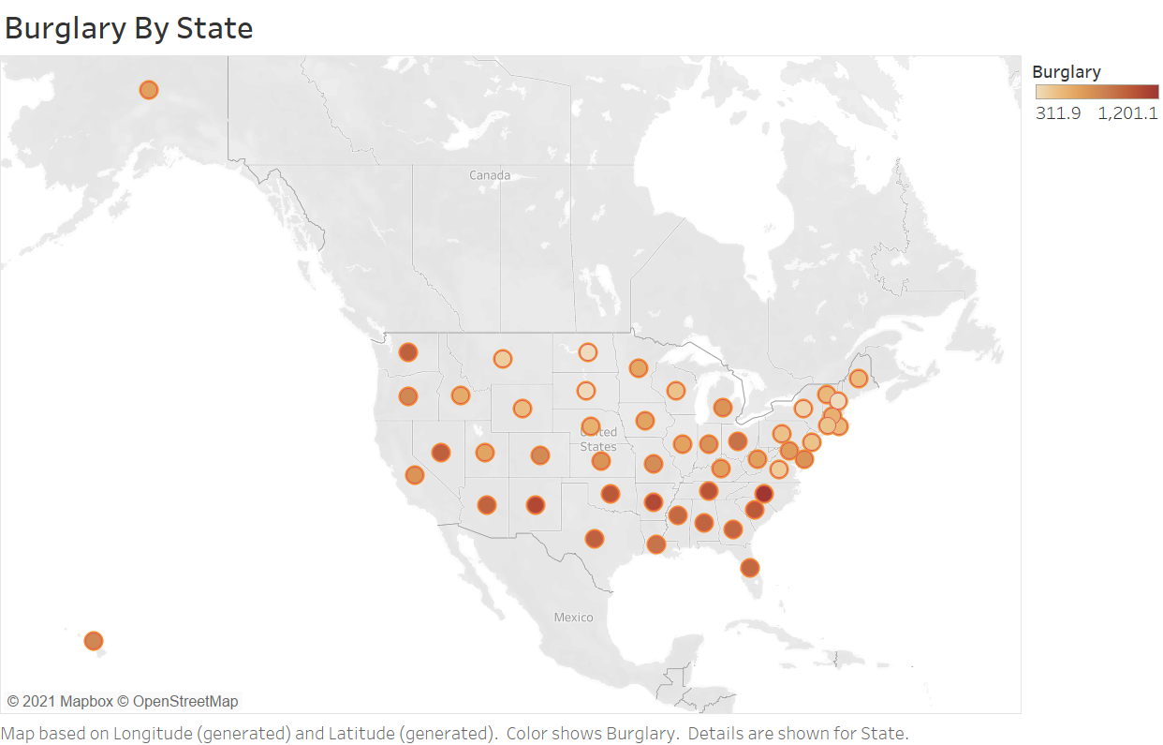
Tableau– Density Map

