Slide 1
Saurabh Shrestha Data Visualization DSC 640

Slide 2
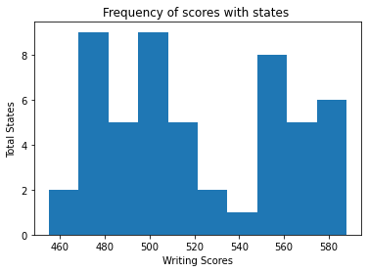
Python – Histogram

Slide 3
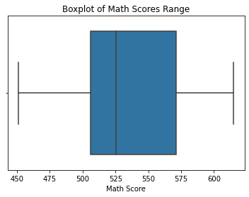
Python – Box Plot

Slide 4
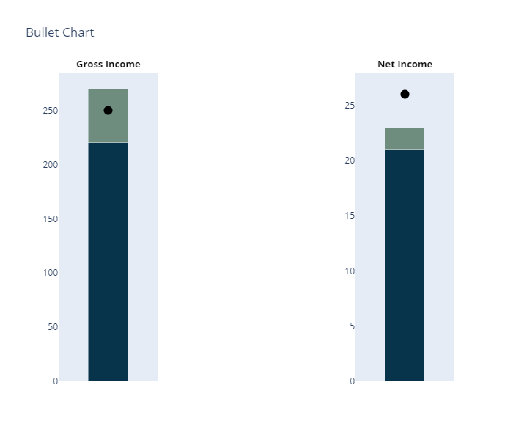
Python – Bullet Chart

Slide 5
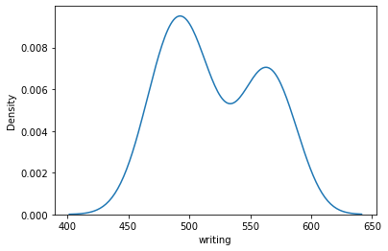
Python – Density plot

Slide 6
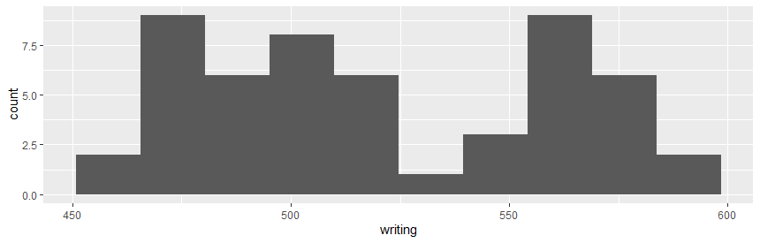
R – Histogram

Slide 7
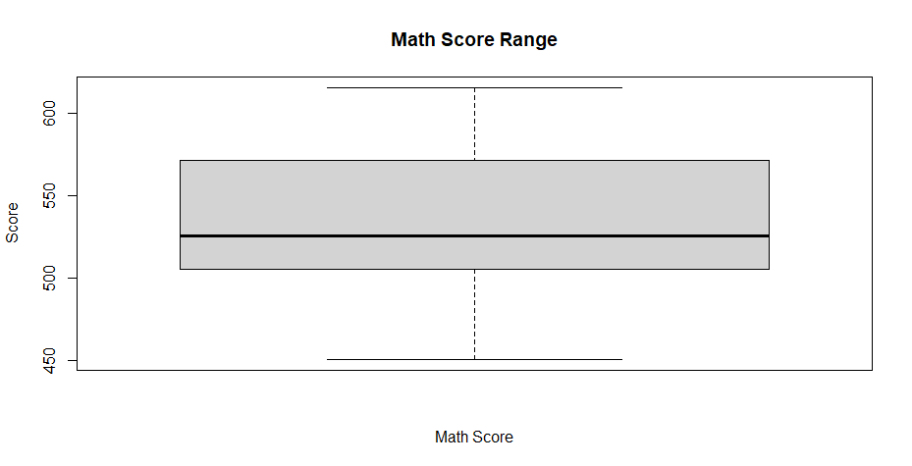
R – Box Plot

Slide 8
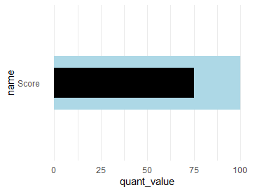
R – Bullet Chart

Slide 9
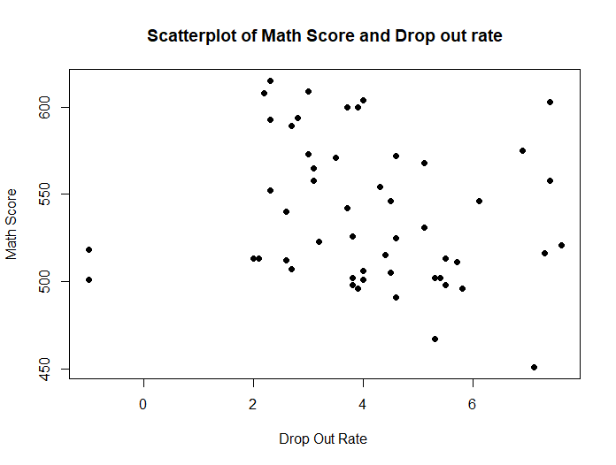
R – Scatter plot

Slide 10
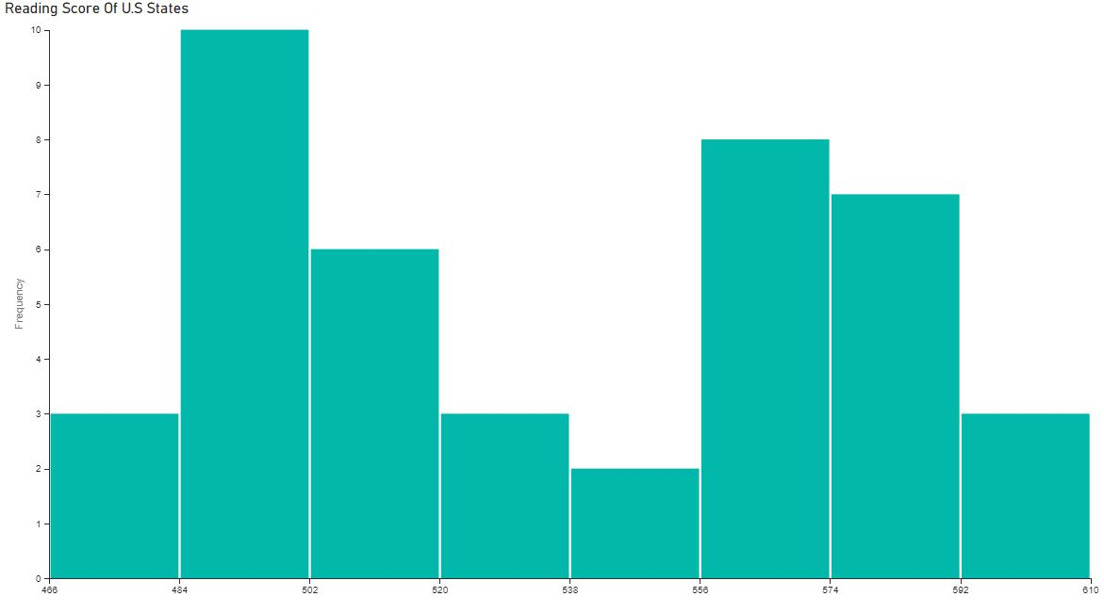
PowerBI – Histogram

Slide 11
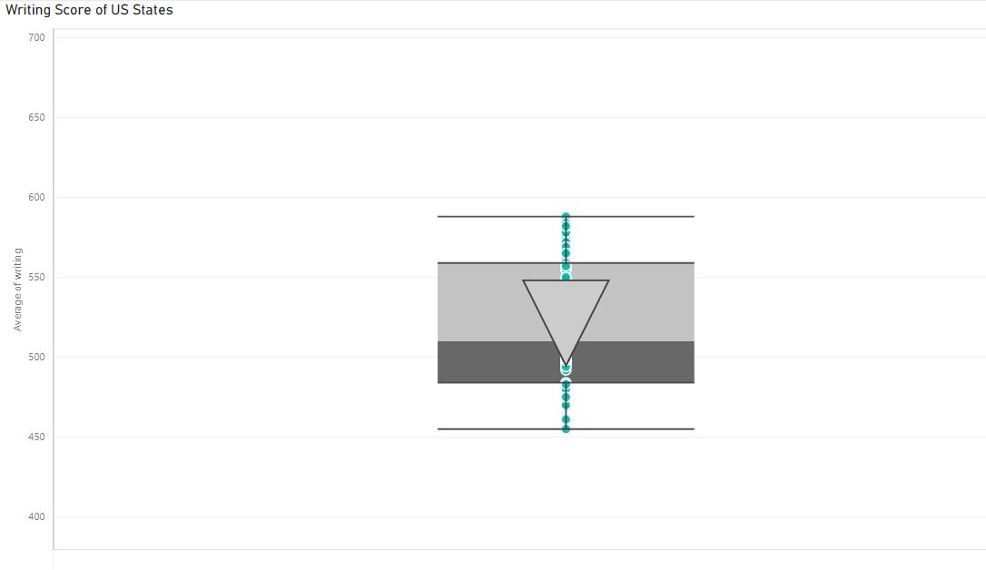
PowerBI– Box Plot

Slide 12
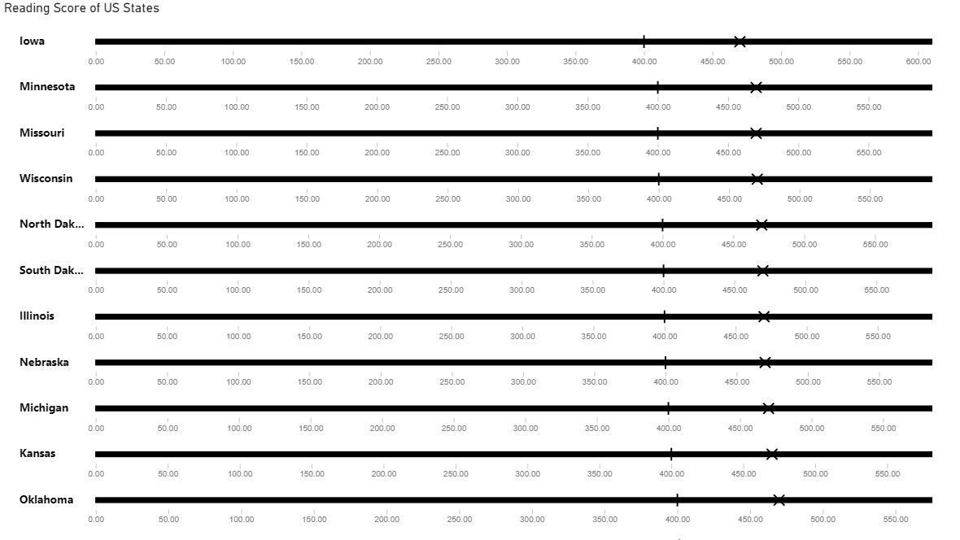
PowerBI – Bullet Chart

Slide 13
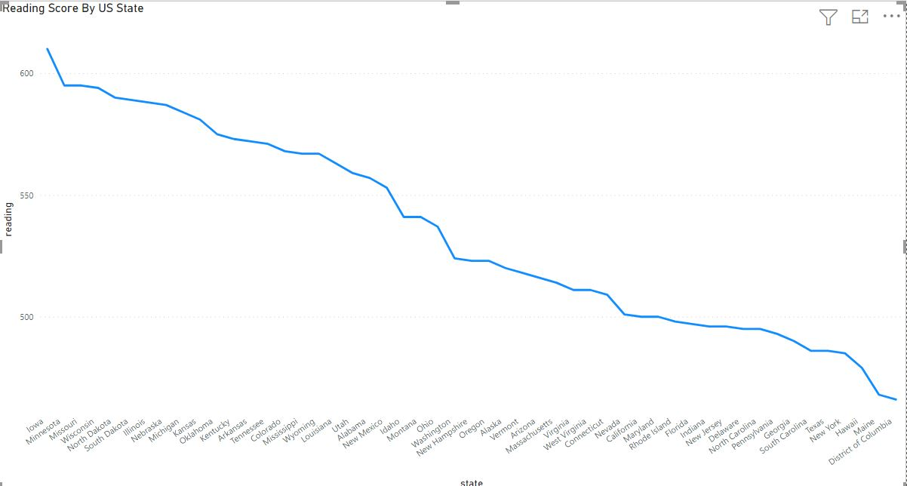
PowerBI – Line Chart

