Slide 1


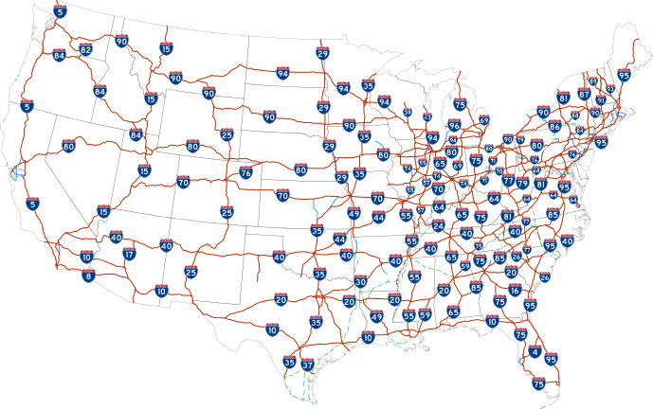



Infographic Resume
AIR SAFETY INFOGRAPHIC
219
million passenger in 2019(to
and from USA)
Average Highway
Vs
Airlines
Fatalities 2000-2014
38,436
613
Highway transportation has the highest fatalities with 94%
Aviation is the safest mode of travel in the United states with
0.07 fatalities per billion passenger miles.

