Slide 1
Saurabh Shrestha Data Visualization DSC 640

Slide 2
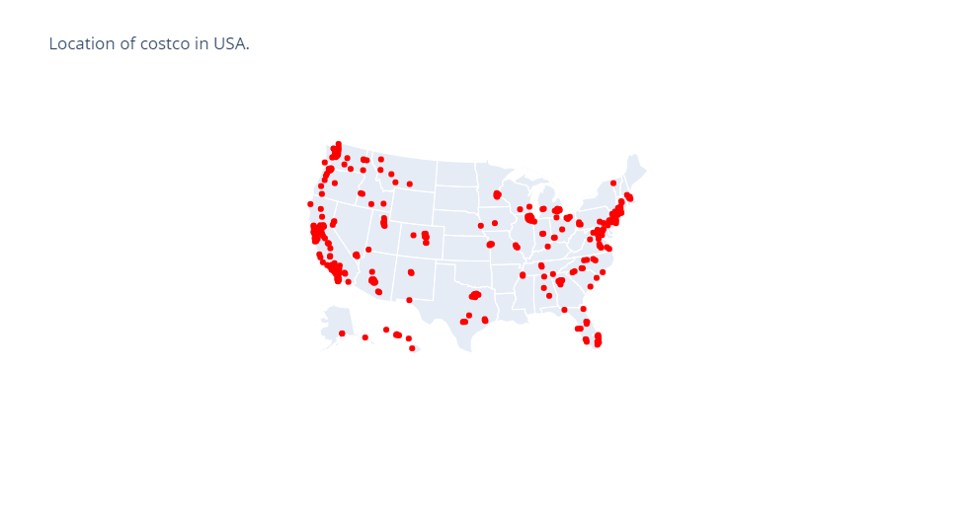
Python – Spatial Chart

Slide 3
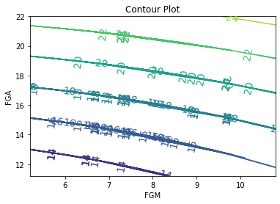
Python – Contour Plot
Field goal attempted with field goal made

Slide 4
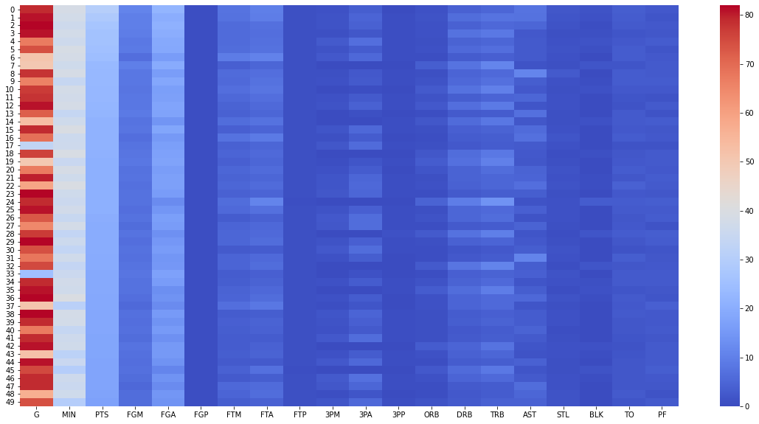
Python – Heat Map
Points per player in basketball(USA) from 2008

Slide 5
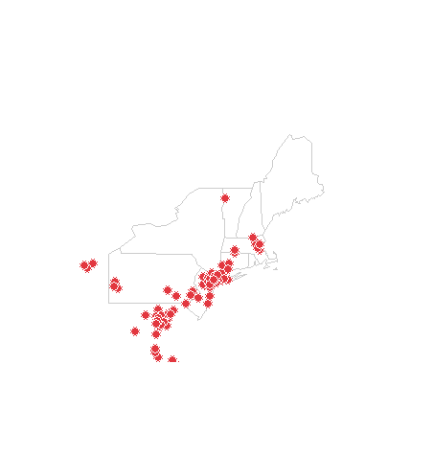
R – Spatial Chart
Costco location in Northeast region

Slide 6
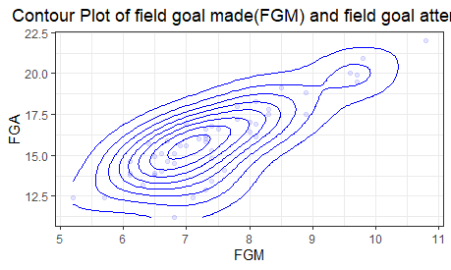
R – Contour plot

Slide 7
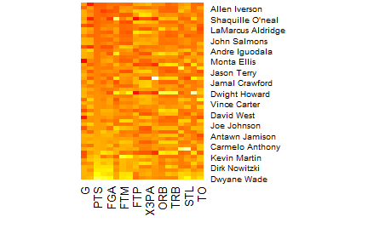
R – Heat map
Points per player in basketball(USA) from 2008

Slide 8
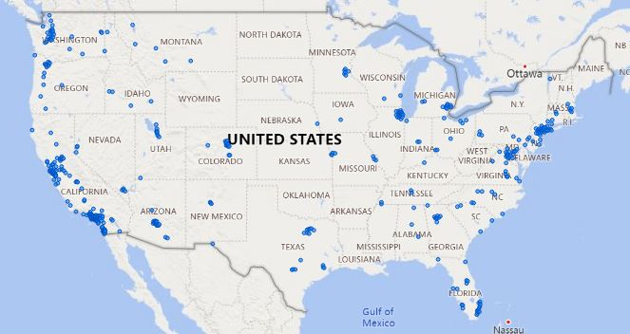
PowerBI – Spatial Chart
Costco locations in usa

Slide 9
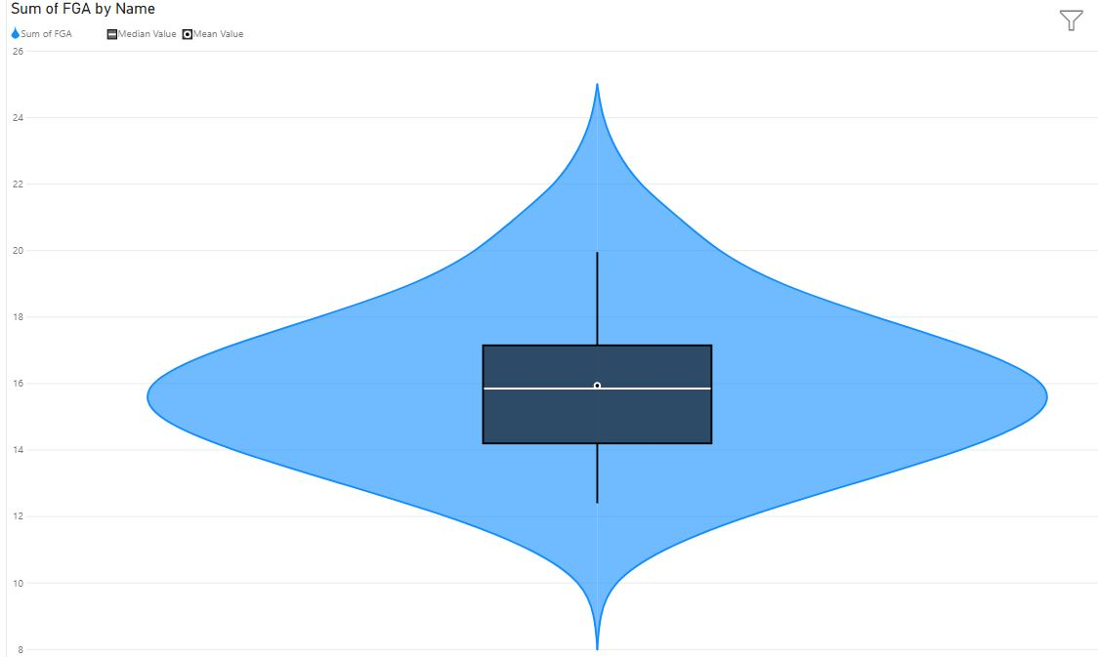
PowerBI– Violin chart
Violin chart of field goal attempted

Slide 10
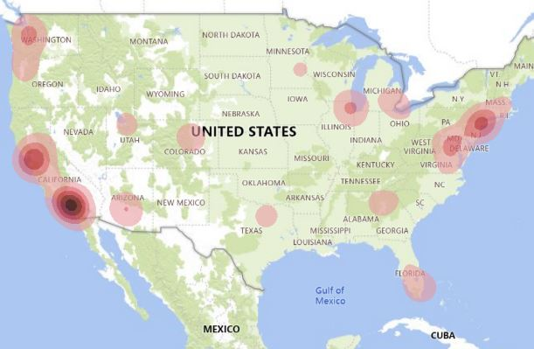
PowerBI- Heatmap
Heatmap of Costco location in usa

