Slide 1
Making news great again
B.Tech Project
Indian Institute of Technology, Roorkee
by
Saurabh Verma - 13114057
Sachin Aggarwal - 13114048
Vikash Kumar - 13114073

Slide 2
Introduction
News articles are very dynamic in nature and have a very short span of life.
Predicting the online popularity of online news articles is a challenging task.
Content of an article must play a significant role in its popularity.
To generate features for the articles, we have used Character-level Convolution Neural Network.
To remove redundant information, we perform specific topic-wise clustering in a certain timeframe.
Our work shall also help content writers to remove irrelevant, outdated, trivial and redundant content.

Slide 3
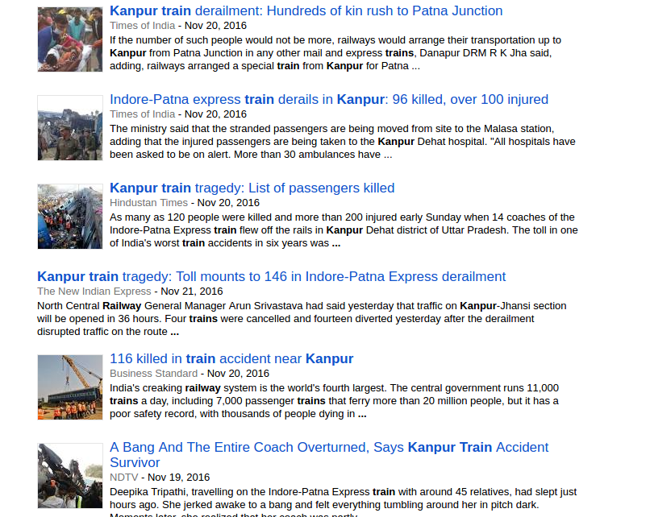
Google News results on query Kanpur train on 26 Nov. 2016 at 16:44 IST.
As we can see, outdated news reports are ranked better than latest news reports. Our aim here is to rank the latest and the most informative articles at the top

Slide 4
BUSINESS
Content Caching and Traffic Management
Advertising
News Aggregation
Trends Forecasting

Slide 5
Prior Art
Text classification
X. Zhang, J. Zhao, and Y. LeCun, “Character-level convolutional networks for text classification,” in Advances in Neural Information Processing Systems, pp. 649–657, 2015
M. Weber and M. H. Lamers, “Finding news in a haystack-event based news clustering with social media based ranking,” in Cloud and Green Computing (CGC), 2013 Third International Conference on, pp. 321–326, IEEE, 2013
Clustering
Popularity Prediction
R. Bandari, S. Asur, and B. A. Huberman, “The pulse of news in social media: Forecasting popularity,” arXiv preprint arXiv:1202.0332, 2012.

Slide 6
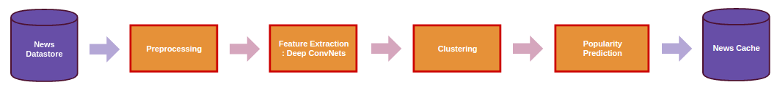
Solution Framework

Slide 7
Preprocessing
Filtering
Tokenization
Stemming
Stopwords removal
Pruning

Slide 8
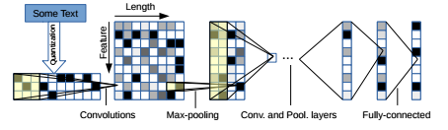
Text Understanding
X. Zhang, J. Zhao, and Y. LeCun, “Character-level convolutional networks for text classification,” in Advances in Neural Information Processing Systems, pp. 649–657, 2015

Slide 9
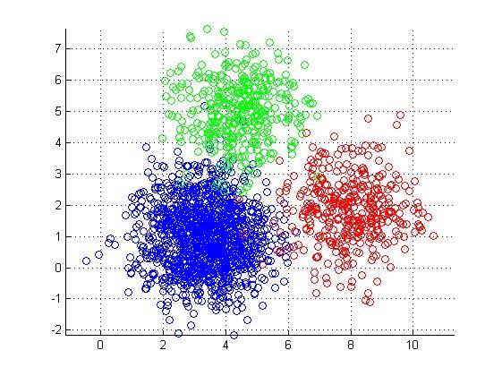
Clustering
M. Weber and M. H. Lamers, “Finding news in a haystack-event based news clustering with social media based ranking,” in Cloud and Green Computing (CGC), 2013 Third International Conference on, pp. 321–326, IEEE, 2013

Slide 10
Popularity Prediction
Age
Text Quality
Source Quality
Subjectivity
Named Entities
Factual Density
R. Bandari, S. Asur, and B. A. Huberman, “The pulse of news in social media: Forecasting popularity,” arXiv preprint arXiv:1202.0332, 2012.

Slide 11
Experimental Evaluation

Slide 12
Dataset
AG’s news corpus: We obtained AG’s corpus of news articles on the web. It contains more than 1 million news articles from more than 2000 sources. We use the source, title, description, rank and publish date fields for our experiments. (https://www.di.unipi.it/∼gulli/AG corpus of news articles.html)
Financial News Dataset: We obtained financial news dataset of Bloomberg and Reuters2 . It contains 450,341 articles from Bloomberg and 109,110 articles from Reuters. It provides us title, content, date and author of the article. (https://github.com/philipperemy/financial-news-dataset )
20 Newsgroups Dataset: The 20 Newsgroups data set is a collection of approximately 20,000 newsgroup documents, partitioned (nearly) evenly across 20 different newsgroups. The data is organized into 20 different newsgroups, each corresponding to a different topic. (http://scikit-learn.org/stable/datasets/twenty newsgroups.html)

Slide 13
Baselines
News Aggregators
TF-IDF Comparison
Bandari et. al.
Clustering Metrics
We conduct an internal survey to verify initial results of the pipeline when compared with different news agents and aggregators like Google News, Feedly, Digg etc.
We use an obvious baseline based on sum of tf-idf scores of entities in the document to rank it’s importance.
We use an obvious baseline based on the tf-idf scores of entities in the document to rank its importance.
We use an obvious baseline based on sum of tf-idf scores of entities in the document to rank it’s importance.
R. Bandari, S. Asur, and B. A. Huberman, “The pulse of news in social media: Forecasting popularity,” arXiv preprint arXiv:1202.0332, 2012
J. C. Dunn, “Well-separated clusters and optimal fuzzy partitions,” Journal of cybernetics, vol. 4, no. 1, pp. 95–104, 1974.

Slide 14
Conclusion
We improve the quality of news cache and recommendations by predicting popularity of articles prior to publishing .
Through deep convolutional neural networks, we extract features of articles at character-level .
We predict the most popular pieces in different clusters to provide the set of most popular articles, which is then used for multiple use-cases in content caching, advertising, forecasting and recommendation .
With an initial survey, we ensure inceptive results of the pipeline versus different competitors .
Lastly, we compare with different baselines to ascertain quality of our work.

Slide 15
Future Work
Information explosion is prevalent not only in news items, but across different content classes. There rises the opportunity to extend the current work for multiple such classes.
There are abundant works which when given initial popularity of some content, are better able to forecast popularity. With that notion, we want to adapt the predictions to incoming hits.
With growing amount of personalization in different news agents , there exists a demand and an opportunity for the same in this work.
Growing number of events and articles pose the need for concise summaries of multiple articles. We believe, successful summarization of one cluster can generate concise, clear and helpful news articles.

Slide 16
Thank you

