Slide 1
Mapping Learning Algorithms on Reconfigurable Architectures
1st Semester 2021-22
Saurabh Tewari (csz158046)
Advisors
Prof. Anshul Kumar
Prof. Kolin Paul

Slide 2
Semester Progress Summary
Implementation of Data Reuse Approach for LSTM on FPGA.
Experiments to observe
Reduction in off-chip memory accesses.
Improvement in energy efficiency and run-time.
Paper Writing and Submission for DATE, 2022.
In Progress
Extending the approach for LSTM accelerators for static storage of LSTM Weights to improve the performance further
Experiments to show improvement in throughput

Slide 3
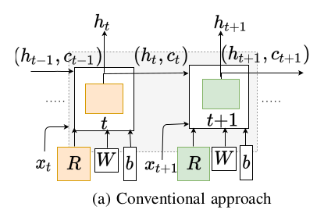
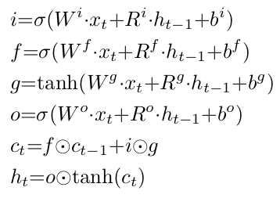
Overview: RNN/LSTM computations
Dominating Operations: 8 MxV Operations W.x and R.h_{t}
Sizes W: 64x1024x4x4=1MB R: 1024x1024x4x4=16MB
On-chip memory in KBs : W and R are accessed repeatedly from off-chip memory

Slide 4
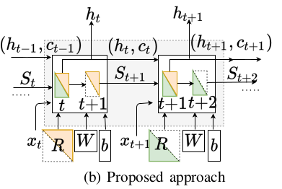
Challenges in LSTM Computations
h_{t} depends on h_{(t-1)} limits
the parallel computations
data reuse due to limited on-chip memory

Slide 5

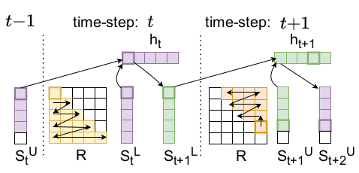

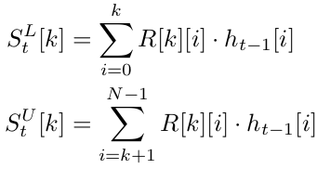
Approach: Data Reuse by splitting the computations
Block Size: Determined based on available h/w parallelism and on-chip storage

Slide 6
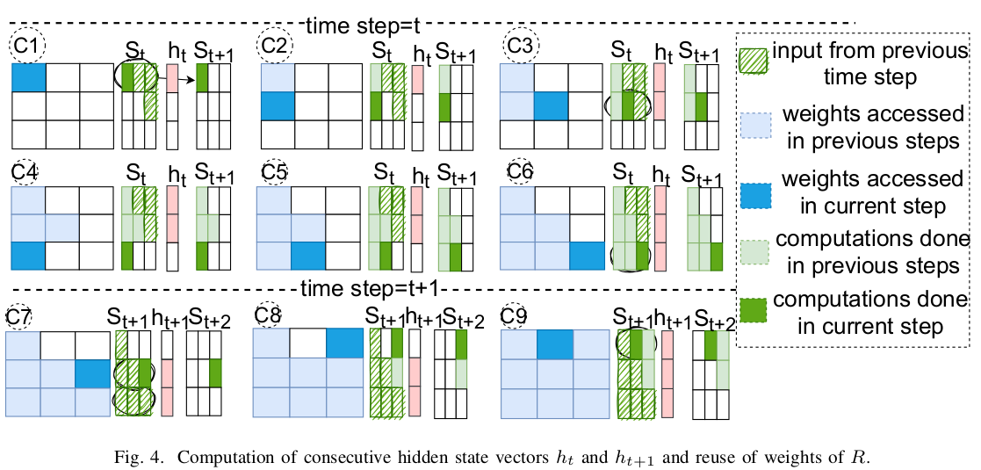
Reuse of weights of R matrix

Slide 7
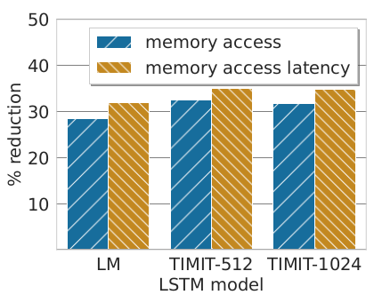
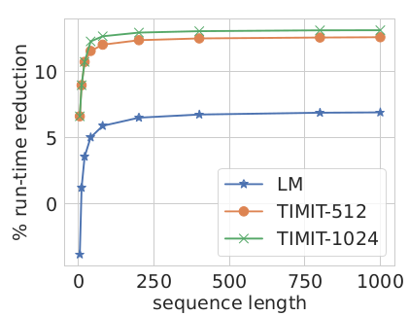
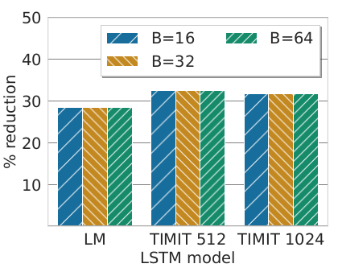
Results
Improvements are independent of on-chip buffer size
Improvement in memory access, run-time, energy.

Slide 8
Work Status and Target Dates
Tasks | Task Details | Expected Completion Date
Work in Progress
1 | Camera Ready Paper for DATE Presentation for DATE conference | Dec 2nd Week Jan 3rd Week
2 | Synopsis Report | Jan 1st Week
3 | Synopsis Presentation and Report Completion | Jan 2/3rd Week
4 | LSTM Mapping: Experiments for throughput improvement and on-chip fixing of weights for larger on-chip memory size accelerators Paper Submission | Feb 2nd Week
Remaining Work
5 | Thesis Report and Presentation | March 2nd Week

Slide 9
Publications
S. Tewari, A. Kumar and K. Paul, “SACC: Split and Combine Approach to Reduce the Off-chip Memory Accesses of LSTM Accelerators”, Accepted DATE 2022
S. Tewari, A. Kumar and K. Paul, "Bus Width Aware Off-Chip Memory Access Minimization for CNN Accelerators," 2020 IEEE Computer Society Annual Symposium on VLSI (ISVLSI), 2020.
S. Tewari, A. Kumar and K. Paul, "Minimizing Off-Chip Memory Access for CNN Accelerators," in IEEE Consumer Electronics Magazine.
D. Stathis et al., "Approximate Computing Applied to Bacterial Genome Identification using Self-Organizing Maps," 2019 IEEE Computer Society Annual Symposium on VLSI (ISVLSI), 2019.

