Slide 1
DATA ANALYST INTERNSHIP
Task 4: Dashboard Design
Sales & Profit Performance Dashboard
Power BI | Sales & Financial Analysis

Slide 2
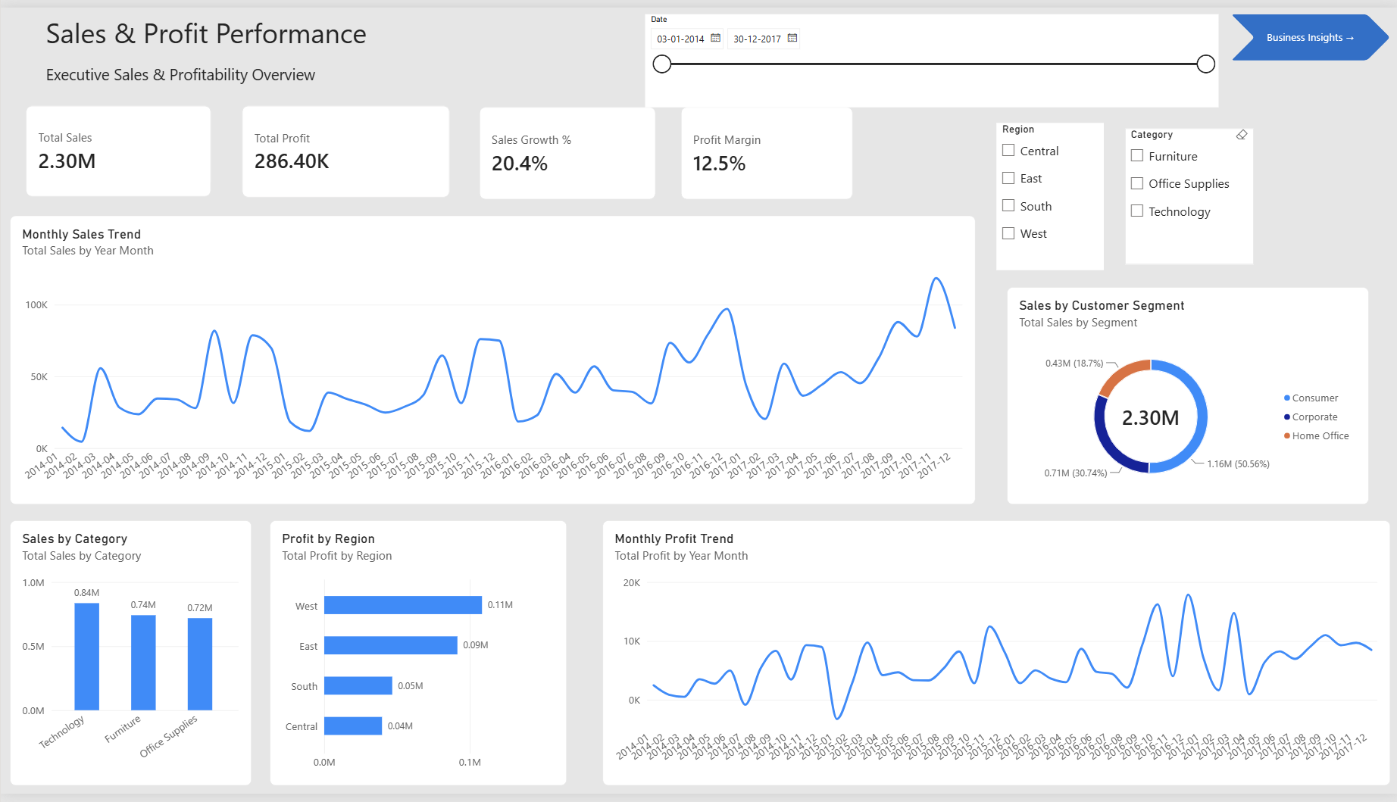
Dashboard Overview
Interactive Power BI dashboard for monitoring sales, profitability, growth, customer segments, categories, and regional performance.

Slide 3
Key KPIs & Findings
Total Sales
2.30M
Total Profit
286.40K
Sale Growth%
20.4%
Profit Margin
12.5%
Key Findings
Technology is the strongest sales-generating category.
West is the most profitable region.
Consumer is the largest customer segment by sales.
Central is the only region showing negative profit.
Monthly sales trends help identify periods of stronger and weaker demand.

Slide 4
Business Insights
Sales Performance:
Technology is the strongest sales-generating category, making it a key contributor to overall revenue.
Profitability :
West is the most profitable region, while Central shows negative profit and should be reviewed for pricing, discounting, product mix, and operating efficiency.
Customer Segments:
Consumer customers contribute the largest share of sales, indicating strong revenue potential from this segment.
Sales Trend:
Monthly sales patterns reveal periods of stronger and weaker demand, supporting better sales, inventory, and marketing planning.

Slide 5
Recommendations & Conclusion
Business Recommendations:
1. Prioritize Technology Sales
Continue investing in high-performing technology products and related promotions.
2. Improve Central Region Profitability
Review pricing, discounting, product mix, and operating costs in the Central region.
3. Focus on High-Value Customer Segments
Use targeted campaigns and retention strategies for the strongest revenue-generating segment.
4. Use Sales Trends for Planning
Use monthly sales patterns to support inventory, marketing, and sales planning.
Conclusion:
The Power BI dashboard provides an interactive view of sales and profitability, helping stakeholders identify performance trends, regional opportunities, customer patterns, and areas requiring improvement.

