Slide 1
BUSINESS ANALYTICS REPORT
Hospital Readmission Risk & Clinical Operations
Analyzing patient demographics, clinical severity, and hospital workflows to identify the primary drivers of 30-day readmission penalties.
Presented by: Saurav Singh
DATA ANALYST

Slide 2
METHODOLOGY
Technical Methodology
Data processing, modeling, and visualization architecture
01
02
03
Data Engineering
Advanced SQL Modeling
Executive Visualization
Processed 99,343 encounters across 69,990 unique patients. Engineered categorical features via Python by mapping raw diagnostic codes and discharge IDs into clinical buckets.
Engineered custom risk segments on the fly using complex CASE WHEN logic. Isolated underperforming departments using CTEs and applied strict filters to remove low-volume noise.
Designed an interactive dashboard featuring dynamic filtering to track macroeconomic risk indicators, establishing a clear operational baseline.
02

Slide 3
BASELINE
Platform Overview
High-level clinical exposure and primary risk indicators post-filtration.
TOTAL ENCOUNTERS
READMISSION RATE
AVG DAYS IN HOSPITAL
FREQUENT FLYERS
99.3K
11.39%
4.38
33K
03

Slide 4
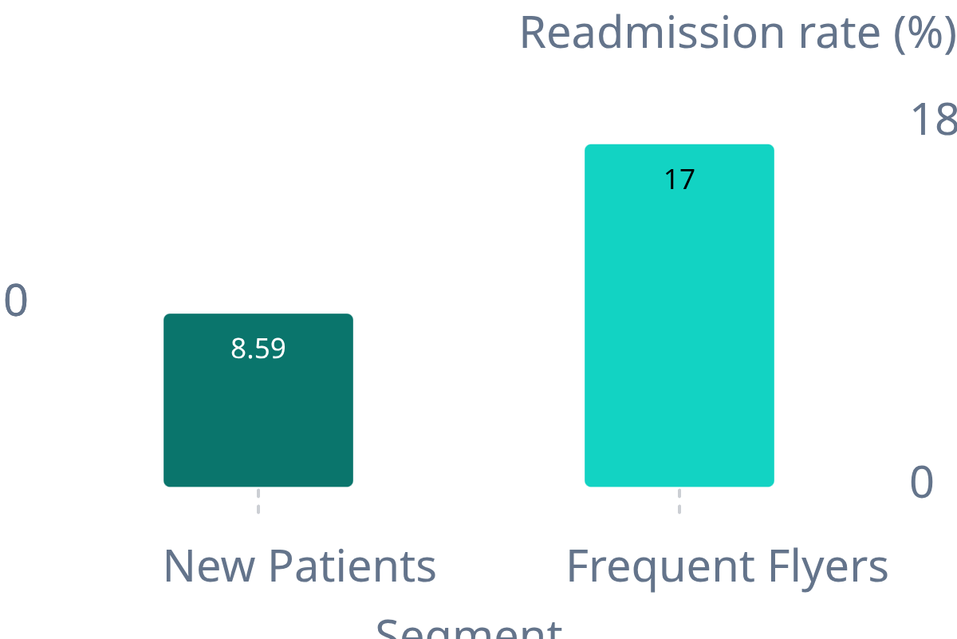









The "Frequent Flyer" Multiplier
The Baseline: 'New Patients' (~66K) maintain a stable and safe 8.59% readmission rate.
The Risk Multiplier: Risk virtually doubles to a severe 16.99% for 'Frequent Flyers' (>0 prior visits).
Action: Automate EHR flags for returning patients to trigger mandatory, high-touch discharge protocols.
READMISSION RATE BY PRIOR VISITS
04

Slide 5
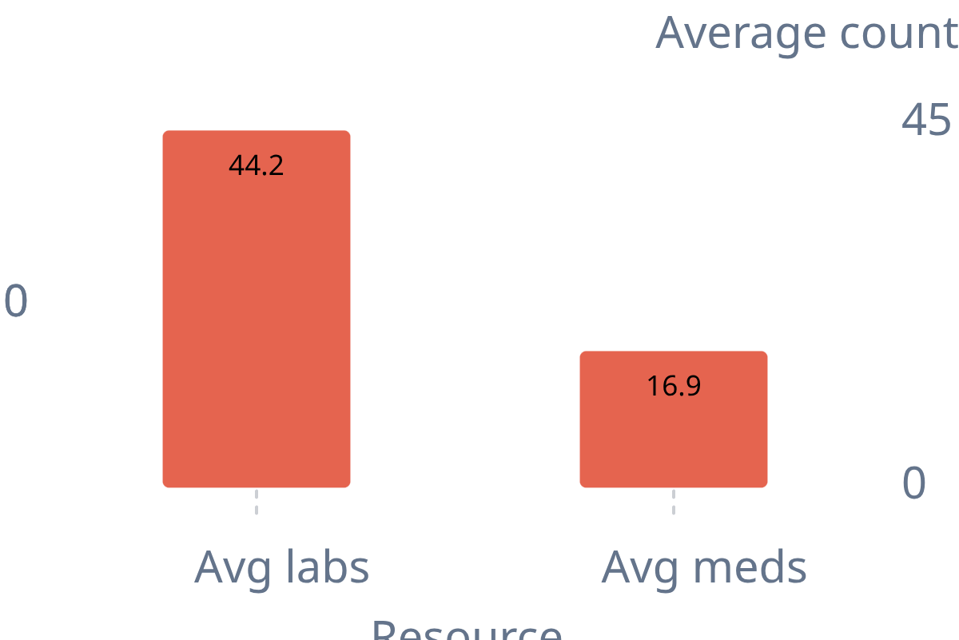

The Cost of Clinical Complexity
Linear Severity Risk: Readmission risk peaks at 12.77% for high-severity patients (>8 diagnoses).
Resource Warning: Failed discharges heavily drained initial resources (avg. 44.2 labs, 16.9 meds).
Action: Mandate a senior physician's sign-off before discharging patients who exceed 40 initial lab procedures.
FAILED DISCHARGES · AVG RESOURCE UTILIZATION
05

Slide 6
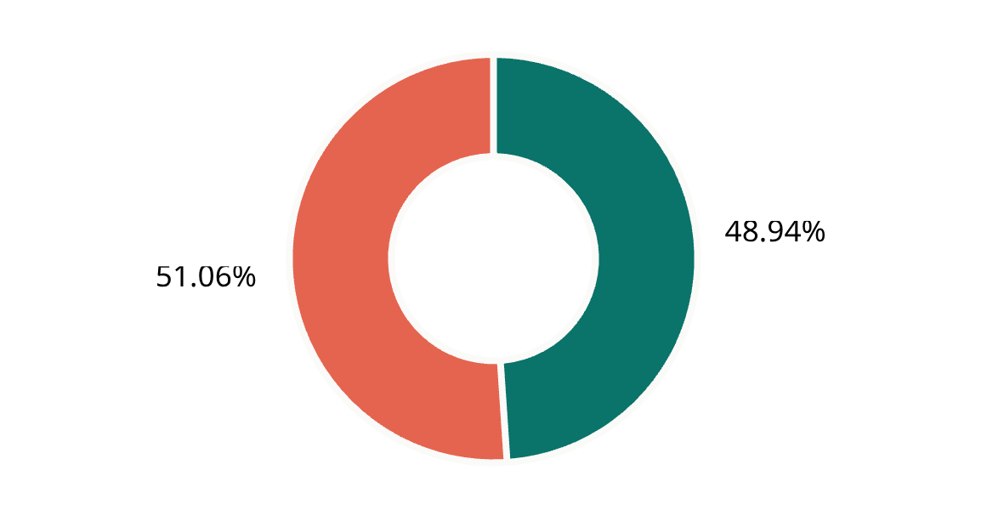
The Departmental Data Gap
The Information Void: 48,616 encounters lack tracking, logged simply as 'Unknown' specialty.
The Hidden Drain: This unclassified cohort masks a severe 11.83% failure rate, exceeding baselines.
Action: Deploy strict EHR validation to permanently block 'Unknown' physician logging at triage.
SPECIALTY LOGGING · 99,343 ENCOUNTERS
'UNKNOWN' COHORT FAILURE RATE
11.83%
06

Slide 7
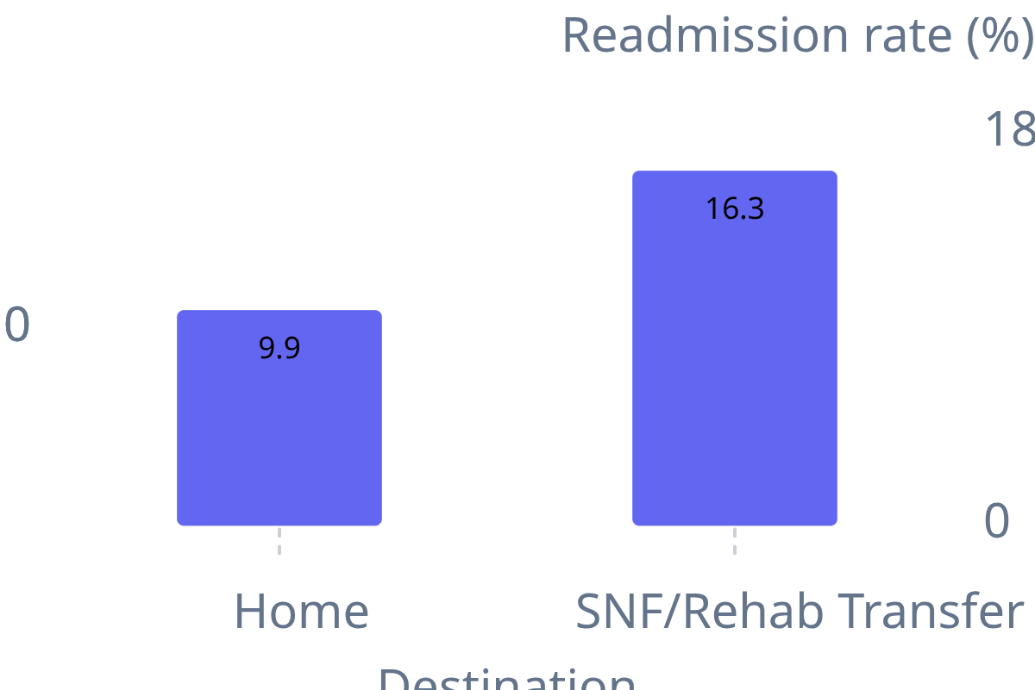








Discharge Destination Vulnerability
The Safe Zone: Direct home discharges maintain a stable 9.9% readmission rate.
High-Risk Transfers: SNF/Rehab facility transfers spike to an alarming 16.3% rate (~18k patients).
Action: Execute immediate clinical audits on partnered SNF/Rehab post-care protocols.
READMISSION RATE BY DISCHARGE DESTINATION
07

Slide 8
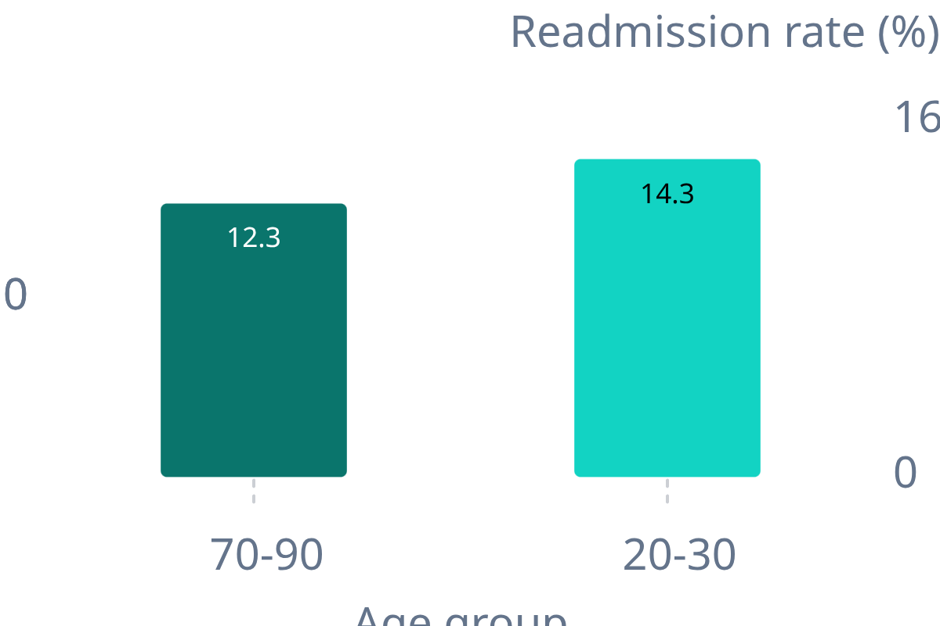




The Age Demographic Anomaly
The Financial Drain: Elderly patients (70-90) drive maximum volume (41.7k) at a 12.3% failure rate.
The Clinical Anomaly: While Young adults (20-30) hold the highest relative risk 14.3% (~1.7k volume).
Action: Target 70-90 group for ROI; audit post-care failures in the vulnerable 20-30 demographic.
READMISSION RATE BY AGE GROUP
08

Slide 9
RECOMMENDATIONS
Strategic Business Recommendations
01
02
Automate Alerts for 'Frequent Flyers'
Implement a 'Complexity' Threshold
Patients with prior inpatient visits fail at a 17.0% rate.
Action: Implement automatic EHR flags forcing a specialized, high-touch discharge review for any returning patient.
High severity and initial resource drain directly predict failure.
Action: Mandate a senior physician's sign-off and assign case managers to high-severity cohorts before authorizing discharge.
03
04
Audit SNF/Rehab Transfers
Fix 'Unknown' Data at Triage
Transfers to Rehab centers carry a severe 16.3% risk.
Action: The hospital must immediately audit third-party facility partners to ensure capable post-discharge protocols.
Over 48,000 encounters operate under an 'Unknown' medical specialty.
Action: Implement hard stops in the admission software to ensure 100% accurate physician specialty logging.

Slide 10
Thank You
Ready for Questions and Deep Dives into the Dashboard
Saurav Singh | LinkedIn
saurav-18s

