Slide 1
Predicting Chess Moves
MET CS 677 – Final Project
Saurav Banerjee
sauravb@bu.edu
August 2020

Slide 2

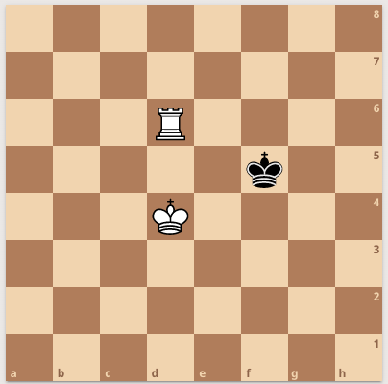
Predicting Chess Moves King-Rook-King Dataset
The dataset presents the end game positions for White King- White Rook- Black King, and the position’s depth of win given black king to move next.
Data Set Attributes
White King Position – d 4
White Rook Position – d 6
Black King Position - f 5
Depth of win - Number of moves required by white to win from this position.
d,4

Slide 3
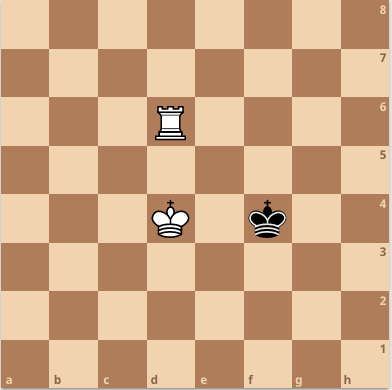
Predicting Chess Moves Best Move Heuristic
Given a position P -White King (d4), White Rook (d6), Black King (f5), Depth of win (2)
From the distances* between the 3 pieces, find the area of the triangle formed between them. (A_{g})
Now, search all the positions where Depth of win is 1, to find a position, with area A_{s}
such that, A_{g} - A_{s} is minimum for all positions with depth of win = 1
Set True Value = A_{g} , for position P
*Euclidian Distances
A_{g}
A_{s}

Slide 4
Predicting Chess Moves Pre-processing to predict heuristic
Columns augmented to dataset
dist_w_rook_w_king – Euclidian distance between white rook and white king
dist_w_king_b_king – Euclidian distance between white king and black king
dist_b_king_w_rook - Euclidian distance between black king and white rook
Area – Using Heron’s formula, compute the triangles formed by the 3 sides.
True_Value – Computing the True value using the best move heuristic.
Data cleanup
For this analysis, rows with depth of win > 4 were removed.
Records were removed for cases where the pieces didn’t form a triangle,

Slide 5
Predicting Chess Moves RMSE of Regressors
Regressors ( finalProject.py )
Polynomial (degrees 3 to 8)
K- Neighbor ( k = 1 to 10)
Decision Tree
Random Forest ( Estimators 1 to 10 )
Support Vector ( Linear, Polynomial, Gaussian)
Conclusion
High root mean squared errors observed
Heuristic, is not adequate to make predictions on best moves
Regressor | Avg. RMSE
Polynomial | 1.5600
K-Neighbor | 1.4213
Decision Tree | 1.5189
Random Forest | 1.5045
Support Vector | 1.5873

Slide 6
Predicting Chess Moves References
References –
Chess Board Editor- https://lichess.org
Chess Dataset - http://archive.ics.uci.edu/ml/datasets/Chess+%28King-Rook+vs.+King%29
SVR - https://scikit-learn.org/stable/auto_examples/svm/plot_svm_regression.html

Slide 7
Event Manager
Thank You
Merry Christmas and Happy New Year 2020 !!

