Slide 1
Image Compression

Slide 2
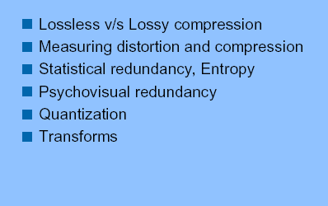
Basic Issues of Compression

Slide 3
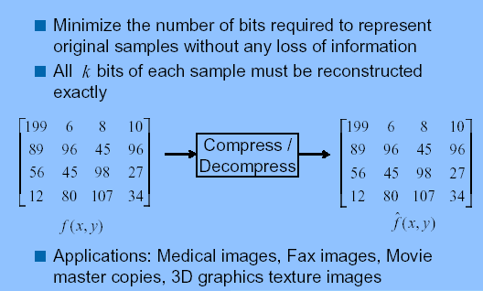
Loss-less image Compression

Slide 4
Compression Issues
Lossless compression
  Coding Efficiency
    Compression ratio
  Coder Complexity
    Memory needs
    Power needs
    Operations per second
  Coding Delay

Slide 5
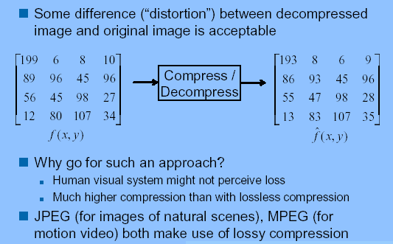
Lossy Image Compression

Slide 6
Compression Issues
Issues particular to Lossy Compression
  Signal quality
    Bit error probability
    Signal/Noise ratio
    Mean opinion score

Slide 7
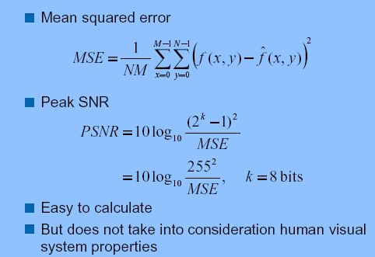
Measuring Distortion

Slide 8
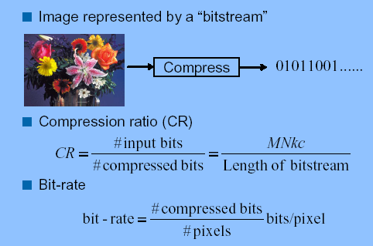
Measuring Compression

Slide 9
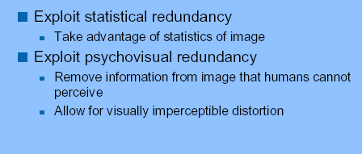
How do you achieve Compression?

Slide 10
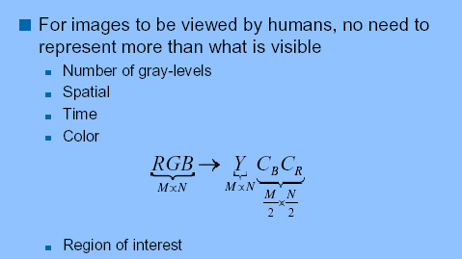
Exploit Psycho-visual Redundancy

Slide 11
Compression Method Selection
Constrained output signal quality? – TV
Retransmission allowed? – interactive sessions
Degradation type at decoder acceptable?
Multiple decoding levels? – browsing and retrieving
Encoding and decoding in tandem? – video editing
Single-sample-based or block-based?
Fixed coding delay, variable efficiency?
Fixed output data size, variable rate?
Fixed coding efficiency, variable signal quality? CBR
Fixed quality, variable efficiency? VBR

Slide 12
Exploiting Psycho-visual redundancy
Transform + Quantization

Slide 13
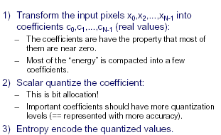
Transform Coding

Slide 14
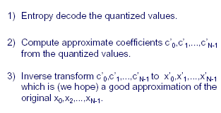
Decoding

Slide 15
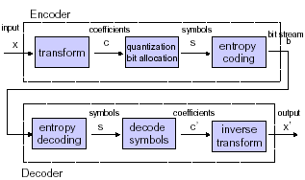
Block Diagram

Slide 16
Linear Transforms
Finite dimensional: which maps n-dimensional input vector x to m-dimensional output vector y, A is a nxm matrix of real or complex valued coefficients
y = Ax
Invertible transforms: x = Sy ;
SA=I (nxn identity matrix)

Slide 17
Vector Space Perspective
Forward transform as inner product
yq = <x, aq>
A transform is orthonormal if
  <ai,aj> =0 , <ai,ai>=1
This means
  AA^{T} = A^{T}A=I and A⁻¹ = A^{T}
An orthonormal transform performs an orthonormal expansion of the input signal as the sum of its projections onto each of the basis vectors
Orthonormal transforms are energy preserving
||x||² =||y||²

Slide 18
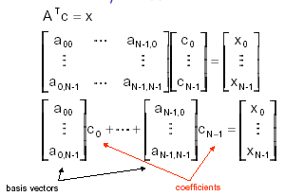
Transform

Slide 19
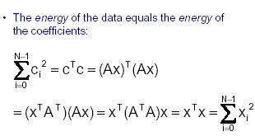
Energy Preserving Property

Slide 20
Energy Preservation and Compression
Let ey= y –y’ error due to quantisation in transform space
Let ex = x-x’ – error in image space after reconstruction
Linearity of the transform implies
ex = Sey
Hence, ||ex||² = ||ey||²

Slide 21
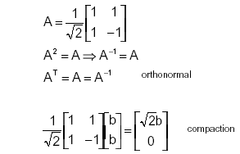
Compaction : Example

Slide 22
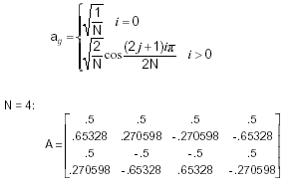
Discrete Cosine Transform

Slide 23
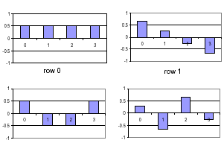
Basis Vectors
row 3
row 4

Slide 24
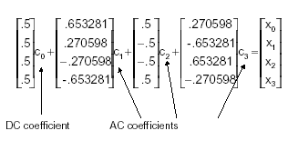
Decomposition in terms of basis vectors

Slide 25
Separable Transforms
2D transform is constructed by separable extension of one dimensional transform
Implemented by applying the 1-D transform to rows of image and then to its column

Slide 26
Blocking of 1D and 2D Signals
Length of the signal is typically unbounded
Source must be processed in blocks
Selection of a finite dimensional transform implies a block transformation process

Slide 27
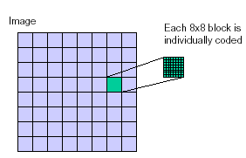
Block Transform

Slide 28
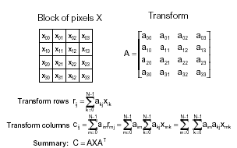
2D Block Transform

Slide 29
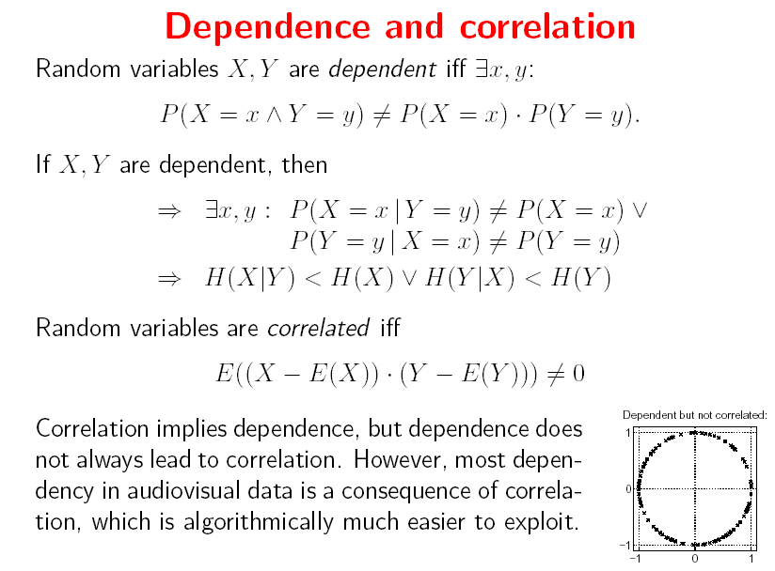

Slide 30
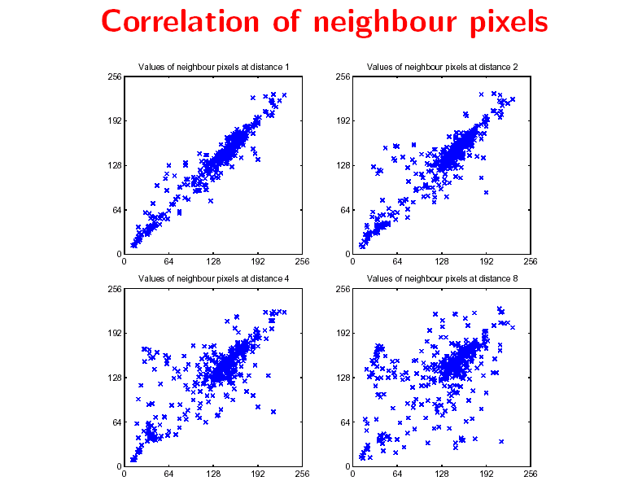

Slide 31
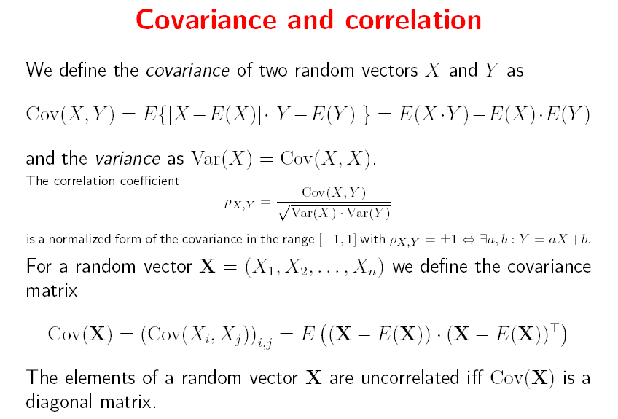

Slide 32
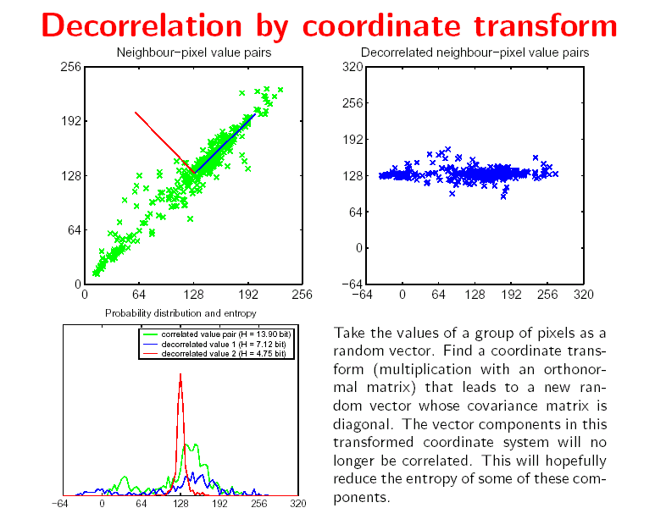

Slide 33
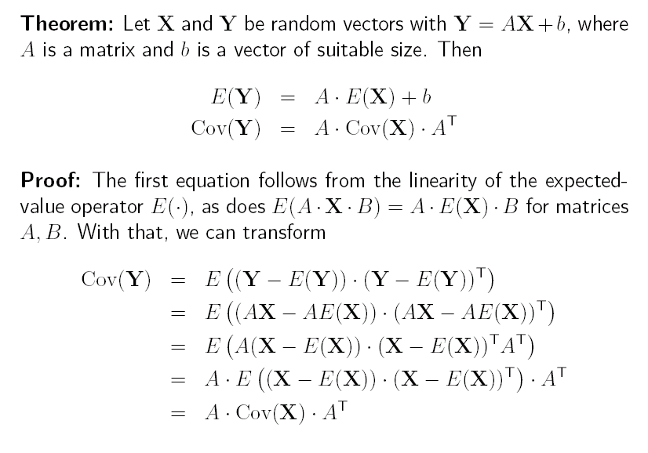

Slide 34
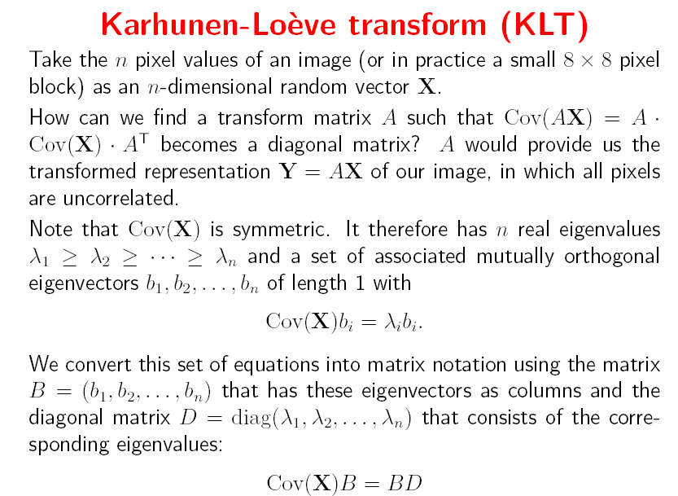

Slide 35
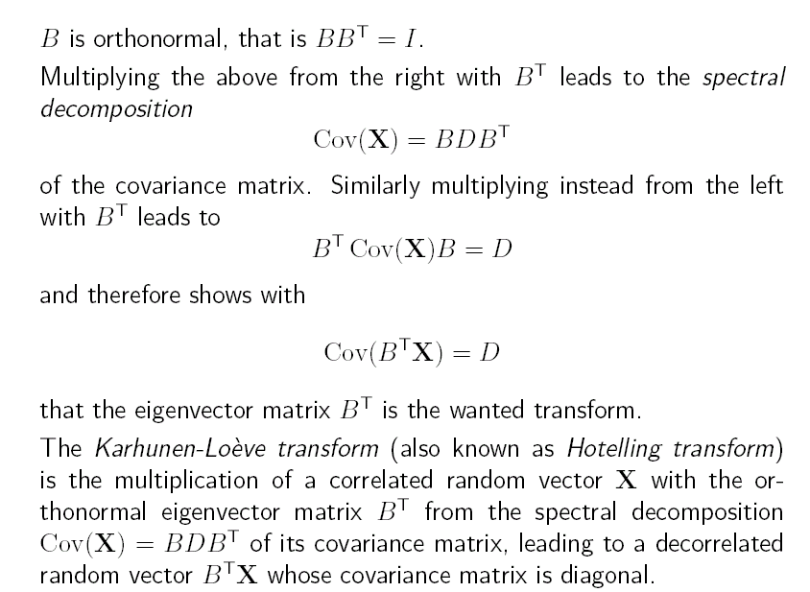

Slide 36
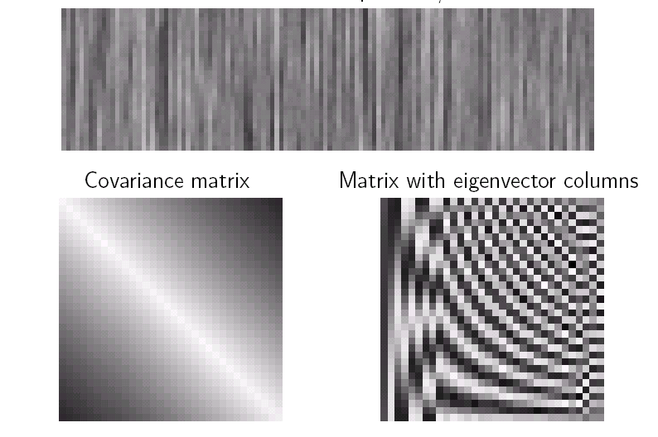
Example

Slide 37
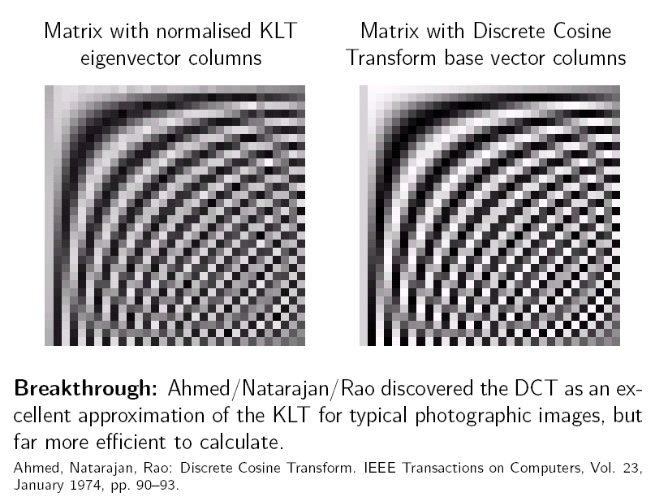
DCT approximately diagonalizes the covariance matrix of first-order Gauss-Markov random process

Slide 38
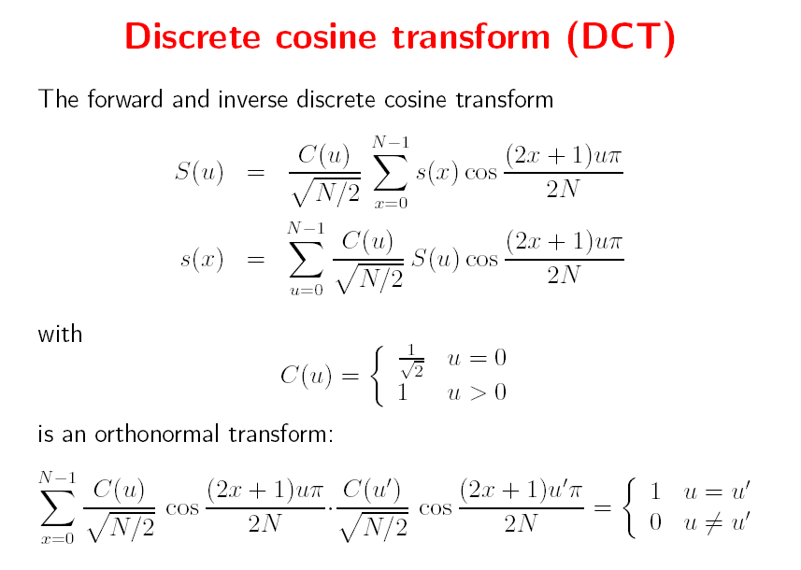

Slide 39
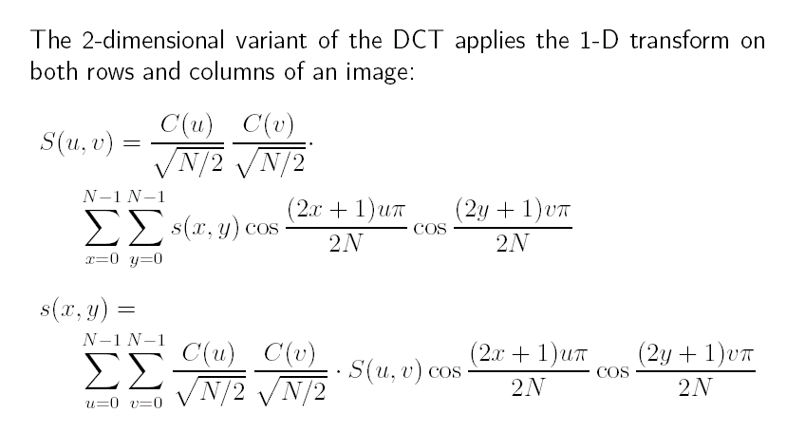

Slide 40
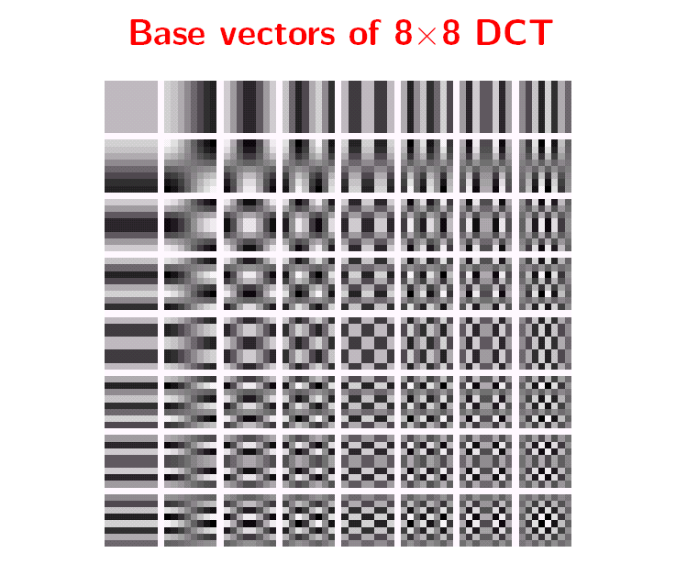

Slide 41
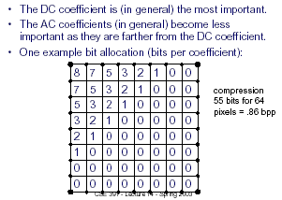
Processing of Coefficients

Slide 42
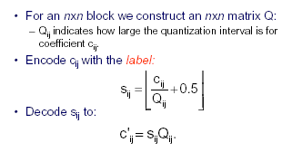
Quantization Table

Slide 43
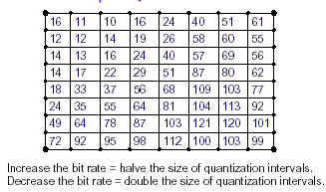
Example Quantization Table

Slide 44
JPEG -lossy
RGB to Y, Cb, Cr
8x8 block
DCT
Quantisation
Block Encoding
Entropy Encoding

Slide 45
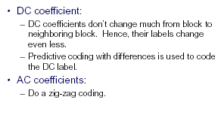
Block Transmission

Slide 46
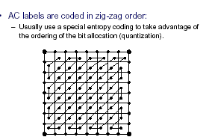
Zig-Zag Coding

Slide 47
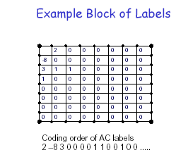

Slide 48
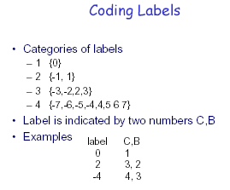

Slide 49
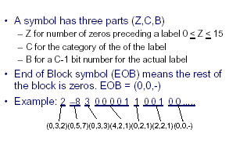
Coding of AC Sequence

Slide 50
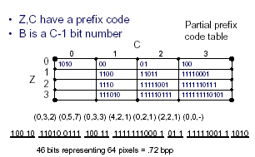
Coding AC label sequence

Slide 51
Block Transforms
Block Transforms
  Transform decomposes the source as a linear combination of disjoint blocks
Neighbouring samples can lie within influence of different blocks
  Transform coefficients from adjacent blocks expected to show significant correlation
De-correlation can be realized asymptotically with block size approaching infinity

Slide 52



SVG 8K
Comparison
JPEG 6K (25%)
GIF 14K

Slide 53
SVG
8K
Small file size, with no quality degradation
Vector-based, scales with no loss of quality

Slide 54

PNG
23K
Lossless raster image=high quality
Supports alpha

Slide 55
JPEG
6K with 25% quality
Image quality suffers, especially sharp lines
No transparency
Read by all Web browsers.

Slide 56
GIF
14K
Only supports 256 colors—results in dithered or banded images
Not good for photographs
Read by all Web browsers

Slide 57
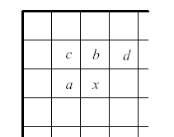
JPEG -lossless
Context based coding of pixel values

Slide 58
The Lossless JPEG standard
 | c | b
 | a | X
Try to predict the value of pixel X as prediction residual r=y-X
  y can be one of 0, a, b, c, a+b-c, a+(b-c)/2,b+(a-c)/2
  The scan header records the choice of y
  Residual r is computed modulo 2¹⁶
  The number of bits needed for r is called its category, the binary value of r is its magnitude
  The category is Huffman encoded

Slide 59
The Lossless JPEG standard
 | 100 | 191
 | 100 | 180
y=(a+b)/2 = 145
r=145-180=-35
Category (r) = 6, Magnitude (r) = 100011
1’s complement of cat (r) = 011100
Rep(35)={6,011100}
Let Huff. code(6) = 1110
Code(-35)=1110011100
MSB=0 fpr numbers < 0
10 bits

Slide 60
The JPEG-LS standard
Near-lossless encoding
  decoder output does not differ from the input by no more than a pre-specified value
JPEG-LS coder
  Context modeling – encoding of a pixel depends on the previous pixels
  Run-length encoder – for smooth parts of the image
  Predictor – like in the lossless JPEG scheme
  Error Coder – to reconstruct the difference between the prediction and the signal

Slide 61
The JPEG-LS standard
Context Model
  two probability models: flat areas and edge-areas
  compute d1=d-a, d2=a-c, d3=c-b
  quantize d1, d2, d3 to Q1, Q2, Q3 using thresholds T1, T2, T3. For 8-bit images they are 3, 7, 21
  any Q can take up to 9 possible values based on the threshold interval it is in
  This produces 9³-1=728 combinations for {Q1,Q2,Q3}, or 364 using symmetry
 | c | a | d
 | b | X

Slide 62
The JPEG-LS standard
Run-mode coder
  If gradients are close to 0, the encoder gets into a run-mode
  So long as |x-b| ≤ ε, the encoder reads subsequent samples
  Then it returns the run-length
  If end-of-line is reached, it encodes the last sample
At the pixel x the predictor computes prediction error e=y-x where
  min(a,b) if c ≥ max(a,b)
  y= max(a,b) if c ≤ min(a,b)
  a+b-c
  Remove any prediction bias
Remap e to e′ = 2e for positive e and –2e-1 for negative e
Encode e′ with ENTROPY CODING

Slide 63
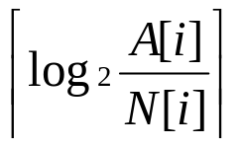
The JPEG-LS standard
The parameter k for Golomb-Rice encoding is obtained by
  k =
  A[i]: accumulated sum of prediction errors
  N[i]: number of prediction residuals seen in context i
Removal of prediction bias
  Idea: the prediction error must follow a 2-sided geometric distribution
  Computed using A[i] – how?
  B[i], sum of errors after correction and C[i], the correction itself are also stored

Slide 64
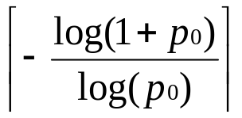
Golomb-Rice Compression
Take a source having symbols occurring with a geometric probability distribution
  P(n)=(1-p₀) p^{n}₀ n≥0, 0<p₀<1
  Here is P(n) the probability of run-length of n for any symbol
Take a positive integer m and determine q, r where n=mq+r.
G_{m} code for n: 0…01 + bin(r)
Optimal if
  m =
q
has log₂m bits if r >sup(log₂m)

Slide 65
Golomb-Rice Compression
Now if m=2^{k}
  Get q by k-bit right shift and r by last r bits of n
Example:
  If m=4 and n=22 the code is 00000110
Decoding G-R code:
  Count the number of 0s before the first 1. This gives q. Skip the 1. The next k bits gives r

Slide 66
Network-Aware Formats
A tradeoff problem
  Compression efficiency vs. progressive transmission performance
  Network factors
    Packet loss
    Asynchronous arrival of packets at destination
  Progressive Transmission Factors
    % of picture visible as a function of time
    Same given a certain amount of packet loss

Slide 67
Network-Aware Formats
Recent Research in University of Delaware
  NETCICATS project (http://www.eecis.udel.edu/~iren/netcicats.html)
  Primary idea
    Break the picture into maximum transmission unit (MTU) sized chunks that a link layer will carry without the IP layer further fragmenting it
    The MTU sized picture fragments (also called application data units) should be “self contained” to the extent possible

Slide 68
Standards
H.323 for Packet Based Networks
Audio only; audio and video; audio,video and data
H.322 for LANs with guaranteed QoS
Protocols specified by H.323: audio codec (G.711), video codec (H.261, H.263 – px64 kbps), admission and status, call signaling, control signaling, RTP, RTCP
H.261: CIF-288x360, QCIF-144x180

Slide 69
Video Compression

Slide 70
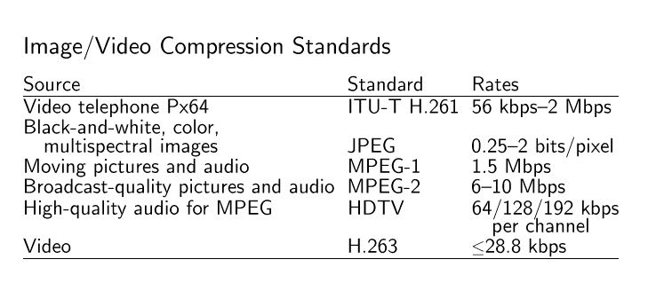
Compression schemes

Slide 71
Background
1980’s technology made possible full-motion video over networks
Needed a standard
  Often trigger needed volume production
    Ala facsimile (fax)
  Avoid de facto standard by industry
1988, Established the Motion Picture Experts Group (MPEG)
  Worked towards MPEG-1

Slide 72
The Need for Video Compression
High-Definition Television (HDTV)
  1920x1080
  30 frames per second (full motion)
  8 bits for each three primary colors
  →Total 1.5 Gb/sec!
Each cable channel is 6 MHz
  Max data rate of 19.2 Mb/sec
  Reduced to 18 Mb/sec w/audio + control …
  →Compression rate must be 83:1!

Slide 73
Compatibility Goals
CD-ROM and DAT key storage devices
  1-2 Mbits/sec for 1x CD-ROM
Two types of application videos:
  Asymmetric (encoded once, decoded many)
    Video games, Video on Demand
  Symmetric (encoded once, decoded once)
    Video phone, video mail …
Video at about 1.5 Mbits/sec
Audio at about 64-192 kbits/channel

Slide 74
Requirements
Random Access, Reverse, Fast Forward, Search
  At any point in the stream
  Can reduce quality somewhat during task, if needed
Audio/Video Synchronization
  Even when under two different clocks
Robustness to errors
  Not catastrophic if bits lost
Coding/Decoding delay under 150ms
  For interactive applications
Editability
  Modify/Replace frames

Slide 75
Introduction to
MPEG 1 & 2
Compression Exploiting Spatial and Temporal redundancy

Slide 76
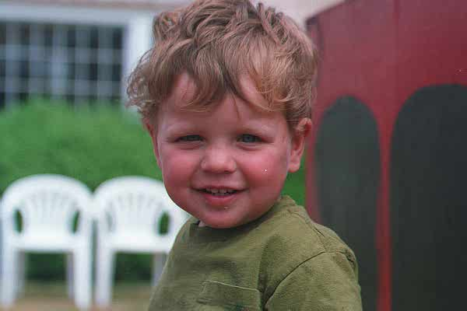

Spatial Redundancy
Take advantage of similarity among most neighboring pixels

Slide 77


Temporal Redundancy
Take advantage of similarity between successive frames
950
951
952

Slide 78
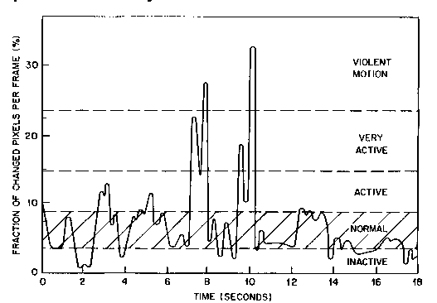
Temporal Activity
“Talking Head”

Slide 79
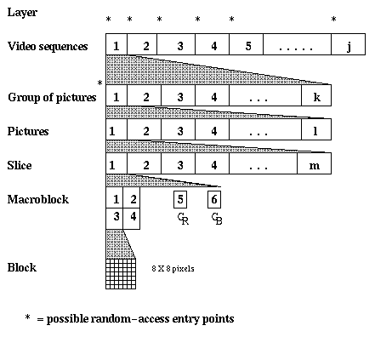
MPEG Layers
Sequence Layer
Group of Pictures Layer

Slide 80
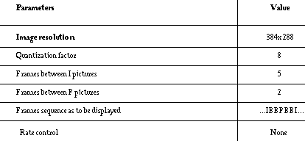
Typical MPEG Parameters

Slide 81
Basics of MPEG
Picture sizes: up to 4095 x 4095
Most algorithms are for the CCIR 601 format for video frames
  Y-Cb-Cr color space
  NTSC: 525 lines per frame at 60 fps, 720 x 480 pixel luminance frame, 360 x 480 pixel chrominance frame
  PAL: 625 lines per frame at 50 fps, 720 x 576 pixel luminance frame, 360 x 576 pixel chrominance frame
SIF (source input format) for digital TV
  Luminance resolution: 360 x 240 pixels at 30 fps or 360 x 288 pixels at 25 fps
  Chrominance resolution: half the luminance resolution in both dimensions

Slide 82
MPEG-1
Targeted CD-ROM Applications
Important features provided
  fast forward/fast reverse
  reverse playback
  editability
of compressed bit stream
Notes:
Algorithms were developed with respect to the JPEG and H.262 activities so that implementation supporting both the standards was possible

Slide 83
Coding Scheme
First frame in intra-frame coding method
Subsequent frames using inter frame prediction mostly
  P frames and B frames
Block based
  Color frame divided into macro blocks
  Each macro block divided into four in Y plane and one chrominance block each for U and V plane
  Each block contain 8x8 pixels

Slide 84
Spatial Redundancy Reduction
RGB to YUV
  less information required, same visually
Macro Blocks
  Take groups of pixels
DCT
  Represent pixels in blocks with fewer numbers
Quantization
  Reduce data required for co-efficients
Entropy coding
  Compress

Slide 85
Intra-frame Coding
DCT is applied to each 8x8 block
Quantisation
DC coefficients encoded using differential prediction
Non-zero coefficients and their locations zig-zag scanned
Run length entropy coded with VLC tables
Notes:
Because there is usually a strong correlation between the DC values of adjacent 8x8 blocks the quantised DC coefficient is encoded as the difference.
Zig-zag scanning is to trace low frequency DCT coefficients before tracing the high frequency coefficients. Location of non-zero coefficients is encoded relative to the location of previously coded coefficient. Zig-zag scan philosophy attempts to trace the coefficients according to their likelihood of appearance to achieve an efficient coding.
Non-zero AC coefficient quantizer values are detected along the scan line as well as the distance between two consecutive non-zero values. Each (run.value) pair is encoded by transmitting only one VLC value.

Slide 86
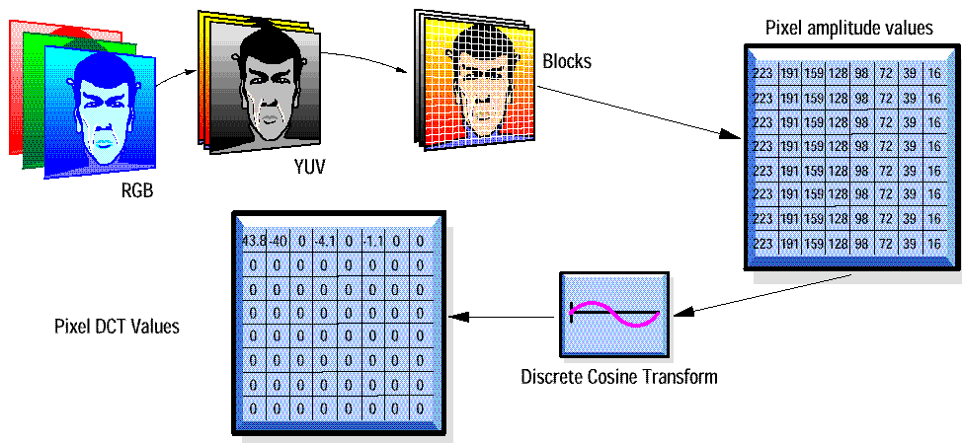
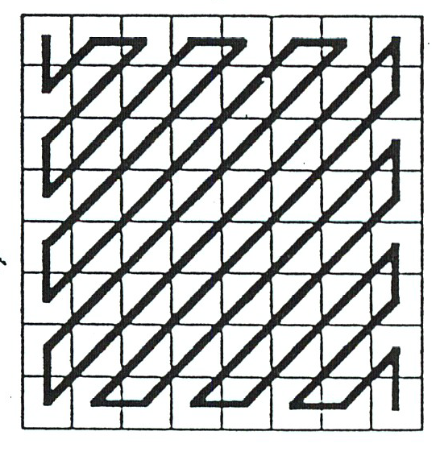
Intra-frame Coding
“Intra-Frame
Encoded”
Quantization
major reduction
controls ‘quality’
Zig-Zag Scan,
Run-length coding

Slide 87
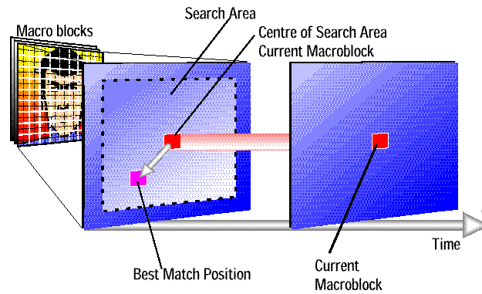
Temporal Redundancy Reduction

Slide 88

Temporal Redundancy Reduction

Slide 89

Motion Compensation
N
p
(x,y)
(x,y)
M
p
Macroblock
(16 x 16)
(x,y)
Reference picture
(x+u,y+v)
Minimize MAE

Slide 90
Motion Estimation
Algorithm 0: full search
Algorithm 1: 2D-logarithmic search
  Partition the [-p,p] rectangle into a [-p/2,p/2] rectangle and the rest
  Compute the MAE function at the center and 8 perimeter points of the [-p/2,p/2] rectangle. Let the points be d₁ pixels apart
  Find the point with the minimum MAE
  Start with this location and repeat the above steps, but reduce the distance to d₁/2
  Repeat until the k-th search when the distance between the points is 1 pixel
Complexity?
When will this algorithm perform poorly?

Slide 91
Motion Estimation
Algorithm 2: Hierarchical Motion Estimation
  Make 2 progressively low-resolution and downsampled versions of the current frame and the reference frame
    Let macroblock of reference frame be located at (x,y)
    Corresponding macroblocks are located in (x/2,y/2) and (x/4,y/4) for Level 1 and Level 2
    Let the size of the Level 0 macroblock be 16 X 16
    Let the motion vector have a dynamic range of ±p pixels
  Estimate motion vector from the Level 2 image, using a macroblock of 4 x 4 and a search space of [-p/4,p/4].
    Let MAE be minimized at (u₂, v₂)

Slide 92
Motion Estimation
At Level 1, perform a motion vector search on 8 x 8 macroblocks
  The search is centered at (x/2+2u₂, y/2+ 2v₂)
  The search space is [-1,1]
  Let the minimal MAE be at (u₁, v₁)
At Level 0, perform a motion vector search on 16 x 16 macroblocks
  The search is centered at (x+2u₁, y+ 2v₁)
  The search space is [-1,1]
  Let the minimal MAE be at (u₀, v_{0 v})
Complexity? Tradeoffs?
When will the algorithm not perform well?

Slide 93
Matching Criteria
Pixel Difference Classification
  Pixels in the macroblock of the current frame: C(x+k,y+l)
  Those in the reference frame: R(x+i+k,y+j+l)
  PDC(i,j)=Σ_{k}Σ_{l}T_{ij} (k,l) where T_{ij} (k,l) = 1 if the difference is < t and 0 otherwise
  Motion vector is defined for pixels with maximum PDC
  If t = 2^{p} the binary form of PDC is:
  BPDC(i,j)= Σ_{k}Σ_{l} and{xnor(C_{p}(x+k,y+l), R_{p}(x+i+k,y+j+l))}
  where C_{p} and R_{p} are the 8 - p most significant bits of C and R
  If more weight are assigned to the more significant bits
    BPROP(i,j)= Σ_{k}Σ_{l} xor(C_{p}(x+k,y+l), R_{p}(x+i+k,y+j+l))
  What is the performance difference?

Slide 94
Matching Criteria
Bit-plane matching
  Let F be a frame
  Filter F with convolution kernel K giving G
    Example: K(i,j) = 1/25 if i,j ∈ [1, 4, 8, 12, 16], 0 otherwise
  Compute binary frame F(i,j) = 1 if F(i,j) ≥ G(i,j), 0 otherwise
    BPM(i,j)= 1/MN Σ_{k}Σ_{l} xor(C(x+k,y+l), R(x+i+k,y+j+l))
Comparison: 720 X 480, 30 fps, [-15, 15]
Search | MAE | BPM | BPM-32
Full search | 29.89 | 3.03 | 1.16
Logarithmic | 1.02 | 364.45 | 300.30

Slide 95

Coding Scheme

Slide 96
Inter frame Coding
Motion Compensation on macro-block basis
  one motion vector for a macro-block
  vector corresponding to minimum error between a macro-block and shifted counterpart in the previous frame
Prediction error is DCT coded using 8x8 blocks
Quantisation, run-length coding and entropy coding
Notes:
This is the straegy followed for P frames.
A video buffer is required to ensure that a constant target bit rate is achieved. Quatisation step size can be adjusted for each macro block in aframe to achieve a given bit rate and to avoid buffer underflow and overflow.
Decoder uses the reverse process to reproduce a macroblock of frame N. The motion compensated pixels from the macroblock of the previous frame contained in the frame store are added to the prediction error to recover the particular macroblock of the current frame.
The advantage of motion compensation is that the residual signal to be coded is greatly reduced if compared to pure frame difference.

Slide 97
B Frames
B-pictures
  Bi-directional prediction /interpolation
  maximum compression efficiency
B-frames coded with respect to nearest I and P frames
B frames introduces coding delay

Slide 98

Coding

Slide 99
Video Encoding: Block Diagram
Regulator
Frame
Memory
+
-
DCT
Quantizer
(Q)
VLC
Encoder
Q⁻¹
Buffer
Pre
processing
IDCT
Predictive frame
Motion vectors
+
Output
Input
Motion
Compensation
Frame
Memory
Motion
Estimation

Slide 100
MPEG: Structure of the Coded Bit-Stream
Sequence layer: picture dimensions, pixel aspect ratio, picture rate, minimum buffer size, DCT quantization matrices
GOP layer: will have one I picture, start with I or B picture, end with I or P picture, has closed GOP flag, timing info, user data
Picture layer: temporal ref number, picture type, synchronization info, resolution, range of motion vectors
Slices: position of slice in picture, quantization scale factor
Macroblock: position, H and V motion vectors, which blocks are coded and transmitted
GOP-1 GOP-2 GOP-n
Sequence layer
I B B B P B B..
GOP layer
Slice layer
Slice-1
Slice-2
…
Slice-N
mb-1
mb-2
mb-n
Macroblock layer
0
1
Picture layer
2
3
4
5
8x8 block

Slide 101


MPEG: Macroblock Coding
MQUANT= scale factor q
A
Quantization matrix

Slide 102
Typical Compression Performance
Type Size Compression
---------------------
I 18 KB 7:1
P 6 KB 20:1
B 2.5 KB 50:1
Avg 4.8 KB 27:1
---------------------
Note, results in Variable Bit Rate, even if frame rate is constant

Slide 103
Media Functionality
Media functionality: random access, FF/FR and editability
Only I frames allow highest degree of media functionality but least compression
Use of I and P frames provide better compression and reasonable media functionality
I, P and B frames increases coding efficiency and coding delay
    not suitable for video telephony or video conferencing

Slide 104
Rate Control
Possibility to tailor bit-rates
Generation of constant bit rate
  buffer the inherently variable compressed bit stream
  decoder receives constant bit stream
MPEG has defined minimum video buffer size needs to be supported by all decoder
Rate control algorithm is not part of the standard

Slide 105
MPEG-2
Why another standard?
  Support higher bit rates e.g., 80-100 Mbits/s for HDTV instead of the 1.15 Mvits/s for SIF
  Support a larger number of applications
  The encoding standard should be a toolkit rather than a flat procedure
    Interlaced and non-interlaced frame
    Different color subsampling modes e.g., 4:2:2, 4:2:0, 4:4:4
    Flexible quantization schemes – can be changed at picture level
    Scalable bit-streams
    Profiles and levels

Slide 106
MPEG-2: Effects of Interlacing
Fields or frame pictures can be encoded
Prediction Modes and Motion Compensation
  Frame prediction: current frame predicted from previous frame
  Field prediction:
    Top and bottom fields of reference frame predicts first field
    Bottom field of previous frame and top field of current frame predicts the bottom field of current frame
  16 X 8 motion compensation mode
    A macroblock may have two of them
    A B picture macroblock may have four!
  Dual prime motion compensation
    Top field of current frame is predicted from two motion vectors coming from the top and bottom field of reference frame
    Works for P vectors

Slide 107
Conditional Replenishment
Depending on the error in motion estimation selection of coding scheme for each macro-block
Selective I, P, B macro blocks in a B-frame

Slide 108
Scalable Coding
To provide inter-operability between different services
Multi-resolution based approach
  Down-scaling video into lower spatial or temporal resolution
  Down-sampled stream encoded into base bit-stream with reduced bit rate
  Upsampled reconstructed video is used as a prediction
  prediction layer encoded into an enhancement layer
Notes:
Receivers either not capable or willing to reconstruct full resolution video can decode subsets of the layered bit stream to display video at lower spatial or temporal resolution or with lower quality. Also, it would provide for layered bit stream amenable for prioritised transmission.
Receiver can decode only the base layer and display the downscaled video. A suitable bit rate can be allocated to each layer in order to meet specific bandwidth requirements of transmission channels or storage media.

Slide 109
Spatial Scalability
To support displays with different spatial resolutions
Algorithm is based upon classical pyramidal approach
Adds considerable implementation complexity

Slide 110
SNR scalability
To provide graceful degradation
Two layers : same spatial resolution
In the base layer DCT coefficients are coarsely quantised
Enhancement layer encodes difference between non-quantized DCT coefficients and quantized coefficients.
Notes:
If the base layer can be protected from transmission error, a version of video with gracefully reduced quality can be obtained by decoding the base layer only.
Video with lower resolution is also possible in this mode by selecting the lowest NxN DCT coefficients from the base layer and using inverse DCT

Slide 111
Sub-band Transforms
Extend block transforms by adding memory
Each output vector formed from multiple input vectors through a sequence of transform matrices A[n]
y[n]=Σ A[i]x[n-i]
M-dimensional Vector convolution
Sliding Window transform
De-correlating convolutional transforms like DCT correspond to frequency band structure – producing sub-band sequences
Filtering source sequence with a bank of m different analysis filters and keeping only every m^{th} sample of each filter’s output

Slide 112

Stationary Signals
Transform domain representation implicitly assumed to be invariant over time
  frequency content of stationary signals do not change in time
Not true for natural signals like speech
Short-time or time dependent Fourier transform will give temporal variation of frequency content
Window function determines the temporal window

Slide 113


Short time Fourier Transform
Window is chosen so that spectral characteristics remain stable during the window duration
More rapidly the characteristic change shorter the window should be
Resolution in the frequency depends on window size

Slide 114
Wavelet Transform
It provides the time-frequency representation of the signal
Instead of fixing time and frequency resolutions one can permit variations of both without violating the constraint
Multi-resolution analysis

Slide 115

Filter-bank Approach
Analysis filter bank consists of band-pass filters with constant relative bandwidth
Window is changed as the transform is computed for every single spectral component
The width of the window is changed as the transform is computed for every single spectral component, which is probably the most significant characteristic of the wavelet transform.
The width of the window is changed as the transform is computed for every single spectral component, which is probably the most significant characteristic of the wavelet transform.

Slide 116
Filter Bank Approach
Time resolution becomes good at high frequency
Two very close short bursts can eventually separated if we go to high frequencies in order to increase time resolution
Wavelet analysis works best if the signal is composed of short duration and low frequency components of long duration

Slide 117

Continuous Wavelet Transform
Impulse response of analysis filters in the filter bank are defined as scaled version of the same proto-type
The filter response becomes

Slide 118

Wavelet Transform
Transformed signal is a function of two variables, tau and s , the translation and scale parameters, respectively.
psi(t) is the transforming function, and it is called the mother wavelet .

Slide 119
Wavelets
The term wavelet means a small wave .
  The smallness refers to the condition that this (window) function is of finite length ( compactly supported). The wave refers to the condition that this function is oscillatory .
Defined with respect to Mother Wavelet
  The term mother implies that the functions with different region of support that are used in the transformation process are derived from one main function, or the mother wavelet.
  In other words, the mother wavelet is a prototype for generating the other window functions.

Slide 120
Wavelets
The term translation is used in the same sense as it was used in the STFT;
It is related to the location of the window, as the window is shifted through the signal.
This term, obviously, corresponds to time information in the transform domain.
We do not have a frequency parameter, as we had before for the STFT. Instead, we have scale parameter which is defined as $1/frequency$.

Slide 121
Wavelets
The parameter scale in the wavelet analysis is similar to the scale used in maps.
  As in the case of maps, high scales correspond to a non-detailed global view (of the signal), and low scales correspond to a detailed view.
Similarly, in terms of frequency, low frequencies (high scales) correspond to a global information of a signal (that usually spans the entire signal), whereas high frequencies (low scales) correspond to a detailed information of a hidden pattern in the signal (that usually lasts a relatively short time).

Slide 122
Scaling
Scaling, as a mathematical operation, either dilates or compresses a signal.
  Larger scales correspond to dilated (or stretched out) signals and small scales correspond to compressed signals.
In terms of mathematical functions, if f(t) is a given function f(st) corresponds to a contracted (compressed) version of f(t) if s > 1 and to an expanded (dilated) version of f(t) if s < 1 .
  However, in the definition of the wavelet transform, the scaling term is used in the denominator, and therefore, the opposite of the above statements holds, i.e., scales s > 1 dilates the signals whereas scales s < 1 , compresses the signal.

Slide 123


Vector Space Interpretation
CWT can be thought of as the inner product of the test signal with the basis functions psi_(tau ,s)(t):
If the signal has a major component of the frequency corresponding to the current scale, then the wavelet (the basis function) at the current scale will be similar or close to the signal at the particular location where this frequency component occurs. Therefore, the CWT coefficient computed at this point in the time-scale plane will be a relatively large number.
If the signal has a major component of the frequency corresponding to the current scale, then the wavelet (the basis function) at the current scale will be similar or close to the signal at the particular location where this frequency component occurs. Therefore, the CWT coefficient computed at this point in the time-scale plane will be a relatively large number.

Slide 124

Types of Wavelets Used : Haar or db1 wavelet
Because of the discontinuous nature of the Harr wavelet and its
Support of only two ,it is not well suited for analyzing most real
Discrete signals .

Slide 125

Daubechies family
They are compactly supported orthonormal wavelets
thus making discrete wavelet analysis practicable.

Slide 126

Coiflet
The Coiflet family is a modification of the Daubechies wavelet family
and is much more symmetrical.

Slide 127

Symlets
Symlet family is another a modification of the Deubachies family

Slide 128

2d Analysis
1. Perform a 1-level, 1D wavelet transform, on each row of f, thereby producing a new image.
2. On the new image obtained from Step 1, perform the same 1D wavelet transform on each of its columns.
The subimages H¹ , D¹, A¹, and V¹ each have M/2 rows and N/2 columns.
The A¹ subimage is a lower resolution (trend) image of the original image.
The H¹ subimage contains the horizontal fluctuations of the original image.
The V¹ subimage contains the vertical fluctuations of the original image.
And finally, the D¹ subimage contains the diagonal fluctuations of the original image.

Slide 129

Figure

Slide 130
JPEG 2000

Slide 131

Why JPEG 2000?

Slide 132

Features of JPEG 2000

Slide 133

More Features

Slide 134

JPEG 2000: Basic Compression Scheme

Slide 135

Tiling
Image is tiled
  Non-overlapping rectangular blocks
Each tile is compressed independently

Slide 136


Slide 137


Slide 138


Slide 139


Slide 140


Slide 141


Slide 142


