Slide 1
JavaScript Tutorials
By Saurav Singh

Slide 2
Basic requirements to build a website
HTML – must to build any website(skeleton).
CSS – for designing.
JavaScript – for client side scripting.
Ex – metallic body of car – HTML
Color + design of car – CSS
Engine - JavaScript

Slide 3
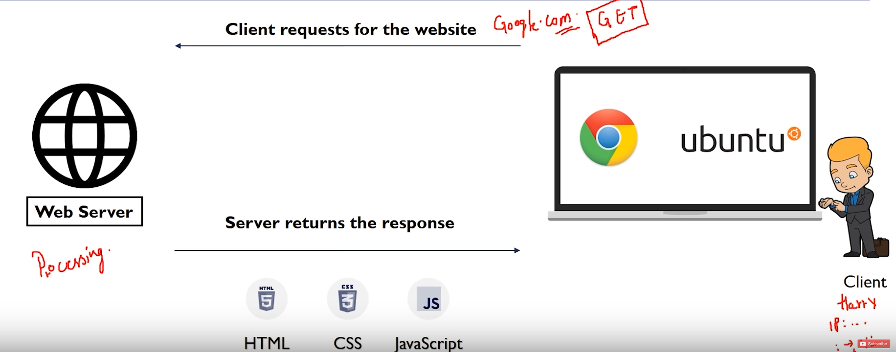
How website works?

Slide 4
JavaScript
Scripts can be executed in the browser itself.
JavaScript and Java are 2 different languages.
It can be executed in browser as well as server.
JavaScript is a safe language when used in browser.
To link js page to html page = <script src =“file.js”>

Slide 5
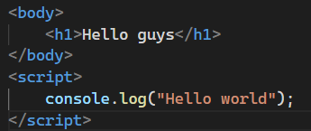

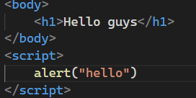
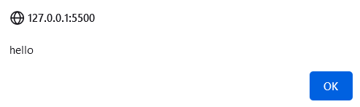
Basics
To print anything on console – Console.log(“Hello World”)
To pop something on screen – alert(“Hello”).

Slide 6
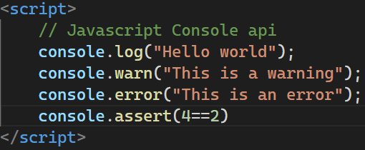
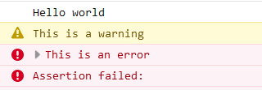
To print anything on the screen – document.write(“Hello World”)
To Print warning on Console – console.warn(“Warning”).
To Print error on Console – console.error(“Error”).
To clear the Console – console.clear() – this is a function.
To check true/false – console.assert(4==2).

Slide 7
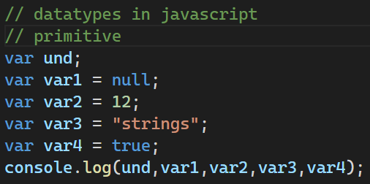

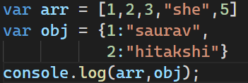
Datatypes in JavaScript
There are 2 types of datatypes – primitive and reference.
Primitive – undefined, null, number, strings, Boolean.
Reference – arrays and objects(like dictionary in python).
Var – to declare variable.

Slide 8
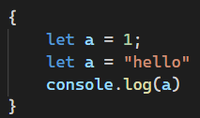


Let vs const vs var
Let – its scope is within the block level i.e. up to the closing of curly braces while var scope is within the program.
And variables with let cannot be redeclared.
Const – you cannot update the value of const once declared.

Slide 9

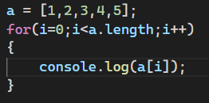

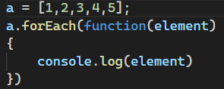
For Loops in JavaScript
There is one more way you can use for loop – ForEach loop

Slide 10
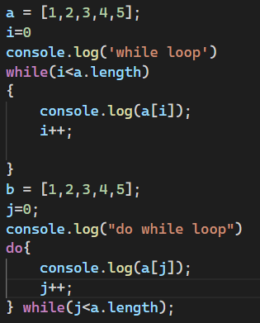
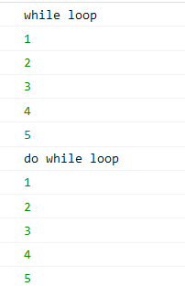
While and do While loop
While first checks the condition and then print.
Do while will print up to one iteration whether the condition is true or false because it will first print the statement then checks the condition.

Slide 11
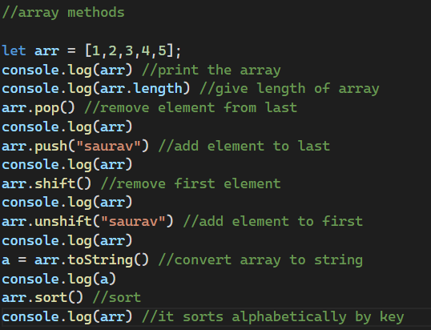
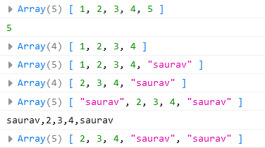
Array methods

Slide 12
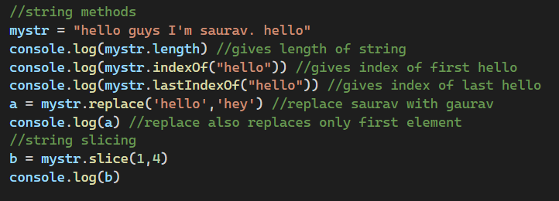
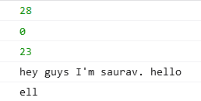
String methods in JavaScript

Slide 13
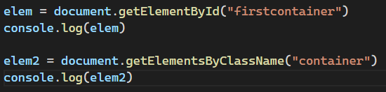

DOM
Now , we have 2 containers having same class name = “container”. We can access them by index – [0] or [1]

Slide 14

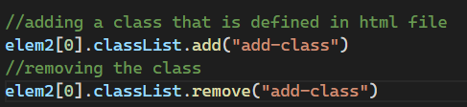

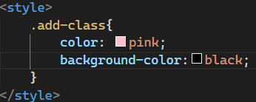

You can also do operations on that class externally.
You can add or remove class from that class –
Browser screen
.js file
Console – you can see that the class add-class gets added
.html file

Slide 15
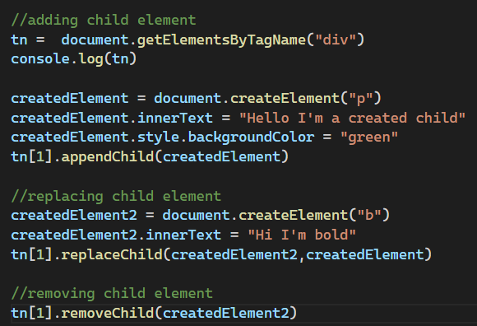
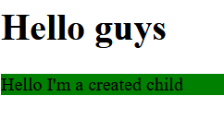
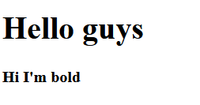
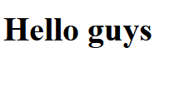
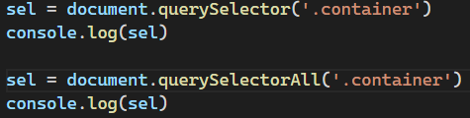

You can also add/replace or remove a child element from that class/tag or Id.
You can access 1 class and all the classes of same name by query selector.
Child class added
Child class replaced
Child class removed

Slide 16
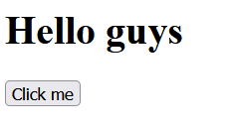
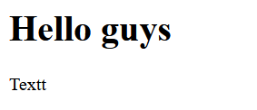
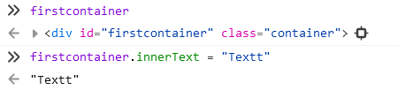

Dom manipulation
You can also change the content temporarily inside the console –
Console –
id name

Slide 17
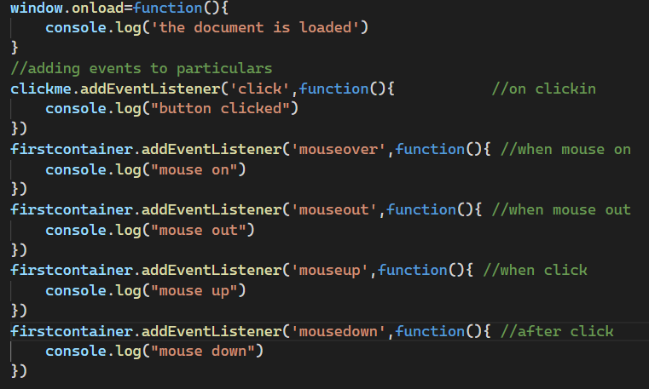
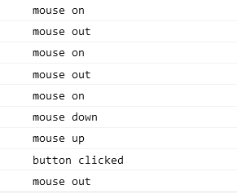
Events in JavaScript
Whatever is happening is an event.
For ex – clicking a button, hovering over a container, color changing etc.

Slide 18
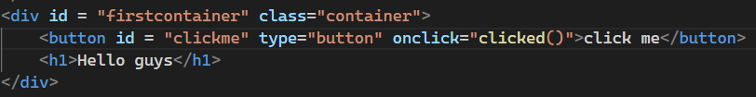


You can also create functions in JavaScript –
.html file
.js file

Slide 19
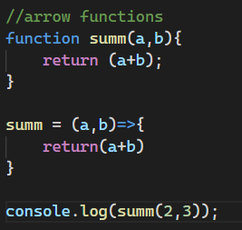
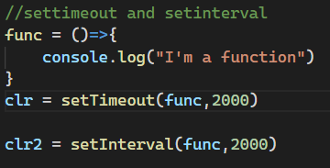


Arrow function
setTimeout and setInterval
setTimeout(function, time in ms) – when you want to do perform your task after the some time
setInterval(function, time in ms) – when you want to do things repeatedly
Use clearTimeout/clearInterval to stop doing the task by setTimeout(id)/setInterval(id).
Both these functions returns an id which is used to stop their functioning.

Slide 20
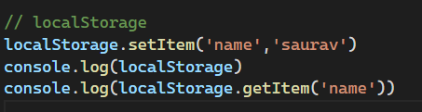

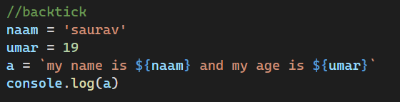

Local storage
Local storage is used to store data in users computer.
The data is in the form of key, value pair.
Backticks –

Slide 21
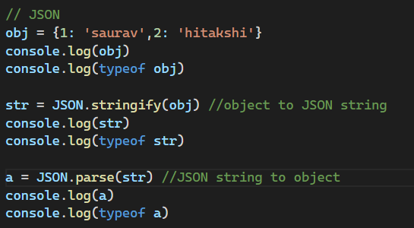
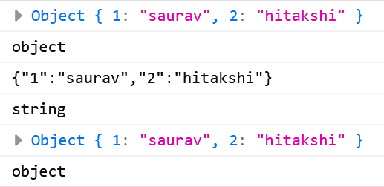
JSON
Json stand for JavaScript object notation and is used to transfer or store data.
JSON.stringify(obj) – for object to JSON.
JSON.parse(str) – for JSON to object.

