Slide 1
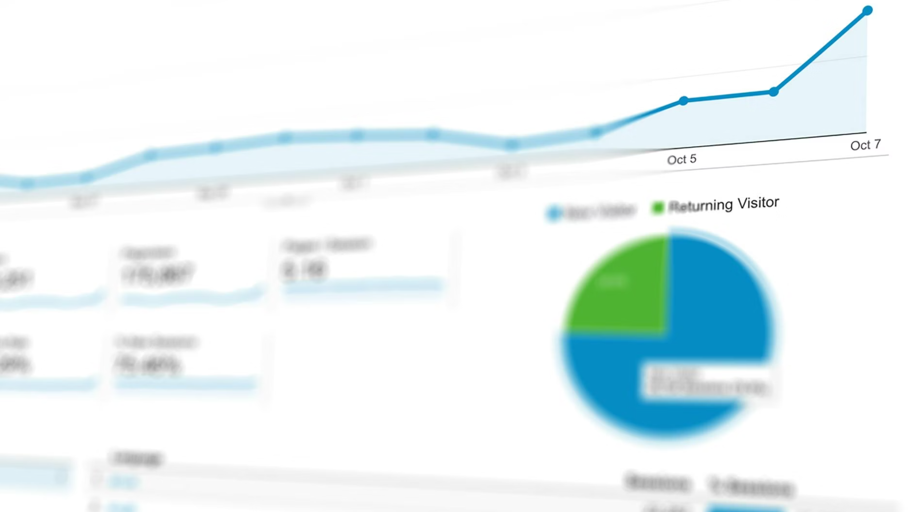
FinTech Transaction Analytics
Comprehensive Business Intelligence Report · Fiscal Year 2024
5K
₹6.59Cr
75.4%
₹17,206
Transactions
Total Revenue
Success Rate
Avg. Ticket
Processed throughout 2024
Gross transaction value
Healthy overall performance
Weighted average size

Slide 2
Revenue by Payment Method
Credit Card leads at ₹11.84M (18.0%), followed by UPI at ₹11.54M (17.5%). All six channels contribute meaningfully to overall revenue.
Credit Card
UPI
₹11.84M · 18.0%
₹11.54M · 17.5%
Avg: ₹14,096
Avg: ₹13,777
Wallet
Cash
₹10.98M · 16.7%
₹10.73M · 16.3%
Avg: ₹13,814
Avg: ₹13,886
Debit Card
Net Banking
₹10.46M · 15.9%
₹10.35M · 15.7%
Avg: ₹13,817
Avg: ₹12,990

Slide 3
Monthly Transaction Volume
Volume remained steady throughout 2024, averaging 417 transactions/month. July peaked at 438, September dipped to 388 (Q3 seasonal dip).
Q1
Q3
Jan: 414 · Feb: 416 · Mar: 414
Jul: 438 · Aug: 419 · Sep: 388
1
2
3
4
Q2
Q4
Apr: 410 · May: 424 · Jun: 398
Oct: 431 · Nov: 427 · Dec: 421

Slide 4

Revenue by Category
Furniture leads at ₹2.67 Cr (40.5%), followed by Electronics at ₹2.03 Cr. Top two categories drive 71% of GMV.
Furniture
Electronics
₹26.7M · 40.5%
₹20.3M · 30.8%
Education
Travel
₹12.3M · 18.7%
₹12.2M · 18.5%

Slide 5
Bank Performance Analysis
Failure rates vary significantly. Paytm highest at 15.6%, BOB and SBI maintain sub-9% rates. Red-flagged banks (>13%) need reconciliation.
Paytm
Mobikwik
15.6% failure rate · 160 txns
14.2% failure rate · 169 txns
GooglePay
PNB
13.8% failure rate · 160 txns
13.5% failure rate · 259 txns
PhonePe
ICICI
13.4% failure rate · 179 txns
13.2% failure rate · 559 txns
Kotak
Amazon Pay
12.8% failure rate · 406 txns
12.3% failure rate · 195 txns
AMEX
HDFC
11.3% failure rate · 151 txns
10.5% failure rate · 533 txns
Axis
Yes Bank
10.2% failure rate · 548 txns
9.6% failure rate · 136 txns
SBI
BOB
9.1% failure rate · 552 txns
8.7% failure rate · 149 txns

Slide 6
Strategic Recommendations
01
02
03
Prioritize UPI & Credit Card
Address Wallet Failure Rates
Boost Furniture & Electronics
These channels contribute ~35% of total revenue. Offer cashback incentives to drive further adoption.
Paytm and Mobikwik show elevated failure rates. Integrate fallback retry logic to recover ~2% additional revenue.
Top two categories drive 71% of GMV. Partner with premium brands and offer EMI on Credit Card and Net Banking.
04
05
Reduce September Dip
Route Volume to Reliable Banks
Transaction volume dips in September. Launch targeted seasonal promotions in August–September to maintain throughput.
Direct high-value transactions through HDFC, Axis, and SBI which maintain the lowest failure rates.

