Slide 1
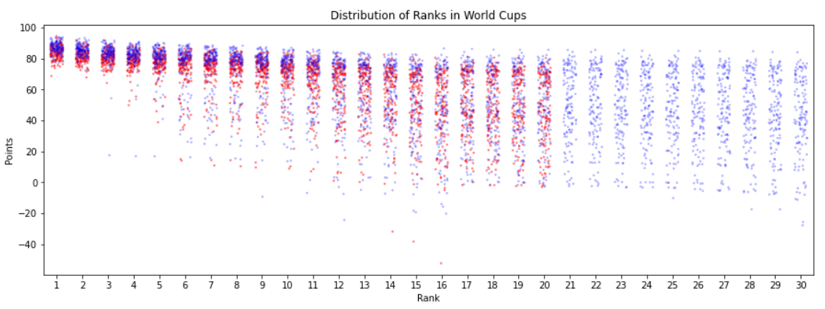
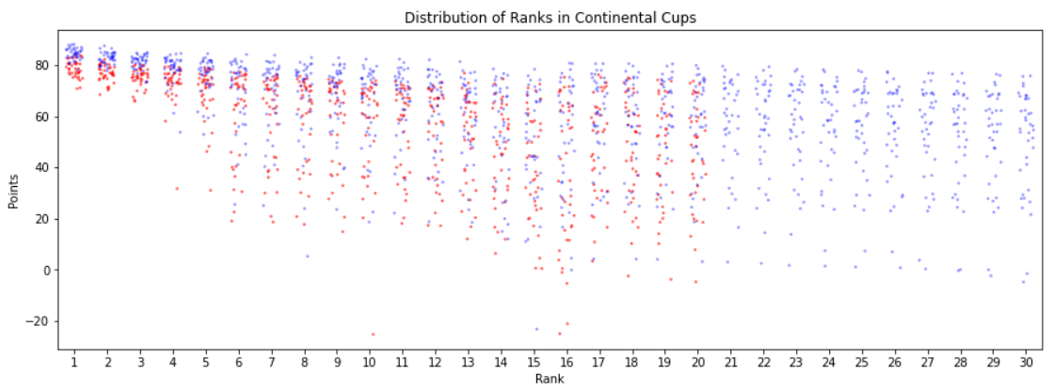
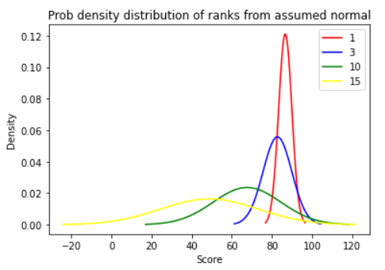
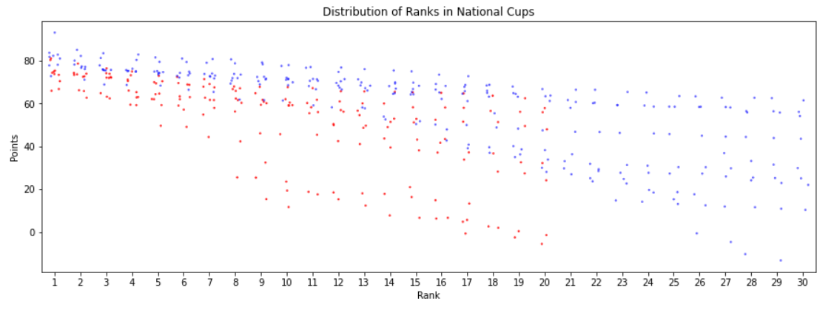
Novel Competition point system in Mogul skiing
${Saurav Chowdhury}^{1,2}$, ${\text{Ming}\text{−}\text{Chang} \text{Tsai} \text{PhD}}^{1}$
$^{1}$Canadian Sport Institute Pacific, Victoria, British Columbia,$^{2}$University of British Columbia, Vancouver, British Columbia
Introduction
OBJECTIVE: To develop a novel rating system for mogul skiing to compare performance across the three levels of competition.
Analysis across levels: 101 players who played both levels in the same season were considered. Linear mixed model was developed with level of competition as fixed and season as random effect on intercept. From the difference in intercepts of any two levels, a calibration factor was determined. This was added to the adjusted scores to make them comparable across all levels.
Conclusions
Mogul skiing is one of the disciplines in freestyle skiing. It consists of moguls and jump features where scores (out of 100) are awarded by judges for technical quality of skier’s turns (50%), aerial maneuvers (25%) and speed (25%). Final rankings are determined based on the judging scores and FIS points are awarded accordingly. Same FIS points are given to the same competition ranking irrespective of the levels of competition (world cup, continental cup and national cup) and the competitiveness of the participating athlete which can influence the final ranking. Therefore, an unbiased point system is needed to allow us to fairly compare performance/rankings between different levels of competition in competitive mogul skiing.
This novel rating system provides an unbiased score that allows for comparisons between any levels of competition in moguls. It is much more robust than the current system of athlete ratings. With addition of new information every year, this model can update all the scores automatically. Although it has been developed for moguls but the same data pipeline can be applied to any other disciplines of skiing as well. This opens the avenue for comparison of player performance across various disciplines directly from the final ratings given they are scored in the same scale. Further improvement can be done with better choice of distributions and more data for cross level mixed models.
Methods
Approach: A normal distribution was assumed for all scores at a given rank for a particular level of competition. These scores were adjusted higher or lower based on the median score for that rank. Once these adjustments were made, calibration between levels were done using linear mixed models.
Data: Competition results from World Cup (n=140), Continental Cup (n=38) and National Cup (n=10) (2002-2019) were considered. Scores and ranking information were analyzed to identify the top 30 ranks in mens and top 20 ranks in womens across qualifying and final rounds of a competition to ensure uniform sample size of scores and ranks for each competition.
Analysis within a level: The actual field scores(FS) were grouped into its corresponding ranks(1-30 for men, 1-20 for women). From a normal distribution within each group, the z-score(Z) were determined corresponding to the actual scores. The adjusted scores (AS)(AS = FS * Z/0.5) was computed. This formula inflates the scores above median and vice-versa
Results and Discussion
Normalizing the scores for all the ranks allowed comparison across athletes within the same level for men and women separately. From linear mixed models, it was found that the scores for world cups was higher than continental cups by 21.47 and higher than national cups by 27.86 for men. For women, they were 49.65 and 64.10 respectively (p < 0.01). This result is consistent with the fact that an athlete tends to perform better and score higher when the level of competition is high. Therefore the scores of world cups is always higher than continental or national cups for the same athletes.
Women
Practical Applications
Men
This rating system can be used to gauge performance of any athlete over time and across all levels of competition.
A dashboard built on top of this model can provide information on athlete performance for any specific country, season or competition. It can also be used to compare multiple athlete.
Further research and data is required to precisely the relation between each level of competition.
Figure 1. Distribution of scores across ranks for World Cups*.
Women
Men
Figure 2. Distribution of scores across ranks for Continental Cups*.
Women
Men
Figure 3. Distribution of scores across ranks for National Cups*.
Figure 4. Assumed normal distribution of ranks from which Z is computed
References
1. https://www.fis-ski.com/DB/freestyle-freeski/fis-points-lists.html
*Note : Negative values are result of uniform sampling across all competitions

