Slide 1



Product Management & Data-Driven Solutions For Industrial Water Management
Jaypee University of Information Technology
Department of Computer Science and Engineering and Information Technology
Major Project - I (18B19CI791) | AY 2025-26
End-Term Evaluation | December 2025.
Group No.: IG21
Team Member
Saurav Kumar (221030345)
Supervisor
Name: Ms. Palak Aar
Designation: Assistant Professor (Grade-I), Department of Computer Science & Engineering and Information Technology

Slide 2
Outline
Introduction
Problem Statement
Objectives
Literature Review
Work Done (after Mid-Term Evaluation)
Project Design and Development
Tools andTechnologies
Data Sources and Field Inputs
Implementation
Experimental Results and Evaluation
Client Engagement and Business Analysis
Key Learnings
Work Contribution and Attendance
Supervisor Interactions
Future Work
Project Plan
References

Slide 3
Introduction
Project Title: Product Management & Data-Driven Solutions for Industrial Water Conservation.
Internship Organisation: FluxGen Sustainable Technologies Pvt. Ltd., a clean-tech organization providing IoT-based industrial water intelligence solutions.
Role: Product Management Intern.
Project Context:
  Contributing to the development of FluxGen’s industrial water-intelligence platform.
  Conducted field studies across multiple industries to analyze water usage, losses, and operational gaps.
  Worked on product workflows including offline data sync, leakage detection logic, and dashboard features.
  Performed in-depth flowmeter benchmarking across multiple parameters.
  Developed PRDs, user stories, and requirement mappings to support product planning and decision-making.

Slide 4
Problem Statement
Water Losses: Industries face significant untracked water losses and inefficiencies.
Data Gaps: Sensor downtime and offline periods lead to missing or unreliable data.
Low Visibility: Decision-makers lack real-time insights for monitoring consumption trends.
Meter Issues: Inconsistent meter performance affects accuracy and reporting.
No Detection Logic: Absence of structured leakage identification leads to delayed action.
Fragmented Workflow: Field realities are not translated into product features.

Slide 5
Objectives
Field Understanding: Conduct site visits and observe sensor deployment.
Client Data Analysis: Evaluate industrial water usage trends and inefficiencies through detailed datasets.
Product Documentation: Create PRDs, mockups, interview insights, and user stories for feature planning.
Strategic Research: Explore remote sensing, catchment intelligence, and water insights.
Client Engagement: Support key accounts with dashboard setup, and ongoing analysis to understand usage trends and inefficiencies.
Flowmeter Evaluation: Benchmark flowmeters across accuracy, stability, and field performance parameters.
System Reliability: Design offline data-buffering flows and leakage-detection logic for zero-loss monitoring.

Slide 6
Literature Review
S. No. | Platform/Concept Explored | Source/Reference (Year) | Tools/ Techniques | Key Findings/ Insights | Limitations/ Gaps Identified
1 | Rainwater harvesting, treatment & analytics | Raimondi et al., 2023 [1] | RWH system assessment, monitoring frameworks, treatment methods | Provides a detailed review of modern rainwater harvesting systems and highlights potential for integrating monitoring + analytics for better water management | Limited evidence of real-time IoT deployments; mostly conceptual review
2 | Rainwater harvesting, treatment & analytics | Raimondi et al., 2023 [2] | RWH system assessment, monitoring frameworks, treatment methods | Provides a detailed review of modern rainwater harvesting systems and highlights potential for integrating monitoring + analytics for better water management | Limited evidence of real-time IoT deployments; mostly conceptual review
3. | Customer handling and review | 20 Customer Service Steps You Need to Succeed In 2024-Invoca (2024) | Communication, Problem Solving | Learn to manage client issues, provide guidance and gather feedback | Requires deeper expertise for large-scale client handling
4. | Material Design 3 (Design principles) | Material Design 3 - Google’s latest open source design system (m3.material.io)(2025) | UI guidelines Component usage | Learned how design consistency improves usability and accessibility | Needs more hands on application

Slide 7
Literature Review (cont…)
S. No. | Platform/Concept Explored | Source/Reference (Year) | Tools/ Techniques | Key Findings/ Insights | Limitations/ Gaps Identified
5. | Types of user interviews | The Ultimate Guide to User Interviews 2025 | Interview Techniques User Testing | Interview Techniques User Testing Learn structured unstructured and contextual inquiry Methods | need more practise in real world interviews
6. | Design System 101 | Lesson 1 : Welcome to design systems Figma Learn (2025) | Design system component Libraries | Understood our design systems create scalable, cohesive experiences | Long term practice required to build and maintain systems
7. | Product Management | Top 200+ Product Management Articles 2024: Essential Reads for PM Success(2024) | Roadmapping, prioritization frameworks | Understood how to align product goals with customer needs | Needs more real-world exposure
8. | Product Analysis | Product Analysis in 2024: Ultimate Guide - TechMagic (2024) | Data Analysis, dashboard design | Gained skills in identifying patterns, improving usability | Advanced analytical expertise yet to be developed

Slide 8
Work Done (after Mid-Term Evaluation)
ASV Contribution: Supported analysis for autonomous surface vehicle data validation and prepared inputs for the ISRO/NRSC collaboration deck.
Hospital Audit: Conducted a detailed block-wise water usage study for a major multispecialty hospital and identified key inefficiency points.
Flowmeter Benchmarking: Expanded the comparison study by adding new technical, operational, and field parameters to improve meter selection decisions
Offline Sync Flow: Designed the complete offline storage hierarchy and sync process to ensure zero data loss during connectivity failures.
Leakage Detection Logic: Developed rule-based conditions and threshold patterns to detect abnormal flows and leakage signatures.

Slide 9
Product Design & Development
System Understanding: Mapped how industrial flowmeters, gateways, and cloud components interact within the water-monitoring setup.
Data Workflow Design: Structured the complete data path, from meter readings to preprocessing, validation, aggregation, and reporting.
Offline Functionality: Designed a reliable offline buffering mechanism and a state-machine sync protocol to prevent data loss during outages.
Leakage Detection Logic: Built a rule-based detection framework using temporal thresholds to flag abnormal continuous flow patterns.
Flowmeter Benchmarking: Evaluated multiple meter types across accuracy, stability, installation constraints, and field performance.
Feature Development: Contributed to volumetric savings calculations, KPI definitions, and alert/notification flows for dashboard improvement.

Slide 10
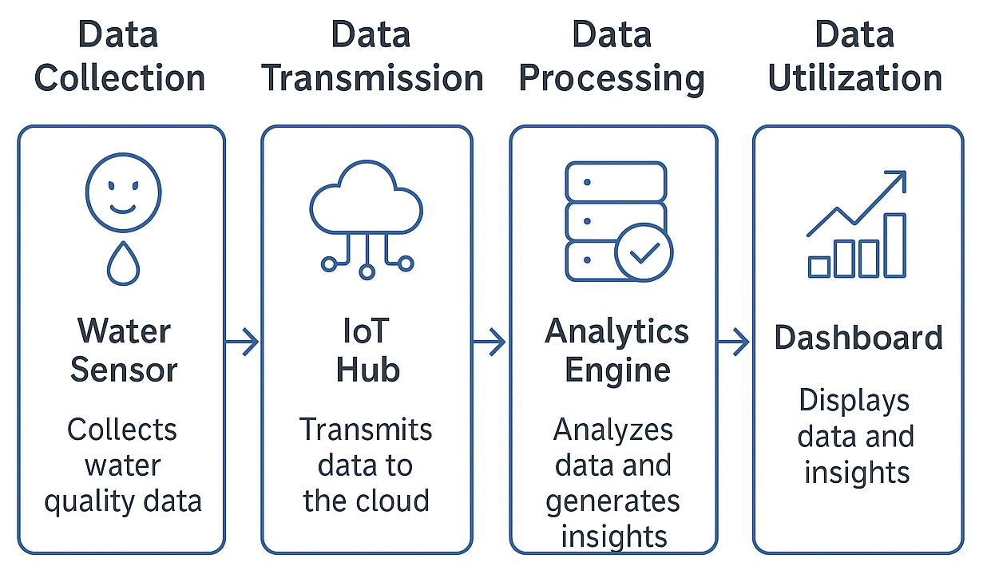
Product Design & Development (cont…)
End-to-End Water Intelligence Architecture

Slide 11
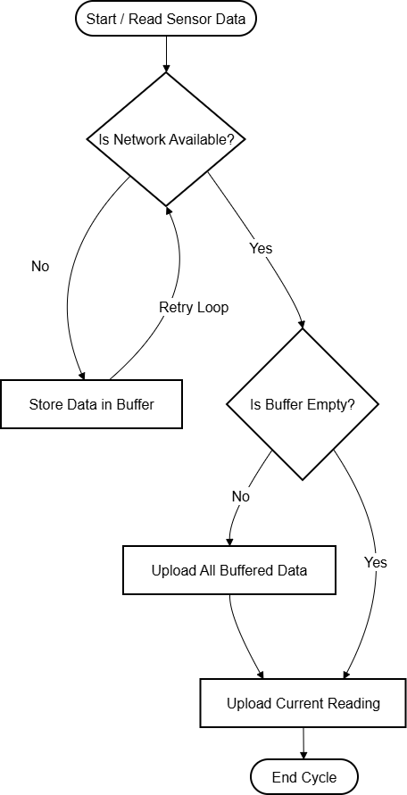
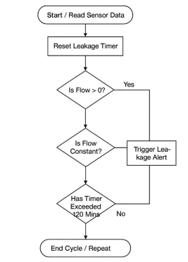
Product Design & Development (cont…)
Offline data-sync Flow Diagram Leakage detection Flow diagram

Slide 12
Tools, Technologies and Languages
Hardware & IoT: AquaGen devices, industrial flow/pressure sensors (LPM), IoT gateways, LoRaWAN/NB-IoT modules, field diagnostic tools.
Data Analysis: Excel, Google Sheets, and internal dashboards.
Logic & Design: Lucidchart, Excalidraw, Draw.io and Notion for State-machine modelling, pseudo-code design, and rule-based logic formulation.
Dashboard: Figma, FigJam and Miro for wireframes and UI Mockups
Cloud: Azure IoT Hub, backend data pipelines for validation, aggregation & event logic.

Slide 13
Tools, Technologies and Languages (cont...)
Documentation: Google Docs, Confluence-style structured documents for PRDs and user stories.
Presentation: Google Slides / PowerPoint for product flows, client insights, and the ISRO/NRSC collaboration deck.
Project Management: Jira / Agile workflows for task tracking
Communication & Collaboration: Slack, Email, and internal client call tools.

Slide 14
Data Sources and Field Inputs
Industrial Flow Data: Continuous readings from flowmeters installed across multiple industrial facilities.
Gateway Logs: Preprocessed values, timestamps, and event markers generated at the edge.
Audit Records: On-site observations, block-wise consumption logs, and operational insights from facility visits.
Historical Usage Data: Daily and monthly usage reports provided by client teams for trend validation.
Anomaly Patterns: Field-observed flow behaviors used to model leakage thresholds and rule logic.

Slide 15
Implementation
Requirement Structuring: Converted client needs and audit findings into actionable workflows using structured documentation tools (Docs, Sheets).
Logic Development: Designed pseudo-code, decision flows, and threshold rules for offline buffering, leakage alerts, and savings metrics .
Data Handling Process: Validate readings using internal dashboards, and test rule behaviour, and verify data transitions across offline → sync → cloud stages.
Cross-Functional Execution: Worked with teams to align logic with gateway behaviour, sync states, and backend pipelines .
Deliverable Preparation: Created PRDs, comparison matrices, sync specifications, and process diagrams to support the technical implementation.

Slide 16
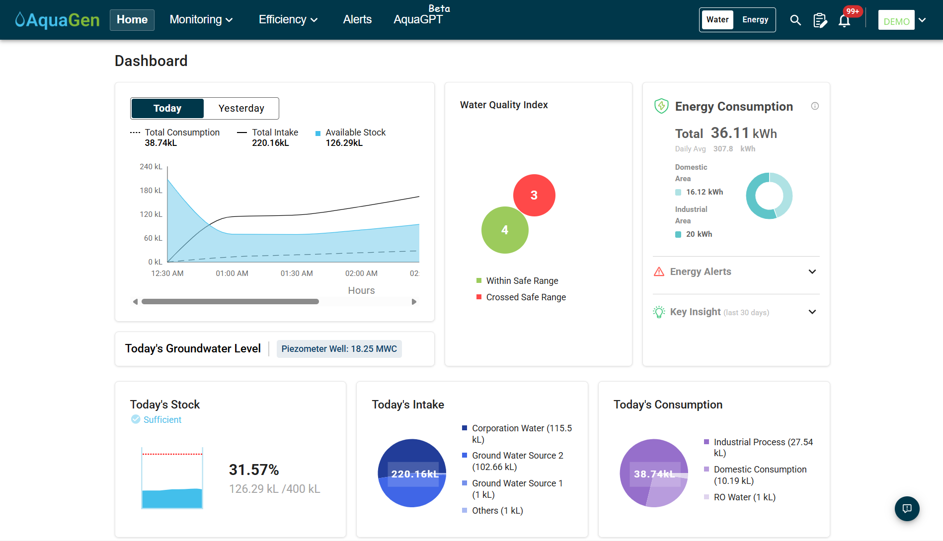
Implementation
AquaGen Demo - User Dashboard

Slide 17
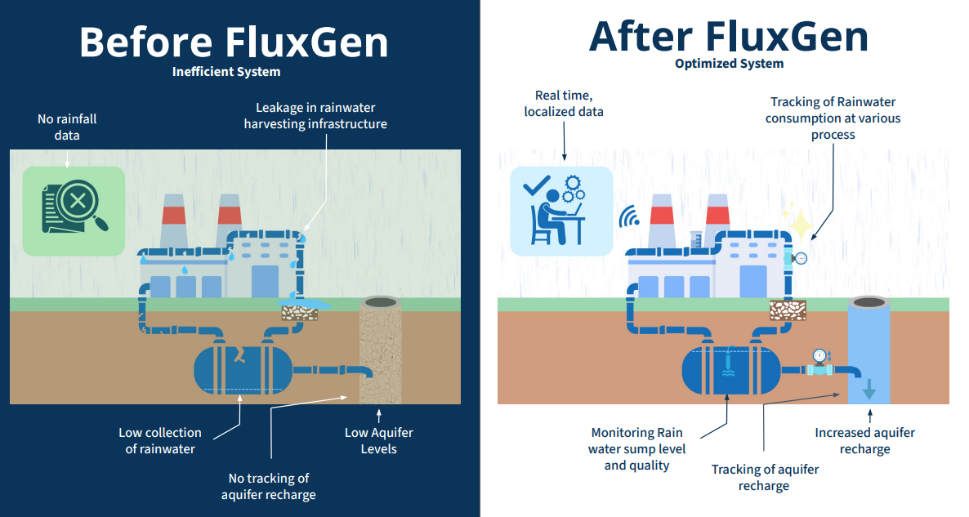
Experimental Results and Evaluation
Comparison (Before vs After)
Before:
Manual logging, no early leak detection, poor visibility, slow audits.
After:
AI alerts, real-time dashboards, automated reporting, measurable savings.
Comparison (Before vs After)

Slide 18
Client Engagement and Business Analysis
Water Efficiency Impact: Helped multiple industrial clients monitor usage patterns and supported them in achieving targeted reductions in overall water consumption.
Operational Insights: Identified high-consumption zones, inefficiencies, and anomalies through block-wise and trend analysis, enabling data-driven decision-making.
Usage Optimization: Supported clients in defining appropriate daily/monthly limits and KPI thresholds, improving the visibility and control of their water operations.
Performance Reporting: Delivered clear summaries highlighting savings opportunities, abnormal flow behaviours, and corrective actions for on-ground teams.
Improved Monitoring Practices: Enabled clients to adopt structured tracking methods through refined dashboards, alerts, and periodic analysis updates.

Slide 19
Key Learnings
Product Management: Defining requirements, structuring feature logic, and aligning product decisions with client needs and business goals.
Data & Technical Design: Designing data flows, state-machine logic, and write pseudo-code-level specifications for reliable offline sync and rule engines.
IoT Understanding: Gained exposure to flowmeters, gateways, connectivity issues, and offline device behavior.
Data-Driven Analysis: Convertng complex flow data and field observations into clear insights, metrics, and actionable recommendations.
Communication & Collaboration: Stakeholder interactions and cross-functional work with engineering and field teams to validate and deliver features.
Professional Growth: Enhanced documentation, research, and problem-solving skills while contributing to real industrial deployments.

Slide 20
Work Contribution and Attendance
GitHub Repository URL: https://github.com/saurav2208/MP_IG21.git
Team Member | Roll No. | Work Done (provide complete details) | Work Contribution (%) | Lab Attendance (%)
Saurav Kumar | 221030345 | Performed competitive benchmarking, operational audits, and business analysis across multiple industrial sites to identify usage patterns, inefficiencies, and improvement opportunities. Conducted in-depth interviews with industrial stakeholders to understand their challenges and workflows. These insights formed the foundation for creating user stories and shaping feature requirements. Contributed to the product design process by creating a detailed Product Requirements Document (PRD), wireframes, and design mockups for a dashboard feature focused on volumetric water savings. Analyzed large datasets from industrial facilities to identify water-usage trends, block efficiencies, and anomalies. These findings were compiled into structured reports used for decision-making and optimisation. Created a strategic research presentation on integrating remote-sensing and catchment-level intelligence, exploring future possibilities in collaboration with ISRO/NRSC. Developed pseudo-code, state-machine flows, and rule logic for critical features such as offline data buffering and leakage detection, supporting the engineering team in implementation. | 100%

Slide 21
Supervisor Interactions (as mentioned in weekly log)
No. of Meetings with Supervisor:
Week No. | Duration | Remarks (as mentioned in the weekly log) | Incorporated (Yes/No)
1. | 15/09/2025 to 21/09/2025 | Initiated competitive analysis work Understood dashboard feature landscape Identified initial differentiation areas | Yes
2. | 22/09/2025 to 28/09/2025 | Completed competitive analysis findings Conducted first field visit for sensor understanding Validated physical deployment insights | Yes
3. | 29/09/2025 to 05/10/2025 | Performed detailed data analysis Drafted initial PRD and mockups Identified usage trends and anomalies | Yes
4. | 06/10/2025 to 12/10/2025 | Finalized comprehensive analysis report Began customer interview evaluations Extracted key requirement insights | Yes
5. | 13/10/2025 to 19/10/2025 | Created structured user stories Started direct client support Configured usage limits and dashboard setup | Yes

Slide 22
Supervisor Interactions (cont…)
Week No. | Duration | Remarks (as mentioned in the weekly log) | Incorporated (Yes/No)
6. | 20/10/2025 to 26/10/2025 | Managed multiple ongoing client accounts Delivered recommendations to improve efficiency Completed strategic remote-sensing research | Yes
7. | 27/10/2025 to 02/11/2025 | Conducted catchment-level intelligence research Explored industrial evaporator technologies Prepared insights for future product direction | Yes
8. | 03/11/2025 to 09/11/2025 | Executed hardware comparison of flowmeters Scoped offline storage logic Documented early workflow considerations | Yes
9. | 10/11/2025 to 16/11/2025 | Finalized flowmeter comparison report Developed state-machine and pseudo-code logic Completed offline buffering system concept | Yes
10. | 17/11/2025 to 23/11/2025 | Built leakage detection backend logic Designed alerting mechanism and flow Created complete offline sync pseudo-code | Yes
11. | 24/11/2025 to 30/11/2025 | Documented full offline sync protocol Finalized UX and notification workflow Started final report drafting | Yes

Slide 23
Future Work
Leakage Detection Enhancement: Improve thresholds and multi-parameter rules for higher accuracy.
Field Validation: Test the improved leakage rules across additional industrial sites to validate behavior under different operational conditions.
Alert Optimization: Enhance the alert flow by improving notification logic, user visibility, and escalation paths based on client feedback.
Pattern Learning: Use historical trends to reduce false alerts.
Advanced Water-Energy Optimization: Explore integrated models for combined resource efficiency.
Cross-Plant Benchmarking: Develop AI-driven comparisons and automated decision recommendations.

Slide 24
Project Plan
Week | Strategic Activities
1 | Conducted competitive benchmarking of the Aquagen1 dashboard against global ESG platforms.
2 | Site visit to St. Martha Hospital to validate sensor deployment infrastructure and identify wastage points.
3 | Deep-dive data analysis for industrial client (AL Tasnim); Drafted initial requirements for "Savings" feature.
4 | Qualitative analysis of customer interviews (Mahindra/Ashok Leyland) to define user pain points.
5 | Translated qualitative data into actionable User Stories; Initiated direct management clients.
6 | Managed healthcare accounts; Authored strategic presentation on Remote Sensing & ASV collaboration.
7 | Research on scaling water intelligence to the Suvarnamukhi Catchment; Evaluation of industrial evaporators.
8 | Technical comparative analysis of Electromagnetic vs. Ultrasonic Flow Meters.
9 | Scoped the state-machine logic for Offline Data Storage to address network instability.
10 | Developed backend logic for Leakage Detection and finalized the Sync Protocol.
11 | Defined UX notification flows; Compiled final documentation and technical specifications.

Slide 25
References
[1] Top 200+ Product Management Articles 2024: Essential Reads for PM Success (2024) https://olvy.co/top-pm-articles
[2] Product Analytics in 2024: Ultimate Guide - TechMagic (2024) https://www.techmagic.co/blog/product-analytics-guide
[3] 20 Customer Service Tips You Need to Succeed in 2024 - Invoca (2024) https://www.invoca.com/blog/customer-service-tips-succeed
[4] Material Design 3 - Google's latest open source design system (2021) https://m3.material.io/
[5] The Ultimate Guide to User Interviews (2024) https://www.looppanel.com/blog/user-interviews
[6] Lesson 1: Welcome to design systems – Figma Learn (2024) https://help.figma.com/hc/en-us/articles/14552802134807-Lesson-1-Welcome-to-design-systems

Slide 26
[7] A. Raimondi, R. Quinn, G. R. Abhijith, G. Becciu and A. Ostfeld, “Rainwater Harvesting and Treatment: State of the Art and Perspectives,” Water, vol. 15, no. 8, p. 1518, (2023). https://doi.org/10.3390/w15081518
[8] H. Y. Teh, A. W. Kempa-Liehr and K. I.-K. Wang, “Sensor data quality: a systematic review,” Journal of Big Data, vol. 7, art. no. 11, (2020). https://doi.org/10.1186/s40537-020-0285-1

Slide 27

Thanks.

