Slide 1
Capstone Project Shop For Home
Team:
Tharun kumar Chinchili
Saurav Kumar
Avula Venkata Mallikarjuna Gagandeep Reddy
Vedapriya M N
Srinivas Mundlamuri

Slide 2
INTRODUCTION
ShopForHome is a popular Store in the market for shopping the home décor stuff .Due to Covid 19 all the offline shopping stopped. So, the store wants to move to the online platforms and wants their own web application.
There are 2 users on the application: -
User
Admin
Online shopping or shopping is a form of electronic commerce which allows consumers to directly buy goods or services from a seller over the internet using a web browser.
It is a B2C process i.e. business to computer ecommerce.
As of 2016 ,customers can shop online using a range of different computers and devices ,including desktop computers, laptops, tablet computers and smartphones.
Online customers must have access to the internet and a valid method of payment in order to complete a transaction.
Online stores are usually available 24 hours a day and many consumers in Western countries have Internet access both at work and at home.

Slide 3
Objectives
Provide visitors a personalized experience.
Make your website responsive
Improve Customer Loyalty
Refine Service Efficiency
Establish Deeper Business Relationships

Slide 4
Online shopping Vs. Traditional Shopping
Online Shopper
I want to buy a dress let’s checkout online.
Easy to find best online stores.
Searching online styles.
I got a best coupon to shop.
Wow, Good discount
Hooray! Got it.
Traditional Shopper
1.I want to buy handbag lets go out find best store
2.Time to find out best store.
3.Oh,I got stucked in traffic
4.I found a shop at least
5.Salesman says no discount.
6.No Home delivery..

Slide 5
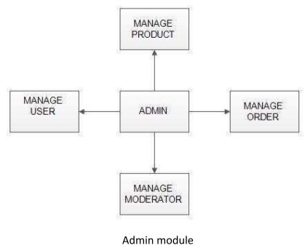
Admin Portal:
The administrator is the super user of this application. Only the admin has access to this admin page. Admin may be the owner of the shop. The administrator has all the information about all the users and about all products. The admin user should be able to: Add or remove different products to or from the application to build a rich product line Edit product item details like name, price, discount, and offers to keep it aligned to the current prices Enable or disable the product items
This module is divided into different sub-modules.
Manage Moderators
Manage Products
Manage Users
Manage Orders

Slide 6
Manage Moderators :
Add Moderator: Only the admin is having the privilege to add a moderator. A moderator can be considered as a staff who manages the orders or owner of a group of products.
Remove Moderator: Admin has the privilege to delete a moderator who was added.
Search moderator: All existing moderators can be viewed by the administrator as a list. If there are a number of moderators and the admin needs to find one of them, the admin can search for a moderator by name.

Slide 7
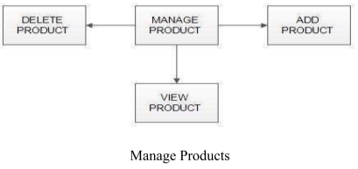
Manage Products
Add Products: The shopping cart project contains different kinds of products. The products can be classified into different categories by name. Admin can add new products into the existing system with all its details including an image.
Delete Products: Administrators can delete the products based on the stock of that particular product.
Search products: Admin will have a list view of all the existing products. He can also search for a particular product by name.

Slide 8
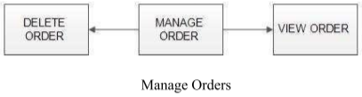
Manage Users
View Users: The admin will have a list view of all the users registered in the system. Admin can view all the details of each user in the list except the password.
● Add Users: Admin has privileges to add a user directly by providing the details.
Manage Orders
View Order: Administrators can view the Orders which are generated by the users. He can verify the details of the purchase.
Delete Order: Admin can delete orders from the orders list when the product is taken for delivery.

Slide 9
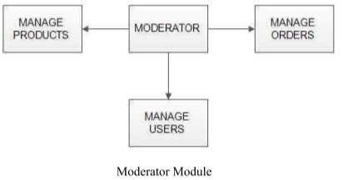
Moderators:
A moderator is considered a staff who can manage orders for the time being. As a future update moderator may give the facility to add and manage his own products. Moderators can reduce the workload of admin. Now moderator has all the privileges an admin has except managing other moderators. He can add products and users.
He can also check the orders and edit his profile.
Manage products
Manage users
Manage orders

Slide 10
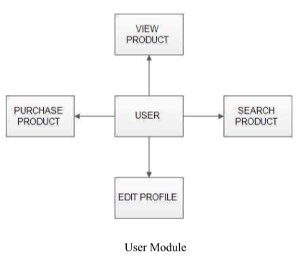
Users Portal
It deals with user activities. The end-user should be able to: Sign-in to the application to maintain a record of activities and Search for product items based on the search keyword. Add all the selected product items to a cart and customize the purchase at the end Perform a seamless payment process Get an order summary details page once the payment is complete

Slide 11
Registration: A new user will have to register in the system by providing essential details in order to view the products in the system. The admin must accept a new user by unblocking him.
Login: A user must login with his user name and password to the system after registration.
View Products: Users. can view the list of products based on their names after successful login. A detailed description of a particular product with product name, product details, product image, and price can be viewed by users.
Search Product: Users can search for a particular product in the list by name.
Add to cart: The user can add the desired product to his cart by clicking add to cart option on the product. He can view his cart by clicking on the cart button. All products added by the cart can be viewed in the cart. Users can remove an item from the cart by clicking remove.
Submit Cart: After confirming the items in the cart the user can submit the cart by providing a delivery address. On successful submitting the cart will become empty.
History: In the history, the user will have a view of pending orders.
Edit Profile: The user can view and edit the profile.

Slide 12
DATA FLOW DIAGRAM
A Data Flow Diagram (DFD) is a structured analysis and design tool that can be used for flowcharting. A DFD is a network that describes the flow of data and the processes that change or transform the data throughout a system. This network is constructed by using a set of symbols that do not imply any physical implementation. It has the purpose of the clarifying system requirements and identifying major transformations. So it is the starting point of the design phase that functionally decomposes the requirements specifications down to the lowest level of detail. DFD can be considered to be an abstraction of the logic of an information-oriented or a process-oriented system flow-chart. For these reasons, DFD’s are often referred to as logical data flow diagrams.

Slide 13
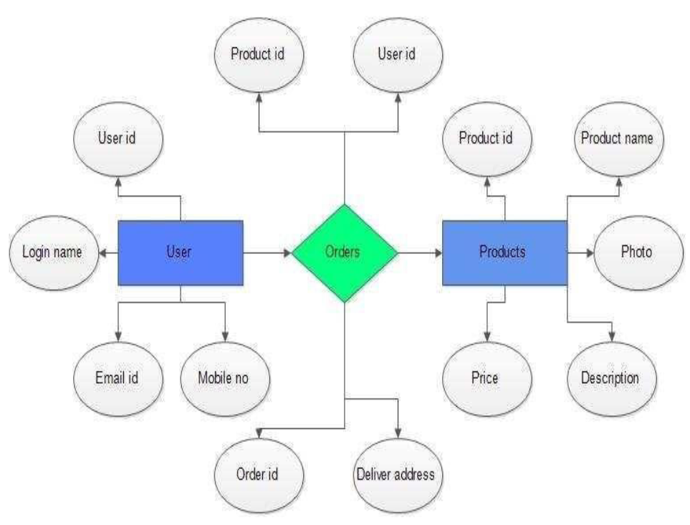

Slide 14
Project Users and Admin Stories
The project is planned to be completed in 2 sprints. Tasks assumed to be completed in the sprint are: Creating the flow of the application and Initializing the git repository to track changes as development progresses. Writing the Java program to fulfill the requirements of the project.

Slide 15
User Stories
As a user, I should be able to login, Logout, and Register into the application.
As a user, I should be able to see the products in different categories.
As a user, I should be able to sort the products.
As a user, I should be able to add the products into the shopping cart.
As a user, I should be able to increase or decrease the quantity added in the cart.
As a user I should be able to add “n” number of products in the cart.
As a user I should be able to get the Wishlist option where I can add those products which I want but don’t want to order now.
As a user I should get different discount coupons.

Slide 16
Admin Stories
As an Admin I should be able to login, Logout, and Register into the application.
As an Admin I should be able to perform CRUD on Users.
As an Admin I should be able to perform CRUD on the products.
As an Admin I should be able to get a bulk upload option to upload a CSV for product details.
As an Admin I should be able to get the stocks.
As an Admin I should be able to mail if any stock is less than 10.
As an Admin I should be able to get the sales report of a specific duration.
As an Admin I should be able to set the discount coupons for the specific set of user

Slide 17
Sprint I Objectives
Create a git repository
Create database schema (all tables along with their relationships)
Create entities in Spring
Create Microservice based structure.
CRUD on Users and Products
Create an eCommerce Template in Angular (Static only) to hold images and product lists.
Develop Search Functionality in Angular
Bulk upload implementation.

Slide 18
Sprint II Objectives
Cart option.
Stock and Sales reports
Create Data Transfer objects
Create repository
Create Service layer logic
Create a Controller to direct the rest API
Create Discount Microservice

Slide 19
System Requirements
CPU: Intel Core or Xeon 3GHz (or Dual Core 2GHz) or equal AMD CPU
Cores: Single (Dual/Quad Core is recommended)
RAM: 4 GB (6 GB recommended)
Graphic Accelerators: nVidia or ATI with support of OpenGL 1.5 or higher
Display Resolution: 1280×1024 is recommended, 1024×768 is minimum.

Slide 20
Tools used
Eclipse 2021-12
MySQL Workbench
Spring Boot
MySQL
Jdk 11
Vscode

Slide 21
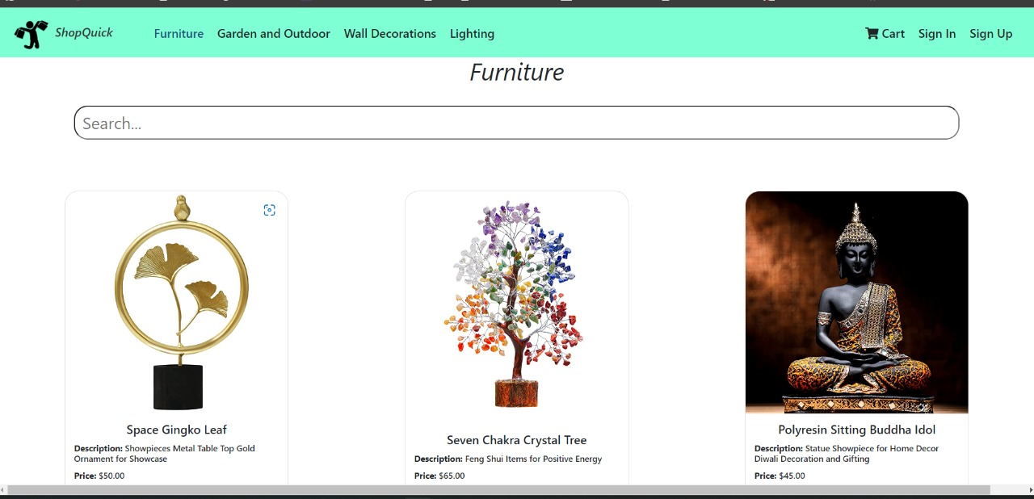
Screenshot
Welcome page

Slide 22
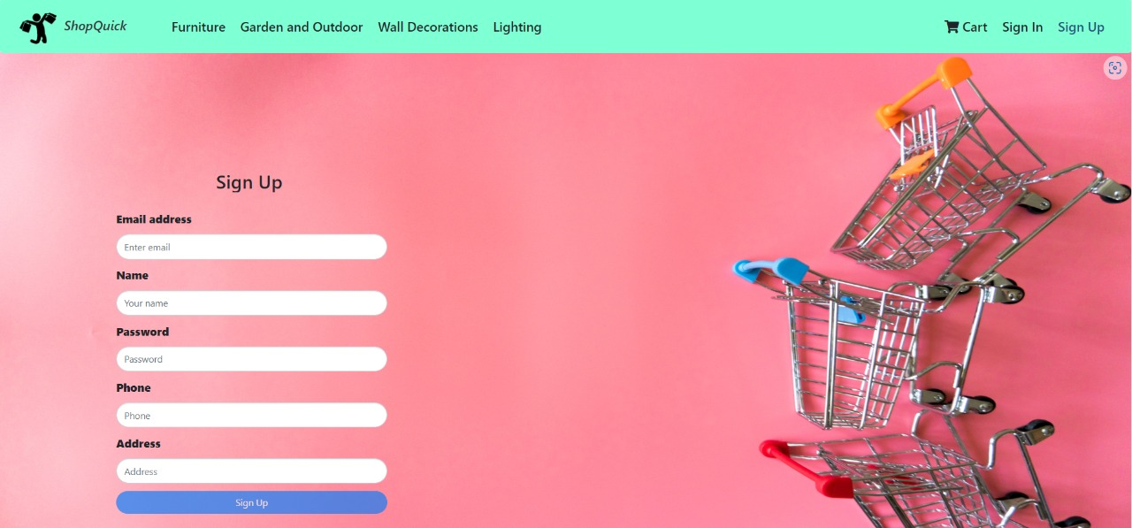
Signup page

Slide 23
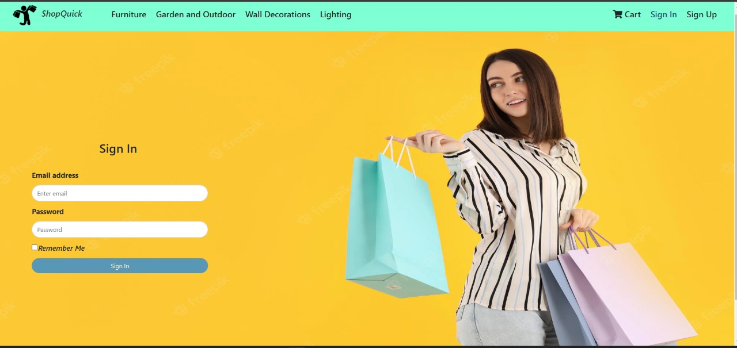
Sign-in page

Slide 24
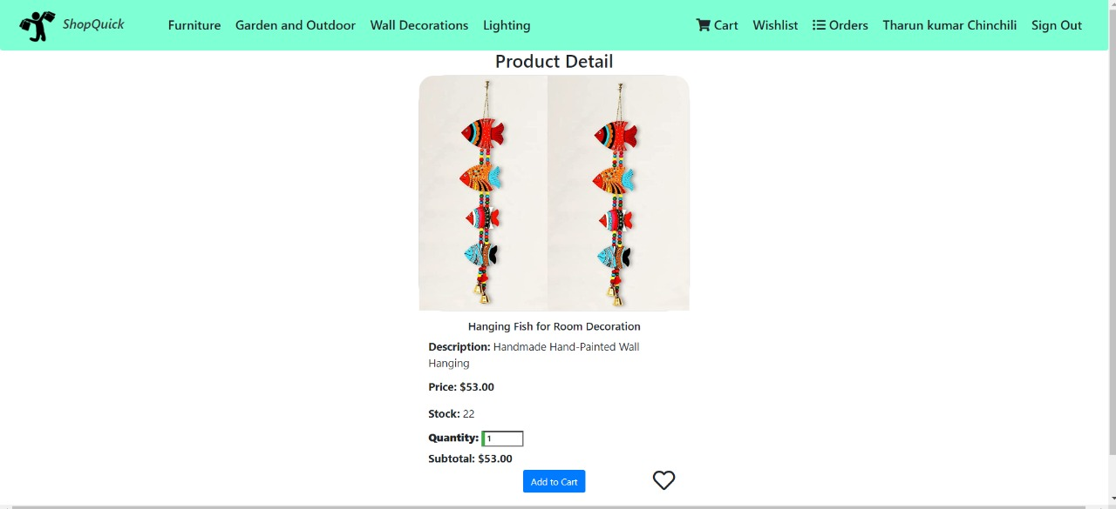
Product details page

Slide 25
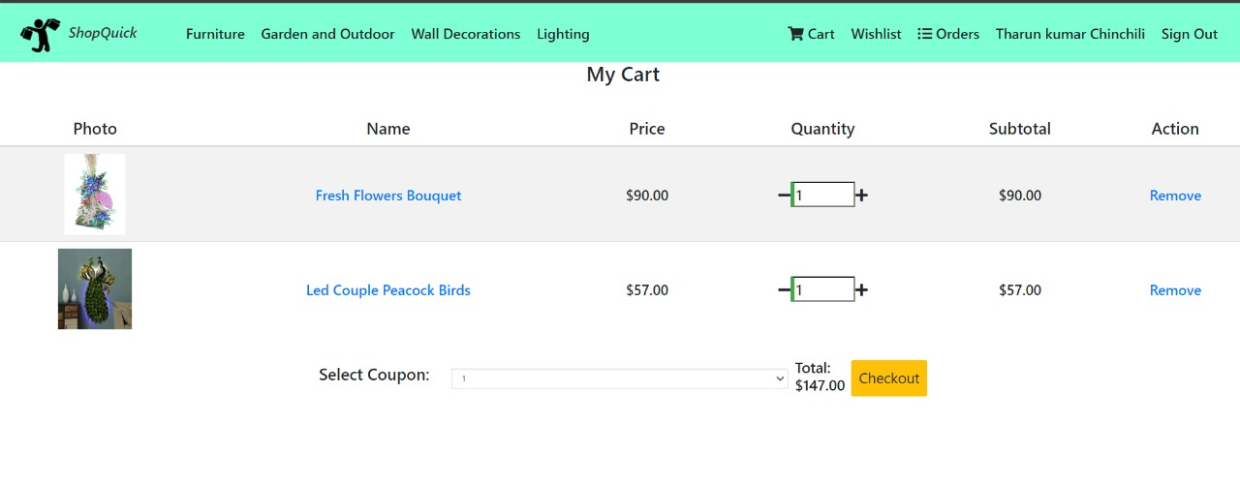
Cart page

Slide 26
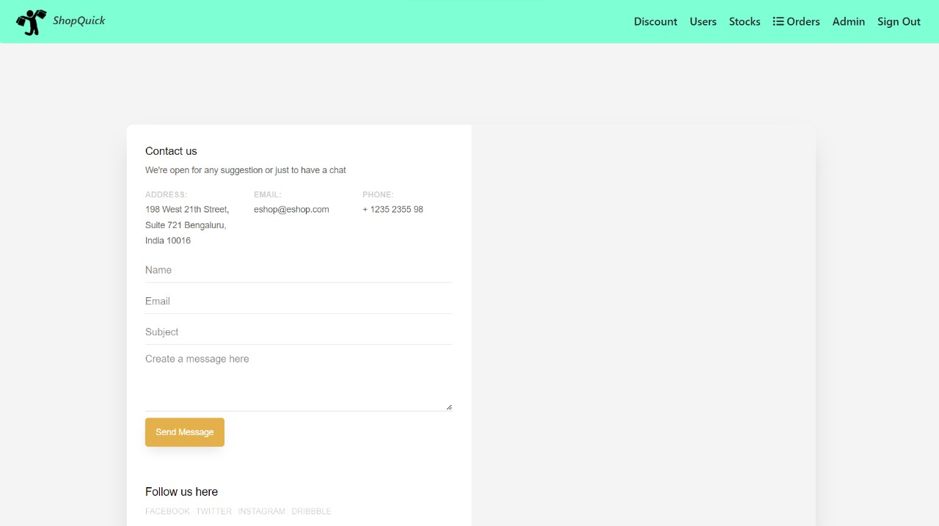
Contact page(when stock <10)

Slide 27
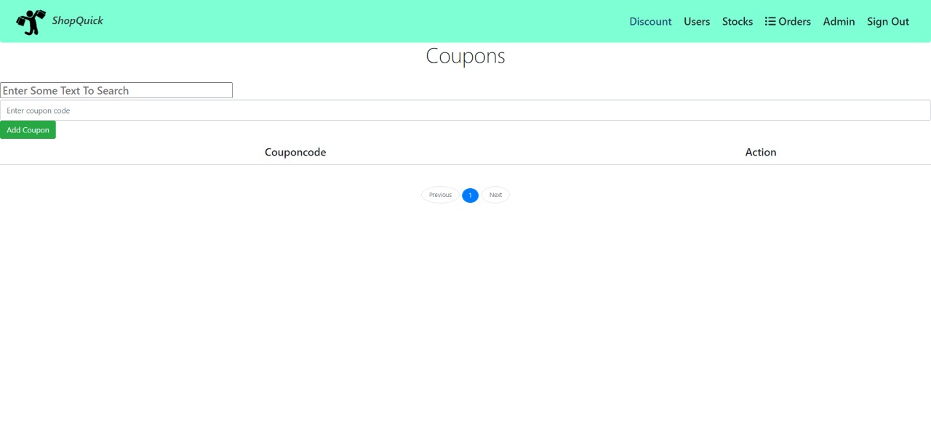
Coupons page

Slide 28
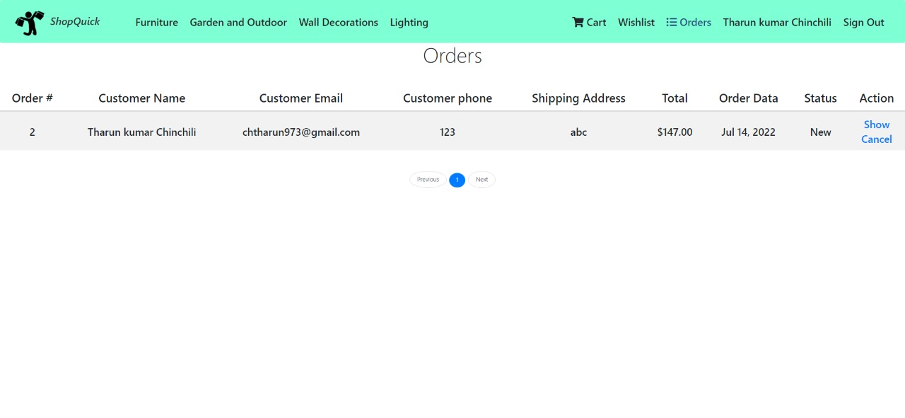
Orders page

Slide 29
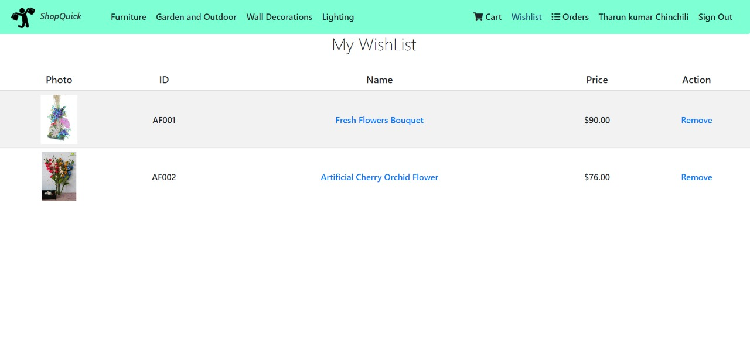
Wishlist page

Slide 30
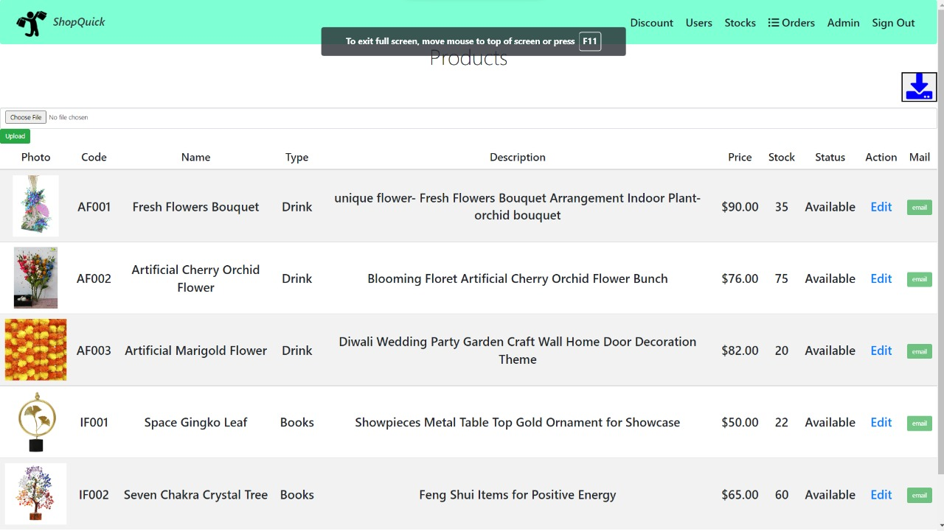
All products page(can add bulk product)

Slide 31
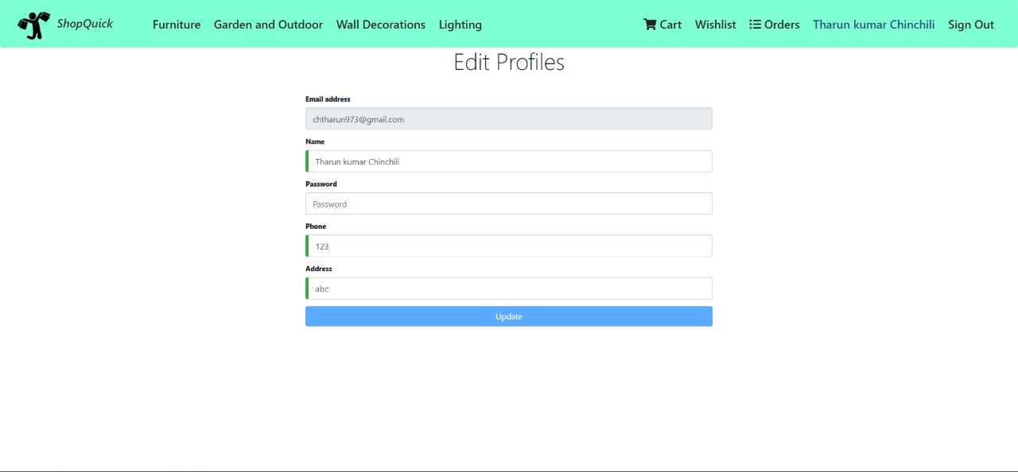
Edit profile page

Slide 32
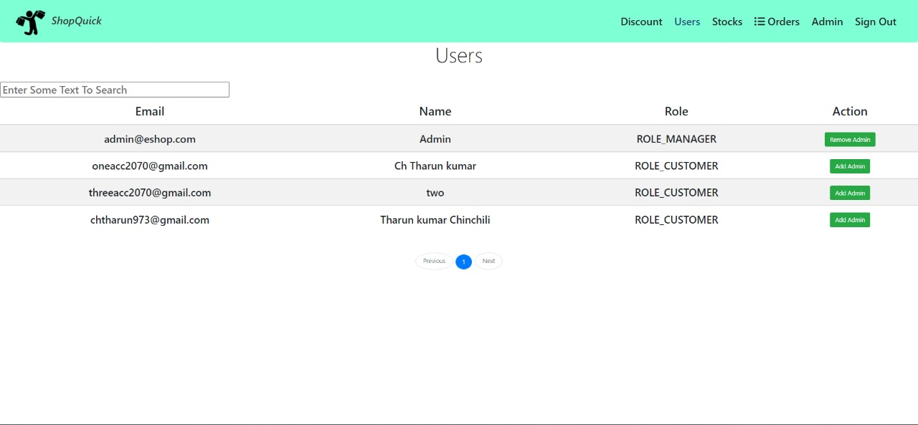
All users page

Slide 33
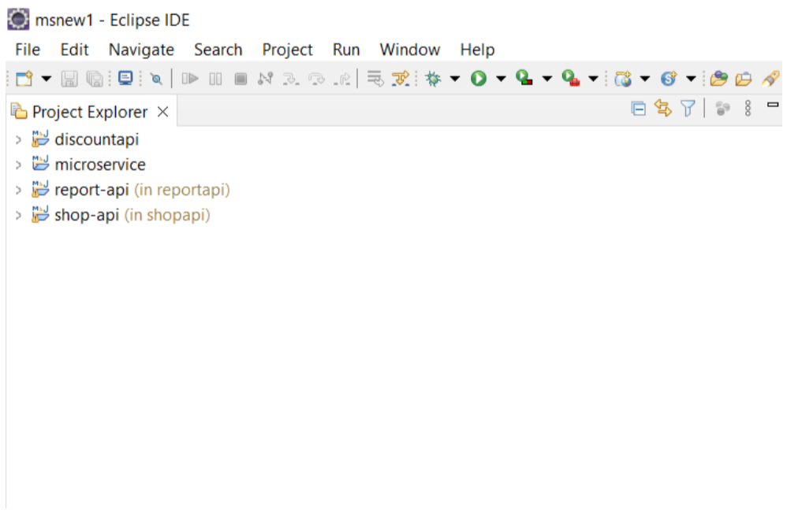
Microservices Structures:

Slide 34
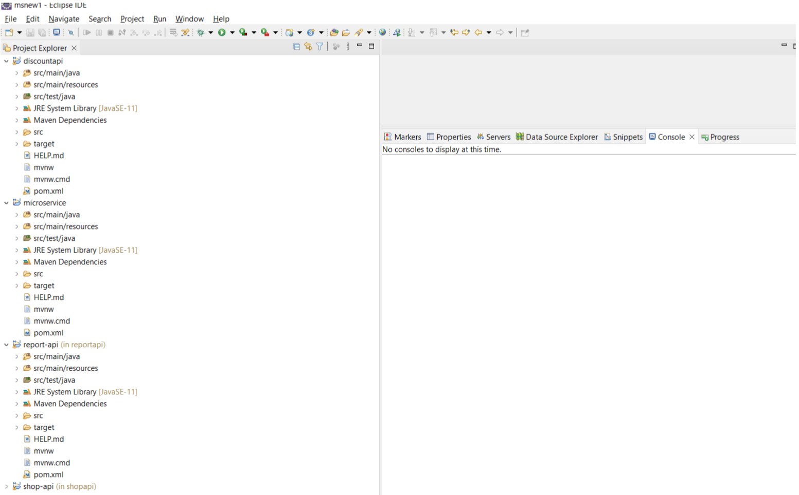

Slide 35
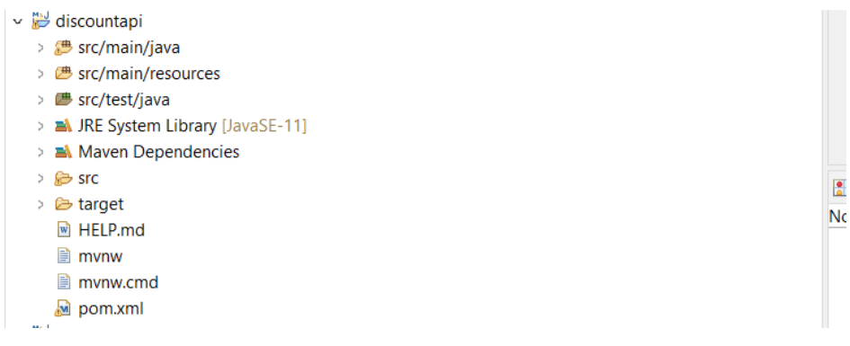
Discount MicroService

Slide 36
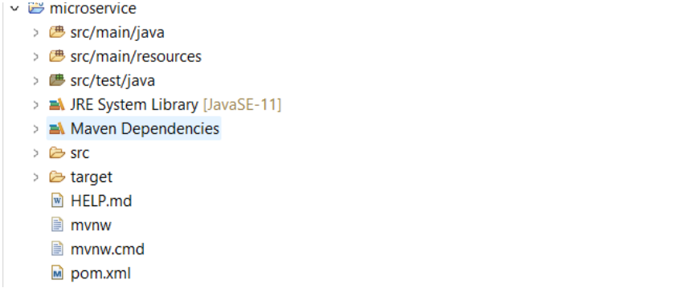
MicrosService

Slide 37
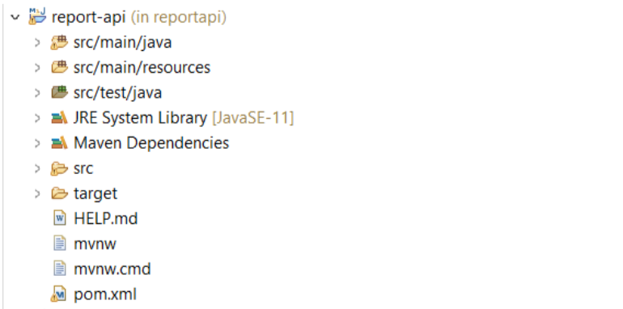
Report MicroService

Slide 38
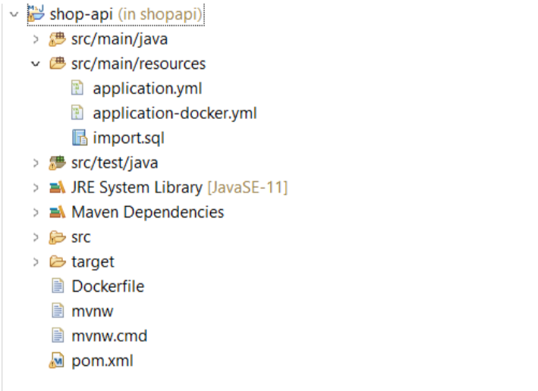
Shop MicroService

Slide 39
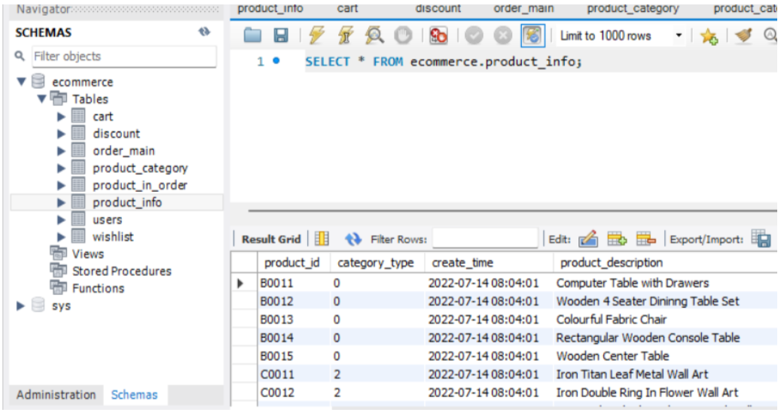
DataBase Tables:

Slide 40
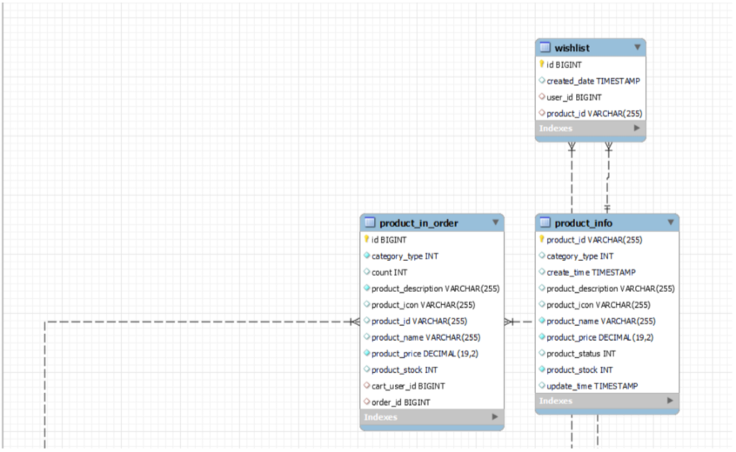
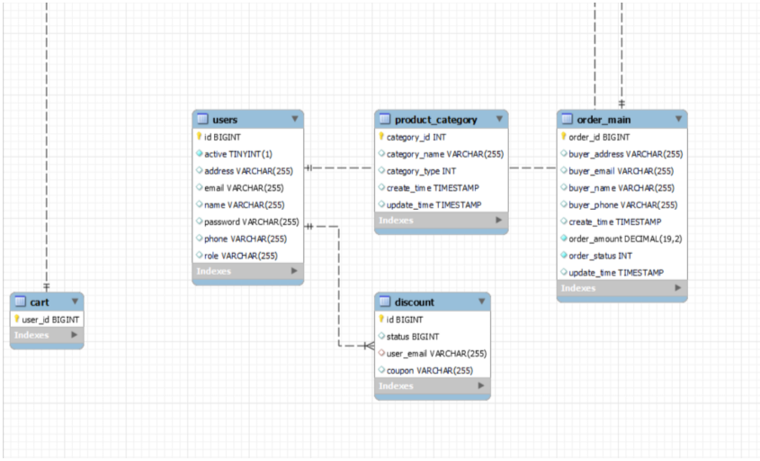

Slide 41
Unique Selling Points of the Application
The application is designed to keep on running and taking user inputs even after exceptions occur. To terminate the application, an appropriate option needs to be selected.
With this application, one can easily access the product items as their own by adding a cart.
Total price is also determined by its own.
Any user can sign up and there are no restrictions.
Online payment is also accepted.

Slide 42
Future Scope
Social networking sites facilitate the purchasing of products from the comfort of our homes, offices, or anywhere with easy login.
As internet use has increased, the eCommerce business has also witnessed a sudden flourishing with it. This leads to an understanding that the internet has influenced the broadening of eCommerce businesses to a considerable proportion. So, we may expect the blooming of in near future in connection with the rise in internet usage.
Also, eCommerce has made the transportation of goods and services between consumers and online shops an effortless task. It even offers customers a tension-free environment to customers and makes their purchases more smooth.

Slide 43
Pros…
Can shop for 24*7.
No need for cash in hand.
A lot of stores within a click away.
Comparison is easy.
No queue to wait.
Shopping Privacy.
Regular discount coupons available

Slide 44
Cons
Not able to touch or ty.
Shipping and handling cost is more.
Credit/Debit card insecurity.
Take much time if connection is slow.
Returning goods is difficult.
Actual product may differ.
Availability of internet is a must.

Slide 45
Tips For Protection
Secured sites should be used.
Spams should be avoided.
Keep password private.
Read privacy and security policy carefully.
Consider alternative payment method.
https:// should be preferred.

Slide 46
Conclusion
It is an user friendly application and promotes user to purchase and shop faster.
With new technology comes better way of doing things.
Being able to buy anytime anywhere.
Allows to place order before purchasing.
Home delivery - you don’t have to travel to shops.
Widespread effects on economy and e-commerce.

