Slide 1

Power Electronics for Renewable Energy Systems EE661 : Course Project
Average current Mode control of Buck Converter
Presented by:
Kashib khan (254102505)
Saurav Kr Yadav (254102112)
Under the supervision of
Dr.Shabari Nath
Electronics and Electrical Engineering Department
Indian Institute Of Technology, Guwahati- 781039

Slide 2
OVERVIEW
• Buck Converter
• Modelling Approach
• Need for control
• ACMC of Buck converter
• Block Diagram of ACMC
• Circuit Diagram of ACMC
• MATLAB Circuit Simulation
• Results
• Applications
• Advantages
• Limitations
• Reference

Slide 3
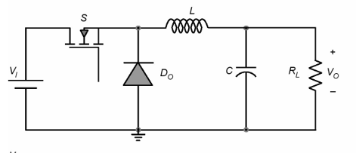
Buck Converter
A buck converter is a type of DC–DC power converter that steps down (reduces) a higher DC voltage to a lower DC voltage efficiently.

Slide 4
Modelling Approach
• A buck converter switching system (nonlinear) To design controllers, we convert it into a Linear small-signal model using a small-signal averaging technique to simplify switching behavior for control design.
• Transfer functions from Buck converter such as vo/d and iL/d are derived to analyze system dynamics.
• Non-idealities are included to ensure the realistic and accurate modeling of Buck converter

Slide 5
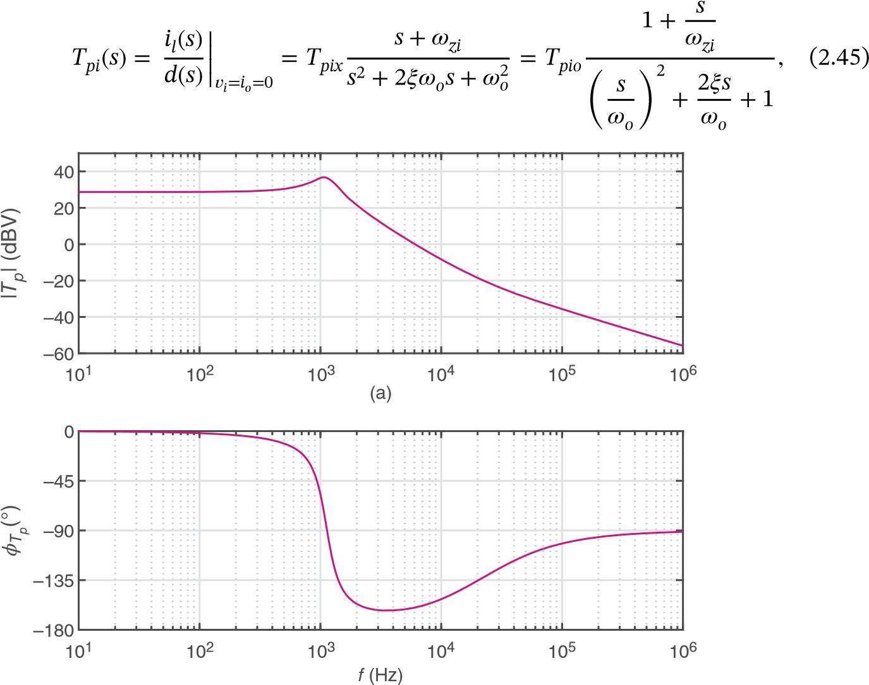
Need for Control
Before compensation : Causes low phase margin, Leads to oscillations or ringing, System may even become unstable, Output voltage does not settle quickly, Resonant peak occur, also due to non-idealities output doesn’t follow reference voltage.
: Bode-plot of duty cycle to output voltage transfer function

Slide 6
ACMC of Buck Converter
Average Current Mode Control (ACMC) is a control technique in which the average value of the inductor current is regulated using an inner current loop, while the output voltage is regulated using an outer voltage loop. Because of the buck converter is a second-order system, direct voltage control is difficult, so ACMC is used to improve stability which enhance dynamic response.

Slide 7
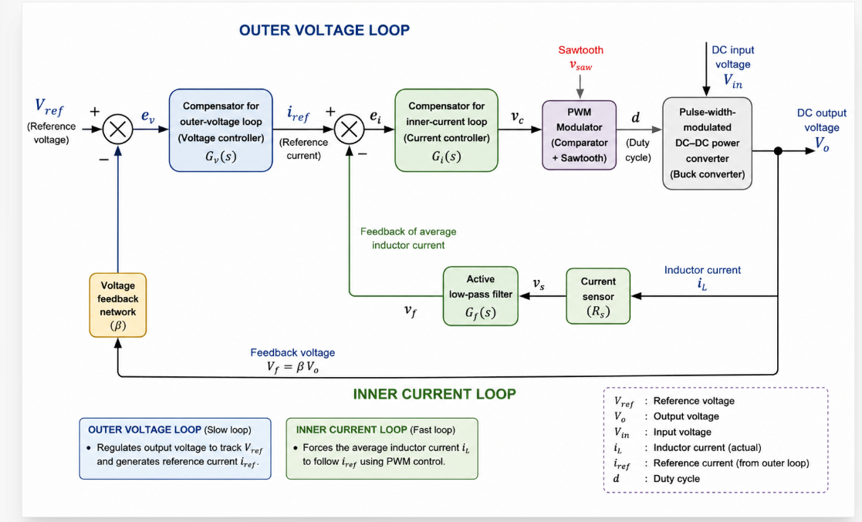
Block Diagram of ACMC

Slide 8
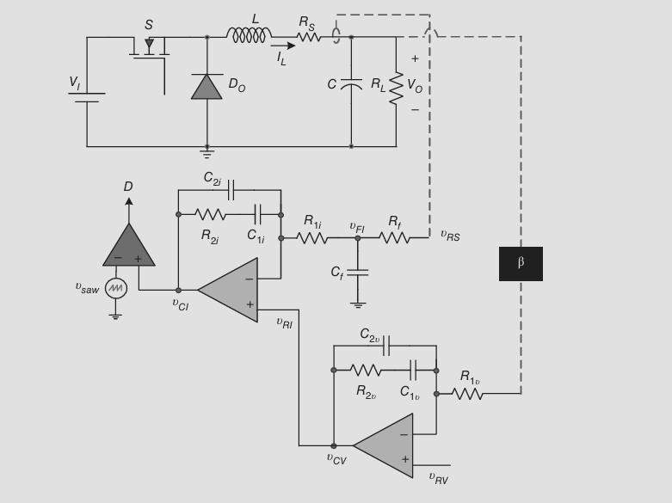
Circuit Diagram of ACMC

Slide 9
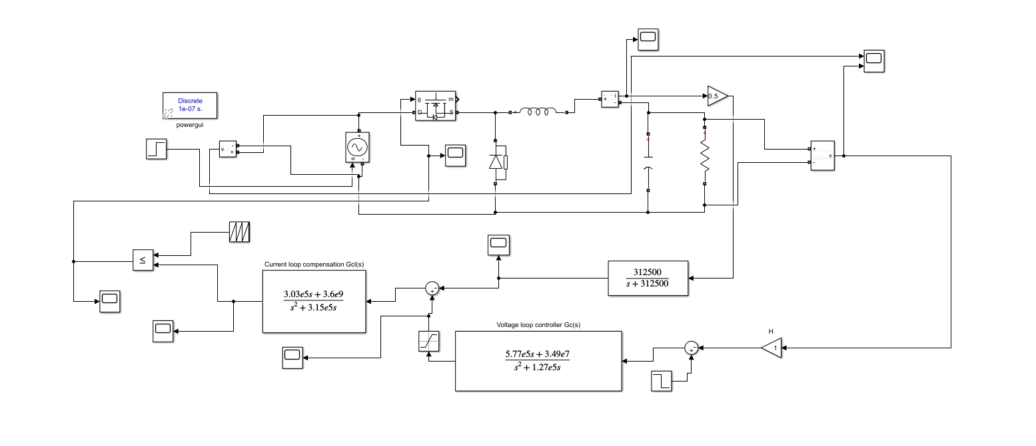
MATLAB Circuit Simulation

Slide 10
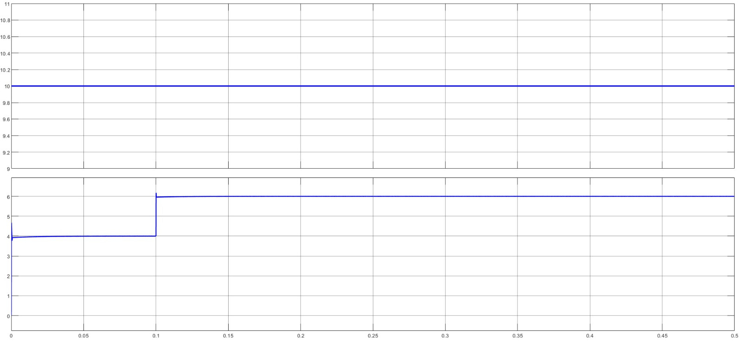
Results
We change the reference voltage at 0.1 sec.

Slide 11
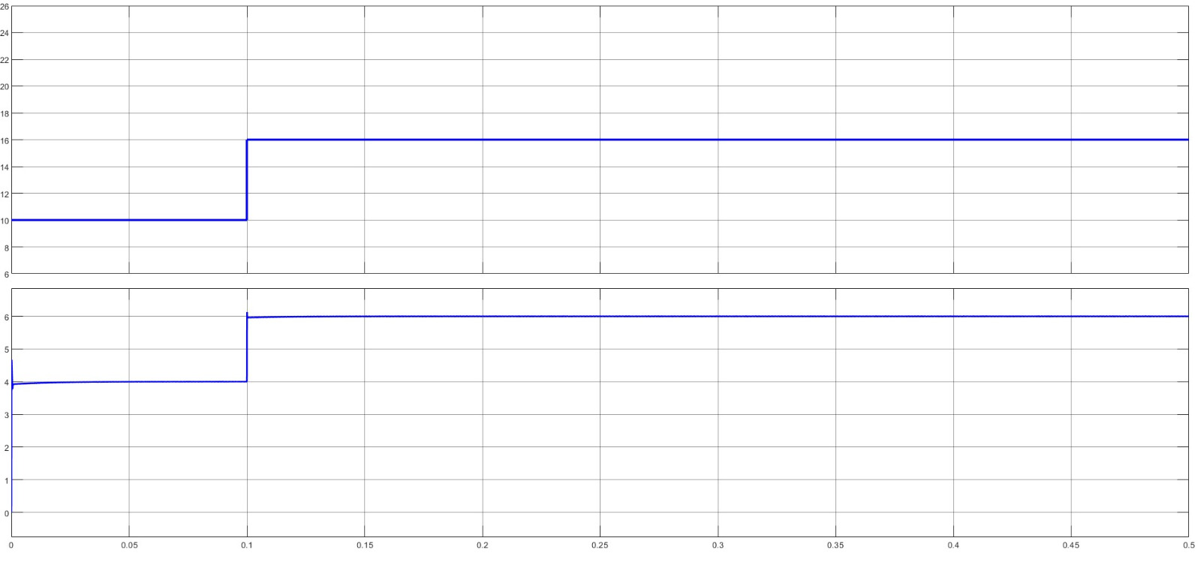
We change both reference and input voltage at 0.1 sec.

Slide 12
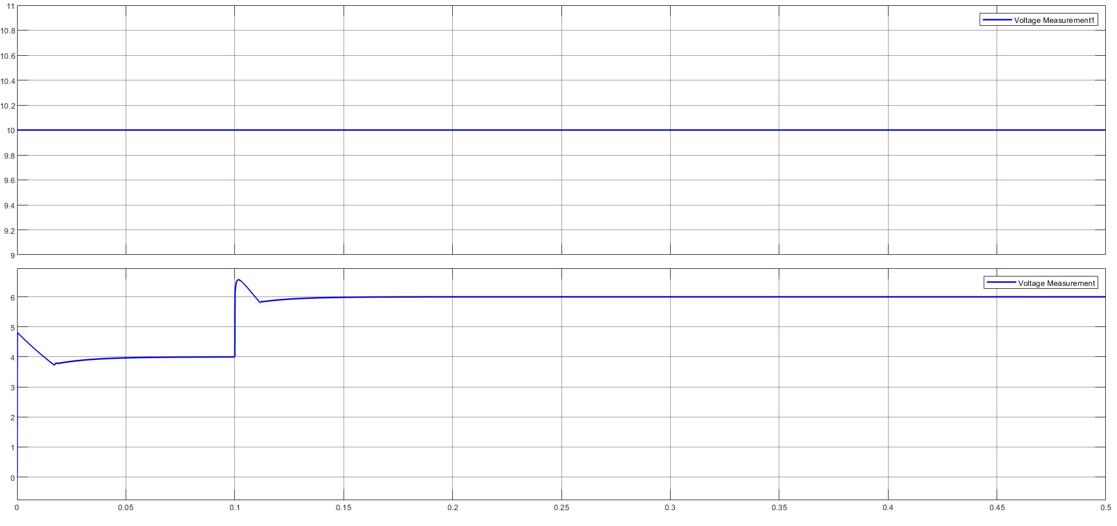
At large value of load resistance keeping input voltage same ripple will increase but this can be mitigate by increasing the filter capacitance.

Slide 13
Applications
Renewable Energy Systems.
Automotive Electronics.
DC–DC Converters in Embedded Systems.
High-Performance Power Supplies.

Slide 14
Advantage
Fast Dynamic Response.
Better Current Control.
Improved Stability.
Line Feedforward Effect.
Better Load Regulation.

Slide 15
Limitations
Noise Sensitivity : Inductor current contain switching noise, ripple components due to this current loop may get disturb.
Power Loss in Current Sensing.
Bandwidth Limitation Due to Averaging : ACMC uses average current, not instantaneous current so we require the low pass filter this introduce the delay.
Complex Compensation Design.

Slide 16
Conclusion
• Efficient control method
• Widely used in power electronics
• Scope for future improvements

Slide 17
References
Power Electronics textbooks
https://ieeexplore.ieee.org/stamp/stamp.jsp?tp=&arnumber=7793204
https://flore.unifi.it/bitstream/2158/1078229/1/Average_Buck.pdf
https://onlinelibrary.wiley.com/doi/10.1002/9781119525592.ch2

