Slide 1

University of Pavia
Department of Electrical, Computer & Bio-Medical Engineering
An Assessment on Video Curriculum
Prof. Maria Grazia Albanesi
(Digital Content Retrieval )
Presented by:
SAURAV ANAND

Slide 2
Content
AIM
Document
WBS
GANTT
SWOT
RISK
Video Presentation
Conclusion

Slide 3
AIM

Slide 4
WBS (Work Breakdown Structure)
&
GANTT CHART
Online tool – digrams.net
app.teamgantt.com

Slide 5
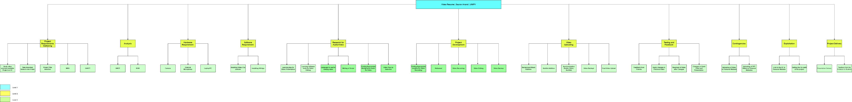

Slide 6
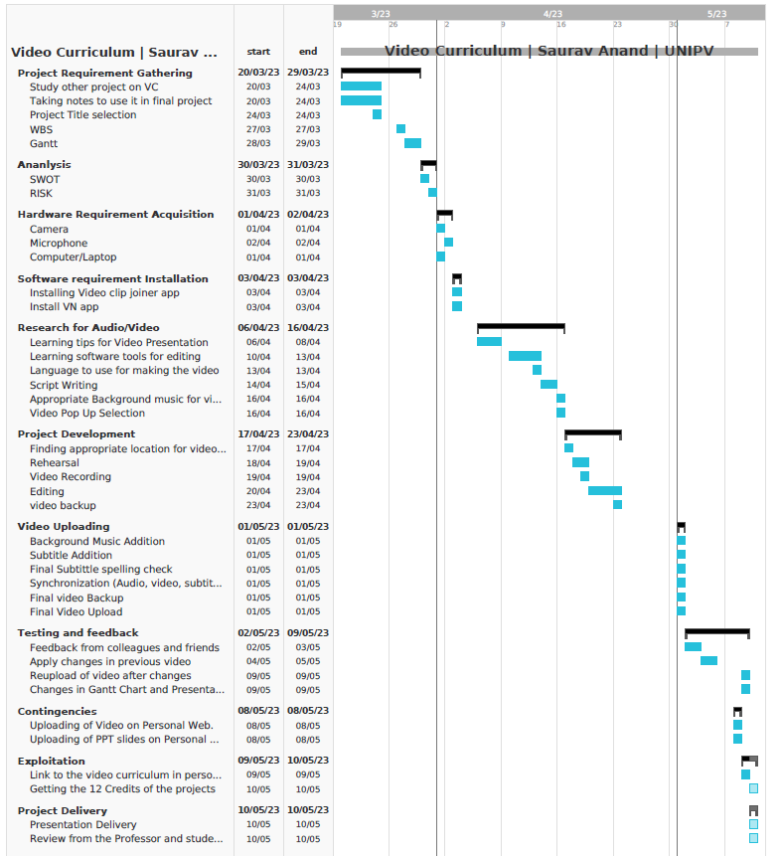

Slide 7
Cost and Effort Estimation
Cost Estimation
This Assessment mainly require Hardware and software tools to complete.
Cost on Hardware = 0 (Previously available)
Cost on Software/Tools = 0 (Online free Tools)
Total Cost = 0
Effort Estimation
Made the GANTT on Day wise but worked on this assessment on hour basis i.e. near about 1 hour a day
Total Days-
All excluding video recording and editing = 27 days = 27 hours
Video Recording and editing = 5 days = 10 hours
Total days = 32 hours
Total hour= 37
Average = 37/32= 1.15 hour/day

Slide 8
SWOT & RISK ANALYSIS ASESSEMENT

Slide 9
SWOT Analysis for VC
STRENGTH
Availability of all required Hardware and Software
Good Speaking Skills
Script writing skills
Chart Preparation skill
WEAKNESS
Video Editing Tool
Unenviability of external mike
Same Facial Expression while delivering the context.
S
W
T
O
OPPERTUNITES
To learn Video Editing
Confidence Building-Camera
VC link in personal website
Interview help
THREAT
Data Loss
Laptop Malfunctioning/Fails
Video not getting uploaded on platform -Authentication issue.
Platform not working on Presentation Day

Slide 10
RISK ASSESEMENT MATRIX
RISK Analysis | Probability | Impact | RISK Weight | Action Taken
Data Loss | Medium | High | Take Action | Allowed automatic backup on cloud
Laptop Malfunctioning/Fails | Low | High | Consider | Already searched for another
If Video not get Uploaded | Low | High | Consider | Searched for alternate platform (e.g- VIMEO )
Video Plat. Not working on Presentation Day | Low | High | Consider | Check how to upload video but do not took any action
Video Editing tool | High | Hight | Take Action | Learned Editing Online
Unavailability of External Mike | High | Medium | Take Action | Arranged it with Other Person
Same Facial Expression Every time | Medium | Medium | Consider | Did Rehearsal
 | LOW | MEDIUM | HIGH
LOW | Ignore | Ignore | Consider
MEDIUM | Ignore | Consider | Take Action
HIGH | Consider | Take Action | Take Action

Slide 11
VIDEO PRESENTATION
Details:
Title: Video Curriculum | SAURAV ANAND | UNIPV 2023
Software Used: VN App, Team Gantt, Infinity free. Draw.net, Youtube Studio, Visual Studio
Hardware Used: Phone Camera, Microphone, Personal Laptop
Compression is done using the VN app using app’s default algorithm.

Slide 12
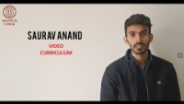
VIDEO PRESENTATION
Source Link- https://www.youtube.com/watch?v=WBVuzWo94o4

Slide 13
Conclusion
Learned about
WBS,GANTT, SWOT, RISK Chart
Tools for Video Editing and Chart making
Helped to speak Infront of Camera
Assessment will help for Interviews

Slide 14
Thank You

