Slide 1
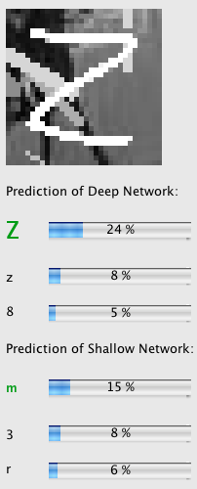
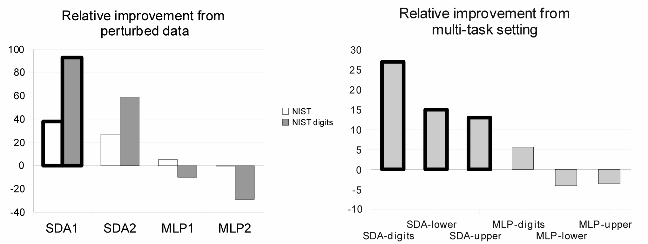
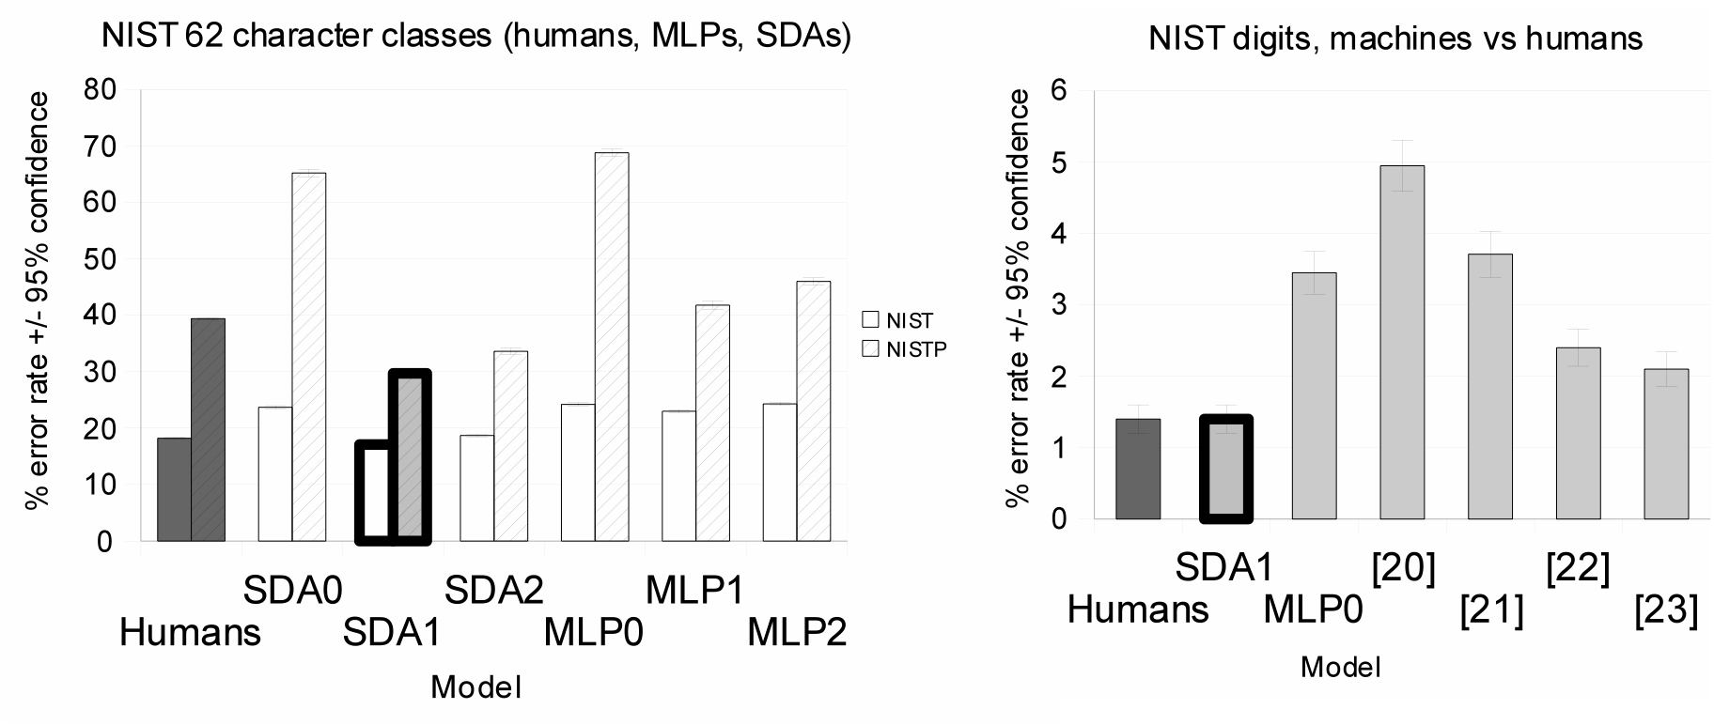
Deep Self-Taught Learning for Handwritten Character Recognition
Y. Bengio et al @ U. Montreal
discriminate 62 character classes (upper, lower, digits), 800k to 80M examples
Deep learners beat state-of-the-art on NIST and reach human-level performance
Deep learners benefit more from perturbed (out-of-distribution) data
Deep learners benefit more from multi-task setting

