Slide 1

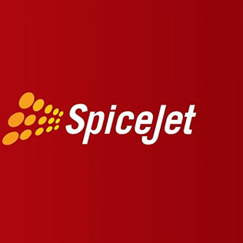


SpiceJet Ltd.
A detailed report on declining Net profit of SpiceJet Ltd.

Slide 2
Executive Summary
SpiceJet, an Indian airline, incurred a net loss of Rs 7.88 Billion in the April to July 2022 quarter, which further increased to Rs 8.38 Billion by the end of the September 2022 quarter. As a result, the company lost a total of INR 16.4 Billion FY 2022, which severely impacted its financial stability. Despite a rise in total income from Rs 1.5 Billion in April to September 2021 to Rs 2.1 Billion as of September 2022 quarter, the mounting losses remained unaddressed. [1]
The company faced several challenges such as flight delays, poor in-flight service, ineffective boarding procedures, and shabby aircraft interiors, as reported by customers. The pandemic had a profound impact on the airline industry, and SpiceJet's passenger count drastically fell over 63% in the last two years. [2]
SpiceJet must take immediate corrective measures to improve customer experience, prioritize automation, technology and sustainability, and phase out older aircraft with newer ones. The rise in operating expenses, poor customer acquisition & service, aging aircraft fleet and competitive threats are among the major challenges that need to be addressed.
In conclusion, SpiceJet needs to implement strategies that focus on improving its financial stability, enhancing customer experience, and increasing profitability to remain competitive in the airline industry.
Source(s):
[1] - https://www.dailyo.in/wallet/spicejet-losses-are-soaring-blame-air-incidents-rising-expenses-pandemic-37904
[2] - https://corporate.spicejet.com/Content/pdf/SJFinancials_website_june2023.pdf (SpiceJet financial results Q4 FY 2022, page 1)
2

Slide 3
Net profit or loss of SpiceJet FY 2016-2022 (in million Indian rupees)
PROBLEM
SpiceJet lost a total of INR 16.48 Billion FY 2022. [1]
It incurred a significant net loss of Rs 7.88 Billion in the April to July 2022 quarter, which further escalated to Rs 8.38 Billion by the end of the September 2022 quarter. [2]
This severely impacted the company's financial stability, despite a rise in total income from the previous year. SpiceJet needs to implement corrective measures to address its financial challenges and prevent further adverse effects on its business operations.
3
Source(s):
[1] - https://corporate.spicejet.com/Content/pdf/SJFinancials_website_june2023.pdf (SpiceJet financial results Q4 FY 2022, page 1)
[2] - https://www.dailyo.in/wallet/spicejet-losses-are-soaring-blame-air-incidents-rising-expenses-pandemic-37904

Slide 4
TOSCA FRAMEWORK
Trouble: SpiceJet is facing a decline in profitability; It incurred a net lose of INR 16.4 Billion in the year 2022.
Owner: The problem is owned by Chief Executive Officer, Chief Revenue Officer and Chief Financial officer of SpiceJet.
Success Criteria: Maintaining a consistent rise in revenue by 20% by the end of the fiscal year 2023. Reducing costs in a sustainable manner, leading to improvement in the company's bottom line.
Constraints: Major constraints are: inefficient operations, aging fleet and government regulations.
Actors: Chief Executive Officer, Chief Revenue Officer, Chief Financial officer followed by the board of directors, shareholders, and customers.
4

Slide 5
Has the Procurement increased?
Are there increase in the inventory costs?
ISSUE TREE
Has the Logistics increased?
Has the expenses increased?
Has the operating expenses increased?
Are there any discrepancies in the Operations?
Why is SpiceJet’s profit declining?
Is the pricing strategy effective?
Has the sales and Marketing costs increased?
Has the capacity declined?
Is competition posing a threat?
Has the revenue declined?
How is the customer service?
Has the Occupancy rate declined?
Is the Customer Segmentation reduced?
5

Slide 6
ISSUE TREE - Description
SpiceJet has been experiencing a decline in profitability compared to its competitors. Upon further analysis, it was discovered that the decline was due to both decreasing revenues and rising costs.
The decline in revenue is due to the decrease in occupancy on some niche routes, where SpiceJet had recently invested in a new fleet. These routes have low demand for airline travel, the demand was expected to grow in the future, and they were also projected to cater to premium SpiceJet customers. Therefore, withdrawing the new fleet from these routes would not be a viable option.
SpiceJet is facing tough competition from IndiGo and Air India in the domestic circuit, where passengers are charged very low prices due to the intense competition, because of which SpiceJet is finding it difficult to acquire customers as they have to keep their prices competitive with their rivals, which is affecting their profitability.
SpiceJet has been facing several challenges on the cost and service fronts. The airline has been grappling with high inventory costs, which have risen recently. This cost is higher than its competitors across all components due to the different types of fleets SpiceJet operates on, requiring more spare parts that they have to hold.
On the service front, customers have criticized SpiceJet for flight delays, poor in-flight services, and ineffective boarding procedures. These issues have negatively impacted the airline's reputation and could potentially harm its net profit. SpiceJet has also claimed to have the highest operating expenses compared to its counterparts, which is reducing its revenue further.
6

Slide 7
Falling Passenger Revenue
Operating revenue of SpiceJet FY 2018-2022, by category
SpiceJet’s passenger revenue has decreased by a whopping 63% in the last 2 years, leading to a net revenue fall of nearly Rs 71,000 Million. [1]
Its potential causes are listed:
Poor Customer Acquisition
Aging Aircraft fleet leading to technical difficulties.
Significant Market competition
Poor Customer Service
Rise in operating costs
These challenges has been discussed in the further slides.
7
Source(s): SpiceJet; ID 1043415
[1] - https://corporate.spicejet.com/Content/pdf/AnnualReport_SpiceJet_202122.pdf (SpiceJet Limited annual report FY 2022, page 96)

Slide 8
Poor Customer Acquisition
Flight bookings by airline brand in India 2022
SpiceJet ranks 5th with only 26% customer acquisition in the total flight bookings by airline brand FY 2022.
Its major competitors IndiGo and Air India has double and triple the numbers, respectively. [1]
SpiceJet has fallen from the rank 2 to 5 in the last 3 years, some of the major cause for the fall are:
Safety concerns due to old fleet of aircrafts.
Poor Customer reviews.
Poor Customer services.
Lack of on time performance. [2]
Note(s): India; four waves from 07 January 2022 to 13 December 2022; 18-54 years; 1568 respondents; respondents who booked a flight (Mobility, Travel)
Further information regarding this statistic can be found on page 8.
Source(s): [1] Statista Consumer Insights; ID 1348482 – https://www-statista-com.proxy.lib.uwaterloo.ca/global-consumer-survey
[2] - https://www.businessinsider.in/business/news/spicejets-safety-is-not-the-only-problem-its-cancellations-and-complaints-are-high-too/articleshow/92647896.cms
8

Slide 9
Aging Aircraft fleet
Fleet of SpiceJet:
Boeing 737-800
Boeing 737-900ER:
Bombardier Q400 [1]
SpiceJet intends to induct 50 Boeing 737 MAX planes by 2023-24 as it hopes to phase out its older Boeing 737-800 NG, which has experienced several safety concerns. [2]
The cost for this would be significantly high because of the types of inventory held. SpiceJet has a diverse fleet of 88 aircrafts, whereas its competitor such as Indigo has a single, standardised fleet. As a result, SpiceJet must stock greater number of spare parts leading to more inventory which results in higher costs.
Since the new fleet is of a different type, the cost of inventory as a result of the new purchase has increased overall costs.
Aircraft fleet of SpiceJet FY 2012-2022
Note(s): India; FY 2012 to FY 2022
Further information regarding this statistic can be found on page 8.
Source(s): SpiceJet; ID 1043655 - https://corporate.spicejet.com/Content/pdf/AnnualReport_SpiceJet_202122.pdf (SpiceJet Limited annual report FY 2022, page 49)
[1] - https://en.wikipedia.org/wiki/SpiceJet
[2] -https://simpleflying.com/several-new-737-max-aircraft-to-join-spicejet-by-december/?newsletter_popup=1
9

Slide 10
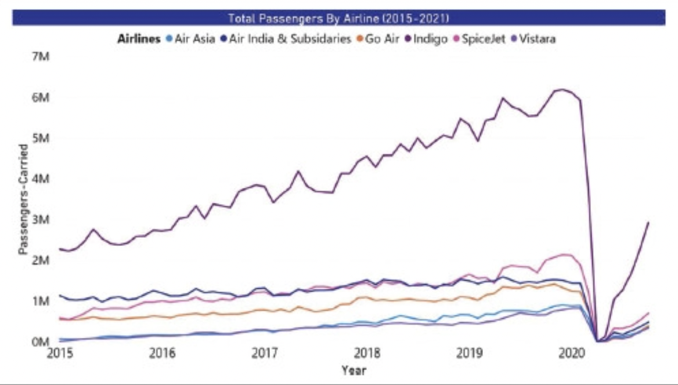
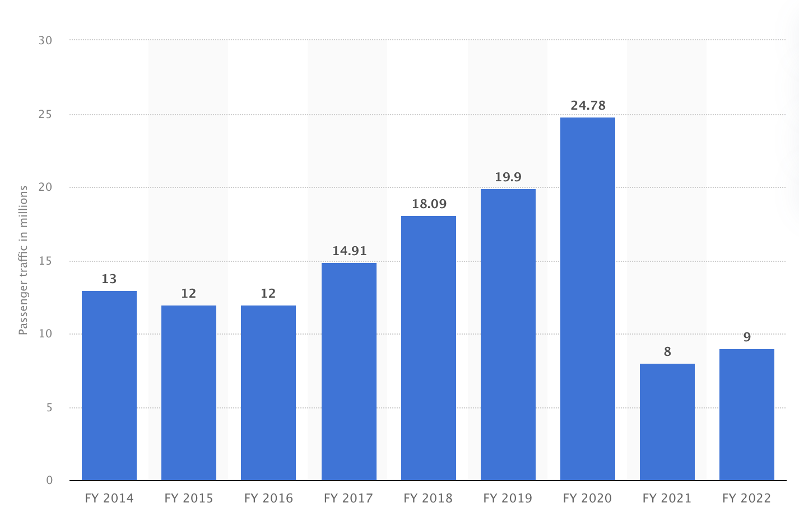
Threat by Competitors
Compared to other domestic competitors, SpiceJet has a very low passenger count, additionally the count has drastically fallen by 63% over the last two years.
Indigo being one of the SpiceJet’s benchmark in the Indian domestic circuit, has seen a consistent rise of 32% in passenger count even after the pandemic.
SpiceJet last year suffered a string of mid-air safety lapses that drove India's aviation regulator to halve its approved fleet in July 2022. The curb was removed on Oct. 30. But the impact on SpiceJet was significant since the airlines company earned lesser revenues and still incurred fixed costs. [1]
Passenger Traffic Comparison of Domestic Flights in India FY 2015 - 2022
Passenger traffic in Million for SpiceJet FY 2014 - 2022
Note(s): India; FY 2018 to FY 2022; standalone figures
Further information regarding this statistic can be found on page 8.
Source(s): SpiceJet; ID 1043415
[1] - https://www.reuters.com/business/aerospace-defense/indias-spicejet-posts-higher-q3-revenue-air-travel-demand-grows-2023-02-24/
10

Slide 11
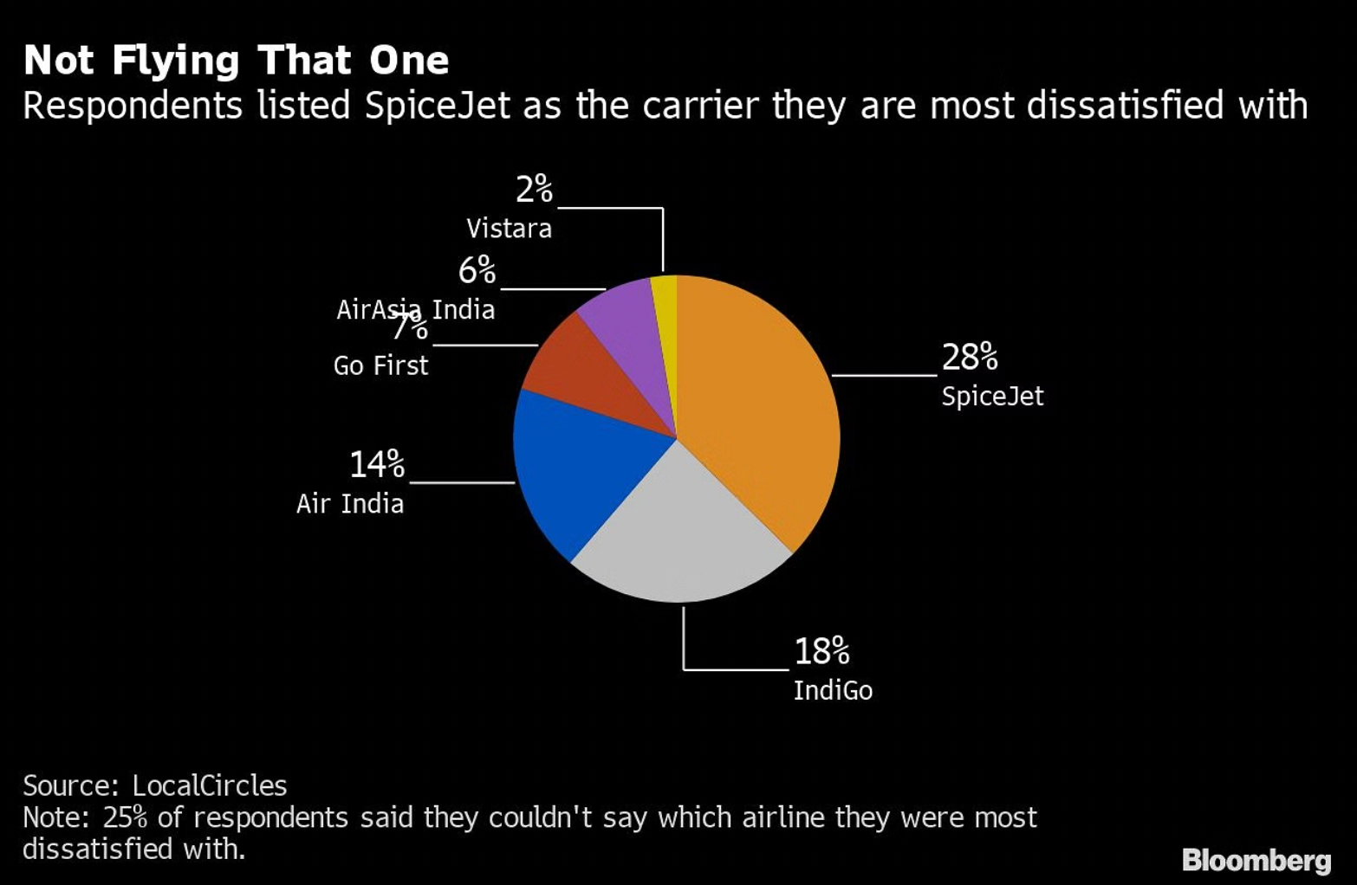
Poor Customer Service
Customer Reviews of SpiceJet FY 2022
About 79% of the 15,000 airline passengers surveyed by Bloomberg said they believe carriers in India are compromising on passenger comfort and cutting corners as a result of the pandemic, souring the reopening of what was prior to Covid the world’s fastest-growing aviation market.
SpiceJet Ltd. topped respondents' list of airlines whose service was deemed most unsatisfactory, followed by IndiGo. Flight delays, poor in-flight service, ineffective boarding procedures, and shabby aircraft interiors were among the complaints received for SpiceJet. [1]
SpiceJet must prioritize automation, technology and sustainability to improve customers’ experience.
Note(s): India; FY 2016 to FY 2022
Further information regarding this statistic can be found on page 8.
Source(s): SpiceJet; ID 1043454
[1] - https://theprint.in/india/spicejet-deemed-has-most-unsatisfactory-customer-service-indigo-in-2nd-spot-finds-survey/972743/
11

Slide 12
Rise in Operating Expenses
Operating expenses of SpiceJet FY 2022, by type
SpiceJet’s quarterly loss had increased due to record high fuel costs and a depreciating rupee. Losses increased to Rs 838 crore ($103.25 million) for the three months ended September 30, up from Rs 562 crore a year earlier, according to an exchange filing by the airline. The cost of aviation turbine fuel has nearly doubled to 12.26 billion rupees. [1]
SpiceJet’s most significant operating expense is Turbine fuel which costed a whopping 29.46 Billion INR in 2022, as a result overall operating expenses has increased.
12
Source(s): SpiceJet; ID 1044067
[1] - https://corporate.spicejet.com/Content/pdf/AnnualReport_SpiceJet_202122.pdf
(SpiceJet Limited annual report FY 2022, page 97)

Slide 13
Recommendations and Additional Research
SpiceJet could standardize their fleet to reduce the number of spare parts needed, have rental agreements with suppliers of inventory (Wet Lease), implement a hub-spoke model to optimize their inventory usage, and order inventory on a need basis instead of maintaining excess. These strategies would help SpiceJet to reduce their inventory storage costs and operate more efficiently.
SpiceJet could address their declining in revenue by improving their marketing activities in specific regions, analyse price sensitivity of customers in those regions, and re-route flights to optimize revenue. Additionally, improving crew training and on-time performance can also improve the overall customer experience and increase customer loyalty. By implementing these strategies, SpiceJet can improve their financial performance and strengthen their position in the competitive Indian airline industry.
13

Slide 14
Conclusion
This research examines the reasons for the decline in SpiceJet’s net profit based on several factors as broken down on the Issue Tree. The primary causes for the decline in the profit is due to the rise in SpiceJet’s expenses and decline in its revenue. Key challenges from both sections were discussed in the report. The recommendations should be carefully considered, and additional research and analysis should be conducted to maintain a consistent rise in revenue which would lead to an improvement in company’s bottom line.
14

