Slide 1
Assignment 1-Implementation of Backpropagation and Training a Palindrome Network
Ashutosh Bharti 210040026
Vaibhav Bhatnagar 23M1062
Saurav Chaudhary 23M0838
Vedant Goswami 23M0766
…
17th February 2023

Slide 2
Problem Statement
Check if 10-bit string is palindrome or not
Technique used:
We have implemented a Neural Network Architecture with BackPropagation for updating parameters from scratch.

Slide 3
Problem Statement
Input: 10-bit String (of numbers)
Output: Palindrome or not (class 0 or 1)

Slide 4
Architecture details
Our neural network architecture consists of:
Input layer: 10 neurons, each representing a 1-bit binary number.
Hidden layer: 2 neurons, utilizing the Sigmoid activation function.
Output layer: 1 neuron, utilizing the Sigmoid activation function.
This architecture is designed to process binary inputs through the network, with the hidden layer applying Sigmoid activation to introduce non-linearity, and the output layer using Sigmoid activation to produce a binary classification or prediction.

Slide 5
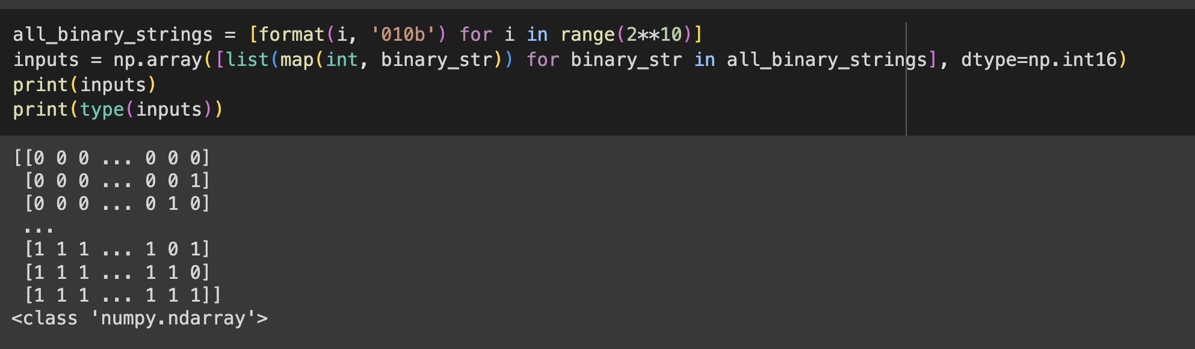
Input representation
A two-dimensional numpy array is used to represent the inputs.

Slide 6
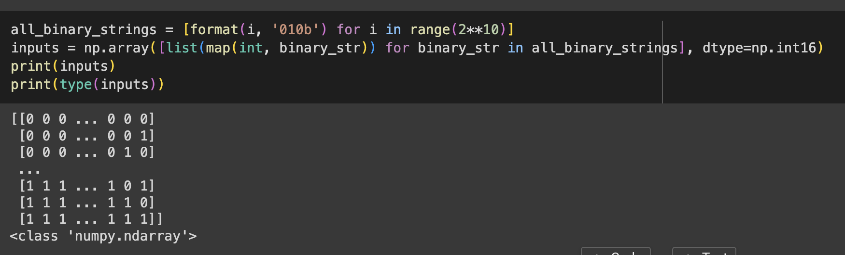
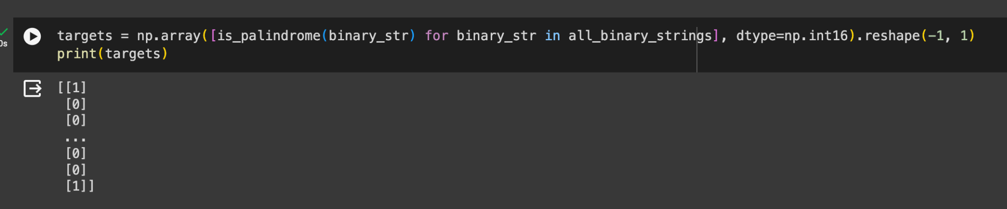
Output representation
It is 2D NumPy array where each row represents the target class corresponding the input sequence.

Slide 7
Hyperparameters
Hidden Layer Size : 2 Neurons
Momentum Factor : 0.3
Seed : 52
Epochs : 10000.
Learning Rate : 0.01.
Number of Folds (KFolds): 5

Slide 8
Overall performance
precision recall f1-score support
0 0.99 1.00 0.99 981 1 1.00 0.74 0.85 43
Precision: 0.986426
Recall: 1.0
F1-score: 0.993127

Slide 9
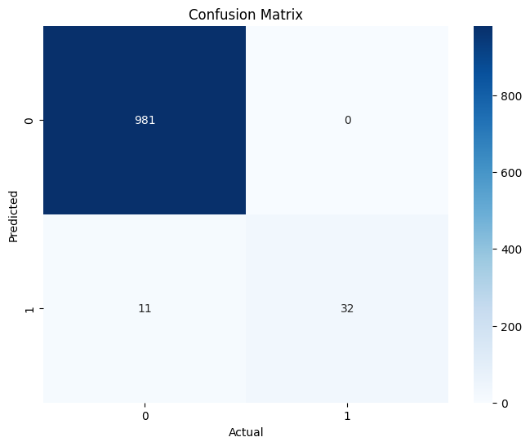
Confusion Matrix

Slide 10
Interpretability of middle layer
Weights to hidden neuron 1
[-21.103238 -5.229046 -10.497463 +13.877196 +7.258210 -7.217289 -13.849237 +10.503724 +5.265200 +21.084626]
Weights to hidden neuron 2
[+21.406045 +5.327159 +10.700617 -12.693136 -7.357754 +7.381260 +12.728184 -10.644741 -5.290742 -21.352189]
Weights to Output neuron
[-30.577723 -30.204053]

Slide 11
Learnings
How gradient flows from the output neuron to the inner layers of the network.
Neural network uses momentum optimization during weight updates, enhancing the convergence speed. The momentum factor is a tunable parameter which helps to move out of local minima.
Explored different activation functions.

Slide 12
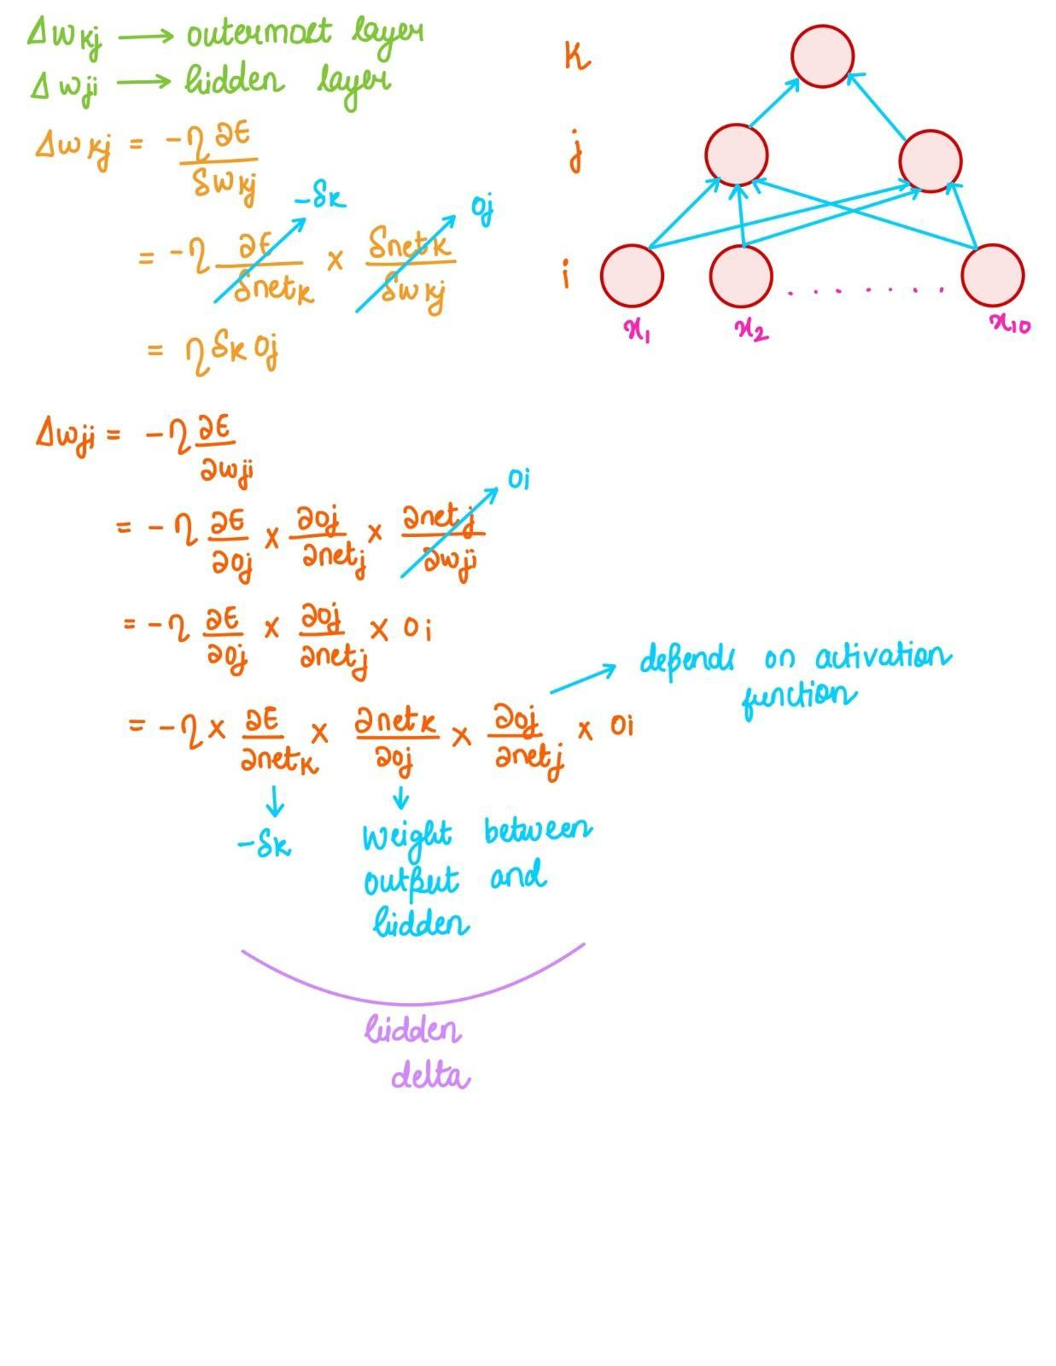
BP implementation

Slide 13
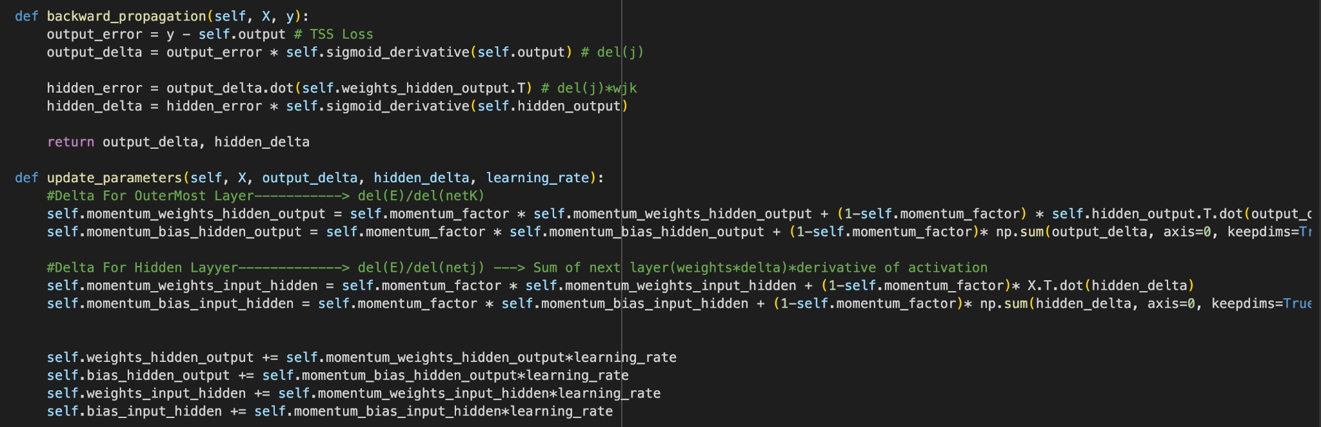
BP implementation

Slide 14
Evaluation Scheme
Input representation - 10
Correct architecture for Palindrome - 30
Back Propagation implementation and clear explaination- 30
Overall Performance - 10
Interpretability of middle layer - 10
Demo -10

