Slide 1
Linux Operating System
Atul Kahate

Slide 2
Introduction to Operating Systems

Slide 3
Program Execution
Disk
Main memory
CPU
Input
Program code read from the disk
Stored program
Execution
Operating system
Output

Slide 4
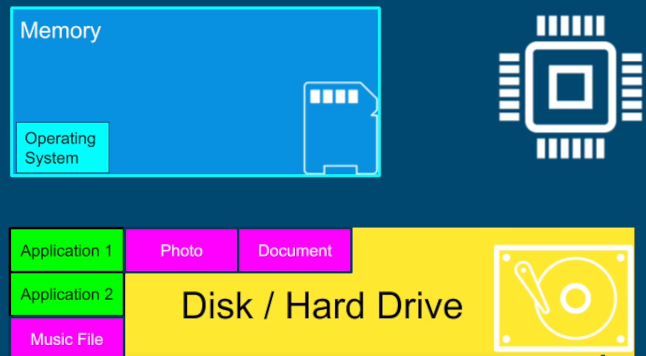
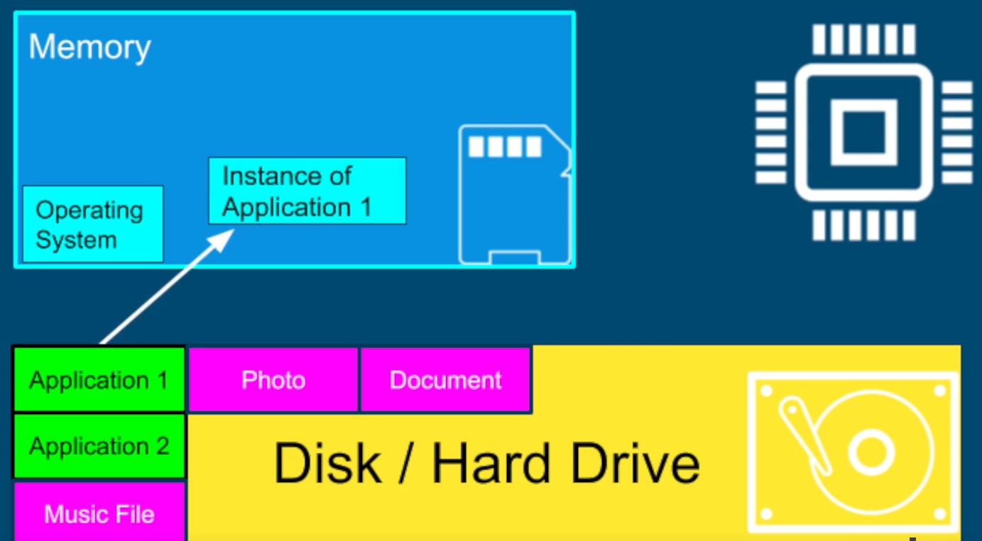
Why Operating Systems?
All our applications are on the disk in the form of files
When we run an application, it is loaded by the operating system into the main memory

Slide 5
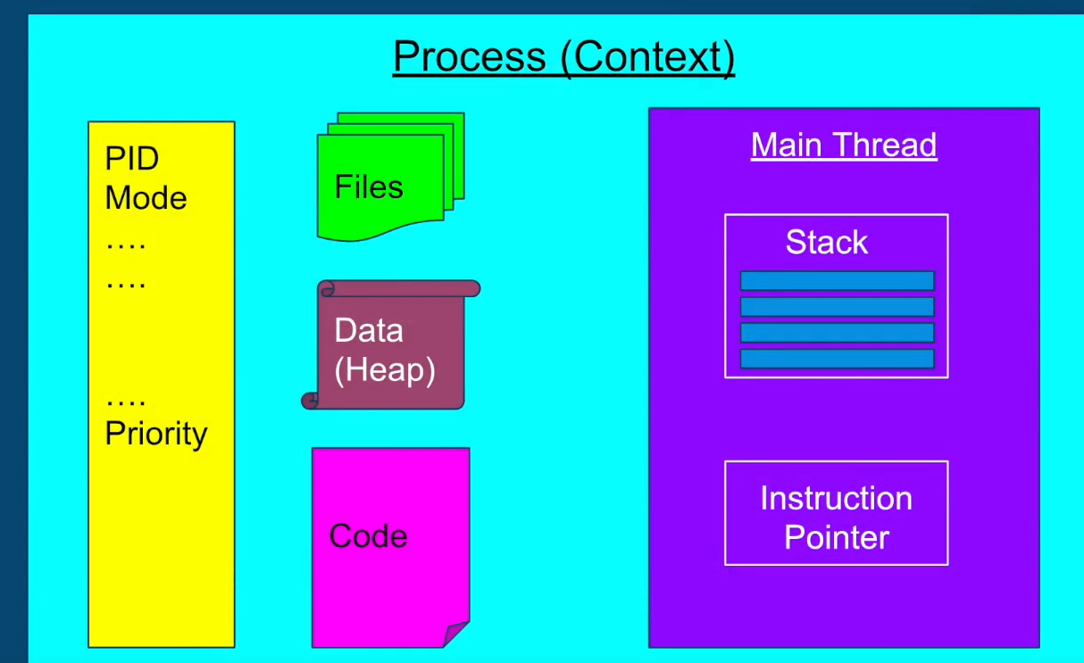
Why Operating Systems?
Process: Instance of a program

Slide 6
General Operating System Organization
User processes
GUI
Servers
Shell
OS
Kernel
System calls
Process Management
Memory Management
Hardware
CPU
Memory
Disks

Slide 7
Kernel
Kernel: Software that manages hardware and allocates resources
Performs tasks such as
Process scheduling
Memory management
File system management
Process management
Device access management
Networking
System call API provision

Slide 8
Introduction to Linux

Slide 9
Linux History
Linux: World’s most widely used operating system
Origins in UNIX (1969): Created by Ken Thompson at Bell Labs with Dennis Ritchie (who also created C)
Too many UNIX versions (proprietary, incompatible)
Richard Stallman launched GNU (1984): Free software alternative to UNIX. GNU provided core utilities (compiler, shell, tools) but was missing a kernel
Free Software Movement:
Freedom to run, copy, distribute, study, change, and improve software
“Free” = freedom, not price
Linux kernel (1991): Created by Linus Torvalds as a free UNIX-like kernel
GNU + Linux = GNU/Linux → Full free operating system
Led to Open Source Movement (late 1990s): A more business-friendly framing of Free Software ideas

Slide 10
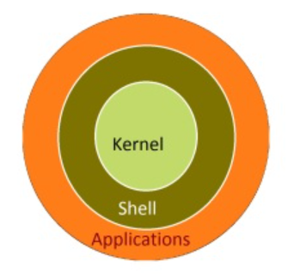
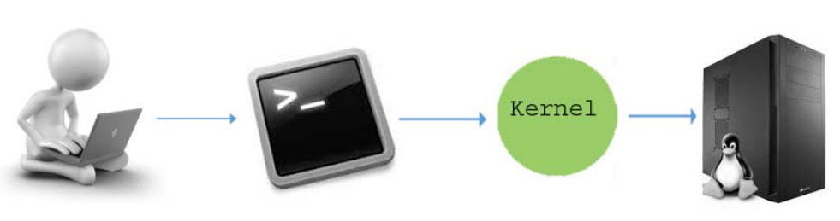
Linux Kernel
Kernel: Main component of the operating system that interacts with the hardware
Responsibilities:
Process Management – Scheduling, multitasking, handling process creation/termination
Memory Management – Allocating RAM, swapping, virtual memory
Device Management – Providing device drivers to interact with hardware (disks, network cards, printers, etc.)
File System Management – Organizing data on storage, permissions, mounting
System Calls Interface – Provides the API between user programs and the OS (e.g., read(), write(), fork())
Linux Kernel Features:
Monolithic (all core services in one large kernel binary, but modular with loadable kernel modules)
Portable (runs on many architectures: x86, ARM, RISC-V, PowerPC, etc.)
Secure and multi-user
Network stack included (TCP/IP, sockets)

Slide 11
Installing Linux – Multiple Options
On a Windows machine, install WSL (Simplest and light-weight)
https://learn.microsoft.com/en-us/windows/wsl/install
Use a virtual machine and install a Linux distribution
VMWare or Oracle VirtualBox (See https://techbland.com/how-to-install-lubuntu-on-virtualbox-on-windows/)
Create a dual-boot machine (Windows and Linux)

Slide 12
Virtual Machine Concept
Hardware
Windows (Host/Base OS)
Virtual Machine Manager (VirtualBox/VMWare)
VM-1 (Linux)
VM-2 (Windows)
VM-3 (Linux)

Slide 13
Linux Distributions (“Distros”)
Distro | Base / Package Manager | Default Desktop (can change) | Best For | Key Features
Ubuntu | Debian / apt | GNOME | Beginners, general use, servers | Large community, easy to use, long-term support (LTS), lots of pre-built software
Debian | Independent / apt | GNOME (default), XFCE, KDE | Stability-focused users, servers | Very stable, free software philosophy, huge package repo
Fedora | Independent / dnf | GNOME | Developers, latest tech | Sponsored by Red Hat, cutting-edge features, close to RHEL
CentOS Stream (successor of CentOS) | RHEL / dnf | GNOME | Servers, enterprises | Rolling release between Fedora & RHEL, stable server environment
Arch Linux | Independent / pacman | None (user chooses) | Advanced users, tinkerers | Rolling release, lightweight, fully customizable, Arch Wiki documentation

