Slide 1
WORKING
OF
HUB

Slide 2
HUB
Hub is a interconnecting device to connect end devices in a network.
Hub works on physical layer.
Hub is a dumb device as it broadcast every time.
Hub is half duplex.

Slide 3
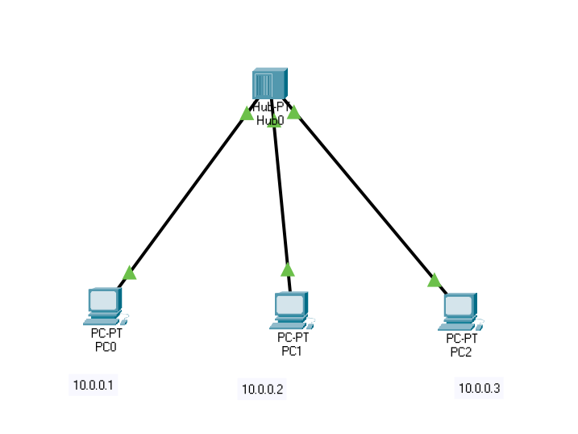
Hub Scenario

