Slide 1
WORKING
OF
SWITCH

Slide 2
SWITCH
Switch is a interconnecting device to connect end devices in a network.
Switch works on data link layer.
It broadcast first time for building the MAC table.
Once the entries in MAC table are created, it start unicasting.
Switch is full duplex.

Slide 3
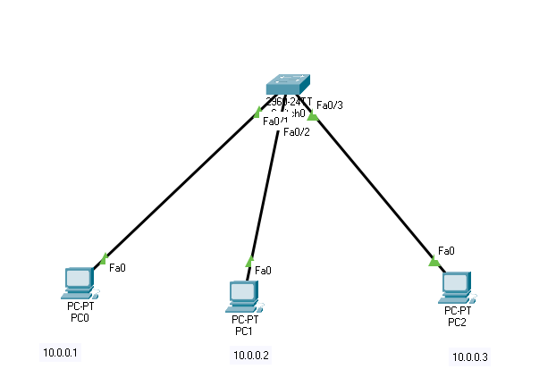
Switch Scenario

Slide 4
Commands
Switch
  en
  show mac-address-table
PC
  arp -a

