Slide 1


TB Saathi
A cross-platform anonymous tuberculosis reporting tool for IPs

Slide 2
Our Idea
01
Anonymous Reporting
02
Communication to Government Healthcare
The identity of the reporting IP remains confidential.
As soon as a new patient’s record is added the nearest PHC is intimated.
03
Volunteer Certification
04
Long-time continuous patient outreach
Any individual or a group that volunteer to help are welcomed and are issued with certificates (government approved when possible)
There will be constant support provided to the patient using our volunteer program.

Slide 3

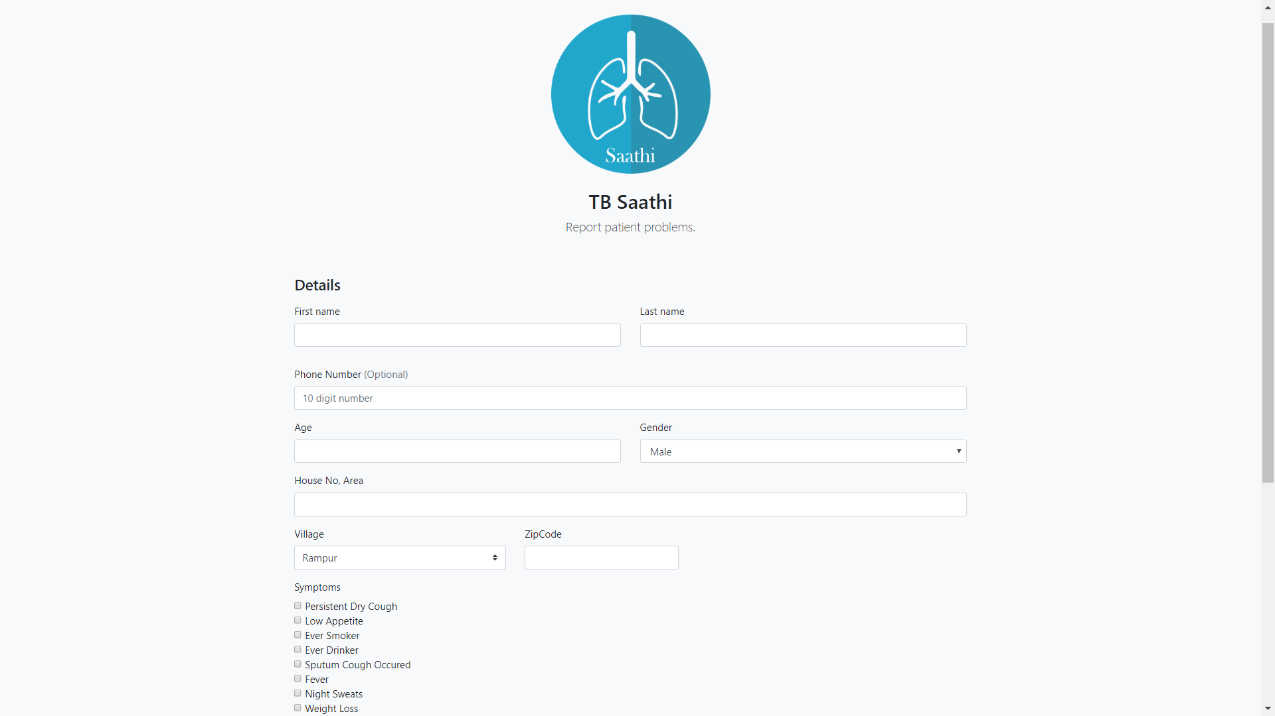
Cross Platform Application

Slide 4
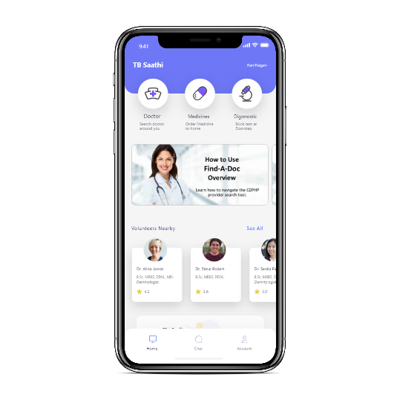
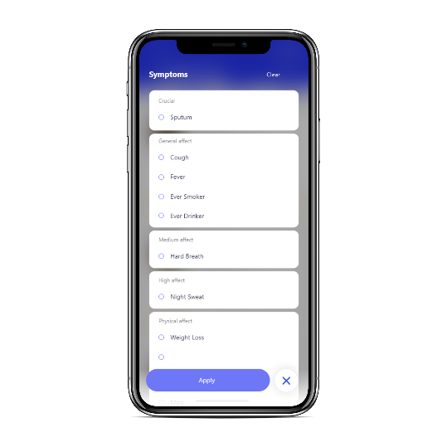
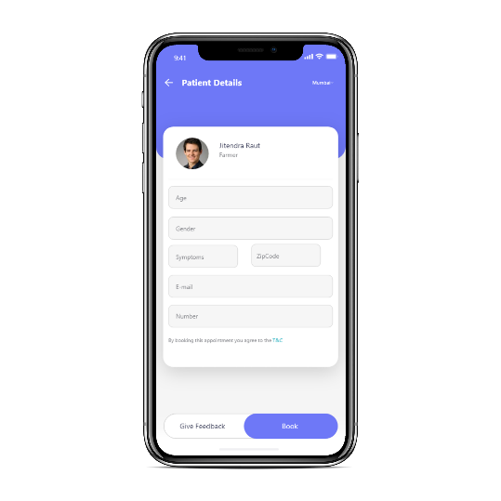

Slide 5
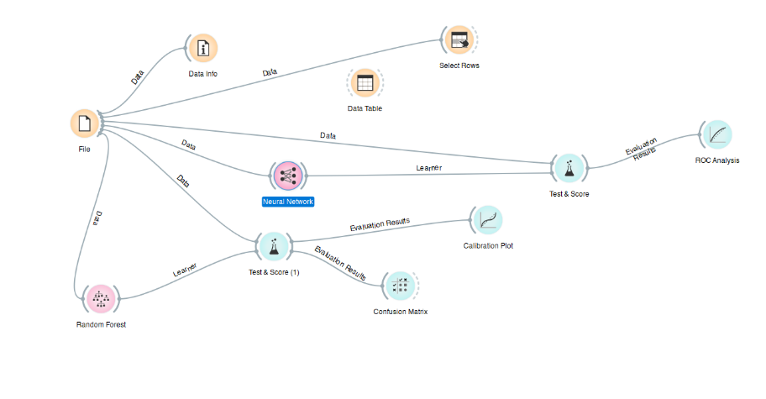

Slide 6
Our Aim
Helping eradicate tuberculosis from the country.
Enhancing the official healthcare database using informal sources.
Providing certified volunteering opportunities.

Slide 7
Current Scenario
Every year approximately 1.12 million patients lack proper access to any formal healthcare system.

Slide 8
Key Activities
Collaborate with volunteering organizations
Building trust among IPs
Building a more robust reference Database.
Partnering with Volunteers and the Government

Slide 9

Revenue Model
Cost Structure
Cloud deployment costs.
Revenue Streams
Google AdSense
Funding from sponsor/Government
Operational Costs
Donations

Slide 10
Key Activities
Key Partners
Value Proposition
Customer Relationships
Customer Segments
Collaborate with volunteering organizations
Building trust among IPs
Building a more robust reference Database.
Patients
IPs
Volunteers
Government (Future plan)
Helping eradicate tuberculosis from the country.
Enhancing the official healthcare database using informal sources.
Providing certified volunteering opportunities.
Patients inaccessible to formal healthcare, approximately 1.12 million people per year.
As the demand increases our application can be further scaled to incorporate other diseases as well.
Building long-term relationships with patients.
Key Resources
Channels
Patient information provided by IP
Technical resources
Easily accessible cross platform application. (Web and Android)
Cost Structure
Revenue Streams
Cloud deployment costs.
Operational Costs
Funding from Government
Google ADSense

Slide 11
Thank You. 👍

