Slide 1
Face Recognition using Siamese Network
Presented By:
Saurav Kant Kumar

Slide 2

Introduction
Siamese Neural Network is a class of neural network architecture that contains two or more identical networks. They share the same configuration with same parameters and weights.

Slide 3
Why Siamese?
Used when less data is available.
Used when new category is included.

Slide 4
Dataset
1. Subset of LFW Dataset
It comprises 2 to 50 images for 1680 person.
Total Number of Images: 8204
2. Custom Dataset
It comprises 1 image for 5 person
Total Number of Images: 5

Slide 5


Data Preparation
Extract Face -- MTCNN
160 X 160 X 3
250 X 250 X 3

Slide 6
MTCNN
Three Stages of MTCNN
1. P-NET: The Proposal Network
Obtain candidate windows and their bounding box regression vectors
2. R-NET: The Refine Network
Reduces the number of candidates, performs calibration with bounding box
regression and employs NMS
3. O-NET: The Output Network
Describe the face in more detail and output the five facial landmarks’ positions

Slide 7
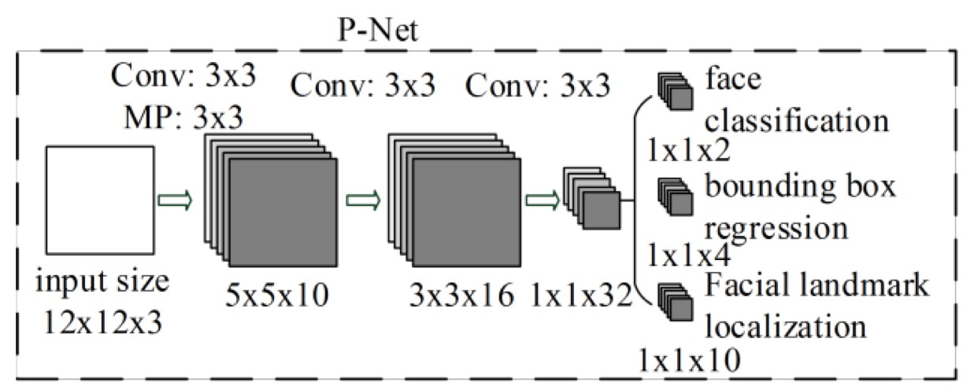
MTCNN
1. P-NET: The Proposal Network
Obtain candidate windows and their bounding box regression vectors

Slide 8
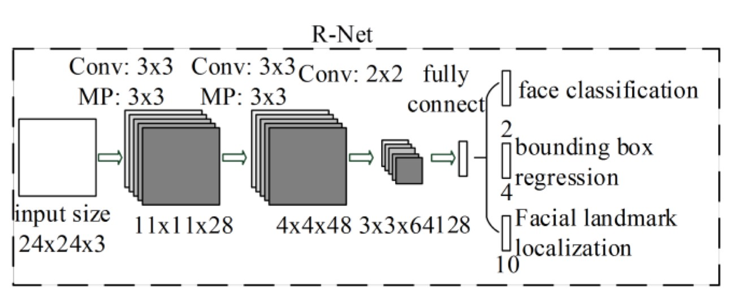
MTCNN
2. R-NET: The Refine Network
Reduces the number of candidates, performs calibration with bounding box regression and employs Non –Max Suppression

Slide 9
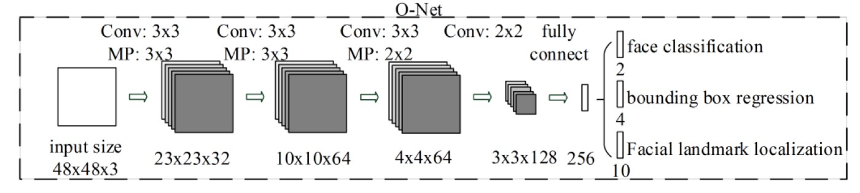
MTCNN
3. O-NET: The Output Network
Describe the face in more detail and output the five facial landmarks’ positions

Slide 10
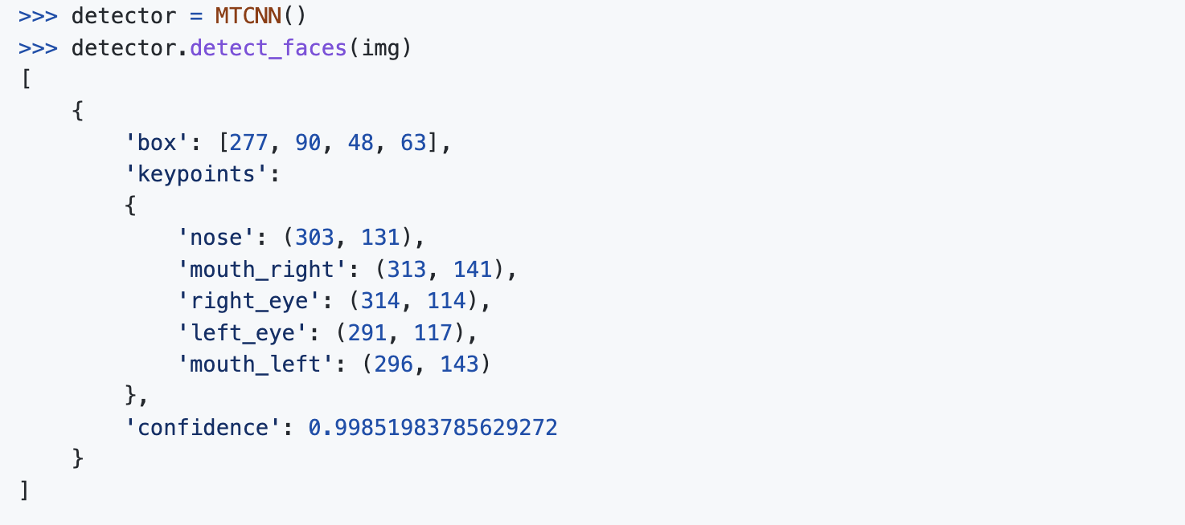
EXAMPLE
The detector returns a list of JSON objects. Each JSON object contains three main keys: 'box', 'confidence' and 'keypoints':
The bounding box is formatted as [x, y, width, height] under the key 'box'.
The confidence is the probability for a bounding box to be matching a face.
The keypoints are formatted into a JSON object with the keys 'left_eye', 'right_eye', 'nose', 'mouth_left', 'mouth_right'. Each keypoint is identified by a pixel position (x, y).

Slide 11

Data Preparation
2. Convert to Gray Scale
160 X 160 X 3
160 X 160 X 1

Slide 12







Training Data
Positive Samples
Negative Samples
1
0
,
,
,
,
1
0
,
,
,
,

Slide 13
Training Data
Total Person = 1680
Train Set: 1430 person
Validation Set: 200 person
Test Set: 50 person

Slide 14
Training Data
Train Set
Same-Same pairs = 46650
Same-Different Pairs = 45917
Validation Set
Same-Same Pairs = 5648
Same-Different Pairs = 5549

Slide 15

Contrastive Loss
(Y) $\frac{1}{2}$ (D_{w})² + (1 - Y) $\frac{1}{2}$ {max(0, m- D_{w})}²
D_{w} = $\sqrt{\text{\{}\text{f}\text{(}\text{x}\text{1}\text{) − }\text{f}\text{(}\text{x}\text{2}\text{)\}}\text{2}}$

Slide 16
CNN for feature extraction
Conv,
Pool
Conv,
Pool
Flatten
X
f(X)

Slide 17
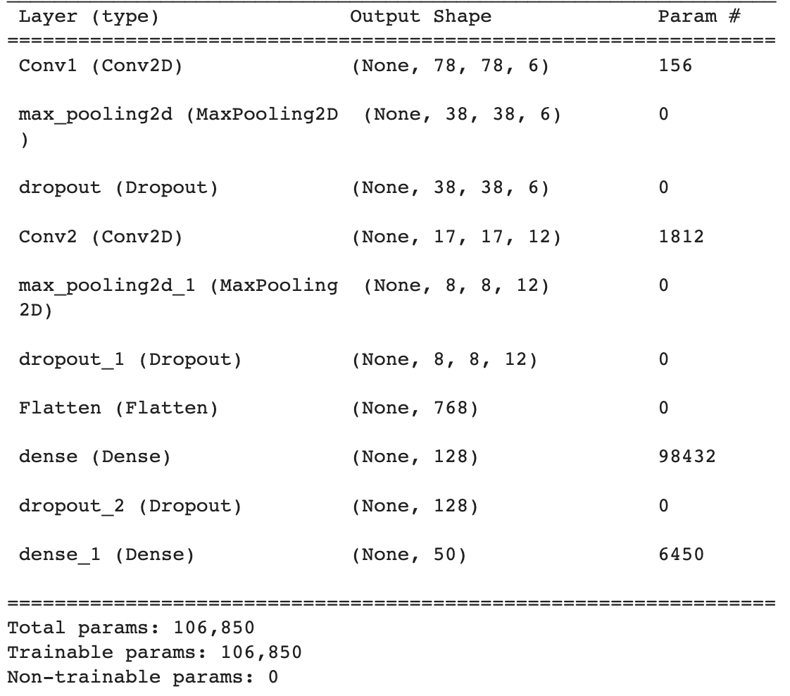
Base CNN Architecture

Slide 18
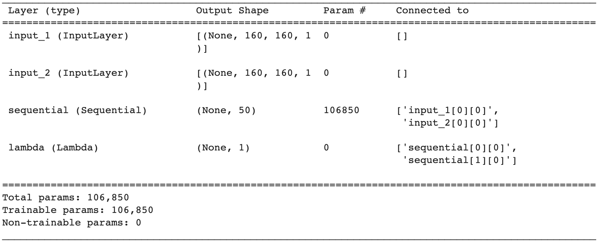
Siamese Architecture

Slide 19
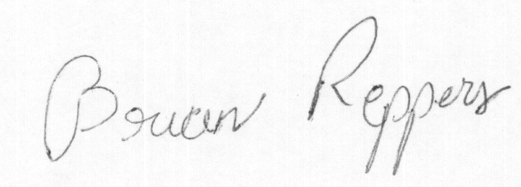
Training Siamese Network
f
Label = 1
f(X₁) - f(X₂)
2
X₁
f(X₁)
Contrastive Loss
f
Z
X₂
f(X₂)

Slide 20
Calculation of Accuracy
Perform Steps 1 – 4 100 times :
Randomly select one image – reference image
Loop through each of the 50 test folders and perform following for each folder:
i. Randomly select one image – current image
ii. Predict and store distance between reference and current image
3. Person with smallest distance from reference image is predicted category
If reference category is same as predicted category then increment count by 1
Accuracy = count / 100

Slide 21
Results and Discussions
Method | Images | Accuracy
Fisher Vector Faces | - | 93.10
Deep Face | 4M | 97.35
Fusion | 500M | 96.37
FaceNet | 200M | 98.87
Paper | 10M | 98.21
Our Implementation | 8.2K | 44.00-62.00

Slide 22
Results and Discussions
Accuracy on inference Dataset: 90.00 %

Slide 23
References
[1] Wu, Haoran, et al. "Face recognition based on convolution siamese networks." 2017 10th International Congress on Image and Signal Processing, BioMedical Engineering and Informatics (CISP-BMEI). IEEE, 2017.
[2] Koch, Gregory, Richard Zemel, and Ruslan Salakhutdinov. "Siamese neural networks for one-shot image recognition." ICML deep learning workshop. Vol. 2. 2015.
[3] Kaziakhmedov, Edgar, et al. "Real-world attack on MTCNN face detection system." 2019 International Multi-Conference on Engineering, Computer and Information Sciences (SIBIRCON). IEEE, 2019.

