Slide 1
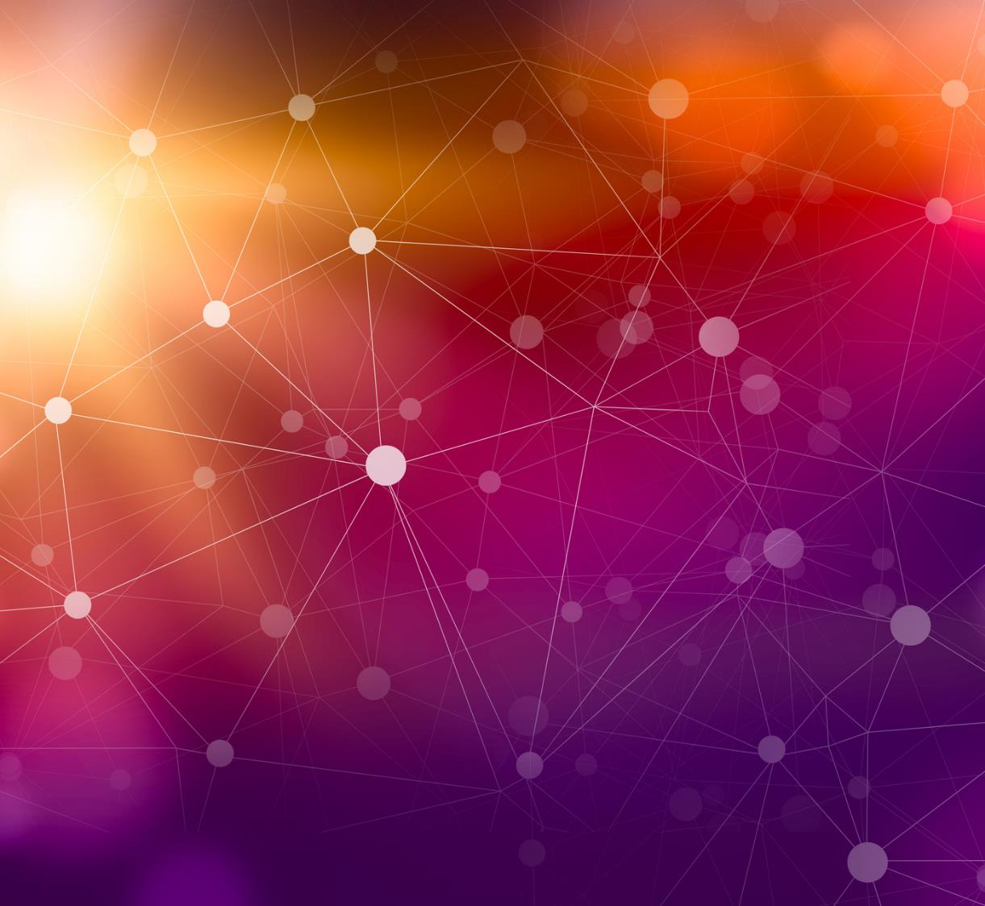

Professor : Student: Saurav kumar - INFORMATICA
Department of Computer Science,
DNA Sequence Classification Using Convolutional
Neural Networks

Slide 2
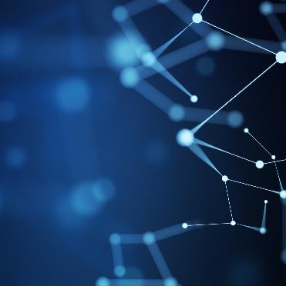
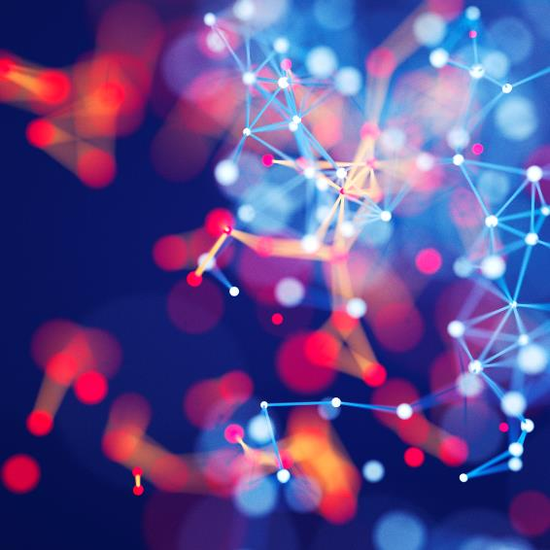
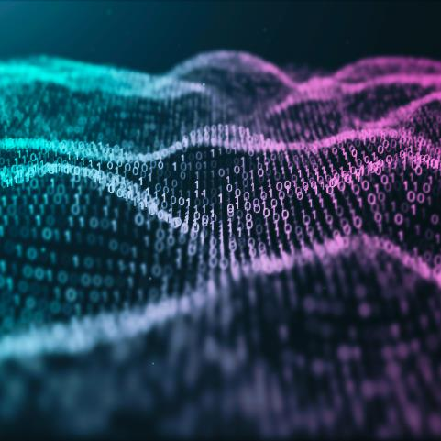
Introduction
we will understand how to interpret a DNA structure and learn machine learning algorithms to classify DNA sequence according to its Gene family and use it to build a prediction model on DNA sequence data.
In this project I proposed a novel method for classifying DNA sequences using a convolutional neural network while researchers treated DNA data as text data. In this project, 4380 human DNA sequences and 7 family genes were employed to train and test a set of models using multiclass classification technique with traditional machine learning algorithms.
Neural networks can be used to identify patterns in the sequence data that may be associated with specific genetic variations or disease risk. I am able to generate models that are near to their accuracy by recreating their architecture. Our model is achieving the accuracy of 96 %.

Slide 3
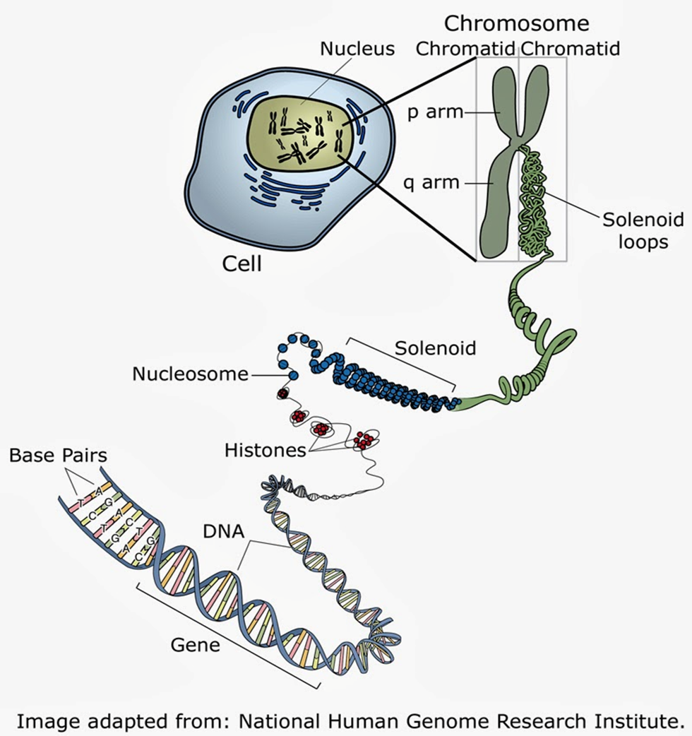
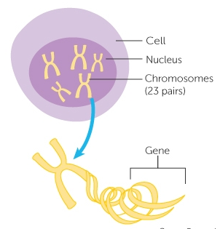
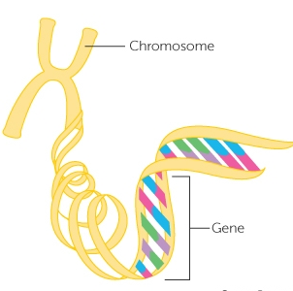
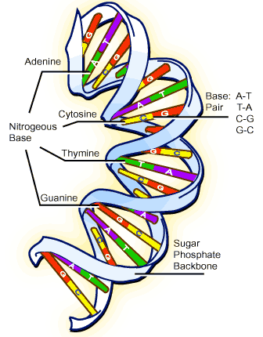
What’s DNA (Deoxyribonucleic Acid)?
DNA (deoxyribonucleic acid) is a molecule that carries genetic information in all living organisms. It is often described as the "blueprint of life" because it contains the instructions that govern the development and function of all living things.
It’s like the description of all information about your body like your eyes color, skin color, genetic diseases (like sugar disease)

Slide 4
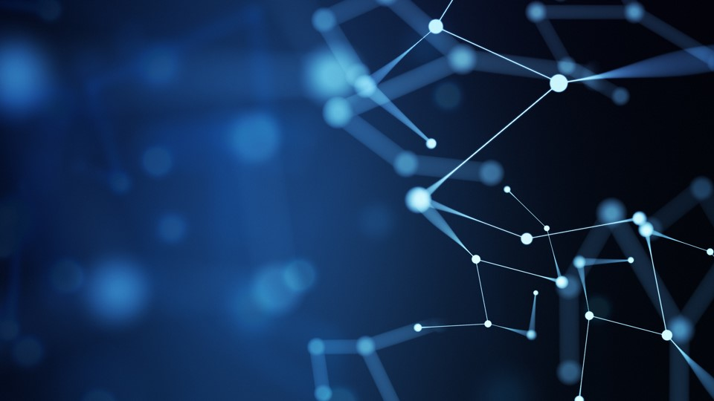
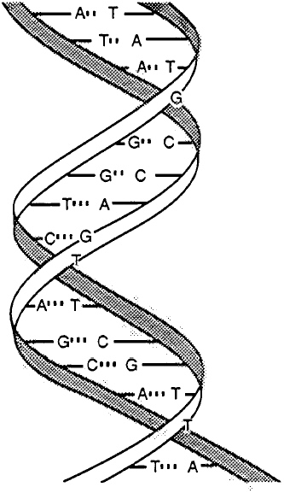
DNA was known to be a linear polymer of four building blocks called nucleotides (referred to as adenine, thymine, cytosine, and guanine, and abbreviated as A, T, C, and G) joined by a sugar-phosphate backbone.
DNA consist of: 1. Sugar (deoxyribose) 2. Phosphate 3. Base pairs
Sugar & Phosphate groups called “sugar-phosphate backbone”
Phosphate with Sugar & 1/2 Base pair called “Nucleotide”.
Watson and Crick correctly inferred the structure of most DNA.
Unwind double helix, each serves as a template for the synthesis of a complete double helix that is passed on to a daughter cell. This process of replication is carded out by enzymes called DNA polymerases.
Mutations are changes in the nucleotide sequence in DNA. Mutations can be induced by external forces such as sunlight and chemical agents or can occur as random copying errors during replication.

Slide 5
DNA sequencing
The process of determining the precise nucleotide sequence of a cloned DNA molecule. With DNA sequencing, it became possible to read the sequence of any gene in stretches of 300 to 500 nucleotides at a time. DNA sequencing has revealed striking similarities among living creatures as diverse as humans and yeast, with far-reaching consequences for our understanding of molecular structure and evolution.
Base pairs consist of four chemicals linked together via hydrogen bonds in any possible order making a chain, which gives one thread of the DNA double-helix. And the second thread of the double-helix balance the first. So if you have ‘A’ on the first thread, you have to have ‘T’ on the second & if you have ‘C’ on the first thread, you have to have ‘G’ on the second, A and T always balance each other & C and G balance each other, So once you identify one thread of the helix, you can always spell the other.
A human genome has about 6 billion characters or letters. The genome(the complete DNA sequence) is like a book, it is a book about 6 billion letters of “A”, “C”, “G” and “T”. Scientists find most parts of the human genomes are like each other.
The goal is to sequence the entire genome, but the intermediate steps include sequencing particular regions, generating more efficient and automated technology and developing better analytical methods for handling DNA information.

Slide 6
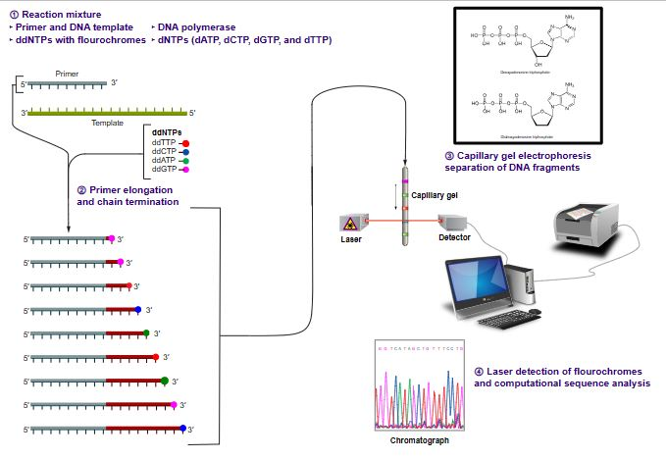
Sanger sequencing
The target DNA is copied many times, making fragments of different lengths. Fluorescent “chain terminator” nucleotides mark the ends of the fragments and allow the sequence to be determined.
Sanger sequencing gives high-quality sequence for relatively long stretches of DNA (up to about 900 base pairs). It's typically used to sequence individual pieces of DNA, such as bacterial plasmids or DNA copied in PCR.
2) Next-generation sequencing
Next generation sequencing (NGS), massively parallel or deep sequencing are related terms that describe a DNA sequencing technology which has revolutionised genomic research.
There are a variety of next-generation sequencing techniques that use different technologies.

Slide 7
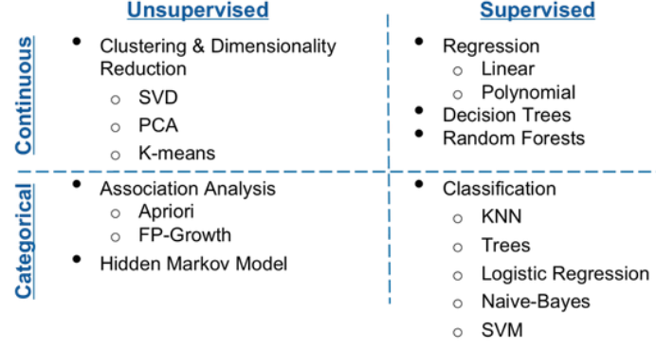
Machine Learning Algorithm

Slide 8
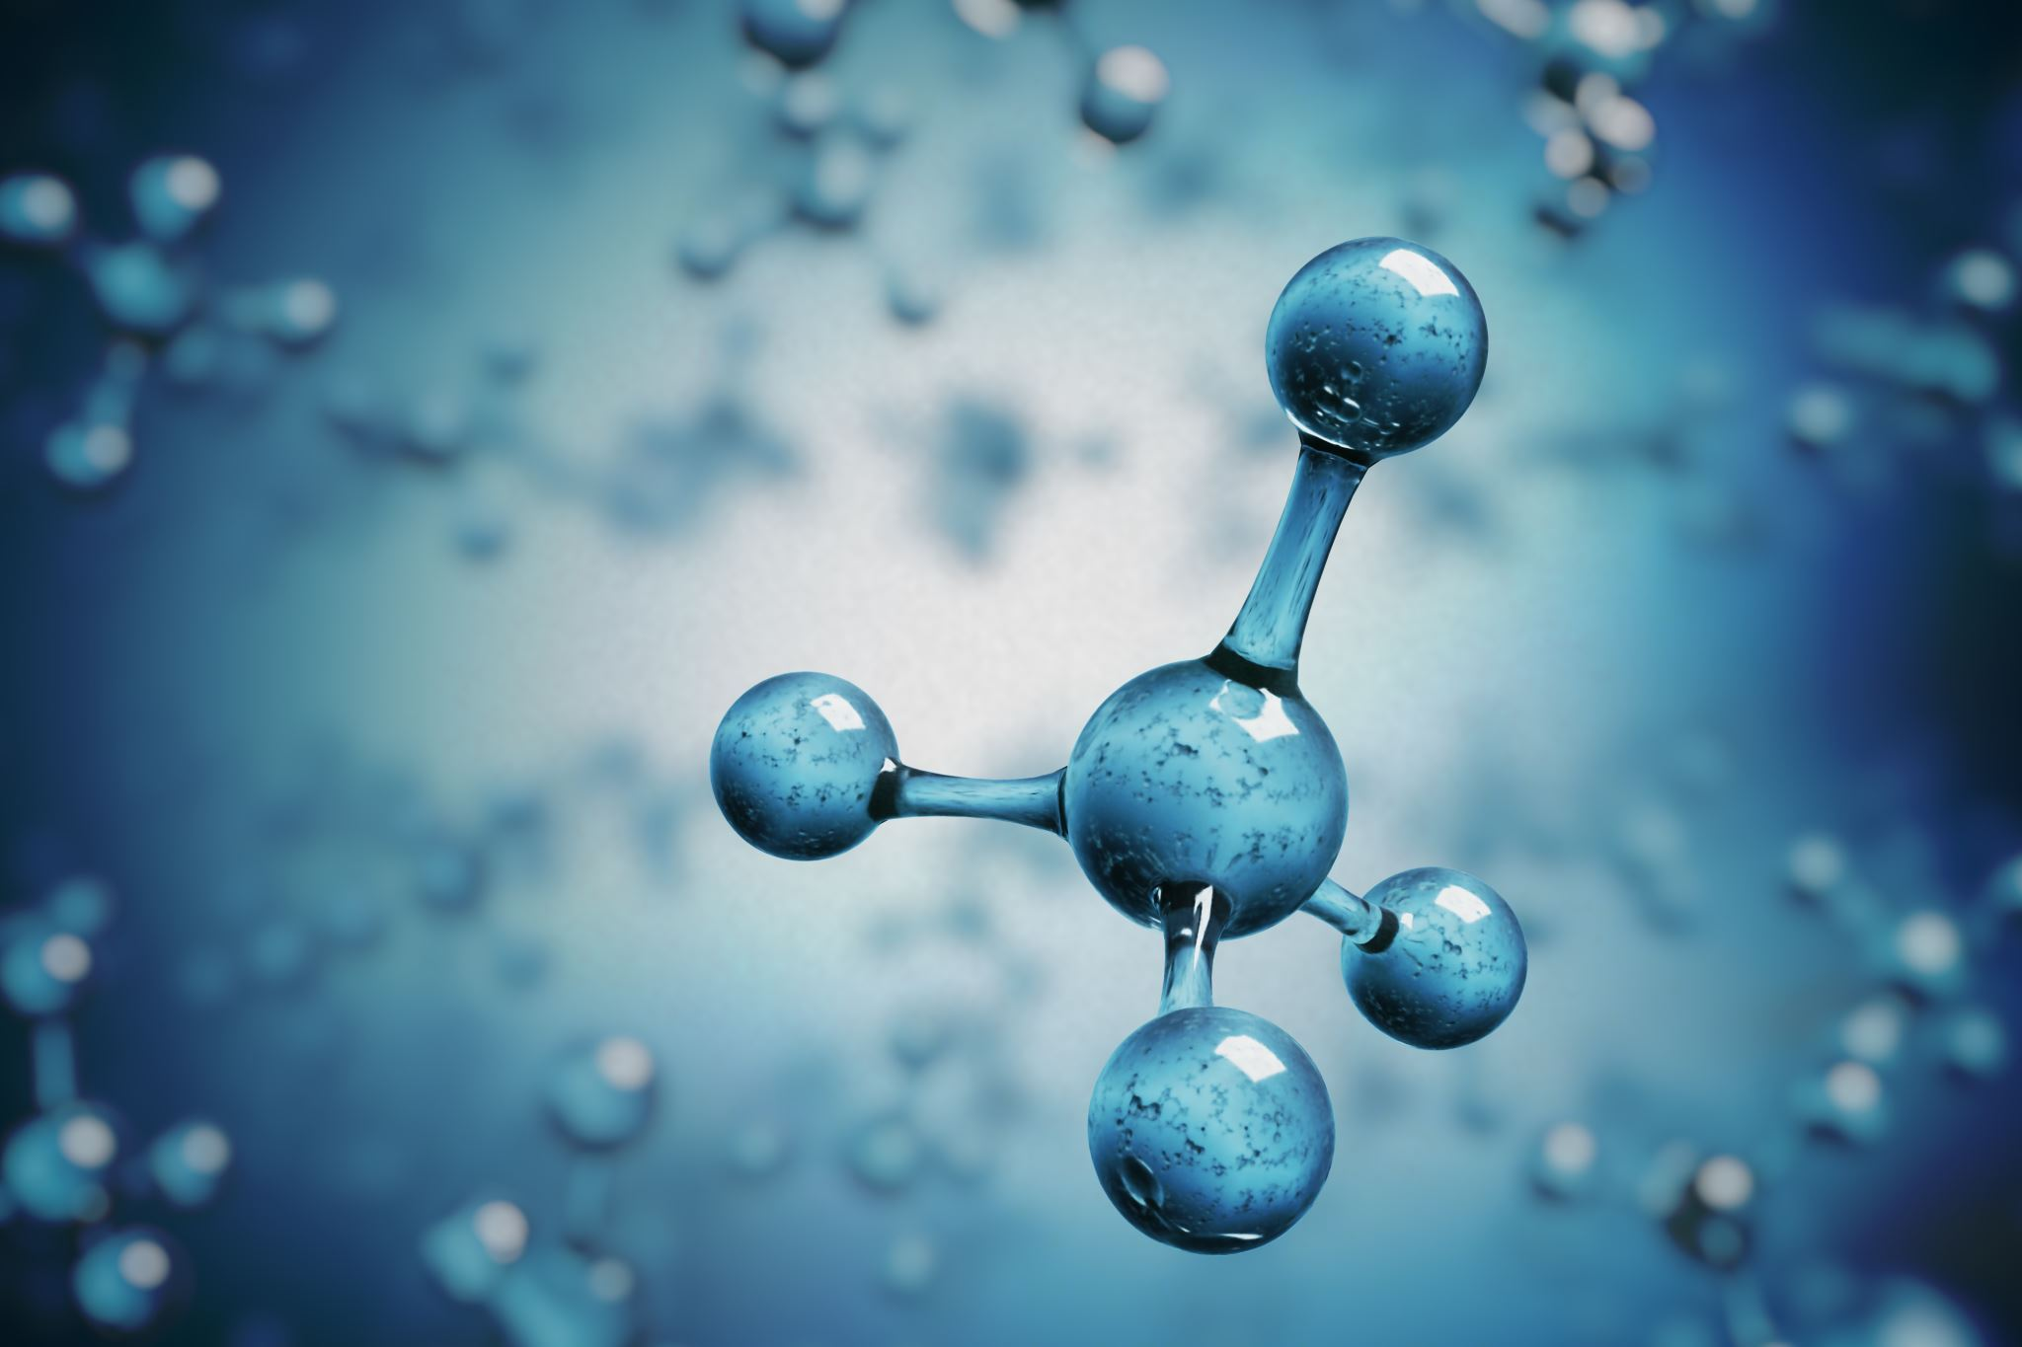
DATA EXPLORATION AND ANALYSIS
In bioinformatics, FASTA format is a text-based format for representing nucleotide sequences or amino acid (protein) sequences, in which nucleotides or amino acids are represented using single-letter codes [A,C,G,T,N] where A=Adenosine, C=Cytosine, G=Guanine, T=Thymidine and N= any of A,C,G,T. The format also allows for sequence names and comments to precede the sequences.
This project will use a dataset from the kaggle Repository that have 7 classes, where the human data has 4380 data points, with 4 sequential nucleotides (“base-pairs”) each.

Slide 9
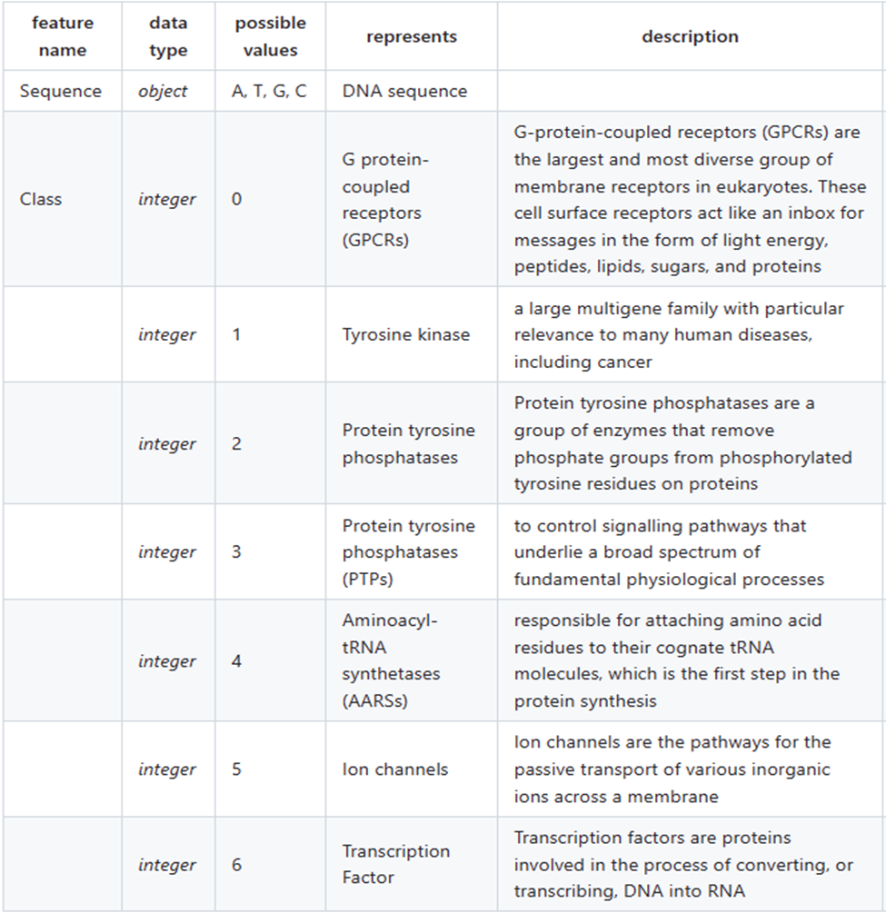
Human dataset: Represent DNA sequences of humans that contain 7 Gene classes.

Slide 10

Feature Selection
Sequence DNA is in characters but Machine learning models require numerical values or feature matrices.
To encode these characters into metrics. There are 2 general methods for encoding DNA sequences:
One-hot encoding DNA Sequence.
K-mer counting: the language of DNA sequence.
One-hot encoding DNA Sequence
When using supervised learning to train a neural network, we provide labeled input to our model, and the model gives a predicted output. Most of the time, the model's output is labels that have been encoded so that they can take the form of integers or vectors of integers.
One- hot encoding transforms our categorical labels into vectors of zeros and ones, the length of these vectors is equal to the number of classes or categories that our model is expected to classify.
This is widely used in deep learning methods and lends itself well to algorithms like convolutional neural networks. In this example, “ATGC” would become and these one-hot encoded vectors can either be concatenated or turned into
2-dimensional arrays.

Slide 11
K-mer counting DNA language:
In DNA sequences, the vocabulary comprises all conceivable k-mers of maximum length k utilizing the four DNA alphabet letters (A, C, T, G).
The vocabulary also includes the shortest of size 1 . The size of the vocabulary V= Σ^{k}_{i=1} 4^{i}
After creating the vocabulary, every sample in the dataset is split into their respective k-mers but moving a sliding window of size k over the DNA sequence, one-step at a time.
Each sample in the dataset is converted into a 1D numerical array of length equal to the vocabulary size.
Define a function to collect all possible overlapping n-grams of a specified length from any sequence string. We will basically apply the n-grams to the complete sequences.
def getKmers(gene, size=4):
allKmers=""
for i in range(len(gene) - size + 1):
allKmers+=gene[i:i+size]
allKmers+=" "
return allKmers[:-1]

Slide 12
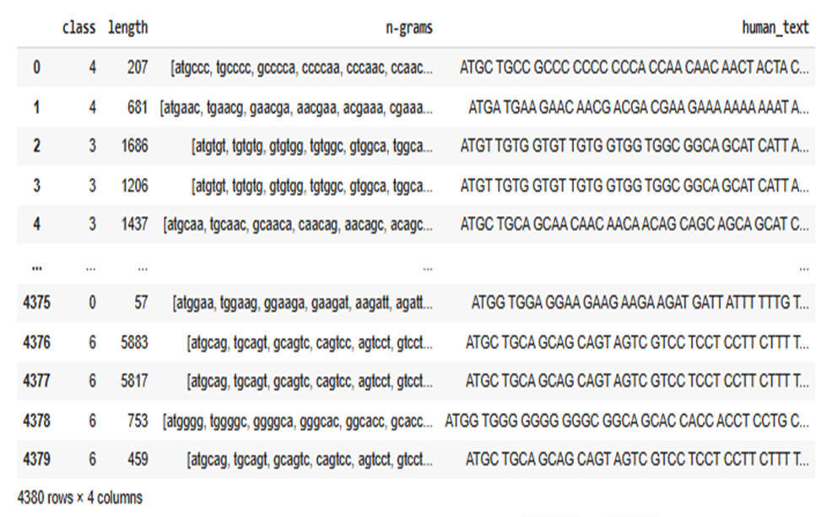
def create_ngrams(sequence, size=6):
return [sequence[x:x+size].lower() for x in range(len(sequence) - size + 1)]
human_data['n-grams'] = human_data['sequence'].apply(create_ngrams)
human_data.head(10)

Slide 13
Convolutional Neural Network Model:
The convolutional neural network is a deep learning model that extracts features from input data using convolutional layers.
A simple extension of the multilayer preceptor model.
Convolutional Neural Network consists of a number of different layers collected together in a deep architecture: an input layer, a group of convolutional and pooling layers (which can be combined in various ways), a limited number of fully connected hidden layers, and an output (loss) layer as well as hyper parameters such as learning rate, dropout probability, number of epochs, batch size, etc.
The model contains 2 convolutional layers. Each of these layers is followed by a subsampling layer. These layers are used to extract features from representation [matrices] of sequences. The extracted features are then transformed by using a fully connected neural network layer which contains 100 neurons. In this layer, we used a dropout value of 0.3 to reduce the effect overfitting. Finally, a soft max output layer is used to predict labels of input sequences.

Slide 14
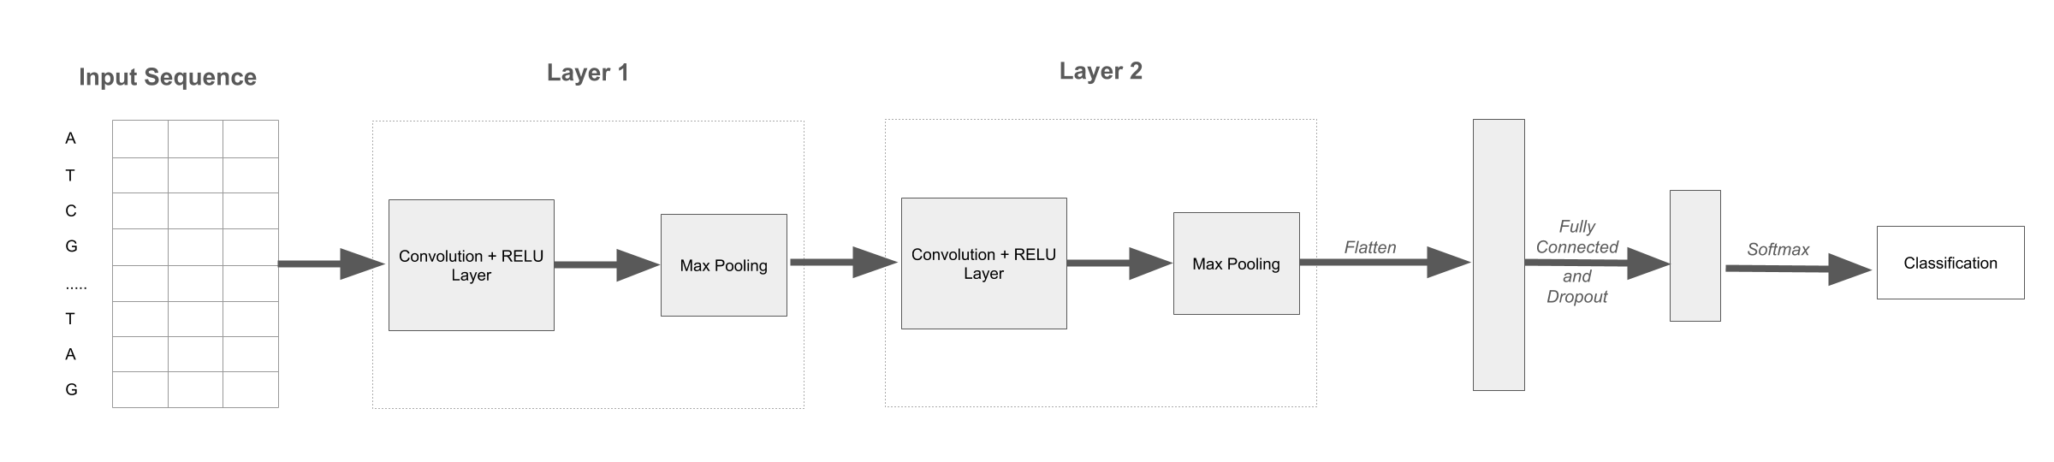
The tokenized input sequence is first put through an encoder. Then it goes through 2 layers that consist of a convolution, a RELU activation, and a max pool. The features are then flattened and go through a fully connected layer that has an output of 100 features. A softmax is then applied, and the classification provided.

Slide 15
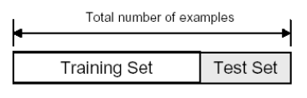
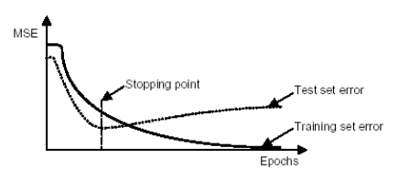
The final preprocessing step is to divide the data into training and test sets once it has been segmented into inputs and labels. However, the "model_selection" library of the "Scikit-Learn library" has the "train_test_split" method, which enables us to divide data into training and test sets with 75% Train dataset and 25% Test dataset.
Training set : Used to train the classifier
Test set : Used to estimate the error rate of the trained classifier
X_train, X_test, y_train, y_test = train_test_split(x, y, random_state=0, train_size = .75)
model = Sequential()
The stopping point for the propagation error
import tensorflow as tf
ACCURACY_THRESHOLD = 0.95
class endRun(tf.keras.callbacks.Callback):
def on_epoch_end(self, epoch, logs={}):
if(logs.get('accuracy') > ACCURACY_THRESHOLD):
self.model.stop_training = True
callbacks = endRun()

Slide 16
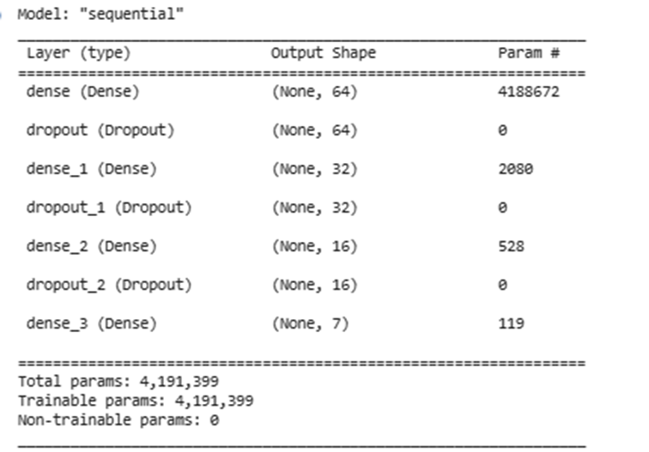
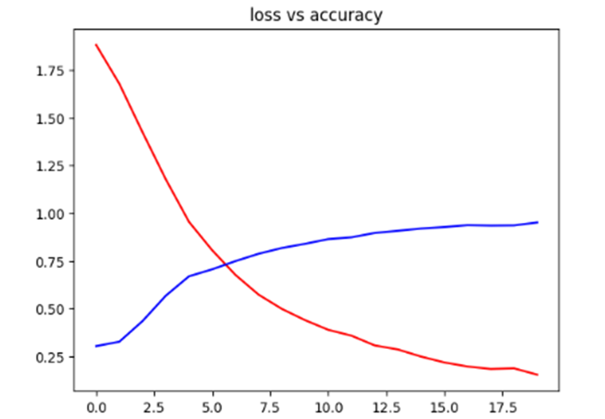
Finally, The created CNN to classify the DNA sequence and found out that, deep learning (CNN) outperforms the other machine learning methods with an accuracy of 95.5%.

Slide 17
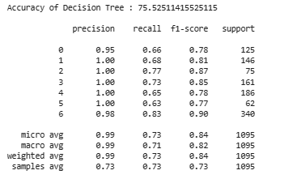
Decision Trees (DTs) are a non-parametric supervised learning method used for classification and regression. The goal is to create a model that predicts the value of a target variable by learning simple decision rules inferred from the data features. The entropy is the measure to understand the impurity or homogeneity of our data set. Since the data has class labels, the decision tree is constructed through the training set to maximize the purity among the class at the leaf nodes. The Impurity reduction from parent to child is maximum The Information gain is the measure of reduction in the entropy after the split of nodes.
Decision Trees
Making Prediction of DTC:# enter all test data test in model
dtc= DecisionTreeClassifier()
dtc.fit(X_train,y_train)
y_pred_dtc = dtc.predict(X_test)

Slide 18
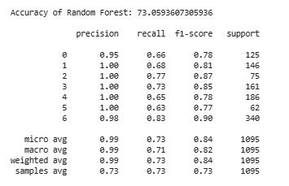
Random forest works in the concept of decision tree. Random forest contains multiple individual decision tree models. The row sampling and feature sampling is done on the dataset and fed to individual decision tree. This process of sampling the data and feeding to the decision tree model is called as bootstrap. Each decision tree predicts the class output; the majority class prediction will be the output of the random forest. This process of selecting the majority vote is named as bagging. In the random forest, the base learners are decision tree. The high variance problem in decision tree can be avoided by using the random forest as only the majority of the vote is considered in the random forest. The number of decision tree is the hyper-parameter of the model.
Random Forest
Making Prediction of RF:# enter all test data test in model
rf = 'Random Forest Classfier'
rf = RandomForestClassifier()
rf.fit(X_train, y_train)
rf_predicted = rf.predict(X_test)
rf_acc_score = accuracy_score(y_test, rf_predicted)

Slide 19
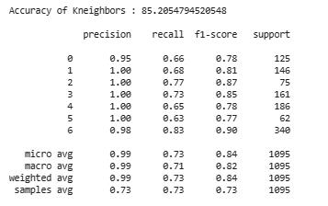
The optimal choice of the value is highly data-dependent: In general, a larger suppresses the effects of noise, but makes the classification boundaries less distinct. This strategy consists in fitting one classifier per class pair. At prediction time, the class which received the most votes is selected. The first step is to import the “KNeighborsClassifier” class from “sklearn.neighbors” library. In the second line, this class is initialized with one parameter, i.e. “n_neigbours”. This is basically the value for the K. There is no ideal value for K and it is selected after testing and evaluation, however, to start out, 5 seems to be the most commonly used value for the KNN algorithm.
K Neighbours Classifier
Making Prediction of KNN:# enter all test data test in model
knn= KNeighborsClassifier()
knn.fit(X_train,y_train)
y_pred_knn = knn.predict(X_test)

Slide 20
CONCLOSION AND FUTURE WORK
we created a CNN to classify the DNA sequence and found out that, deep learning (CNN) outperforms the other machine learning methods with an accuracy of 95.5%.
A state-of-art machine learning models like Random Tree, Random Forest, Decision Tree and K Neighbours are applied to classifier the DNA sequence. We found that the K Neighbours provided the highest accuracy of around 85.20% when compared to other machine-learning model.
there are some limitations in our model, it requires the sequence to be in uniform length. The other limitation is the numbers of samples in each class is not uniformly distributed. To improve the accuracy in future we can use ensemble model.

Slide 21
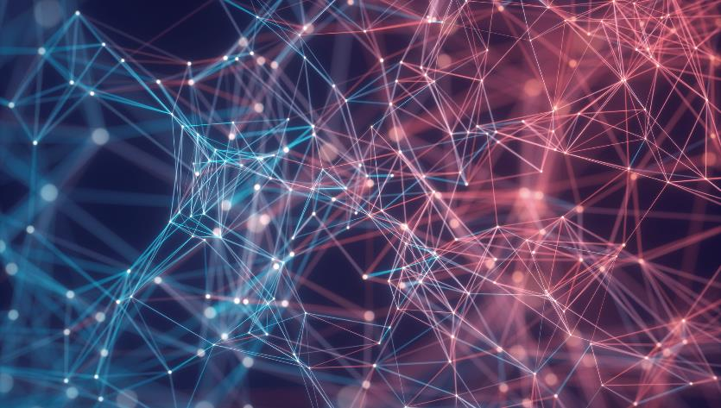
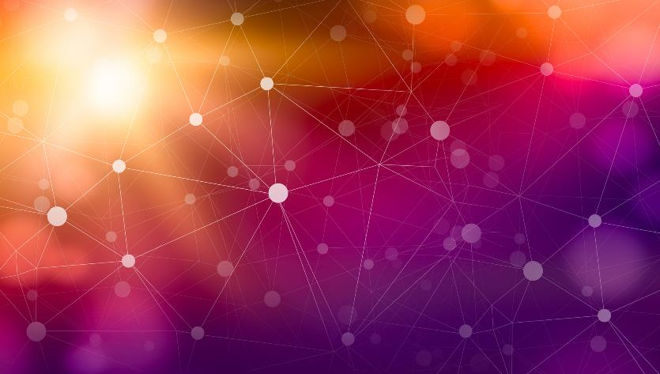
Thank You
Name: Saurav Kumar
Matricola: 923676
Email: saurav.kumar@studenti.unimi.it

