Slide 1
Socket Programming Computing Lab-II

Slide 2
Course rules
We are 2 instructors and 10 TAs
We will typically have the tutorials on Wednesdays. This will be followed by the broadcast of the assignment.
You will be given typically 1 week to solve the assignment. Wednesday following week 2pm would be the deadline for the submission therefore.
Plagiarism penalty = 0 in the corresponding assignment. We will use softwares to check the similarity. >=50% similarity = Plagiarism.
Submissions will be on moodle and evaluation will be typically offline (unless otherwise declared).
++++++++++++++++++++++++++++++++++++++++++++++++++++++++++++++++++++++++++++++++++++++++++++++++++++++++++++++++
The entire batch will be divided into groups of 7-8 each. One TA will dedicatedly connect to help you for all your doubts just after the assignment is floated on Wednesday. This will be done by a common meet link shared between the group and the TA and will last upto 5pm Wednesday.
Friday class: ONLY for additional doubt clearance. If you have any leftover doubts, please take prior appointment with your group TA and meet on Friday to clarify your doubts. If the doubt is still not cleared, you can get in touch with one of the instructors.

Slide 3
Socket and types
Sockets allow communication between two different processes on the same or different machines. To be more precise, it's a way to talk to other computers using standard Unix file descriptors.
A Unix Socket is used in a client-server application framework. A server is a process that performs some functions on request from a client. Most of the application-level protocols like FTP, SMTP, and POP3 make use of sockets to establish connection between client and server and then for exchanging data.
There are four types of sockets available to the users. The first two are most commonly used and the last two are rarely used.
Stream Socket (SOCK_STREAM) : Stream sockets are reliable two-way connected communication streams.
Datagram Socket (SOCK_DGRAM) : Datagram sockets are sometimes called “connectionless sockets”.
Raw Socket
Sequenced Packet Socket

Slide 4
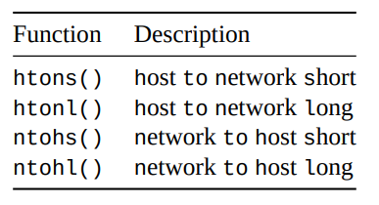
Byte Order
Byte order refers to the order multi-byte are stored by the hardware.
Little-Endian : store the bytes reversed, so b34f would be stored in memory as the sequential bytes 4f followed by b3. This storage method is called Little-Endian.
Big-Endian : It is also called Network Byte Order.
Host Byte Order: If it’s an Intel 80x86, Host Byte Order is Little-Endian. If it’s a Motorola 68k, Host Byte Order is Big-Endian.
A lot of times when you’re building packets or filling out data structures you’ll need to make sure your two and four-byte numbers are in Network Byte Order.
There are two types of numbers that you can convert: short (two bytes) and long (four bytes). These functions work for the unsigned variations as well. Say you want to convert a short from Host Byte Order to Network Byte Order. Start with “h” for “host”, follow it with “to”, then “n” for “network”, and “s” for “short”: h-to-n-s, or htons() (read: “Host to Network Short”).

Slide 5
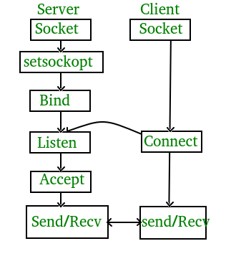
Creating Socket on Server Side
Create a socket with the socket() system call.
Bind the socket to an address using the bind() system call. For a server socket on the Internet, an address consists of a port number on the host machine.
Listen for connections with the listen() system call.
Accept a connection with the accept() system call. This call typically blocks until a client connects with the server.
Send and receive data using read() and write() system calls.

Slide 6
Creating Socket on Client Side
Create a socket with the socket() system call.
Connect the socket to the address of the server using the connect() system call.
Send and receive data using read() and write() system calls.

Slide 7
Problem Description-
Problem 1-
Write two separate C program, one for TCP server and one for TCP client in which server listens on some port, client connects to server sending some arbitrary message and server acknowledges it.
Problem 2-
Write two separate C program, one for TCP server (handles request for single user) and other one for client.
At server side-
Creates a socket and listens on some specific port to process client request.
There is a default file present having n lines and the server should be able to process EVALUATEX and WRITEX request from the client.
1. The server process should tokenize string received from the client that may contain EVALUATEX or WRITEX request in following format-

Slide 8
Problem Description-
EVALUATEX k- read kth line from the starting of file, evaluate the expression and return result to client.
Algorithm for Expression Evaluation-
Create 2 stacks for arithmetic expression evaluation, one value stack to store the numbers and another operator stack to store the operators.
1. While there are still tokens to be read in expression,
1.1 Get the next token.
1.2 If the token is:
1.2.1 A number: push it onto the value stack.
1.2.2 A left parenthesis: push it onto the operator stack.

Slide 9
Problem Description-
1.2.3 A right parenthesis:
1 While the thing on top of the operator stack is not a left parenthesis,
1 Pop the operator from the operator stack.
2 Pop the value stack twice, getting two operands
3 Apply the operator to the operands, in the correct order.
4 Push the result onto the value stack.
2 Pop the left parenthesis from the operator stack, and discard it.
1.2.4 An operator (Call it thisOp):
1 While the operator stack is not empty, and the top thing on the operator stack has the same or greater precedence as thisOp,

Slide 10
Problem Description-
1 Pop the operator from the operator stack.
2 Pop the value stack twice, getting two operands.
3 Apply the operator to the operands, in the correct order.
4 Push thisOp onto the operator stack.
2 Push thisOp onto the operator stack.
2. While the operator stack is not empty,
1 Pop the operator from the operator stack.
2 Pop the value stack twice, getting two operands.

Slide 11
Problem Description-
3 Apply the operator to the operands, in the correct order.
4 Push the result onto the value stack.
WRITEX expr- append expression string to the end of file present at server and return “SUCCESS!!” to the client as acknowledgement.
At client side-
1. Client process should take input from the user whether to EVALUATE or WRITE on the server side.
2. It then initiates connection to server and forwards the query to server.
3. Receives output from server and displays it to the user.

Slide 12
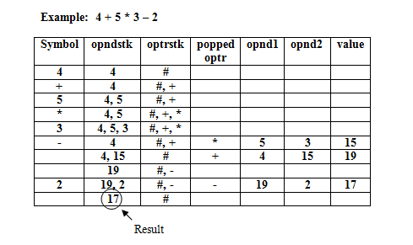
Example of infix expression evaluation

Slide 13
Submission Guidelines
File submission name –
server.c
client.c
Compress the folder into a tar.gz format only.
Name of the compressed folder should be in format A1_RollNo.tar.gz for assignment1 ( Example : A1_20CS60R01.tar.gz )
Code should be properly commented and indented.
Marks will be deducted if above guidelines are not followed.

Slide 14
Online Tutorial Link
https://www.linuxhowtos.org/C_C++/socket.pdf
http://alumni.cs.ucr.edu/~ecegelal/TAw/socketTCP.pdf
https://beej.us/guide/bgnet/pdf/bgnet_usl_c_1.pdf
https://www.geeksforgeeks.org/socket-programming-cc/

