Slide 1


Zomato analysis

Slide 2
Title: Building Data Model & KPI Analysis
GROUP 04
1. SRUSHTEE Kokate 4. ISHA AGRAWAL 7. Saurav Maurya
2. Pranit NADAWADEKAR 5.Afrin Ansari
3. Pragatidhar Sharma 6. UPENDRA GOSAVI

Slide 3
introduction
Zomato is prominent Online Food Delivery and Restaurant discovery platform operating globally with millions of users and an extensive network of restaurants. Zomato plays significant role in the food Industry.
The usage of Zomato has tremendously increased from past few years. The main aim of the project is to perform the descriptive and statistical analysis based on few goals designed
Excel , Pivot charts, Powerbi,Tableau, MySql tools are used to analyse the data and interpret the results.

Slide 4
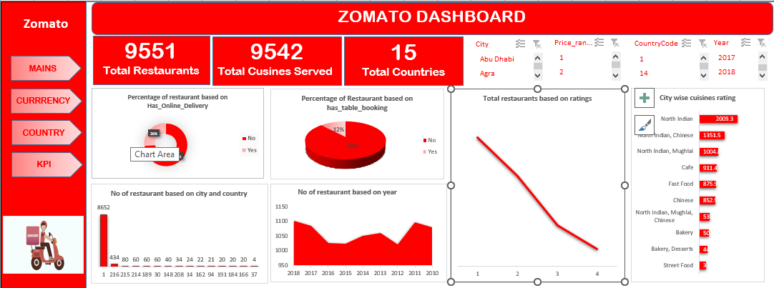
Data analysis in excel
Utilize Excel Functions and tools to analyse the data
Create Pivot tables ,charts, trends, rating and popular cuisines.
This dashboard interactive using features like slicers, filters, and dropdown lists for user-friendly navigation

Slide 5
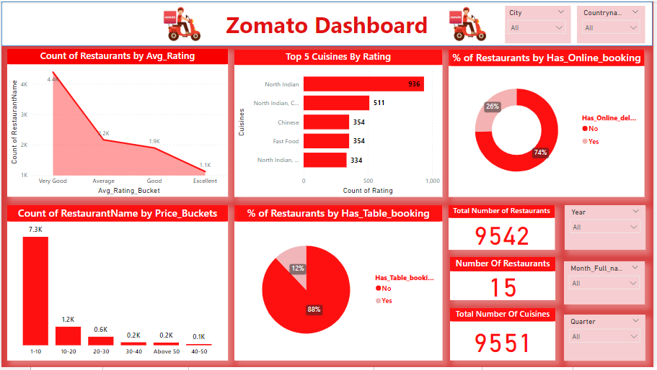
Data analysis in power bi
Utilize the Power BI features like first we extract the data then we created the relationship between the data sources.
Introduce calculated columns and measures.
Combine multiple visualizations into a signal sharable view.
The Visual used are bar chart, column chart donut chart, slicers, cards, filters applied on it
The special visual , scroller visual also imported to showcase the data

Slide 6
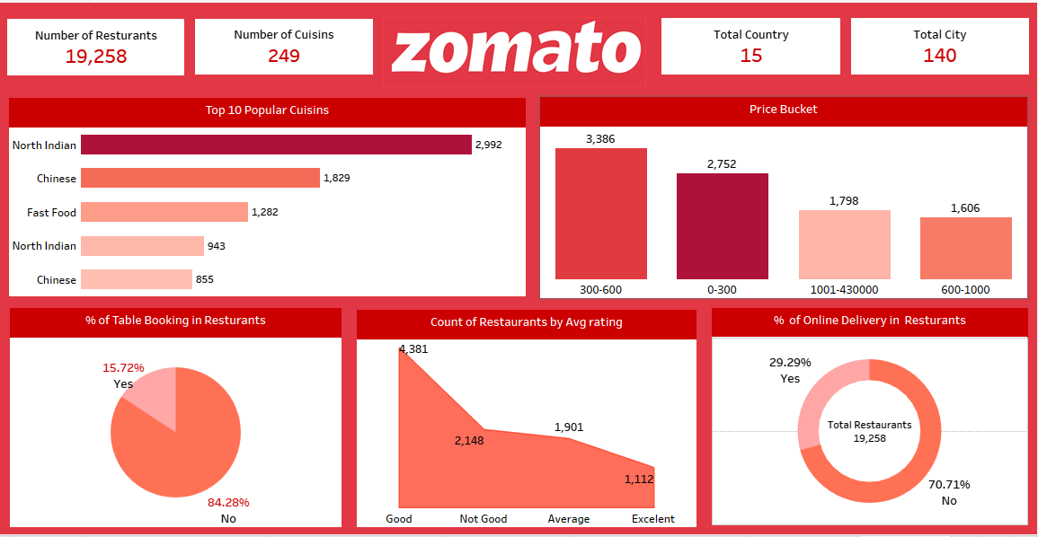
Data analysis in tableau
Utilize Tableau’s features to create Visualizations like bar charts , maps,
And scatter plots to represent various aspects of restaurant data.
Interactivity in tableau :- implement , filters, actions and dynamic
Parameters to allow users to interact with the dashboard.
Enable users to explore specific regions, cuisines or rating dynamically.

Slide 7
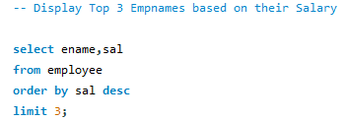

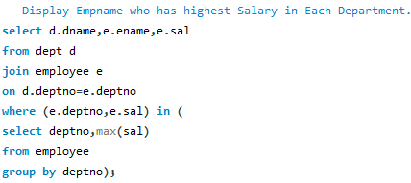

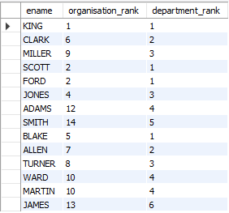
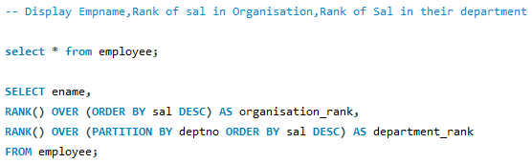
DATA ANALYSIS IN SQL
In this we can see that top 3 employees are listed according to their salary
In this we can see that department wise top employees are listed according to their salary
In this we can see that rank of employees by organization and by department wise is listed according to their salary

Slide 8


