Slide 1
Data Science Capstone Project Part of Coursera IBM Applied Data Science Capstone
Opening a Supermarket in Los Angeles, California
By: Saurav Arun Nair
22nd May 2020

Slide 2
Introduction
In today’s fast paced world, there is should be a one stop place for everything people would like to purchase rather than having to visit different shops for every particular item on their shopping list as this would be very time consuming. Supermarkets are stores where one can easily purchase all the required items like grocery, toys, food, packaged products, home appliances, clothes etc. Supermarkets are efficient as they provide the customer all they need at one location without having to visit different stores for each particular item. There are various supermarkets in Los Angeles namely Raley’s Supermarket, Rosco Supermarket, CostCo, Walmart etc. As Efficient as they are, Supermarkets are costly to build and maintain as they require a big amount of land. For a real estate developer or investor, it is important that the supermarket is opened in such a location where there is less competition from other supermarkets.

Slide 3

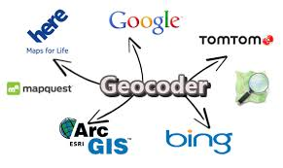

Data Source
Los Angeles neighbourhood names from Wikipedia.
Geocoder package to gather latitude and longitude data.
Foursquare API to gather venue data for each Neighbourhood.

Slide 4
Data Description
Neighbourhood names will gathered from Wikipedia from the source mentioned in the data description section. We will also require longitude latitude details of all the neighbourhoods in our data which can be obtained through the geocoder package in python. Venue data for each neighbourhood will also be required to see what are the different outlets in a particular neighbourhood. For this purpose, we will use Foursquare API which will allow us to get nearby venue data for each neighbourhood.

Slide 5
Methodology
Analytic approach: We use K means clustering method to divide the neighbourhoods into various clusters based on the presence of supermarkets. This will help us to understand how many supermarkets are present in a neighbourhood. The cluster with the least amount of supermarkets will be our target cluster.
Data Requirements: Neighbourhood names will gathered from Wikipedia from the source mentioned in the data description section. We will also require longitude latitude details of all the neighbourhoods in our data which can be obtained through the geocoder package in python. Venue data for each neighbourhood will also be required to see what are the different outlets in a particular neighbourhood.
Data Collection: Once the data requirements are met we can check the data for possible outcomes. This initial phase will help us determine if we need more data and if the data has enough parameter to make a decision. This will also help us understand if we have enough data related to supermarkets to make a prediction as to where a new supermarket can be opened.
Data Understanding and Preparation: using descriptive statistics and visualization we can determine how certain parameters or variables are related to each other to better understand the link between the data by using techniques like correlation. In terms of visualization, We can use Folium package in Python to plot our data using the longitude latitude collected through geocoder.
Modelling and Evaluation: K means clustering will be used to divide the data into clusters which will help us identify location with no or less supermarkets. Of the 4 clusters created, we can see that neighbourhoods in cluster 1 has no supermarkets. These neighbourhoods can serve as places where a new supermarket can be opened.

Slide 6
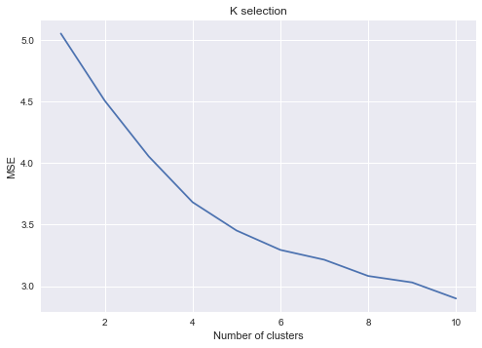
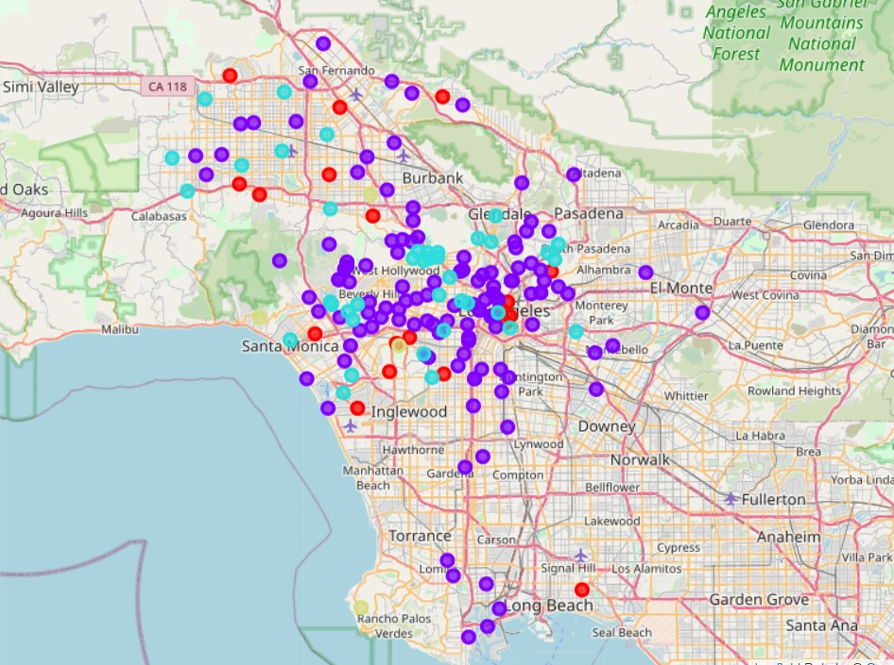
Outputs

Slide 7
Results
After using the K means algorithm we can see that the data can properly clustered into 4 clusters as per the image below. Dividing the neighbourhood into 4 clusters we can see that cluster 1 has no supermarkets followed by some supermarkets in cluster 2, cluster 0 and cluster 3 respectively. This tells us that cluster 1 can be used further to determine a location for our supermarket. As there are no Supermarkets in the neighbourhoods present in cluster 1, there will less competition. This will ensure that the business will run efficiently.

Slide 8
Future Scope
Based on the above discussion section, we can further continue our analysis by including data for cost of land in each neighbourhood. We will also need to include data for population in each neighbourhood as these two factors will play a key role in determining the neighbourhood that will be the most suitable for opening a supermarket. Although, Supermarkets may not be present in the neighbourhood that we finalize, we may also need to consider the smaller establishments that sell the same products our supermarket is willing to sell. This may affect the business as people may rely on such stores to get their items. We can gather more data from Foursquare API to check for more similar establishments in the neighbourhood.

Slide 9
Conclusion
Based on the Analysis, we can confirm that neighbourhoods present in Cluster 1 can serve as the best locations to open a new supermarket. We can further analyse base on cost of land and population data of these neighbourhoods to pick out one neighbourhood that will best suit to open a new supermarket.

