Slide 1
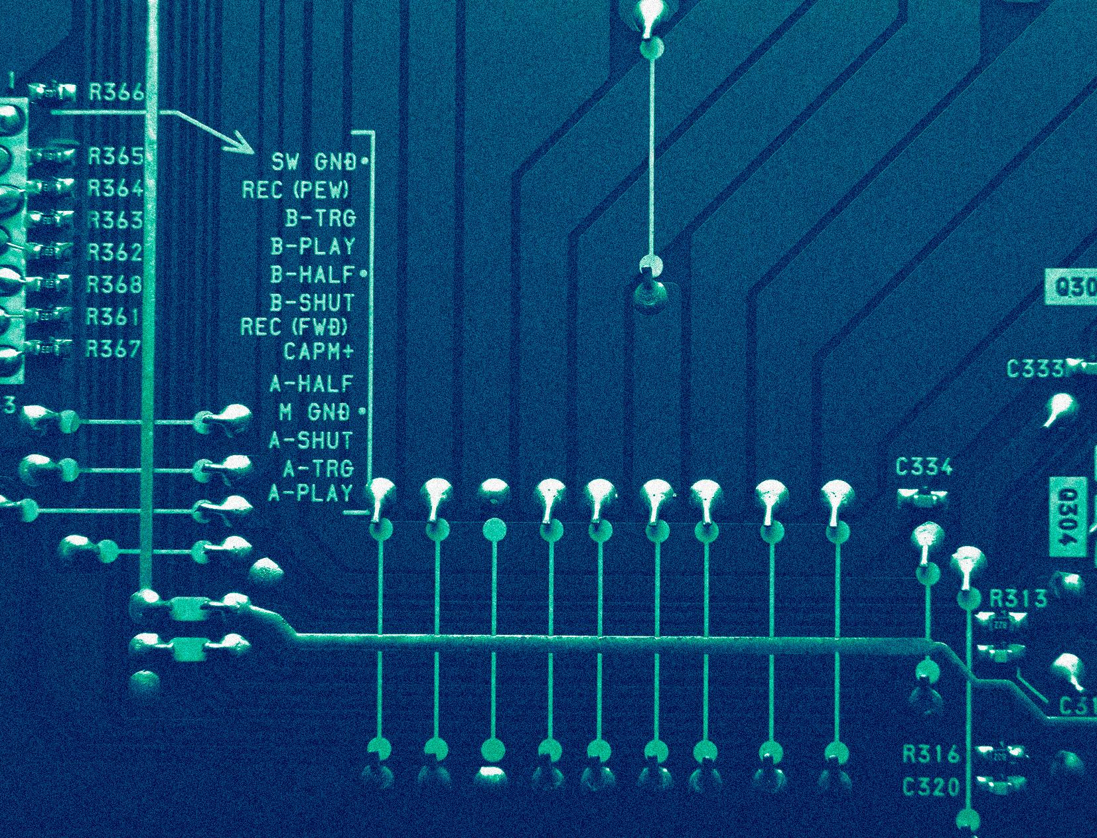

SOFTWARE GROUP PROJECT:
THE AUCTION
ACTION
Are you ready to sell ? 💸💸💸

Slide 2
Contents
Member Details
Project Definition
Abstract
Literature Review
Project Planning
Technology Stack
Proposed Outcome
Lights off … away we go
🏎️💨

Slide 3
Member Details
NAME | ENROLLMENT NUMBER
Manan Shah | IU1941230068
Saurav Panchal | IU1941230093
Abhi Patel | IU1941230097
🏎️💨
01

Slide 4

Project Definition
To enable auction experience from comfort of your couch.
🏎️💨
02

Slide 5
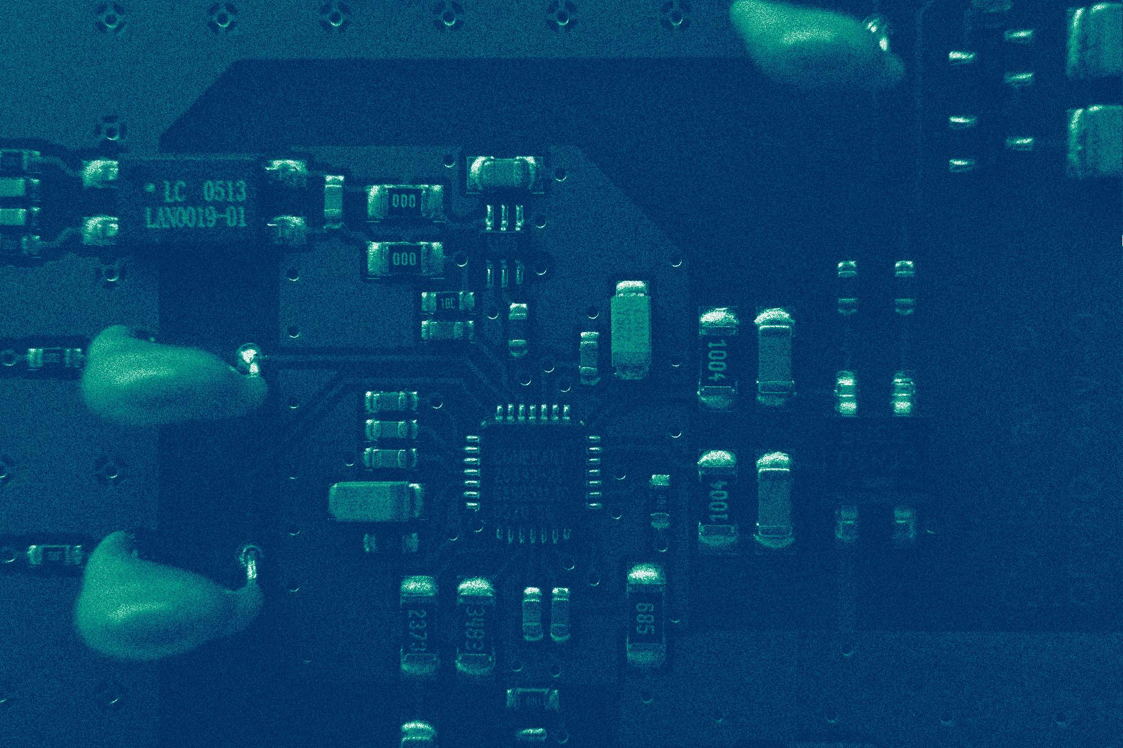
Abstract
E-auction are among the most significant online business applications. Their impact changes market significantly due to online auctions, on trading in business to business, business to consumer as well as in the consumer to consumer segment. Customers are moving toward to online Auction for purchasing and selling items, so e-auction is increasing with the flow of time. Quite a few companies have started projects of their own, trying to improve their purchasing as well as sales channels. We will use ReactJS and Django technologies for our project. We aim at building a robust online auction system involving the bidder and the seller.
🏎️💨
03

Slide 6
Literature Reviews
Paper - 1
Paper - 2
Paper - 3
To achieve goal online auction system using the Unified Modelling language technique.
By using XML & SA-MDSOC, shows how to model concerns of an online auction system.
The whole designing process of the online auction system is using AOSAD
🏎️💨
04
Notes:
AOSAD - Aspect-Oriented Software Architecture Design approach

Slide 7
Paper - 1
Paper - 2
Paper -3
http://ieeexplore.ieee.org/xpl/articleDetails.jsp?tp=arnumber=5232484 queryText%3DOnline+Auction+System
http://ieeexplore.ieee.org/xpl/articleDetails.jsp?tp=arnumber=6682396 queryText%3DOnline+Auction+System
http://ieeexplore.ieee.org/xpl/articleDetails.jsp?tp=&arnumber=4690594&queryText%3DOnline+Auction+System
🏎️💨

Slide 8
Project Planning
Planning
Analysis
Design
Development
Testing
Integration
Literature survey, target audience and available market
Feasibility study, functional / non-functional requirements
User experience and interaction
Rapid, robust and scalable with QA
Unit Testing and QC
Loosely coupled and high cohesion
🏎️💨
05

Slide 9
Technology Stack
ReactJS
PostgreSQL
Django
Simple, fast, reusability and component-based approach
(v18)
Open-source, readability, offer relational/non-relational support and reliable
(v14.1)
Robust, secure, rapid development, clean design and scalable
(v4.1)
🏎️💨
06

Slide 10
Proposed Outcome
Accessibility
Bid in seconds
1
2
3
4
Scalable
No limited seats
🏎️💨
07

Slide 11
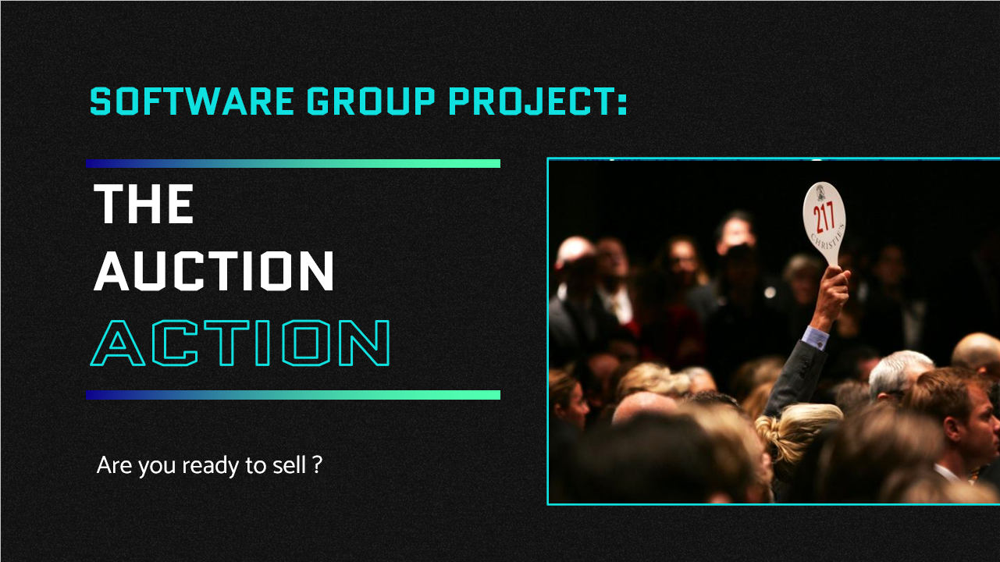
Thank You !
Questions ? 🔨
{ shahmanan .19.cs } \
{ sauravpanchal .19.cs } \
{ abhipatel .19.cs } \
@iit.indusuni.ac.in
🏁🏎️💨

