Slide 1
Solar Power Forecasting
Group: 24
VAIBHAV PARIKH 1217458
SAURAV DHARMESHBHAI PATEL 1220888

Slide 2
Topics
Previous Work
Data set
Data Preparation
Output
Model Evaluation
Conclusion
Reference

Slide 3
Previous Work
Previously we read different relevant research papers and algorithms which they had used and based on that we tested and tried to implement it.
We collected Data and worked on the data based on the research paper and tried different ML algorithms.

Slide 4
Data set
The data set is of the 21 German Solar Farms and their power generated.
To make their output comparable we have converted it into the normalized form.
Which makes this algorithm even better because we can use it to generalize the algorithm.
This data is of 990 days.
So we had total data of 121580 and 55 features.

Slide 5
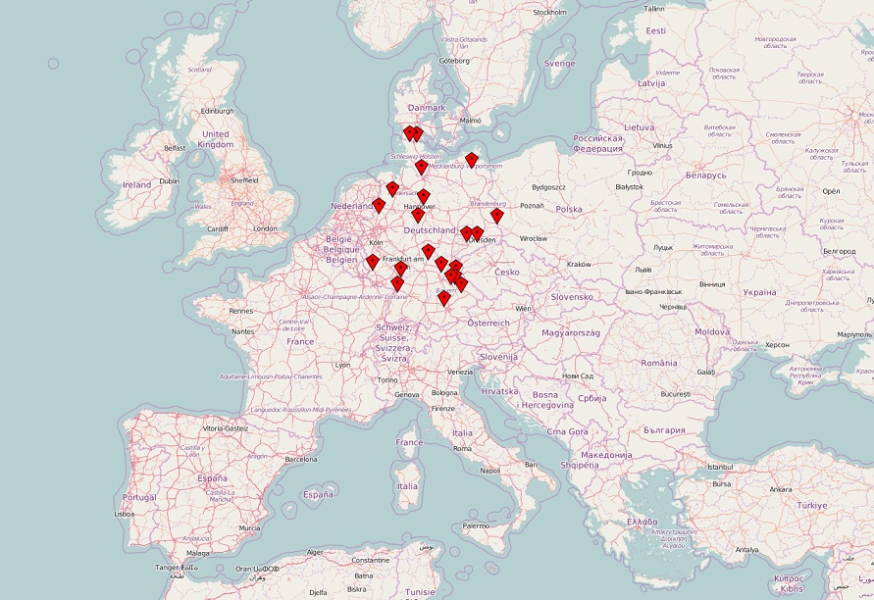

Slide 6
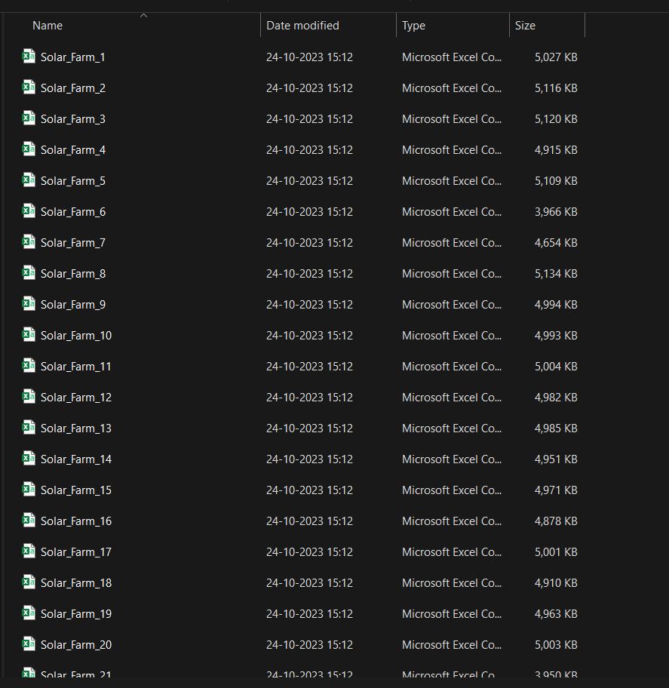
Data of different Solar Farms of Germany.
We got this data from the research paper we read

Slide 7
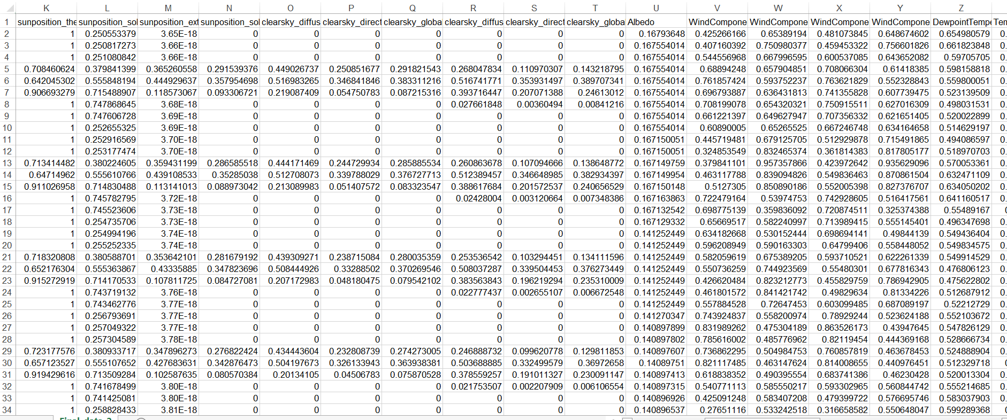
Data set

Slide 8
Data set
1)Weather data:- Temperature, Relative Humidity, Wind speed.
2)Solar Radiation:- Global Horizontal Irradiance, Direct Normal Irradiance, Diffuse Horizontal Irradiance and Spectral Irradiance.
3)Past Data:- for the training of the model
4)Cloud Cover:- It can be calculated with resistance temperature detector. (It is difficult to calculate the accurate data for all solar panels)
5)Solar Sensor Data
6)Geographical Data (some solar panels are at the fixed position.)
7)Other:- snow cover,terrain and topology

Slide 9
Data Preparation
Data Collection
Data Cleaning
Handling the null values.
Data Exploration
Used normalized format data so that different solar farm can be taken into account.
Convert the simple data into sequential format.

Slide 10
Why we took LSTM (Long Short Term Memory)
Temporal Dependency Handling
Time Series Data
To Capture the trends (Yearly trends)
Non- Linearity
Information Integration
Handling Irregular Intervals

Slide 11
Note:- Before LSTM we explored different Algorithms
We read different research papers and tried the following algorithm.
We tried the MLP(Multilayer Perceptron) algorithm but didn’t receive that much accuracy.
We also tried to use DBN for the feature extraction and LSTM to train data on that network, but it didn’t perform well.
We tried to tune it, and we made some progress, but we found out that due to DBN, it was losing some temporal features.

Slide 12
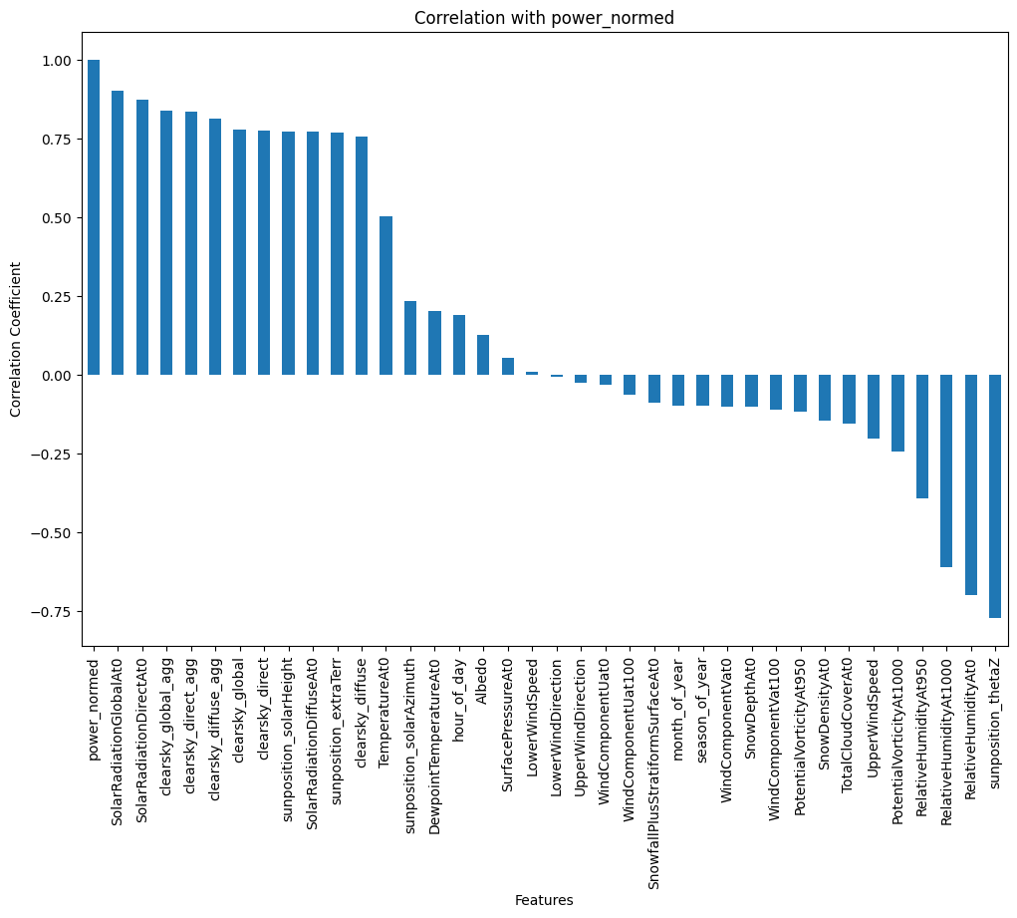

Slide 13
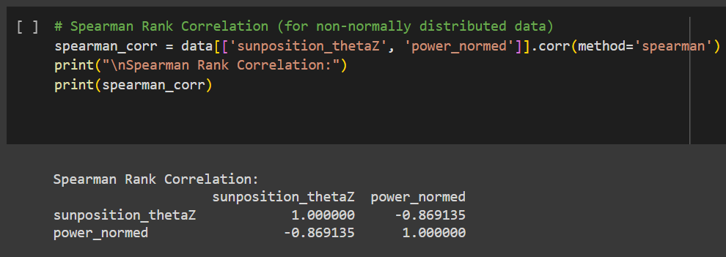
Spearman Rank Correlation

Slide 14
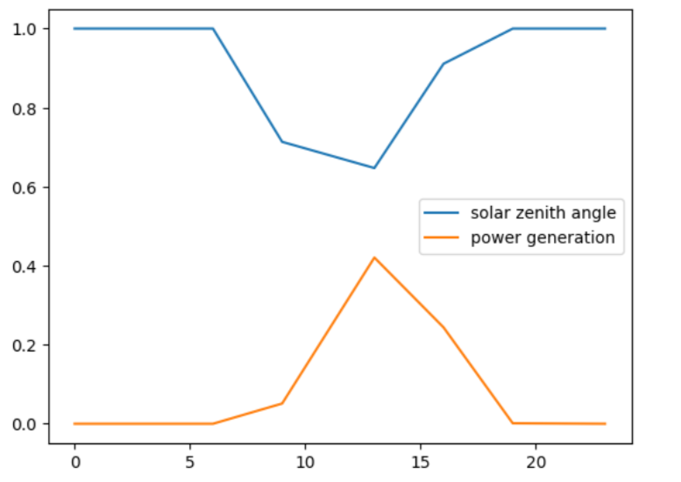

Slide 15
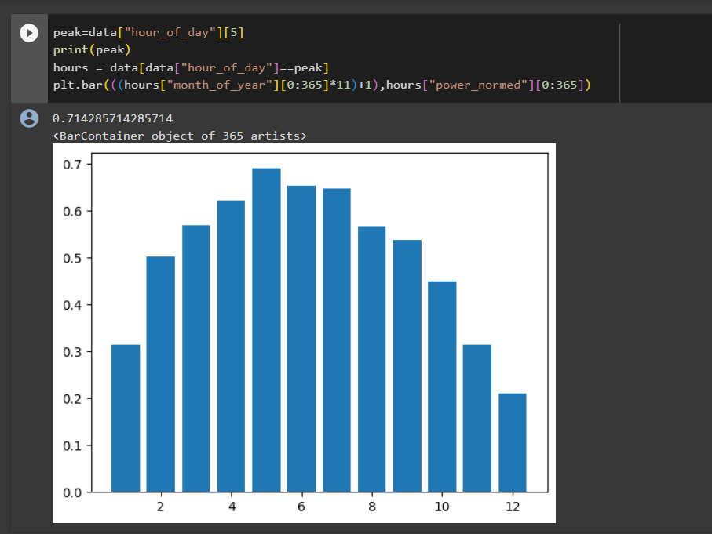

Slide 16
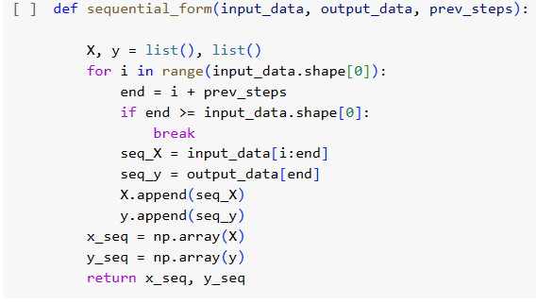
Data conversion into sequential format

Slide 17
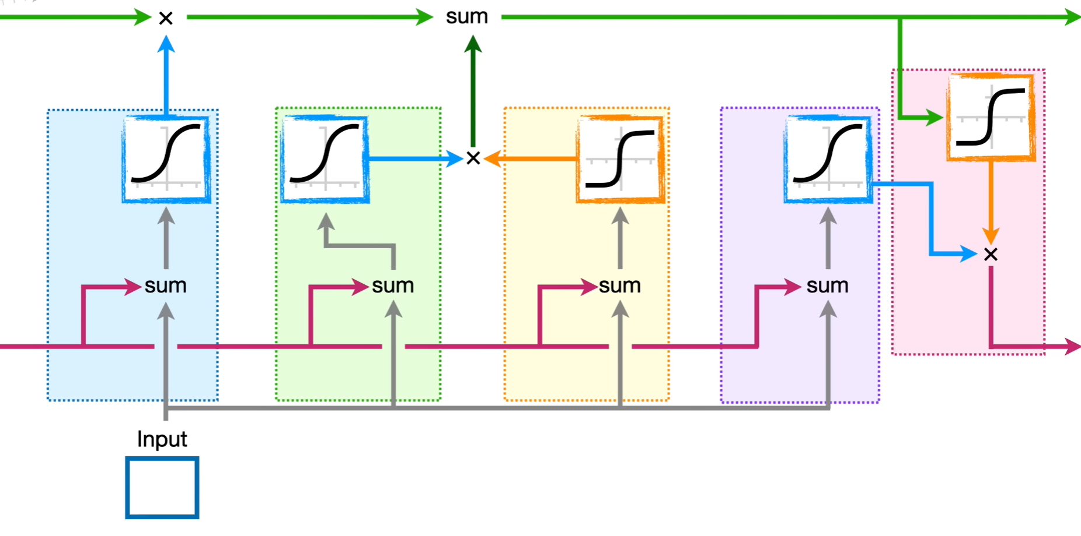
LSTM Model
Ref:- https://bit.ly/3QryY3O

Slide 18
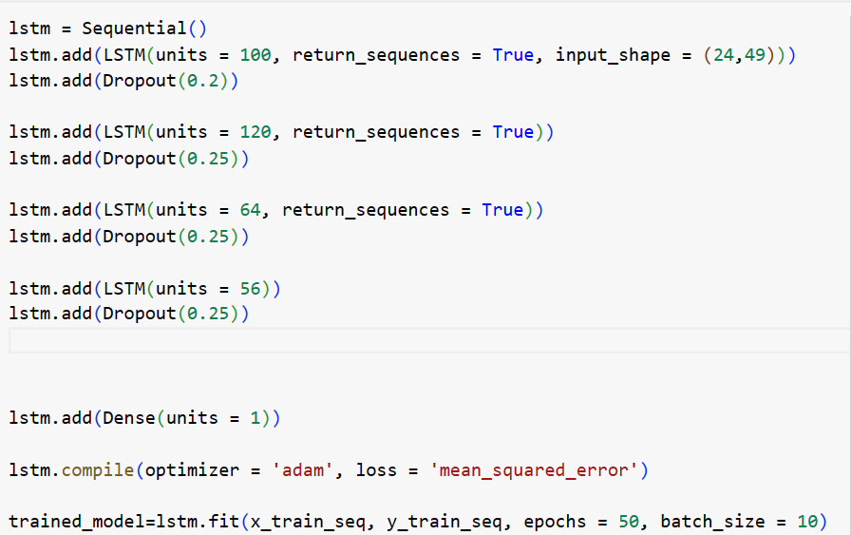
LSTM Code

Slide 19
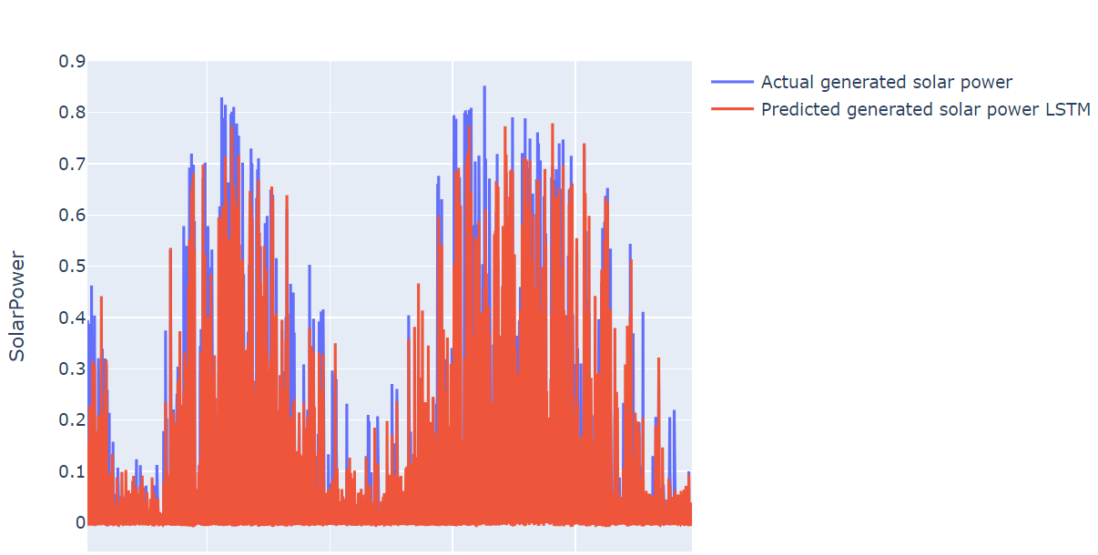
Model Evaluation

Slide 20
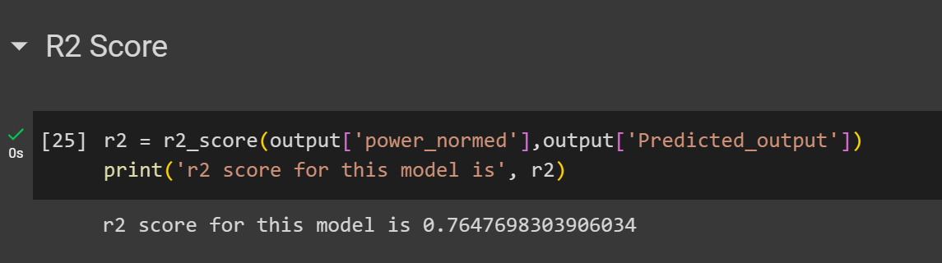
Performance Metrics : R2 Score

Slide 21
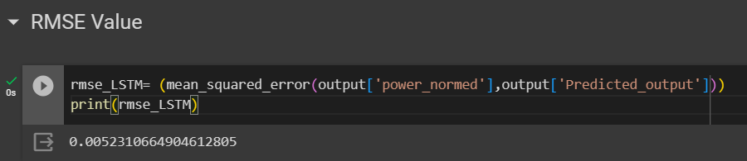
Performance Metrics: RMSE Score

Slide 22
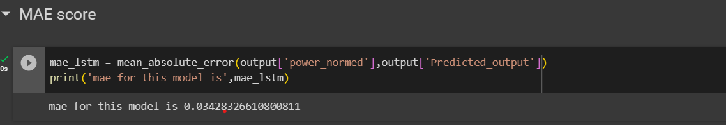
Performance Metrics : MAE Score

Slide 23
Reference
1.Gensler, André, Janosch Henze, Bernhard Sick, and Nils Raabe. "Deep Learning for solar power forecasting—An approach using AutoEncoder and LSTM Neural Networks." In 2016 IEEE international conference on systems, man, and cybernetics (SMC), pp. 002858-002865. IEEE, 2016.
2.Wan, Can, Jian Zhao, Yonghua Song, Zhao Xu, Jin Lin, and Zechun Hu. "Photovoltaic and solar power forecasting for smart grid energy management." CSEE Journal of Power and Energy Systems 1, no. 4 (2015): 38-46.
3.Wang, Huaizhi, Yangyang Liu, Bin Zhou, Canbing Li, Guangzhong Cao, Nikolai Voropai, and Evgeny Barakhtenko. "Taxonomy research of artificial intelligence for deterministic solar power forecasting." Energy Conversion and Management 214 (2020): 112909.
4.Na, Zhang, Tao HanZhen, Liu YuTong, Cui Jia, Yang JunYou, and Gang Wang. "Short-term load forecasting algorithm based on LSTM-DBN considering the flexibility of electric vehicle." In IOP Conference Series: Earth and Environmental Science, vol. 546, no. 4, p. 042001. IOP Publishing, 2020.
5.Patel, Vidhi Rajeshkumar, Mihir Sanjaykumar Patel, Manish Upendrakumar Patel, Tejas Chandramauli Patel, and Mihir R. Patel. "Solar Power Generation Forecasting Using Adaptive Boost and Random Forest." (2022).

Slide 24
Thank You

