Slide 1
Watson Studio — Decision Optimization Collect. Optimize. Transform your business. — Presenter Name Presenter Title BU IBM Email: xxx Linkedin: xxx
Notes:
Title
Watson Studio Premium Modernization Upgrade – SPSS Modeler
Abstract:
[Watson Studio Premium Modernization Upgrade] EXCLUSIVELY AVAILABLE for IBM SPSS Modeler and IBM Decision Optimization / CPLEX clients
As we go through business disruptions and unchartered territories, one thing is clear: data Science and AI is more vital than ever. In today’s world, you need to rev up your innovation engine while keeping the lights on. This is why IBM is offering the Watson Studio Premium Modernization Upgrade to our valued clients.
Watson Studio Premium Modernization Upgrade offers existing clients of IBM SPSS Modeler a cost-effective way to benefit from SPSS Modeler and Cloud Pak for Data while modernizing at their own pace - all with a heavy discount. We also improved licensing and reduced pricing for Watson Studio Premium for Cloud Pak Data. In essence, with this offer, you can chart your own path to modernize data science at your own pace.
As an IBM client, you can keep your existing SPSS Modeler investments and build data and AI services with prediction and optimization on a modern data science and AI platform. In this presentation, we will discuss the benefits of Watson Studio Premium Modernization Upgrade, review sizing examples and outline how you can include this new offer as part of your data science and AI journey.

Slide 2

With predictive analytics alone, you’re only getting half the story
Predictive analytics
Tells you what is likely to happen
Tells you what to do about it
Prescriptive analytics
Tells you what to do about it
Notes:
Now we’d like to move onto another feature of Watson Studio Premium – Decisio Optimization. In previous slides, we’ve focused on how WSP improves predictive analytics; however, with predictive analytics alone, you’re only getting half the story. You have the “what is likely to happen”, but you’re missing the “what to do about it”.

Slide 3
Solve for what to do next with machine learning and prescriptive and predictive analytics
IBM Decision Optimization for Watson Studio software evaluates millions of possibilities to find the one with the greatest probability of success.
Planning
What is our plan?
Prescriptive
What should we do?
Descriptive
What happened?
Analytics cycle
Predictive
What will happen next?
Diagnostic
Why did it happen?
Notes:
IBM Decision Optimization for Watson Studio delivers leading-edge prescriptive analytics
Talking points:
Once you’ve used data to predict what will happen, the next step is to decide what to do about it.
Combining massive data resources with cutting-edge analytics and optimization tools, IBM Decision Optimization reduces the effort, time and risk associated with finding answers.
With IBM Decision Optimization, you can simplify complex business decisions using data science.

Slide 4
Machine learning + optimization = actionable insights
Predictive analytics
Basic (supervised): You know the answer, and you train the machine how to find it.
Advanced: Unsupervised, reinforcement, deep learning
Prescriptive analytics
You don’t know the answer, and you provide the machine the logic on what is a good and a bad solution.
Advanced: Robust, stochastic, etc.
Unknowns (decision variables)
Train model
Prediction
(optional)
Solve model
Sample data
Decisions, plans, schedules
Solve trained model
Prediction, pattern, classification
Observations
Business goals
Notes:
Predictive analytics consists of a couple of broad categories:
Basic (supervised): you know the answer and you teach the machine how to find it
More advanced
Unsupervised learning: machine discovers patterns
Reinforcement learning: awards indicate success – think self-driving cars
Deep learning: pattern/image/object/speech recognition, text processing, time series analysis
Optimization (prescriptive analytics) is different:
You don’t know the answer, and you teach the machine the logic to find it
Capture business goals, decision variables, and constraints
More advanced – robust/stochastic
Parallels between machine learning & decision optimization
Complexity
Both involve complex mathematics and algorithms
Both require experts to effectively build & deploy solutions
Both involve exponential network growth (e.g. MIP trees, deep nets), and often weights & probabilities (e.g. stochastic)
Proven – both have been around for decades
Data
Results depend on the quality of data
Require analysis to verify the accuracy of results (training vs post-optimization analysis)

Slide 5


Prescribe action by optimizing decisions on discovery and predictions for modern apps
Discover and predict with SPSS Modeler and Watson Studio Premium
Optimize decisions with Decision Optimization
Continuous AI model governance
Discovery
Trends & patterns
Correlations
Insight for hypotheses
Prediction
Segmentation and attrition
Contact center optimization
Predictive / preventive maintenance
Risk / governance / fraud
Decision Optimization
Scheduling
Demand and supply matching
Allocation
Logistics
Pricing and category management
Scenario planning
To drive action and business results in a prescriptive way
Multicloud
Containerized apps
Notes:
You’re likely using SPSS Modeler for things like discovering trends and patterns, finding correlations and uncovering insights for hypotheses. Or you might be predicting customer segmentation and attrition, optimizing your contact center, predicting maintenance on machines or preventing fraud.
What can get interesting here that you can now apply decision optimization into the insight you just generated. This includes
Scheduling
Demand and supply matching
Allocation
Logistics
Pricing and category management
Scenario planning

Slide 6
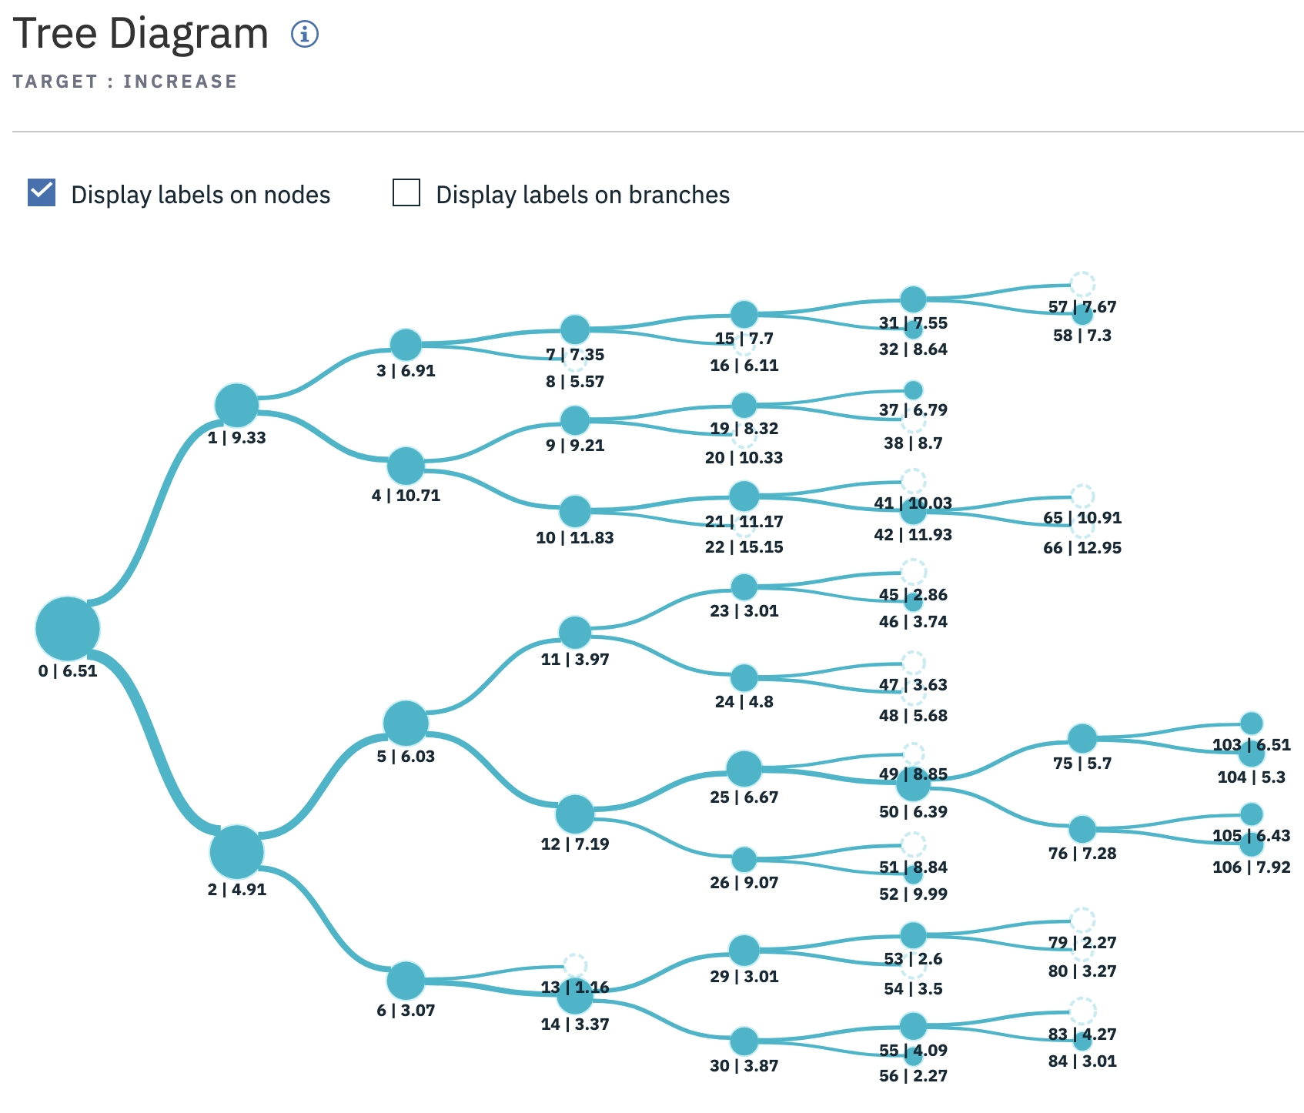
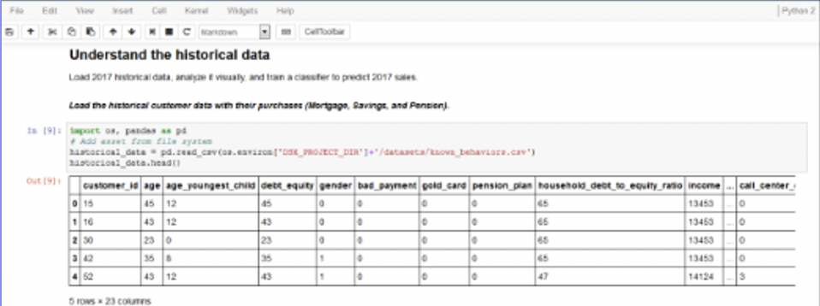
Power of the platform Example 3: Predictive to prescriptive
1. Open SPSS Modeler Use SPSS Modeler to prep data and generate predictive models, then export into projects. Easily share that project with Decision Optimization users in your organization.
Use AutoAI to predict Using Decision Optimization tools in Cloud Pak for Data, open the SPSS Modeler predicted results and pass in the predicted variable from SPSS Modeler to a data asset. This can be used as a constraint in the optimization model.
SPSS Modeler users can collaborate with Decision Optimization experts to turn analysis into action by passing in the predicted variable.

Slide 7
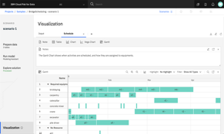
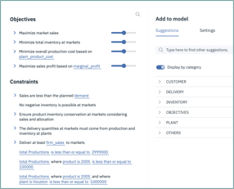
Power of the platform Example 4: No-coding model generation with NLP
A powerful and modern model builder development experience:
Build models with Python, OPL or natural language assistant
Visualize results and manage scenarios
Deploy optimization models
Modeling assistant enables a no-coding approach and uses natural language to build optimization models.
Notes:
IBM Decision Optimization can speed the process of building optimization models quickly. Decision Optimization on Watson Studio premium offers a modern and intuitive model builder development experience. You can easily create an optimization model by coding in Python or using the built-in modeling assistant. Modeling Assistant enables a no-coding approach and uses natural language to build optimization models. It also uses visual dashboards and other tools to simplify the process of testing multiple scenarios.

Slide 8
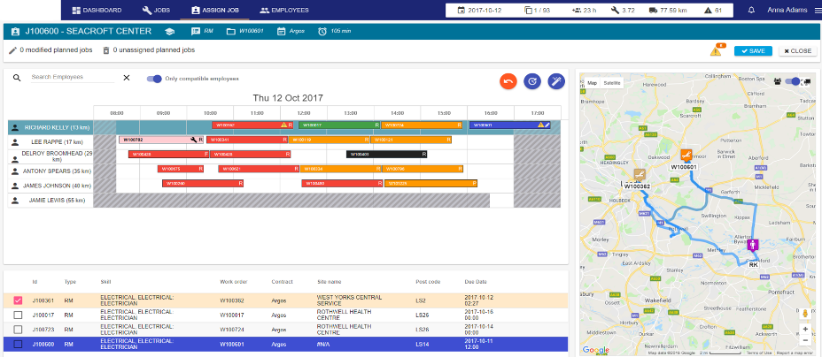
Power of the platform Example 5: No-coding model generation with NLP
Predictive analytics
Basic (supervised): You know the answer, and you train the machine how to find it.
Advanced: Unsupervised, reinforcement, deep learning
Prescriptive analytics
You don’t know the answer, and you provide the machine the logic on what is a good and a bad solution.
Advanced: Robust, stochastic, etc.
LOB application
Custom LOB application
Decision Optimization Center (DOC)
Planning Analytics
Unknown (decision variables)
Business goals
Business constraints
Sample data
Train model
Write DO Model
Prediction
(optional)
Solve trained model
Prediction, pattern, classification
Solve DO model
Decisions, plans, schedules
Observations
Notes:
Learning 101
Basic (supervised): you know the answer and you teach the machine how to find it
More advanced
Unsupervised learning: machine discovers patterns
Reinforcement learning: awards indicate success – think self-driving cars
Deep learning: pattern/image/object/speech recognition, text processing, time series analysis
Optimization 101
You don’t know the answer, and you teach the machine the logic to find it
Capture business goals, decision variables, and constraints
More advanced – robust/stochastic
Parallels between machine learning & decision optimization
Complexity
Both involve complex mathematics and algorithms
Both require experts to effectively build & deploy solutions
Both involve exponential network growth (e.g. MIP trees, deep nets), and often weights & probabilities (e.g. stochastic)
Proven – both have been around for decades
Data
Results depend on the quality of data
Require analysis to verify the accuracy of results (training vs post-optimization analysis)

Slide 9
IBM Decision Optimization
When to use prescriptive analytics (IBM Decision Optimization)
When you want to manage efficiency, utilization and allocation of limited resources
Resources | Choices to make
Capital | Invest, allocate
People | Hire, assign, schedule
Equipment | Acquire, schedule, locate
Facilities | Locate, size, schedule, maintain
Vehicles | Acquire, route, schedule, deliver, maintain
Materials and products | Acquire, allocate, produce, deliver, maintain
Notes:
Prescriptive analytics has many uses. We’ve listed a few on this slide.

Slide 10
Delivering massive return on investment
Chilean forestry companies (two examples) | Timber harvesting | $20M/year + 30% fewer trucks
UPS | Air network design | $40M/year + 10% fewer planes
South African National Defence Forces | Force and equipment planning | $1.1B/year
Motorola | Procurement management | $100M–150M/year
Samsung Electronics | Semiconductor manufacturing | 50% reduction in cycle times
SNCF (French rail network) | Scheduling and pricing | $16M/year rev + 2% lower operating expense
Continental Airlines | Crew rescheduling | $40M/year
AT&T | Network recovery | 35% reduction spare capacity
Grantham, Mayo, Van Otterloo & Co. (GMO) | Portfolio optimization | $4M/year
Notes:
As you can see, clients from a wide array of industries have seen tremendous ROI from optimization.

Slide 11
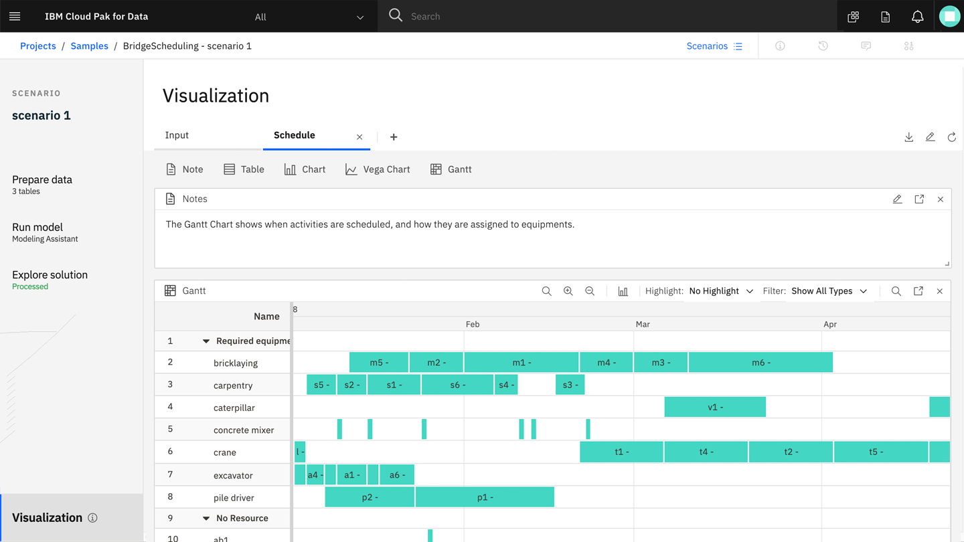
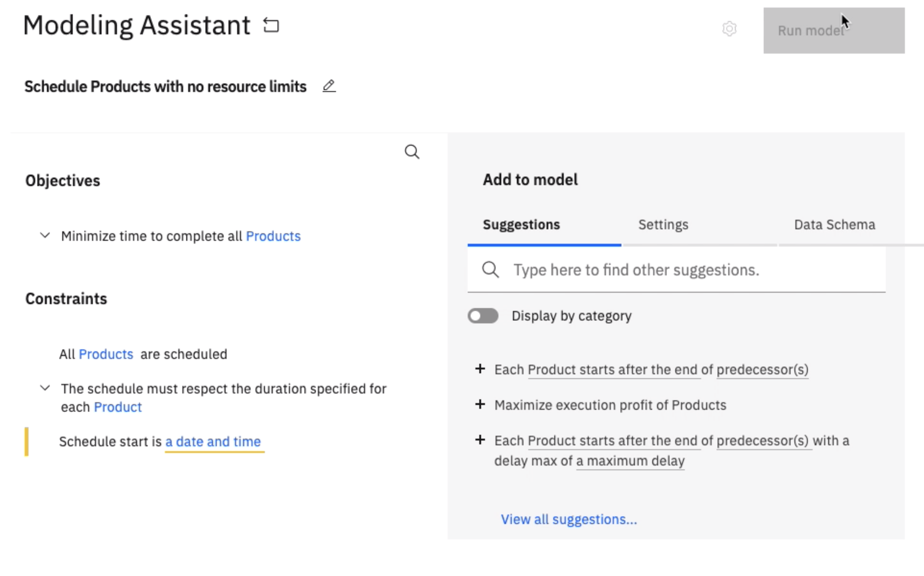
Decision Optimization features Not found in standalone
Found only in Watson Studio Premium on Cloud Pak for Data
Use natural language to build your optimization model with no coding.
Model builder is a modern and intuitive development experience that includes visualization and scenario management.
Notes:
As with SPSS Modeler, Decision Optimization in Watson Studio Premium has to features that are not found in the standalone version. For example, DO in WSP allows you to building optimization models using natural language, eliminating the need to code. It also includes model builder – a modern and intuitive development experience with visualization and scenario management .

Slide 12




Why Watson Studio for Cloud Pak for Data? Increase your returns on AI investment by applying decision optimization to your discovery and prediction
Automate AI life cycle management
Speed data science projects and manage AI success end-to-end
Empower data and analytics experts
Activate and reskill developers and analytic experts to be AI ready
Predict and optimize business outcomes
Activate and reskill developers and analytic experts to be AI ready
Bring analytics closer to data
Take advantage of your existing Hadoop/big data securely
Watson Studio = SPSS Modeler + Decision Optimization + Hadoop Execution Engine
Notes:
This combination of capabilities is uniquely available with Watson Studio Premium for Cloud Pak for Data. It helps you dramatically increase your returns on AI investment by applying decision optimization to your discovery and prediction.
Watson Studio Premium combines SPSS Modeler + Decision Optimization + Hadoop Execution Engine and is expressly designed to empower you to accelerate time to value.
With IBM Cloud Pak for Data you can:
Automate AI life cycle management as part of the base
Empower data and analytics experts with SPSS Modeler
Predict and optimize business outcomes with Decision Optimization
Bring analytics closer to data with Hadoop Execution
Supporting the base Watson Studio components where you can deploy open source data science with extensive data connectivity, this extension further helps you solve talent, data and trust issues that every organization must tackle to get ahead.

