Slide 1
UE24CS352A MACHINE LEARNING | MINI-PROJECT
Forecasting Bike Rental Demand
Predicting hourly Capital Bikeshare rentals from date, time and weather
Greeshma K (PES1UG24AM368)
Saurav S (PES1UG24AM398)
Notes:
Introduce the team and the one-line goal: given the date, hour and weather, predict how many bikes will be rented in that hour. Mention the reference paper (Stanford CS229, 2014) and that we follow its pipeline with scikit-learn.

Slide 2
Predict the next hour of rentals
THE PROBLEM
Given the date, the hour and the weather, how many bikes will people rent?
How we are scored
RMSLE = sqrt( mean( (log(p+1) - log(a+1))^2 ) )
Data comes from Capital Bikeshare in Washington D.C. (Kaggle: Bike Sharing Demand). A good forecast helps operators move bikes between stations and plan how big the fleet needs to be.
Errors are judged as ratios, not raw counts: being 20 bikes off hurts far more when 30 were rented than when 600 were.
Lower is better.
Reference: Du, He & Zhechev, Stanford CS229 (2014)
Notes:
Why it matters: operators rebalance bikes between stations and plan fleet size from demand forecasts. Why RMSLE: it compares ratios, so a miss of 20 bikes counts far more at 30 rentals than at 600.

Slide 3
Two years of hourly bikeshare data
THE DATA
10,886
6,493
What each row holds
training rows (days 1-19 of each month)
test rows (day 20 onwards, no labels)
Date and hour
Season, holiday, working day
Weather type (1 to 4)
Temperature, feels-like, humidity, wind
Target: count = casual + registered
2 years
0
January 2011 to December 2012
missing values
Notes:
Kaggle split: training rows are days 1-19 of every month, test rows are day 20 onwards with labels hidden. No missing values. count = casual + registered is what we predict.

Slide 4
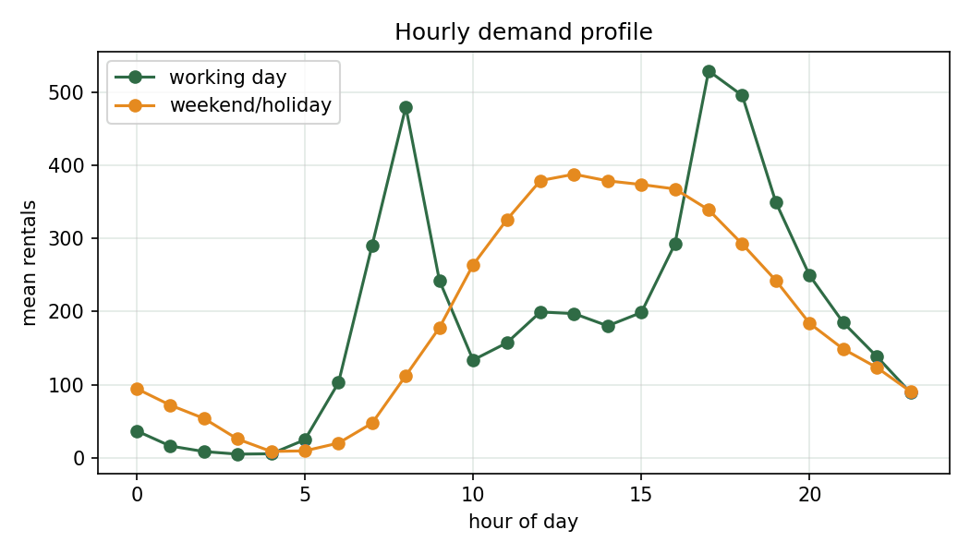
Demand follows the working day
EXPLORING THE DATA
Two commuter peaks
On working days rentals spike around 8 am and again at 5-6 pm. Weekends peak around 1 pm.
Skewed counts
The mean is 192 but the median is 145, so we train on log(1 + count).
Growth and seasons
2012 averaged 1.65x the demand of 2011, and summer months rent the most.
Notes:
Point at the green line: two commuter peaks, around 8 am and 5-6 pm. Orange (weekends and holidays) is one broad hump around lunchtime. Counts are right-skewed, hence the log transform.

Slide 5
64 feature combinations, one winner
FEATURES
0.4151 > 0.3743
average error with no extra features versus the chosen set
The chosen combination
Month instead of season
Day of week added
Holiday flag dropped
Weekday and weekend peak-hour flags
Weather values bucketed
Notes:
Six optional feature ideas from the paper give 2^6 = 64 combinations. Each was scored with a fast decision tree on the mean of 5-fold CV and the temporal hold-out. The curve shows all 64 sorted from best to worst.

Slide 6
Seven models and a time-aware split
MODELS AND VALIDATION
Every month of the data
Train: days 1-14
Validate: 15-19
Kaggle test: day 20 onwards
We also score with K-fold cross-validation, but the later block is what mimics the real test: models never see days 15 onwards while fitting.
Linear family
Tree models
Kernel
Stack
Linear regression
Poisson GLM
PCR
Decision tree
Random forest
HistGradientBoosting
SVR with RBF kernel
Tree + forest + boosting, combined by a linear model in log space
Notes:
Random K-fold lets a model see the hours right next to the one it is predicting, which flatters the score. So we also hold out days 15-19 of every month, which behaves like the real test split (day 20 onwards). Everything is trained on log(1+count) so squared error equals the RMSLE objective.

Slide 7
Stacking edges out gradient boosting
RESULTS
0.3182
Stack, hold-out RMSLE
Gradient boosting is a close second at 0.3204, with the best CV score of 0.2728.
Linear models sit near 0.51 and PCR at 0.98 is far behind.
Notes:
Read the bars top to bottom: hold-out RMSLE, lower is better. Stack wins narrowly. The stack has no CV score because it is only evaluated on the hold-out. Linear models are far behind, PCR especially.

Slide 8
The hour of day matters most
WHAT DRIVES DEMAND
Hour dominates
Shuffling it raises RMSLE by about 1.29, more than five times the next feature.
Calendar beats weather
The weekday peak flag, year and month come next. Temperature, humidity and wind add far less.
A likely reason linear models struggle
The hour effect is not a straight line, and it differs between working days and weekends.
Notes:
Permutation importance on the random forest: shuffle one feature and see how much the error rises. Hour is more than five times as important as anything else. Weather variables matter much less once the time is known.

Slide 9
Try it on a single hour
DEMO
What to point out
python src/predict.py
python src/demo.py --datetime "2012-06-15 08:00:00" --temp 24 --humidity 55 --windspeed 10 --weather 1
python src/demo.py --datetime "2012-06-16 03:00:00" --temp 20 --weather 3
predict.py writes a Kaggle-format file with 6,493 rows
Weekday 8 am, clear weather: expect a high count
Saturday 3 am, rain: expect a low count
The results folder holds the tables and figures
Notes:
Run predict.py first to show the Kaggle-format submission, then the two demo commands. A clear weekday at 8 am should give a high count; a rainy Saturday at 3 am should give a low one. Then open the results folder.

Slide 10
What we take away
TAKEAWAYS
What we found
What is still missing
The stack reached a hold-out RMSLE of 0.3182, just ahead of gradient boosting (0.3204) and random forest (0.3339).
Hour of day, the weekday peak pattern and year carry most of the signal.
The feature search cut the average error from 0.4151 to 0.3743.
The hold-out covers days 15-19, only a proxy for the real test days.
No lag or rolling features, so this is not a true time-series model.
Casual and registered riders are modelled together, with one seed and a limited grid.
Next: lag features, cyclic hour encoding, separate casual and registered models, a wider search.
Notes:
Finish on the numbers, then be upfront about limits. Hold-out is a proxy for the real test days. We did not use lag features, so this is not a full time-series model.

