Slide 1


Artificial Intelligence and Data Science
Data Science and Visualization
24ADI204
DATA-VIZ HACK-A-BIT (2026-2027)
FINAL REVIEW (Sept 2026)
Team Number: 3
EMPLOYEE ATTRITION EVIDENCE LAB
Weeks 1–9 · analysis, PCA and narrative dashboard
Notes:
Team No. 3. Completed Weeks 1–9 code and review materials. Actual expo and viva attendance remain team activities. PCA is unsupervised; no attrition classifier is claimed.

Slide 2
Problem Statement
Employee attrition analysis often starts with patterns before checking whether the data are reliable.
This file contains missing values, duplicate rows and fields with uncertain definitions.
Our question: which observed differences remain credible after transparent cleaning checks?
Notes:
The aim is descriptive evidence, not causal inference or individual employee prediction. Dataset source: https://www.kaggle.com/datasets/nikhilbhosle/employee-attrition-uncleaned-dataset

Slide 3
Project Objectives
Audit the 74,610-row dataset and document its origin, types and quality issues.
Create a reproducible cleaned baseline without silently deleting unusual records.
Explore single-variable and group distributions with clear charts.
Check sample size, uncertainty and sensitivity before calling a pattern robust.
Notes:
Nine executed notebooks cover Weeks 1–9. Fourteen automated tests passed. The final report and dashboard are included.

Slide 4
Scope of the Project
WEEKS 1–5
Audit and EDA
Source, cleaning, distributions and review materials
WEEKS 6–7
Feature engineering
Transform, encode, select and run PCA
WEEKS 8–9
Narrative dashboard
Interactive evidence, final report and viva guide
Novelty: each claim includes uncertainty, cleaning sensitivity and job-role checks.
Notes:
All code and review materials are delivered. Physical presentation, peer review and viva must be completed by the team. The gate is a descriptive project heuristic.

Slide 5
Dataset Description
SOURCE
Kaggle / Nikhil Bhosle
RAW DATA
74,610 records · 24 original columns
TARGET
Attrition: Left or Stayed
TYPE
Structured employee-level CSV
CLEAN BASE
74,498 rows after 112 exact duplicates
Notes:
Dataset: https://www.kaggle.com/datasets/nikhilbhosle/employee-attrition-uncleaned-dataset. Source sampling process, time period and real/synthetic status are unverified. Clean base has 74,498 unique IDs.

Slide 6
Methodology(Process / Workflow)
1 Audit and clean
Load raw data; deduplicate, impute and retain flags
2 Explore and check
Distributions, intervals, cleaning sensitivity and role checks
3 Transform and encode
Income Yeo–Johnson; numeric scaling; one-hot encoding
4 PCA and dashboard
Variance retention, 2D/3D maps and six story chapters
Nine executed notebooks · 14 automated tests passed · eight interactive plot types
Notes:
The shared scripts build the audit, feature transformations and PCA. The dashboard uses saved analytical reports and a reproducible baseline.

Slide 7
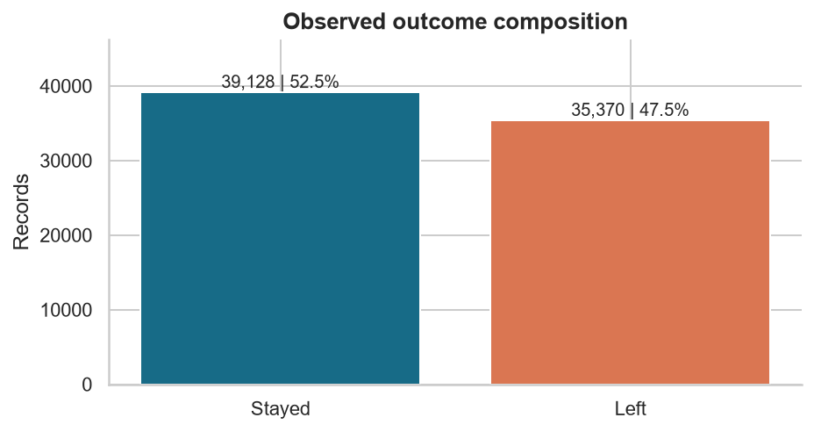
Week 1 | Project setup & data source
Formed the team and selected the employee attrition dataset from Kaggle.
Created the project structure and GitHub repository; began the Pandas and NumPy workflow.
Recorded the dataset source and starting outcome composition.
Selected dataset: Left / Stayed
Team 3 | Weeks 1–4: Rohith Varma | Weeks 5–9: Nisha & Saurav Santhosh

Slide 8
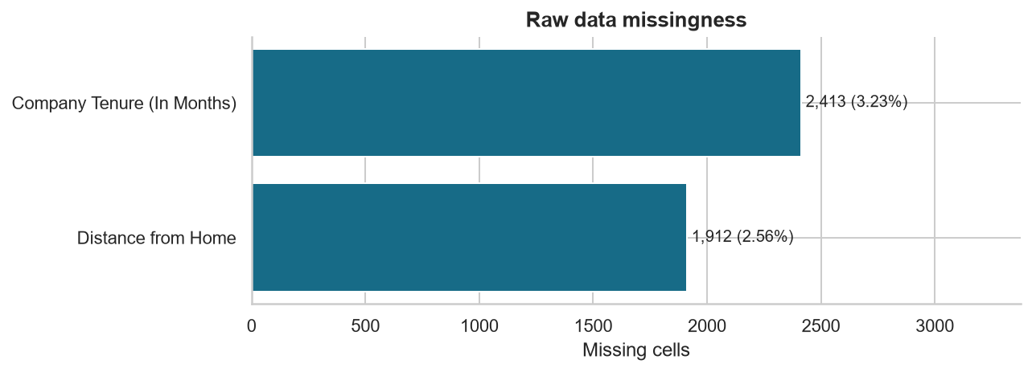
Week 2 | Know your data
Loaded the CSV and reviewed its rows, columns, field types and structure.
Checked missing values and prepared the first impression of the dataset.
Identified fields needing closer cleaning and definition checks.
Missing data found in the source
Team 3 | Weeks 1–4: Rohith Varma | Weeks 5–9: Nisha & Saurav Santhosh

Slide 9
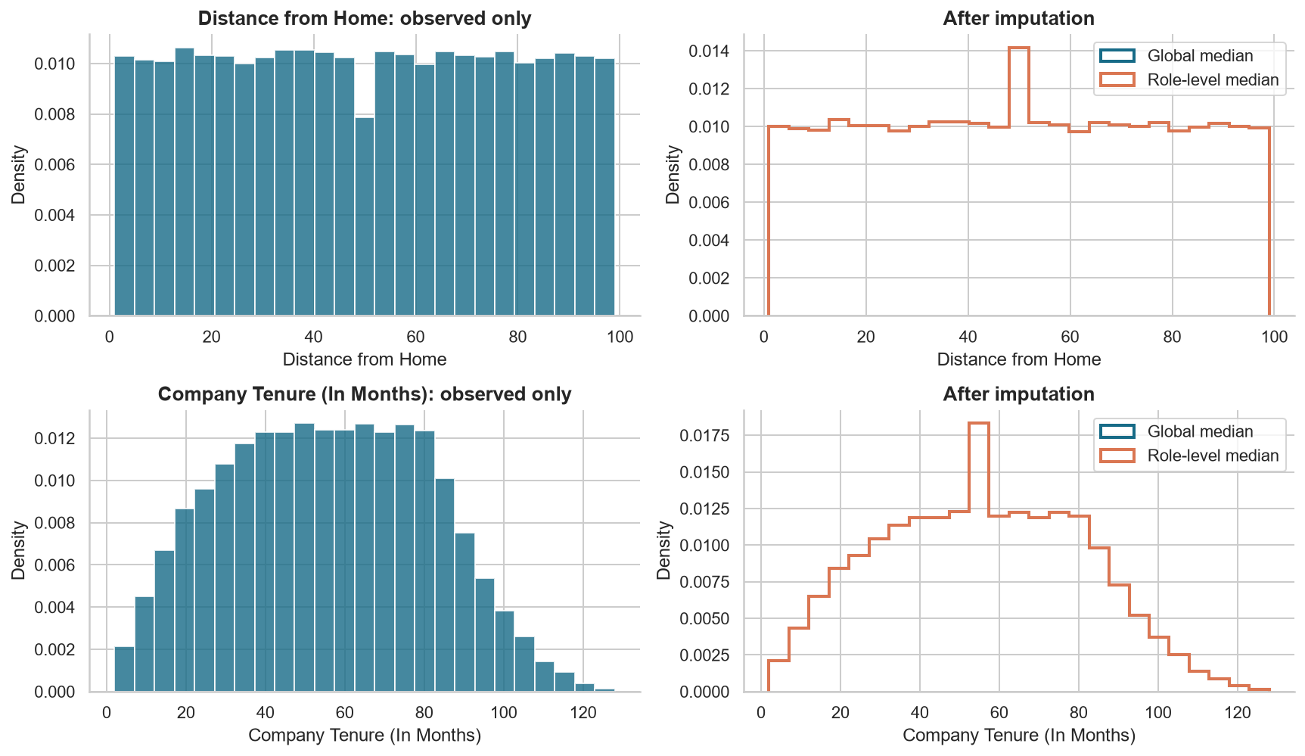
Week 3 | Cleaning sprint
Removed 112 exact duplicate rows and retained flags for unusual values.
Median-imputed missing distance and tenure values; kept imputation flags.
Flagged income outliers for review instead of silently deleting them.
Observed and imputed values
Team 3 | Weeks 1–4: Rohith Varma | Weeks 5–9: Nisha & Saurav Santhosh

Slide 10
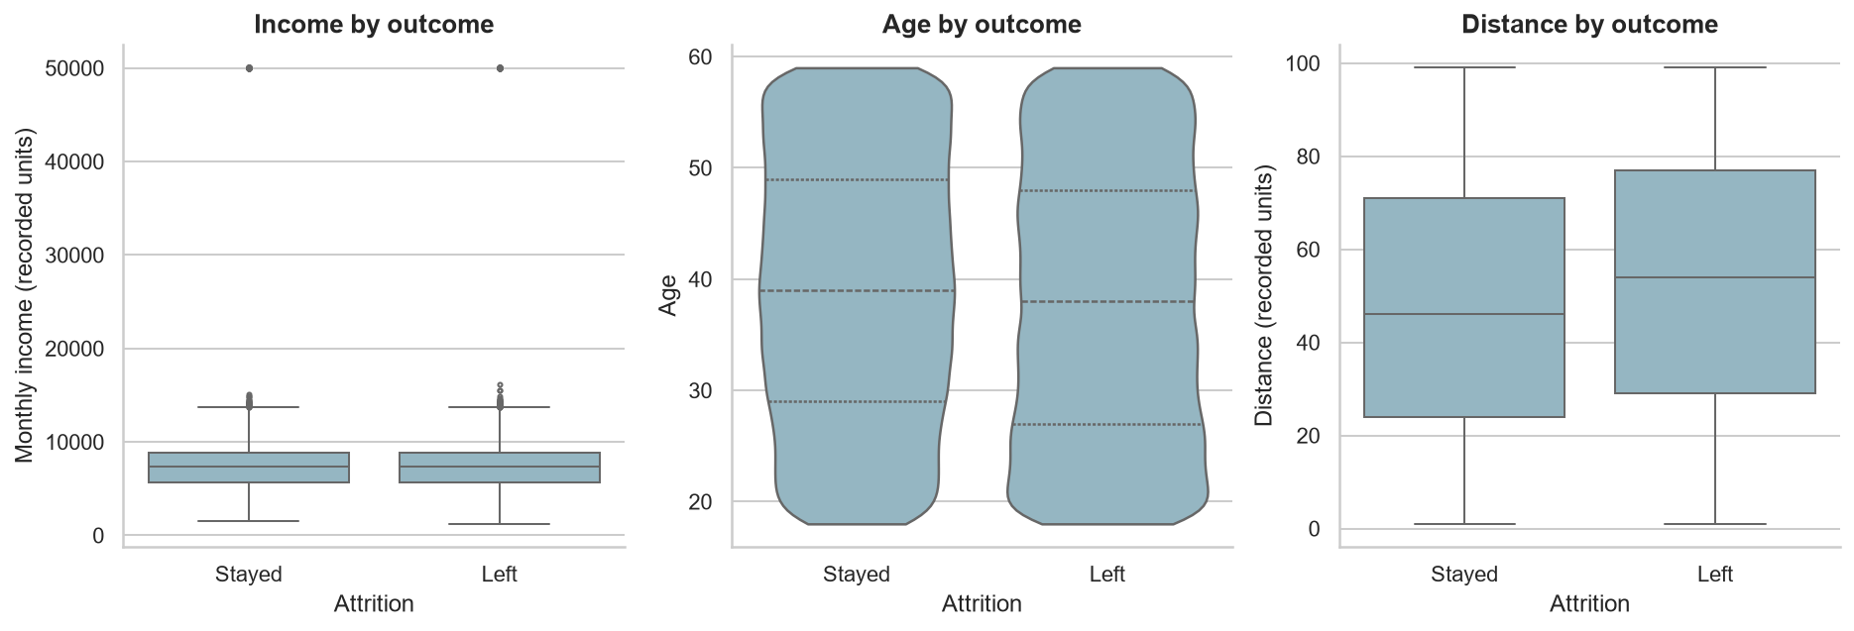
Week 4 | EDA deep dive
Compared numeric and categorical distributions across employees who left and stayed.
Reviewed group shares, relationships and within-role patterns.
Used plots to describe observed differences, not claim causation.
Numeric distributions by attrition outcome
Team 3 | Weeks 1–4: Rohith Varma | Weeks 5–9: Nisha & Saurav Santhosh

Slide 11
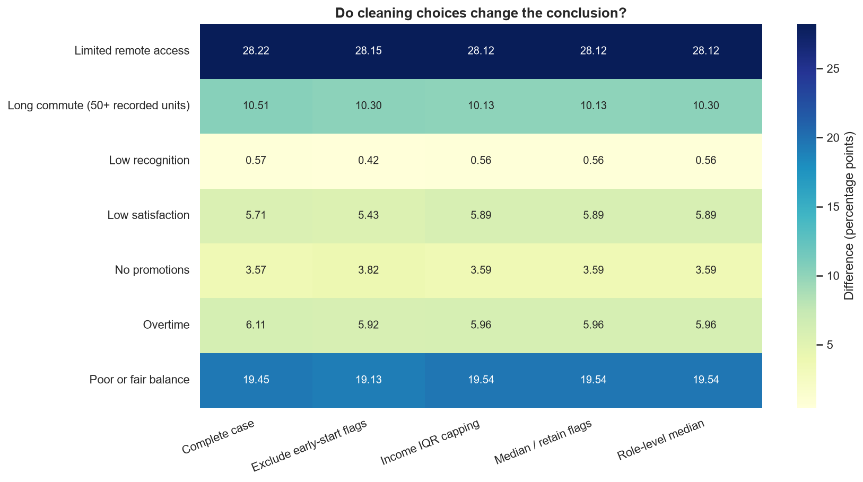
Week 5 | Data audit review
Reviewed data quality decisions and the cleaned baseline before advanced analysis.
Checked how cleaning choices affect key estimates and interpretations.
Documented dataset limitations, including unclear units and field definitions.
Sensitivity of results to cleaning choices
Team 3 | Weeks 1–4: Rohith Varma | Weeks 5–9: Nisha & Saurav Santhosh

Slide 12
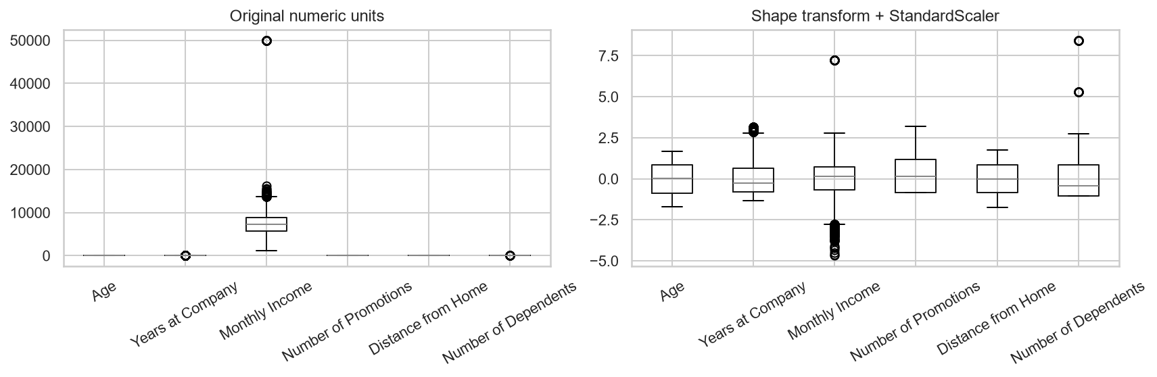
Week 6 | Feature engineering
Applied Yeo–Johnson transformation to reduce income skew.
Scaled numeric features and encoded categorical fields for analysis.
Compared scaling approaches before dimensionality reduction.
Feature scaling comparison
Team 3 | Weeks 1–4: Rohith Varma | Weeks 5–9: Nisha & Saurav Santhosh

Slide 13
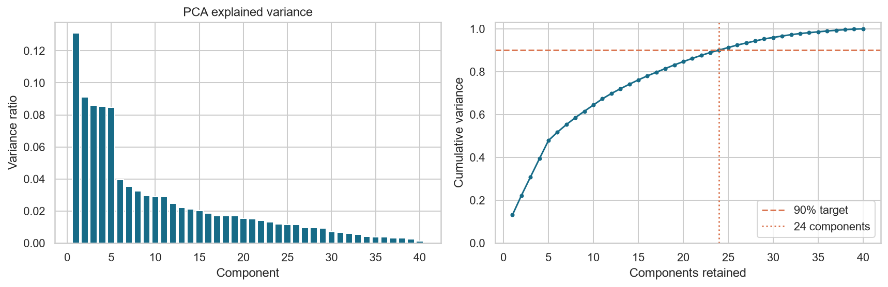
Week 7 | Feature selection & PCA
Tested transformed features using zero-variance and |r| > 0.90 redundancy rules.
The data-driven check retained all 40 candidate inputs for this dataset.
PCA retained 90.10% of variance in 24 components; PC1 and PC2 show 22.24%.
PCA explained and cumulative variance
Team 3 | Weeks 1–4: Rohith Varma | Weeks 5–9: Nisha & Saurav Santhosh

Slide 14
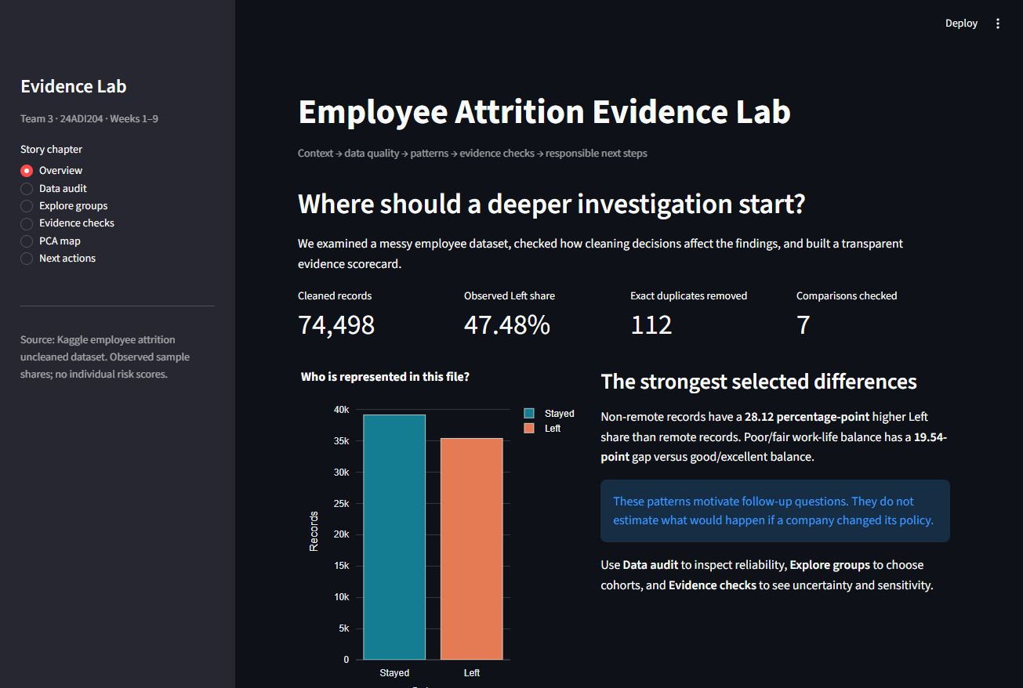
Week 8 | Narrative dashboard
Built an interactive Streamlit dashboard with six evidence chapters.
Added cohort and job-role exploration with eight plot types.
Kept full-cohort evidence distinct from filtered views.
Dashboard chapter overview
Team 3 | Weeks 1–4: Rohith Varma | Weeks 5–9: Nisha & Saurav Santhosh

Slide 15
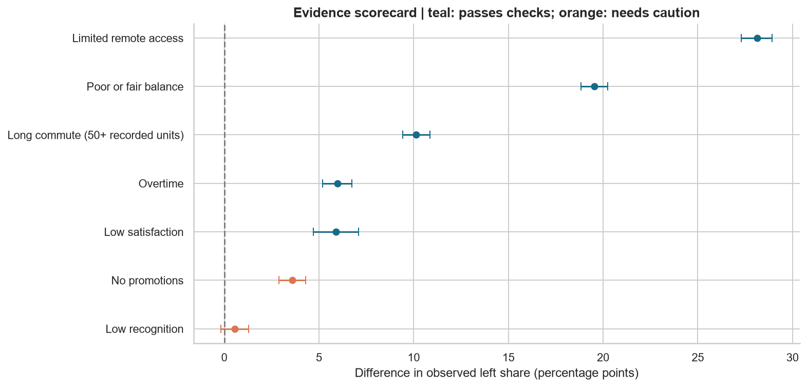
Week 9 | Final submission & viva
Prepared the final presentation, project report and viva/demo guide.
Organized notebooks, code, figures and evidence for review.
Project materials are ready; formal review and presentation remain team actions.
Evidence review scorecard
Team 3 | Weeks 1–4: Rohith Varma | Weeks 5–9: Nisha & Saurav Santhosh

Slide 16
Results From Workflow
74,610
112
4,325
raw rows
exact duplicates removed
raw missing cells
After deduplication: 1,897 distance and 2,381 tenure values median-imputed; flags kept.
Two corrupted education labels repaired; 151 income IQR outliers flagged.
Notes:
The 4,325 missing-cell figure is before deduplication; the two imputed-field counts are after deduplication. No missing cells in the cleaned baseline. Outliers were flagged, not removed.

Slide 17
Results From Workflow
Observed left share: 47.48% (35,370 Left / 74,498 records)
Largest selected gaps: limited remote access +28.12 pp; poor/fair balance +19.54 pp.
Notes:
Figure from Reports/Figures/04_evidence_scorecard.png. Differences are percentage points in observed Left share, with 95% intervals. Teal comparisons pass our exploratory heuristic; orange need caution. Associations are not causes.

Slide 18
Final Results: Features & PCA
40 encoded features → 24 components → 90.10% variance retained
Feature (largest |PC1|) | PC1 loading | PC2 loading
Years at Company | 0.707 | 0.007
Age | 0.707 | 0.013
Monthly Income | -0.015 | 0.961
Distance from Home | -0.013 | -0.046
Number of Dependents | 0.012 | 0.005
Company Size_Medium | -0.004 | -0.000
Job Level_Mid | 0.004 | -0.004
Company Size_Small | 0.003 | -0.000
Income skew: 5.208 → 0.038. Heatmap shows the eight strongest PC1 feature loadings on PC1 and PC2.
Notes:
Yeo–Johnson changes income shape; scaling alone does not. Twenty-four components are the minimum reaching 90% under numeric z-score plus unscaled dummy weighting. All-column standardization needs 30 components. Correlation screening removes zero additional columns. Variance retention is not classifier accuracy.

Slide 19
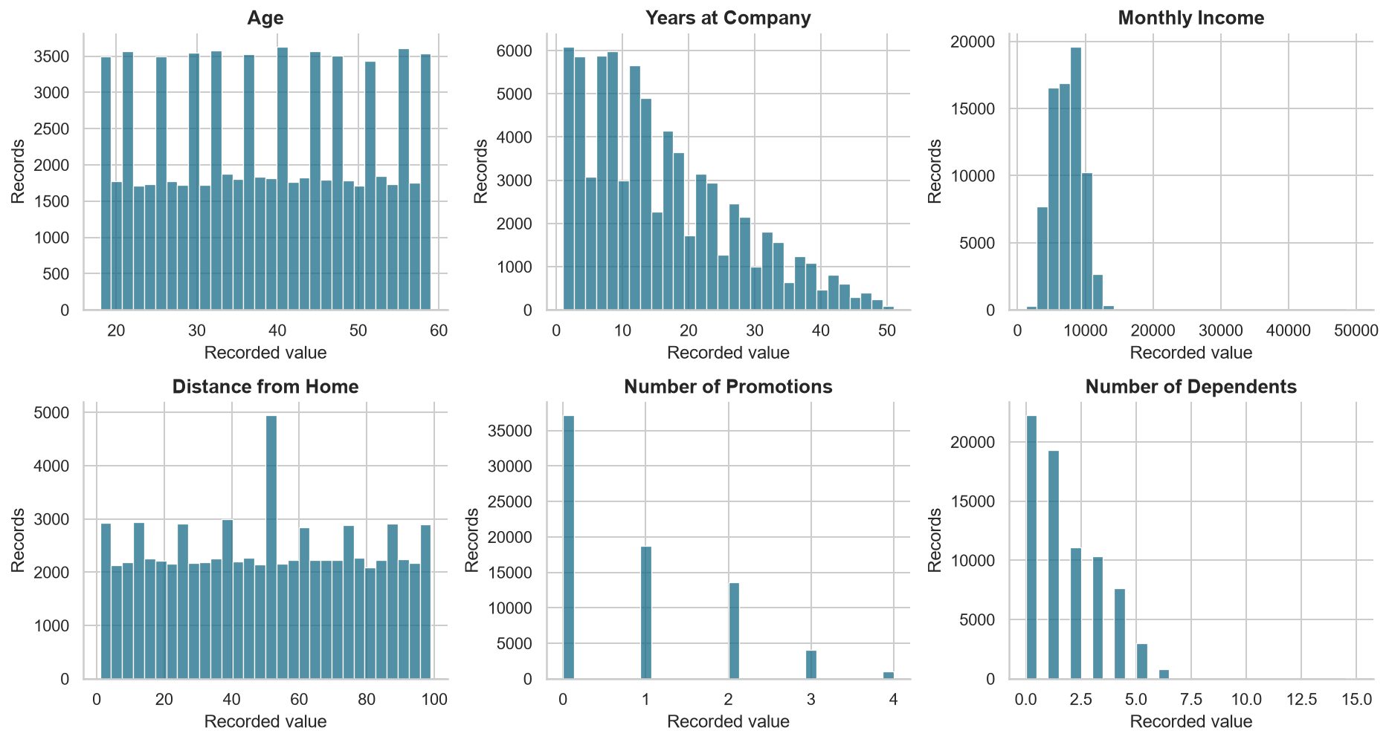
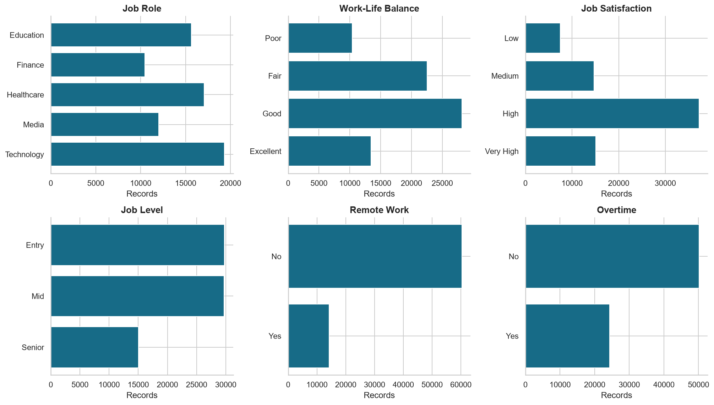
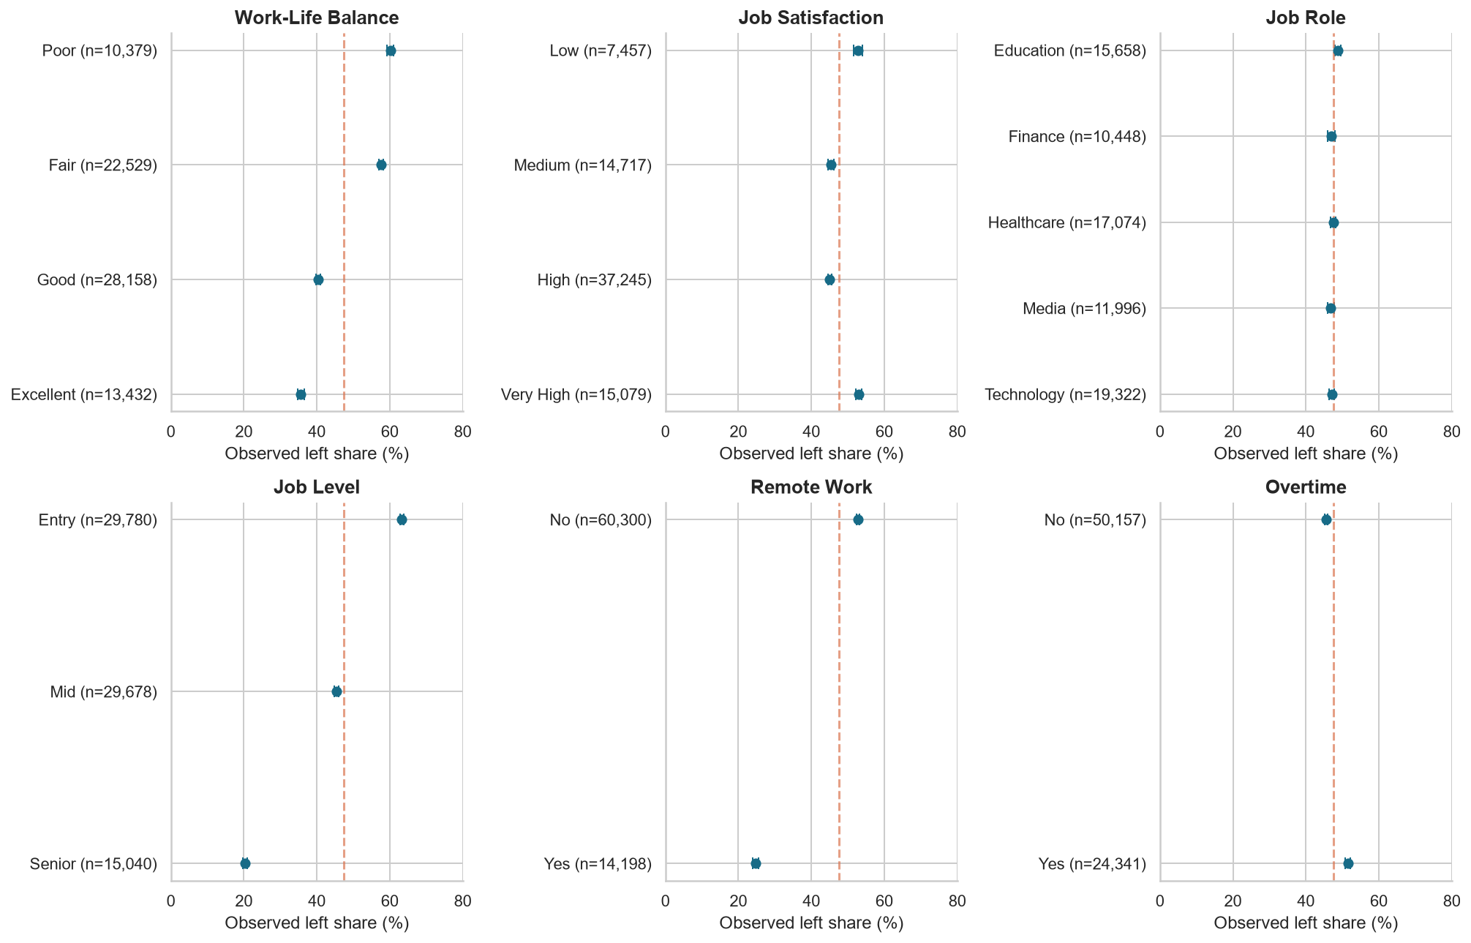
Visual Evidence | Distributions
Numeric feature distributions
Categorical feature distributions
Attrition shares across selected groups
Outcome composition

Slide 20
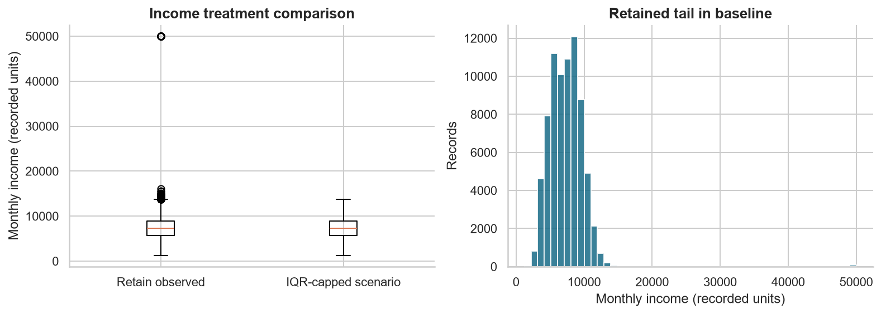
Visual Evidence | Data Quality & Robustness
Missing values in the source data
Observed and imputed values
Income outlier screening
How cleaning choices change estimates

Slide 21
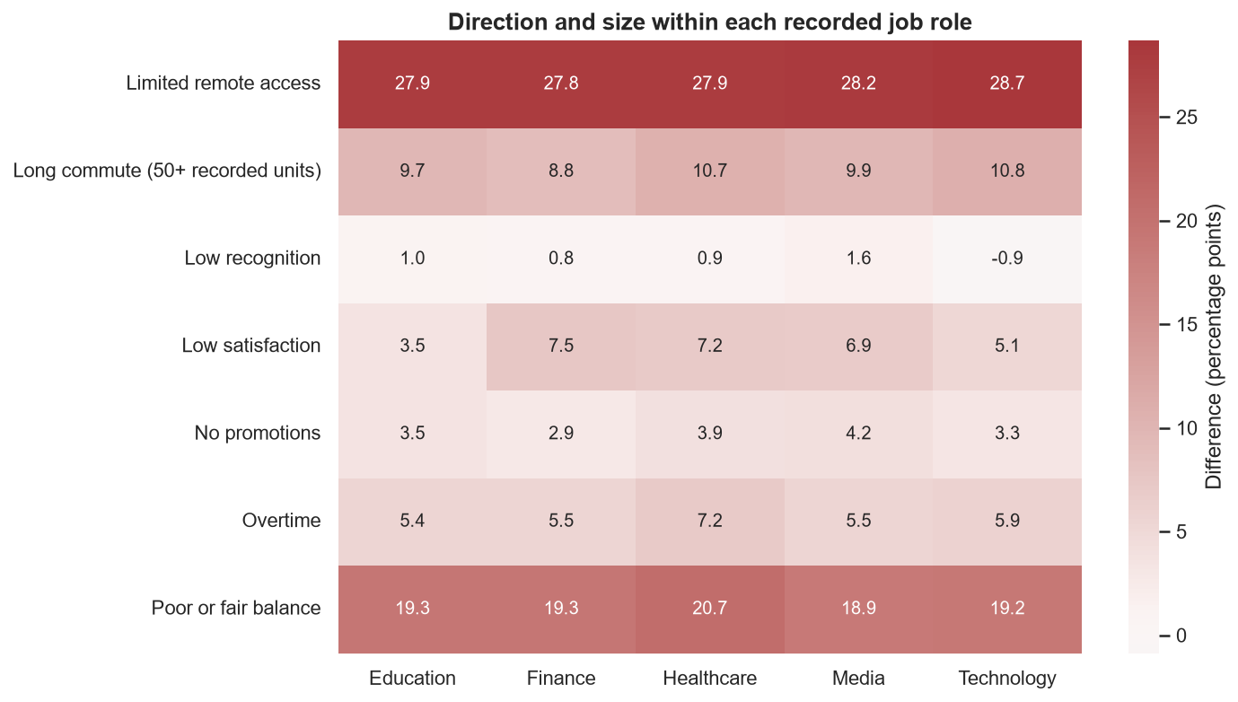
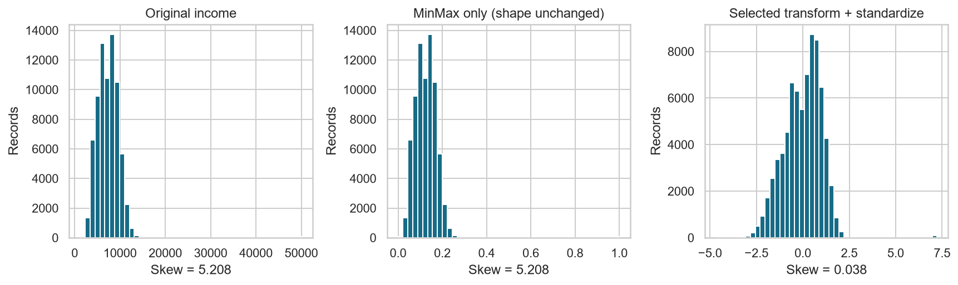
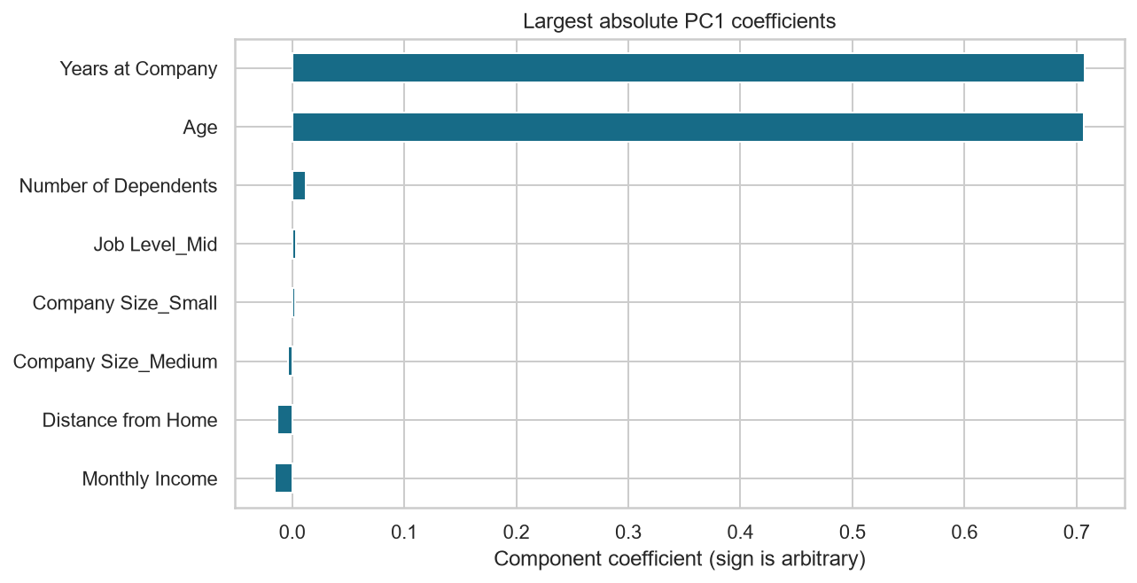
Visual Evidence | Groups & PCA
Attrition comparisons within job roles
Income before and after transformation
PCA explained and cumulative variance
Largest absolute PC1 loadings

Slide 22
Roles & Responsibilities
Team Member | Roles & Responsibilities
Rohith Varma (25BAD090) | Data engineering: source, quality audit and cleaning
Saurav Santhosh (25BAD104) | Data analysis: comparisons and evidence checks
Sinan Ubaid (25BAD107) | Visualization: EDA charts and interpretation
Nishanth (25BAD070) | Lead / storyteller: documentation and review narrative
Team No. 3 (shared) | Notebook review, testing and presentation
Notes:
Member names and previously stated roles come from the earlier Week 2 team log, confirmed by the user for Team No. 3. Exact allocation of notebook commits should be verified with members.

Slide 23
Challenges Faced
1,897 distance and 2,381 tenure values required imputation after deduplication.
17,824 records imply starting age below 14; tenure fields often disagree under one interpretation.
The dataset does not define distance units, sampling period or label time window.
Outliers and category patterns needed careful interpretation; left/stayed is fairly balanced.
Notes:
17,824 early-start flags and 66,049 tenure-pair disagreements under the same-definition assumption are questions for source clarification, not confirmed errors. Left share 47.48%; do not call this severe class imbalance.

Slide 24
Future Work & Conclusion
DELIVERED
Six dashboard chapters
Nine executed notebooks
Nine-page business insight report
NEXT IN PRACTICE
Clarify source definitions; investigate working conditions; measure a prospective pilot.
A reproducible evidence workflow supports careful questions and a clear visual story.
Notes:
Demonstrate the dashboard: Overview, Data audit, Explore groups, Evidence checks, PCA map, Next actions. Show at least five plot types. No measured policy impact or prediction accuracy is claimed.

Slide 25
References
Dataset: Nikhil Bhosle, “Employee Attrition Uncleaned Dataset,” Kaggle.
Course brief: DSV Rule Book (24ADI204), supplied by faculty.
Project source: GitHub repository / DSV_PROJECT / Weeks 1–9 notebooks, dashboard and reports.
Methods: Newcombe intervals; scikit-learn transforms/PCA; Streamlit/Plotly (see report).
Dataset: kaggle.com/datasets/nikhilbhosle/employee-attrition-uncleaned-dataset
Notes:
Kaggle dataset: https://www.kaggle.com/datasets/nikhilbhosle/employee-attrition-uncleaned-dataset
Project: https://github.com/sauravsanthosh-prog/24ADI204_DSV_Team3/tree/main/DSV_PROJECT
Methods and novelty documents are in the project Docs folder.

