Slide 1
Air Quality Monitoring
Author: Saurav, Naveen, Parin
Date: 13/04/2017

Slide 2
Problem statement
Goal of the project is to develop Wireless Sensor Node that has the following features :
On board sensors for measuring parameters of air quality such as Particulate Matter (2.5), CO, Temperature and Humidity
On board communication
Low power operation and using solar panel as alternate source of power
Small form factor
Sensor stack - provision for add extra sensors in future
A web based data visualization tool for interpreting sensor data and Air Quality Index

Slide 3
System Architecture
CC2530
Zigbee Communication module
Raspberry Pi
(Web and data server)
DSM501
(Particulate Matter)
CC2530
Zigbee Communication module
PWM
UART
MSP430F5529 Microcontroller
UART
Single Wire
ADC
DHT22
(Temperature + Humidity)
MQ7
(Carbon Monooxide)
Battery Powered + MOSFET controlled switches for sensors + Solar Power

Slide 4
Milestones completed
Literature Survey and Finalizing Hardware
Circuit/Stack design
Wireless communication
Webpage layout, database schema design
Sensor Interfacing
Solar Panel Testing
Sensor Calibration
Testing

Slide 5
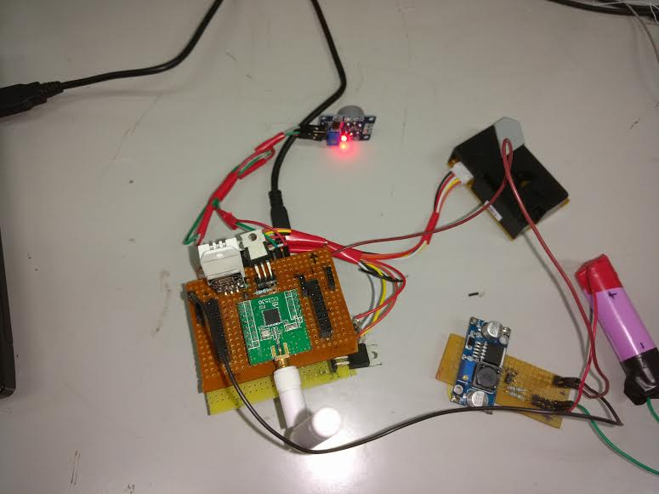
Sensor Node

Slide 6
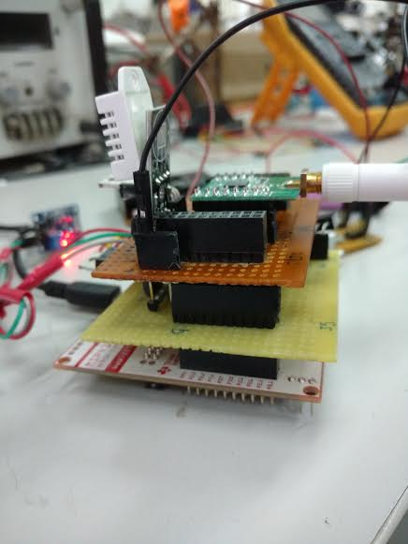
Sensor Stack

Slide 7
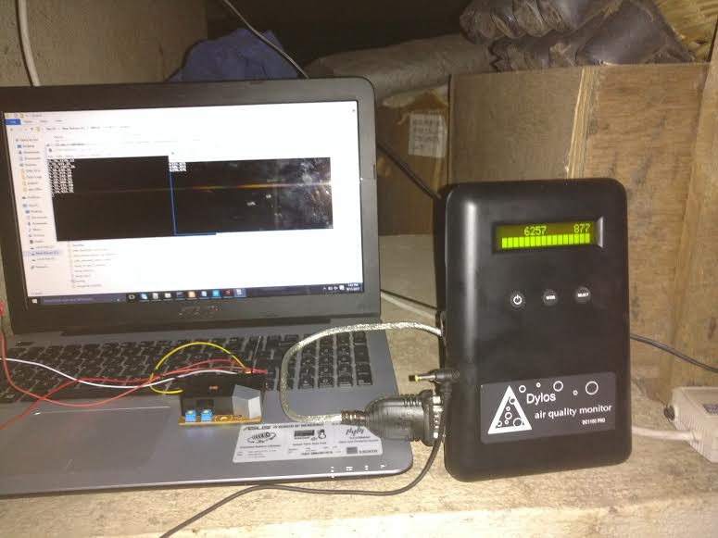
Dylos vs DSM501A

Slide 8
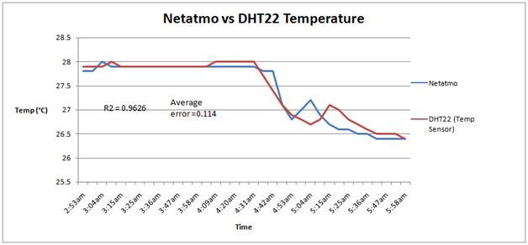

Slide 9
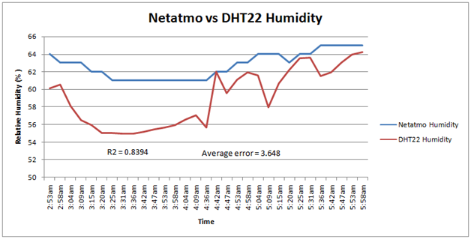

Slide 10
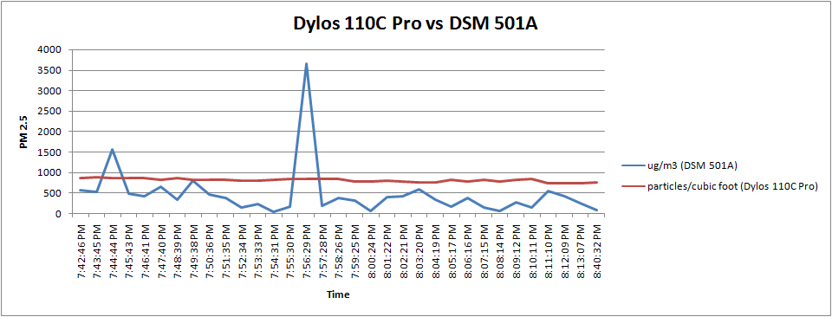

Slide 11
Key Challenges
Sensor interfacing and calibration
Stack Design
Issue of Data loss, multiple zigbee network
Customization for low power
Notes:
1.Finalizing the right hardware - sensor, controller, communication module. This is a challenge because we need to explore the low power option, range, sensor reliability, resolution, interfacing, current consumption factor.
2.Design of System architecture and task of each components(Raspberry Pi and microcontroller). We need to think about how different sensor node can communicate amongst themselves/central server specifically deciding the topology (Star, Mesh, Tree), data flow path.
3.Designing test cases and resolving issues. For example, what will happen if particular sensor node stops responding due to some reason, intermittent loss of data packets, interference for external sources.
4.Sensor interfacing and calibration. Interfacing can be easily resolved by reading datasheet. Calibration is challenging. We need find a standard device which can be used for calibration purpose. These standard devices are costly. We have read about system some test setup available with Prof. Virendar Sethi in Energy Science. We will try to explore the option available by further discussion.
5.Demonstration of project - environment with dust and CO will have to be created to demonstrated working of the project.
6.Solar powering of system
7. Case design to keep form factor as small as possible, stackable design

Slide 12
Thank You

