Slide 1
Development of wireless Sensor Node for urban agriculture

Slide 2
Objective
compare and contrast zigbee(802.15.4) and wifi(802.11) communication protocol to find an optimal solution for urban agriculture setup on Terrace
what to compare
power consumption
range
scalability factor
cost
Design working sensor node that can be developed on terrace or similar environment
Develop a backbone with sensor node and test strategies to carry out future study on different hardware and other communication module
Notes:
scalability - option to add sensors in future, easy to program
communication protocol
topology
hardware
stability
power options

Slide 3
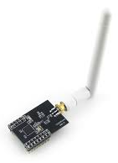
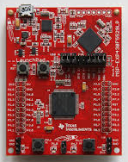
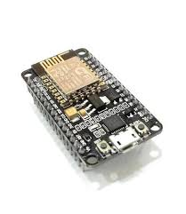
Requirement
Hardware
MSP430f5529
Temperature+humidity sensor
Zigbee module - cc2530
wifi - ESP8266
Batteries
cc2530 with SMA antenna
MSP430 microcontroller
ESP8266 Wifi module

Slide 4
Test Strategies
Power Consumption
Lab test - check power consumption using DMM/DSO
In field test - Measure battery voltage, deploy sensor for duration of 24 hours and log sensor reading, measure battery voltage again.
Range
Deploy sensors at farthest location/max. theoretical range suggested in datasheet. Log sensor reading to ensure no data loss is occurring.
Deploy multiple sensor nodes at strategic locations to check effect of obstructions
Scalability
Effect of adding/removing nodes on data transmission and power consumption

Slide 5
Milestone
Reading about protocols and existing work in this field
UART communication on MSP430
using TI Z-stack API to connect cc2530 with MSP430
Test zigbee based sensor node in lab ( 13/03)
Deploy sensors on terrace to test log sensor data (19/03)
interface esp8266 with MSP430 (31/03)
Test wifi based sensor node in lab (31/03)
Deploy sensors on terrace to test log sensor data (02/04)
Obtain result based on data (16/04)

Slide 6
Choosing right hardware
Embedded Multi-chip sensor nodes
Microcontroller, transceiver, sensor and power supply
System-on-chip sensor nodes
On-chip controller and transceiver
Consideration factor
Peripheral features to attach sensors
power consumption
memory
cost

Slide 7
Factors to be considered
Area
Power options available
sensor requirement

Slide 8
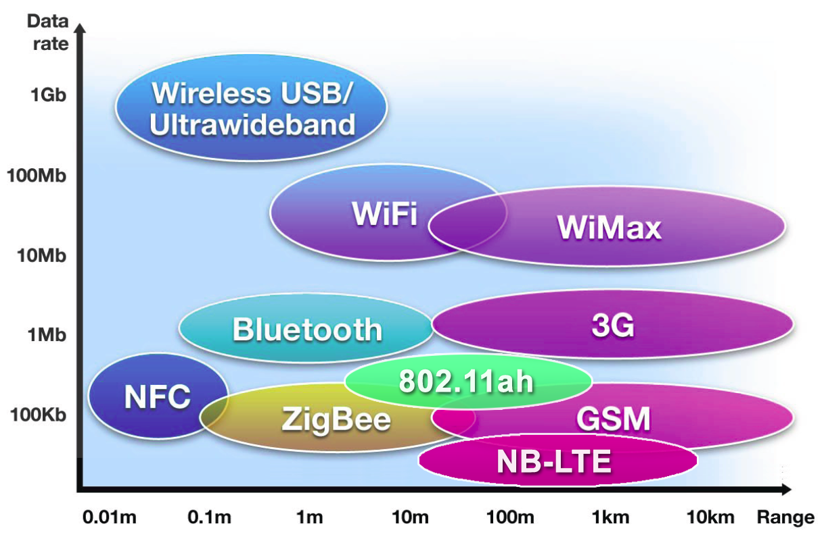
Range vs Data Rate comparison
Source: www.embedur.com

Slide 9
Wireless Communication
Zigbee
802.15.4,
250 kbps @2.4 GHz
low-cost
energy efficient
Support Mesh topology
100m - 1.5Km
Wifi
802.11
2-54 Mbps @2.4 GHz
low-cost
high energy consumption
Only Star
100m

Slide 10
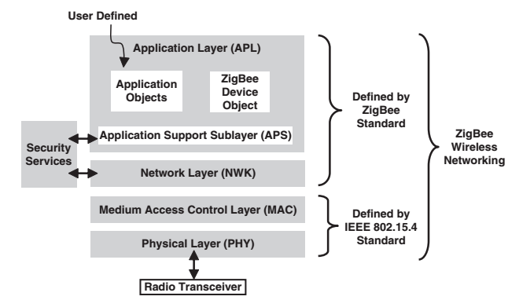
Network Layers
Zigbee Protocol Layers
derived from OSI model

Slide 11
Network architecture for agriculture applications
Stationary
sensor nodes are deployed at a fixed position (example: temperature, moisture, wind speed etc)
Mobile
devices changes position with time (example: network of drones, farmer carrying sensor/cell phone)
Hybrid
mix of Stationary and mobile
What is our requirement: Stationary

Slide 12
Types of sensor nodes
WSNs are deployed on land, underground and underwater
5 types
Terrestrial WSN
underground WSN
underwater WSN
multi-media WSN
mobile WSN
Notes:
Resource: WSN survey paper
Multi-media WSNs: enable monitoring and tracking of events in the form of multimedia such as video, audio, and imaging. consist of a number of low cost sensor nodes equipped with cameras and microphones.

Slide 13
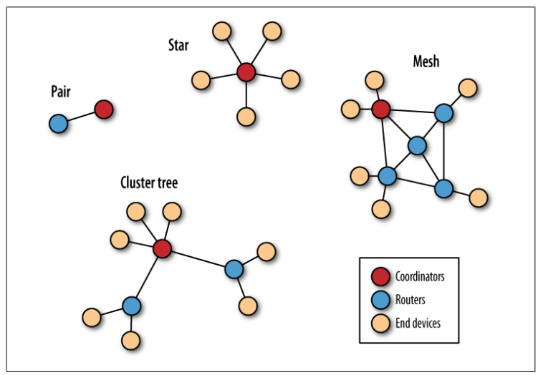
Zigbee Network topology

Slide 14
To buy
MSP430f5529 - 8 -Rs. 1384
CC2530 - 5 -Rs. 949
Nodemcu - 5

Slide 15
Intelligent decision making capability
multihop

