Slide 1
Introduction To CSS

Slide 2
Context
px vs em vs pt vs %
Position
Display
Float

Slide 3
CSS Measuring Units
One of the most confusing aspects of CSS styling is the application of the font-size attribute for text scaling. In CSS, you’re given four different units by which you can measure the size of text as it’s displayed in the web browser
“Ems” (em): The “em” is a scalable unit that is used in web document media. An em is equal to the current font-size, for instance, if the font-size of the document is 12pt, 1em is equal to 12pt. Ems are scalable in nature, so 2em would equal 24pt, .5em would equal 6pt, etc. Ems are becoming increasingly popular in web documents due to scalability and their mobile-device-friendly nature.

Slide 4
CSS Measuring Units
Pixels (px): Pixels are fixed-size units that are used in screen media (i.e. to be read on the computer screen). One pixel is equal to one dot on the computer screen (the smallest division of your screen’s resolution). Many web designers use pixel units in web documents in order to produce a pixel-perfect representation of their site as it is rendered in the browser. One problem with the pixel unit is that it does not scale upward for visually-impaired readers or downward to fit mobile devices.
Points (pt): Points are traditionally used in print media (anything that is to be printed on paper, etc.). One point is equal to 1/72 of an inch. Points are much like pixels, in that they are fixed-size units and cannot scale in size.

Slide 5
CSS Measuring Units
Percent (%): The percent unit is much like the “em” unit, save for a few fundamental differences. First and foremost, the current font-size is equal to 100% (i.e. 12pt = 100%). While using the percent unit, your text remains fully scalable for mobile devices and for accessibility.
Example:
  body {font-size: 62.5%}
  div.txtHeader {font-size: 1.8em;}
  span.error {font-size: 15px; color: red;}
  Span#name {font-size:17pt;}

Slide 6
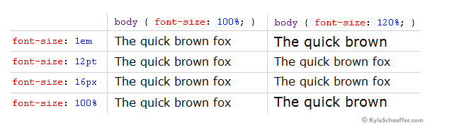
CSS Measuring Units
It’s easy to understand the difference between font-size units when you see them in action. Generally,1em = 12pt = 16px = 100%. When using these font-sizes, let’s see what happens when you increase the base font size (using the body CSS selector) from 100% to 120%.

Slide 7
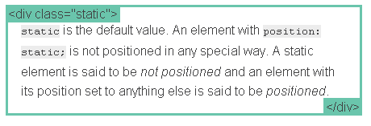
CSS Position
  Static:
  static is the default value. An element with position: static; is not positioned in any special way. A static element is said to be not positioned and an element with its position set to anything else is said to be positioned.
  Example:
  .static { position: static; }

Slide 8
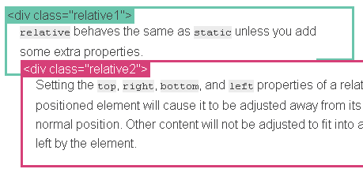
CSS Position
  Relative:
  A relative positioned element is positioned relative to its normal position. The content of relatively positioned elements can be moved and overlap other elements, but the reserved space for the element is still preserved in the normal flow.
  Example:
  .relative1 { position: relative; }
  .relative2 { position: relative; top: -20px; left: 20px; background-color: white; width: 500px; }

Slide 9

CSS Position
  Fixed:
  A fixed element is positioned relative to the viewport, which means it always stays in the same place even if the page is scrolled. As with relative, the top, right, bottom, and left properties are used.
  Example:
  .fixed {
    position: fixed;
    bottom: 0;
    right: 0;
    width: 200px;
    background-color: white;
  }

Slide 10
CSS Position
  Absolute:
  Absolute is the trickiest position value. absolute behaves like fixed except relative to the nearest positioned ancestor instead of relative to the viewport. If an absolutely-positioned element has no positioned ancestors, it uses the document body, and still moves along with page scrolling. Remember, a "positioned" element is one whose position is anything except static.
  Example:
  .relative { position: relative; width: 600px; height: 400px; } .absolute { position: absolute; top: 120px; right: 0; width: 300px; height: 200px; }

Slide 11
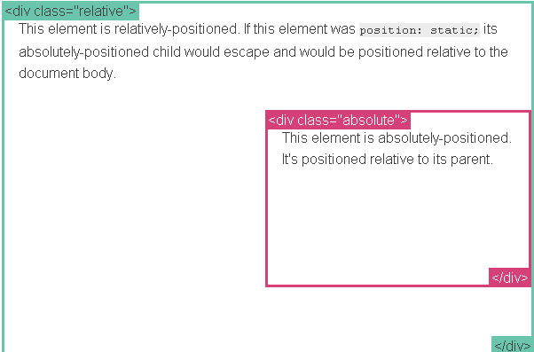
CSS Position
  Absolute:

Slide 12
CSS Display
  The display CSS property specifies the type of rendering box used for an element. In HTML, default display property values are taken from behaviors described in the HTML specifications or from the browser/user default style sheet.
  Display values:
  inline
  block
  Inline-block
  none

Slide 13
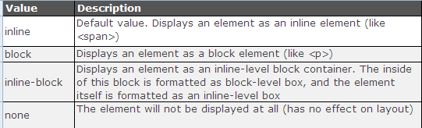
CSS Display

Slide 14
CSS Float
Elements are floated horizontally, this means that an element can only be floated left or right, not up or down.
A floated element will move as far to the left or right as it can. Usually this means all the way to the left or right of the containing element.
The elements after the floating element will flow around it.
The elements before the floating element will not be affected.
Float Values:
  Right
  Left

Slide 15
CSS Float
Turning off Float - Using Clear
Elements after the floating element will flow around it. To avoid this, use the clear property.
The clear property specifies which sides of an element other floating elements are not allowed.
Clear values:
  Left
  Right
  both

Slide 16
Reference links
http://www.barelyfitz.com/screencast/html-training/css/positioning/
http://www.w3schools.com/cssref/pr_class_display.asp

