Slide 1
HTML – Hypertext Markup Language

Slide 2
Table Design vs Div Design vs Frameset Design

Slide 3

HTML Tables
Tables represent a simple mechanism for creating rows and columns of data.
This is a great tool for laying out the content of any web page, especially when you omit the border by using:
… border = “0” …
Tables are very widely used and supported by all common browsers.
Tables use a very simple tag structure.

Slide 4
HTML Tables
In this chapter you will learn that tables have many uses in
HTML.
Objectives:
Upon completing this section, you should be able to:
Insert a table.
Explain a table’s attributes.
Edit a table.
Add a table header.

Slide 5
HTML Tables
Backgrounds
Use < body bgcolor = “ …” > for a background color with a hex version of a web-safe color:
<body bgcolor = “ccffff”>
For a tiled background using an image file:
<BODY background="backgroundPicture.gif">

Slide 6
HTML Tables
The <TABLE></TABLE> element has four sub-elements:
Table Row<TR></TR>.
Table Header <TH></TH>.
Table Data <TD></TD>.
Caption <CAPTION></CAPTION>.
The table row elements usually contain table header elements or table data elements.

Slide 7
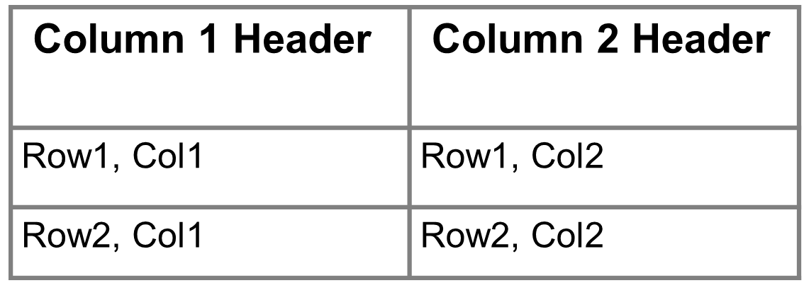
HTML Tables
<table border=“1”>
<tr>
<th> Column 1 header </th>
<th> Column 2 header </th>
</tr>
<tr>
<td> Row1, Col1 </td>
<td> Row1, Col2 </td>
</tr>
<tr>
<td> Row2, Col1 </td>
<td> Row2, Col2 </td>
</tr>
</table>

Slide 8
HTML Tables
Table Attributes
<TABLE ALIGN=“left" BORDER=0 BGCOLOR=“cyan“ width=600 cellpadding=0 cellspacing=0>
Align: "left", "center" or "right“ - "left" is the default
Border: thickness of the border in pixels - 0 for no borders
Bgcolor: is background color in HEX or as a name color
Background=url (works with IE only)
Cellpading=n (n is number of pixels (space) between cell content and its border
Cellspacing=n (n is number of pixels (space) between cells)
Height=n (height of table in pixels or percentages 100%)
Width=n (Width of table in pixels or percentages 100%)
Colspan = “n” (Merge the n columns)
Rowspan = “n” (Merge the n rows)

Slide 9
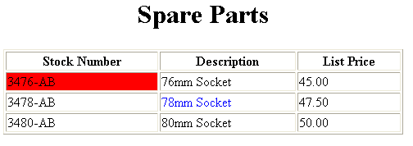
HTML Tables
<TABLE BORDER=1 width=50%>
<CAPTION> <h1>Spare Parts <h1> </Caption>
<TR>
<TH>Stock Number</TH>
<TH>Description</TH>
<TH>List Price</TH>
</TR>
<TR>
<TD bgcolor=red>3476-AB</TD>
<TD>76mm Socket</TD>
<TD>45.00</TD>
</TR>
<TR>
<TD >3478-AB</TD>
<TD><font color=blue>78mm Socket</font> </TD>
<TD>47.50</TD>
</TR>
<TR>
<TD>3480-AB</TD>
<TD>80mm Socket</TD>
<TD>50.00</TD>
</TR>
</TABLE>

Slide 10
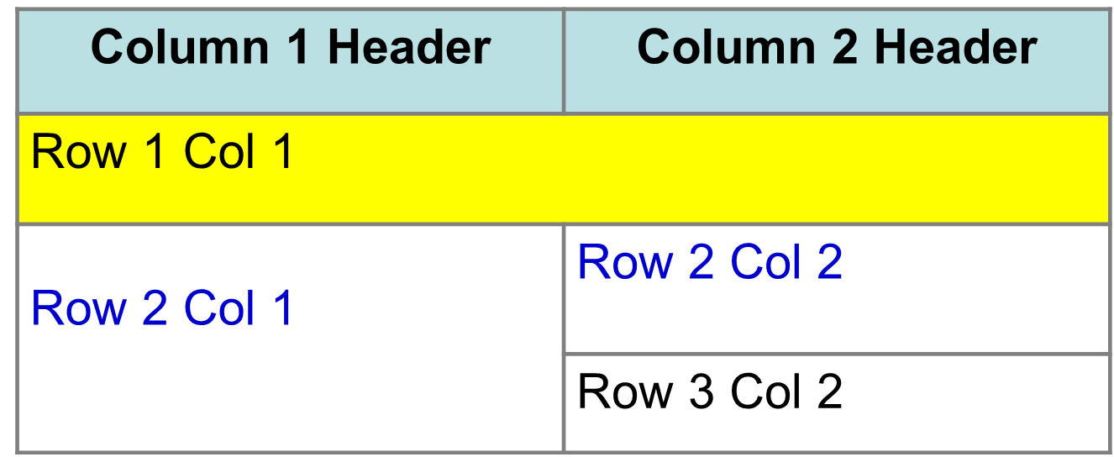
HTML Tables
<Table border=1 cellpadding =2>
<tr> <th> Column 1 Header</th> <th> Column 2 Header</th> </tr>
<tr> <td colspan=2> Row 1 Col 1</td> </tr>
<tr> <td rowspan=2>Row 2 Col 1</td>
<td> Row 2 Col2</td> </tr>
<tr> <td> Row 3 Col2</td> </tr>
</table>

Slide 11

HTML Tables

Slide 12
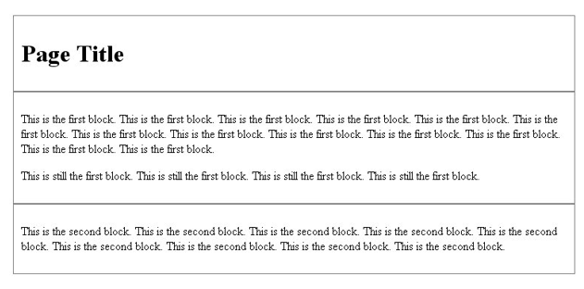
HTML DIV
The div element is a block level element used for grouping HTML elements.

Slide 13
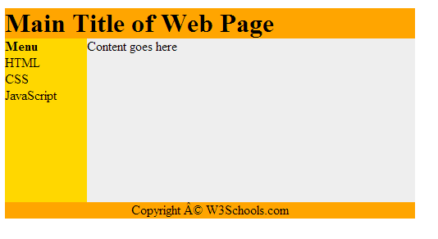
HTML DIV
The div element is a block level element used for grouping HTML elements.

Slide 14
HTML DIV vs html table
Most of the web designers directly chose the table based layout for their websites. Reason behind this is it's very easier to design a webpage rather than going for div based layout or the web designers are not that much familiar with CSS. But there are lots of drawbacks in it. Page Size will Increase Table has lot of inner tags like TR, TD, TH and each inner tag will have separate styles in it. Need to write styles for each and every tag. Surely it will increase the page size and because of that downloading speed and the network bandwidth will get increased. Whereas in Div layout, it's just the single tag Div, all the styles can be declared in the CSS files, which reduce the web page size. Page rendering will be slow Page rendering will be slower in table based layout, because page content won't be displayed until the end tag of table reached. But in Div based layout, rendering will be faster, since it won't wait for the end tag for the content display.

Slide 15
HTML DIV vs html table
Difficult to maintain When we want to change the design in an existing page, it's very difficult in table based layout, because code impact will be more. Whereas in div based layout, it's very easy to change the design, because everything will be handled in the CSS. No Consistency in pages In Div layout, there will be a consistency in all the pages, but in table layout if we miss any parameter like table border, padding or anything, entire content will be changed and will not be consistent in all the pages. Separating Content and Visual Presentation In div layout we are separating the HTML content and the visual presentation, so it's make the search spider of the web page to act in quick manner. Whereas in table layout, extra HTML pushes the important content further down to the page which increase the time to render the page. Search Engine Tools Div layout helps the search engine tools to search faster when compared with table layouts, since its need to traverse several HTML tags.

Slide 16
HTML frames
Frames are a relatively new addition to the HTML standard.
Objectives:
Upon completing this section, you should be able to:
Create a Frame based page.
Work with the Frameset, Frame, and Noframes elements.
Use the attributes of the Frames elements to control the display.

Slide 17
HTML frames
A framed page is actually made up of multiple HTML pages. There is one HTML document that describes how to break up the single browser window into multiple windowpanes. Each windowpane is filled with an HTML document.
For Example to make a framed page with a windowpane on the left and one on the right requires three HTML pages. Doc1.html and Doc2.html are the pages that contain content. Frames.html is the page that describes the division of the single browser window into two windowpanes.
Doc1.html
Doc2.html
Doc1.html
Doc2.html
Frames.html

Slide 18
HTML frames
Frame Page Architecture
A <FRAMESET> element is placed in the html document before the <BODY> element. The <FRAMESET> describes the amount of screen real estate given to each windowpane by dividing the screen into ROWS or COLS.
The <FRAMESET> will then contain <FRAME> elements, one per division of the browser window.
Note: Because there is no BODY container, FRAMESET pages can't have background images and background colors associated with them.

Slide 19
HTML frames
Frame Page Architecture
<HTML>
<HEAD>
<TITLE> Framed Page </TITLE>
<FRAMeSET COLS=“23%,77%”>
<FRAME SRC=“Doc1.html”>
<FRAME SRC=“Doc2.html”>
</FRAMeSET >
</HEAD>
</HTML>

Slide 20
HTML frames
The Diagram below is a graphical view of the document described above
FRAMESET COLS=”23%, 77%”
FRAME
NAME= left_pane
SRC=Doc1.html
FRAME
NAME=right_pane
SRC= Doc2.html

Slide 21
HTML frames
<FRAMESET> Container
<FRAMESET> : The FRAMESET element creates divisions in the browser window in a single direction. This allows you to define divisions as either rows or columns.
ROWS : Determines the size and number of rectangular rows within a <FRAMESET>. They are set from top of the display area to the bottom.
Possible values are:
Absolute pixel units, I.e. “360,120”.
A percentage of screen height, e.g. “75%,25%”.
Proportional values using the asterisk (*). This is often combined with a value in pixels , e.g. “360,*”.
<Frameset cols=“200,20%,*,2*”>

Slide 22
HTML frames
Creating a Frames Page
COLS: Determines the size and number of rectangular columns within a <FRAMESET>. They are set from left to right of the display area.
Possible values are:
Absolute pixel units, I.e. “480,160”.
A percentage of screen width, e.g. “75%,25%”.
Proportional values using the asterisk (*). This is often combined with a value in pixels , e.g. “480,*”.

Slide 23
HTML frames
Creating a Frames Page
FRAMEBORDER : Possible values 0, 1, YES, NO. A setting of zero will create a borderless frame.
FRAMESPACING: This attribute is specified in pixels. If you go to borderless frames you will need to set this value to zero as well, or you will have a gap between your frames where the border used to be.
BORDER(thickness of the Frame): This attribute specified in pixels. A setting of zero will create a borderless frame. Default value is 5.
BORDERCOLOR: This attribute is allows you choose a color for your border. This attribute is rarely used.

Slide 24
HTML frames
<Frame> Tag
<FRAME>: This element defines a single frame within a frameset. There will be a FRAME element for each division created by the FRAMESET element. This tag has the following attributes:
SRC: Required, as it provides the URL for the page that will be displayed in the frame.
NAME: Required for frames that will allow targeting by other HTML documents. Works in conjunction with the target attribute of the <A>, <AREA>, <BASE>, and <FORM> tags.

Slide 25
HTML frames
<Frame> Tag
MARGINWIDTH: Optional attribute stated in pixels. Determines horizontal space between the <FRAME> contents and the frame’s borders.
MARGINHEIGHT: Optional attribute stated in pixels. Determines vertical space between the <FRAME> contents and the frame’s borders.
SCROLLING: Displays a scroll bar(s) in the frame. Possible values are:
Yes – always display scroll bar(s).
No – never display scroll bar(s).
Auto – browser will decide based on frame contents.
By default: scrolling is auto.
NORESIZE: Optional – prevents viewers from resizing the frame. By default the user can stretch or shrink the frame’s display by selecting the frame’s border and moving it up, down, left, or right.

Slide 26
HTML frames
<noframe> Tag
<NOFRAMES>: Frame – capable browsers ignore all HTML within this tag including the contents of the BODY element. This element does not have any attributes.
<FRAMESET COLS="23%,77%">
<FRAME SRC="" NAME="left_pane“>
<FRAME SRC="" NAME="right_pane">
<NOFRAMES>
<P> This is a Framed Page. Upgrade your browser to support frames.</P>
</NOFRAMES>
</FRAMESET>

Slide 27
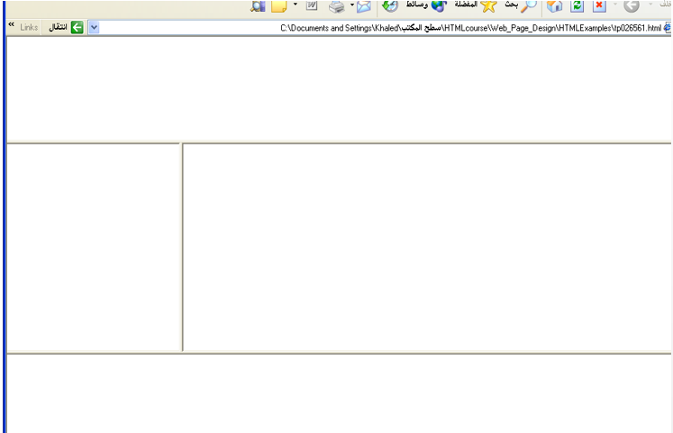
HTML frames
<HEAD>
<FRAMESET ROWS="25%,50%,25%”
<FRAME SRC="">
<FRAMESET COLS="25%,*">
<FRAME SRC="">
<FRAME SRC="">
</FRAMESET>
<FRAME SRC="">
</FRAMESET>
</HEAD>

Slide 28
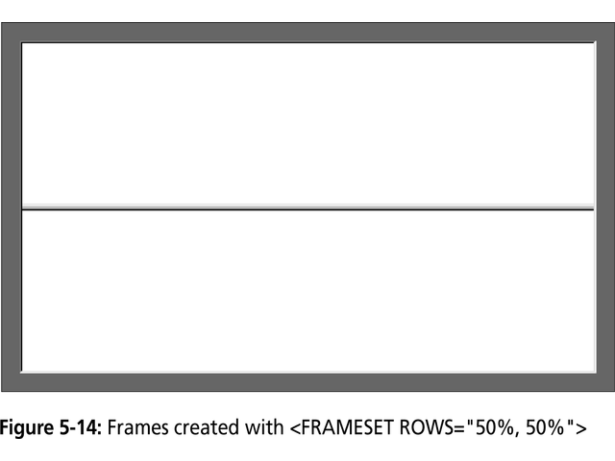
HTML frames

Slide 29
HTML frames

Slide 30
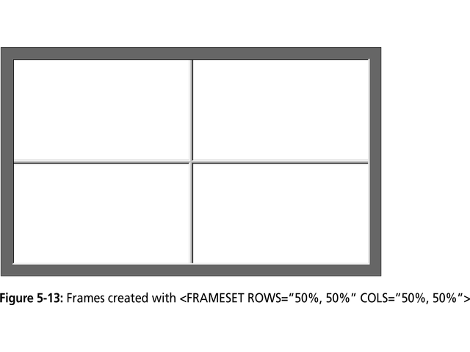
HTML frames

