Slide 1
HTML – Hypertext Markup Language

Slide 2
HTML Forms

Slide 3
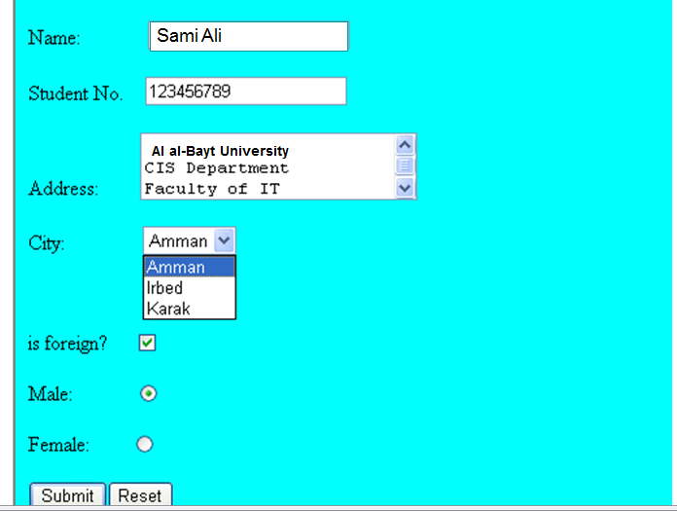

HTML Forms

Slide 4
HTML Forms
Forms add the ability to web pages to not only provide the person viewing the document with dynamic information but also to obtain information from the person viewing it, and process the information.
Objectives:
Upon completing this section, you should be able to
Create a FORM.
Add elements to a FORM.
Specify an action for the FORM.
Forms work in all browsers.
Forms are Platform Independent.

Slide 5
HTML Forms
Form elements
Input
Text
Button
Submit
Password
Hidden
Text area
Check box
Radio button
Select
Single select
Multi select

Slide 6
HTML Forms
Input types
Type=“text”
<input type="text" name="fname">
Type=“button”
<input type=“button" name="fname“ value=“Submit”>
Type=“submit”
<input type=“button" name="fname“ value=“Submit”>
Type=“password”
<input type=“password" name=“password">
Type=“hidden”
<input type=“hidden" name=“hiddenValue">

Slide 7
HTML Forms
Input types
Text area
<textarea rows="4" cols="50" /></textarea>
Check box
<input type=“checkbox" name=“checkbox" value=“checkme“/>
Radio button
<input type="radio" name=“button" value=“Radio“/>
Select
Single select
Multi select

Slide 8
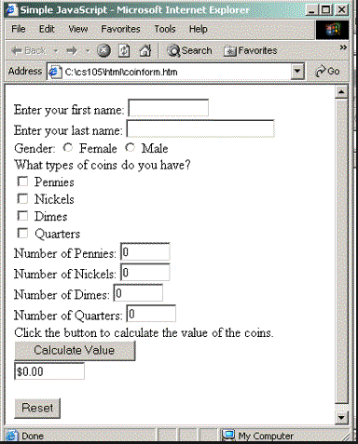
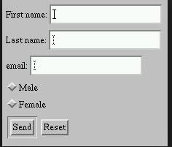
HTML Forms

Slide 9
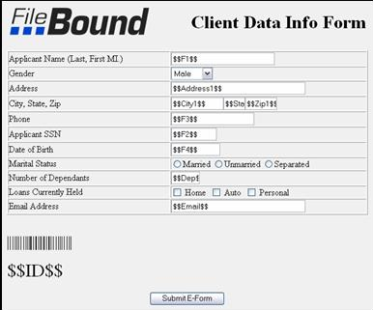
HTML Forms

Slide 10
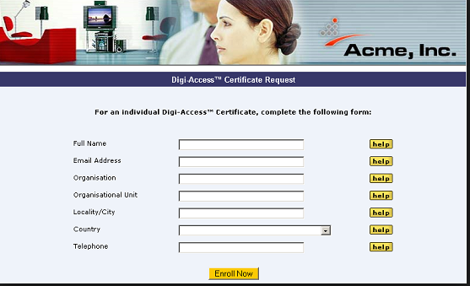
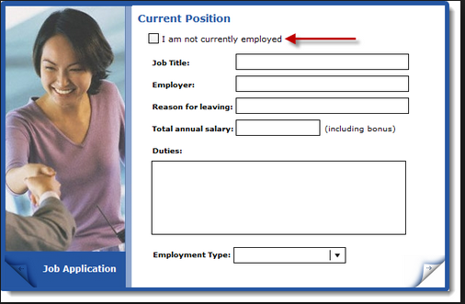
HTML Forms

