Slide 1
Stock Market Prediction Using Text Analysis
Parth Doshi | 1215200012 | pdoshi4@asu.edu | 20%
Ammar Gandhi | 1213347432 | ajgandhi@asu.edu | 20%
Akhila Muthyala | 1213175494 | amuthyal@asu.edu | 20%
Saureen Parekh | 1214327464 | sparekh1@asu.edu | 20%
Sucharitha Rumesh | 1213120166 | srumesh@asu.edu | 20%

Slide 2
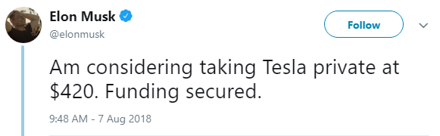
Why ML in Stock Market?
Volatile economy.
Impact of sentiments of company stakeholders.
Example - Tweet from Elon Musk, CEO- Tesla, Inc on August 7, 2018.
Notes:
Change title to Motivation.

Slide 3
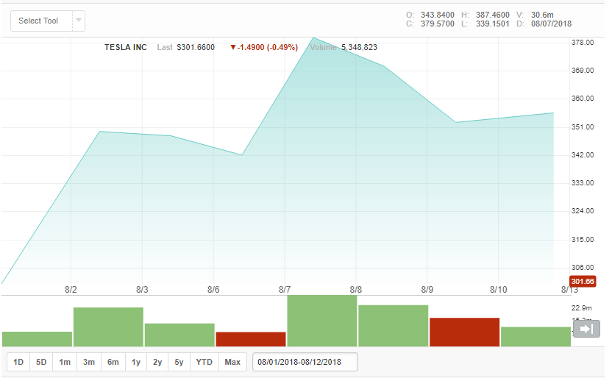
Why ML in Stock Market?
Impact -
Notes:
Synonym for Impact, Change Description

Slide 4
Technical Rationale and Approach
Top 25 articles compared with daily stock close price to determine the impact.
We use two datasets with headlines from different sources(NYTimes, Guardian) for the time period of 2007 to 2016.
Notes:
Dataset1 : NYTimes – scrapped ourselves. Dataset2 : Guardian – available online for reference.

Slide 5
Implementation
Data Preprocessing
80-20% Data split
Bag of Words
Four classifiers are implemented
Naïve Bayes
Logistic Regression
Support Vector Machine
Random Forest
Notes:
Punctuation, Stop words, lower text, stemming**

Slide 6
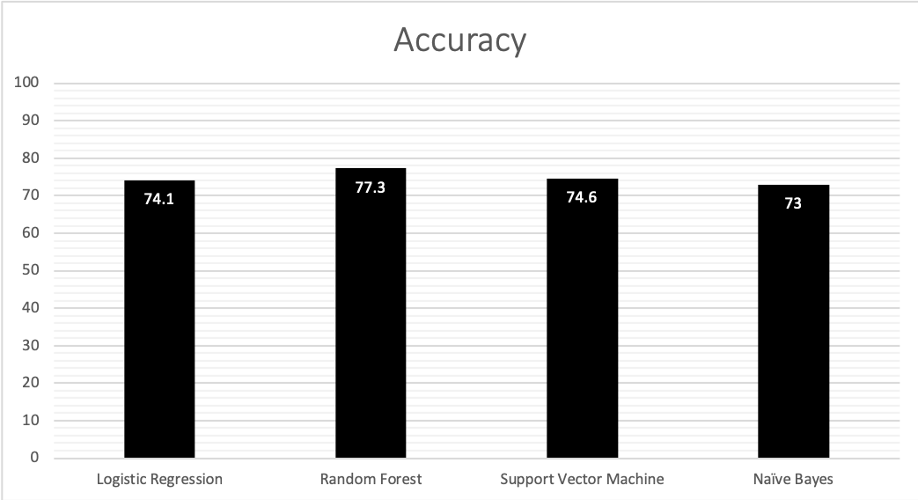
Results for NYTimes Data

Slide 7
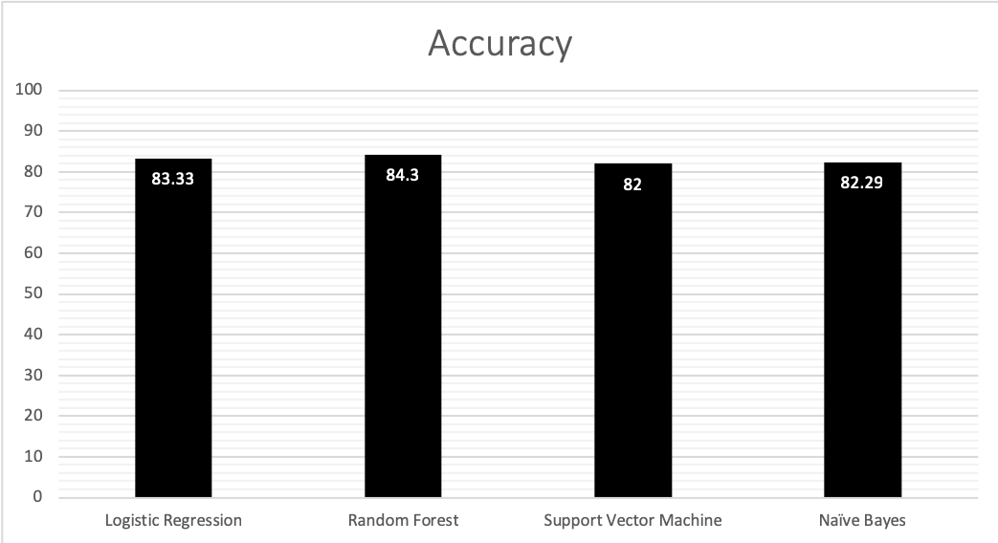
Results for Guardian’s Data

Slide 8
Results
Random Forest has the best accuracy
Multiple decision trees are built and merged together for best results.
Easy handling of large training examples.
Logistic Regression is prone to overfitting. Due to our large data size, the accuracy is less when compared to others.

Slide 9
Results
Clustered data can be difficult to separate with a margin using Linear SVM.
Naive Bayes works well with large data set, however, the accuracy of the traditional Naive Bayes classification model is still low and can be improved.
Notes:
For example, word X can be used in two different contexts and hence it will be difficult for SVM to classify data.

Slide 10
Conclusions and Future work
We can see that Random Forest provides highest accuracy among the four classifiers implemented.
Based on these results, we see the impact of news articles on stock price.
Future work - Implement these models for multiple stocks and find a trend instead of calling rise or fall.
Notes:
Future work- time series data prediction works better with LSTM(NN)

Slide 11
Individual Contribution
Parth Doshi | 1215200012 | pdoshi4@asu.edu | 20% | Logistic Regression + Data Scraping
Ammar Gandhi | 1213347432 | ajgandhi@asu.edu | 20% | Naïve Bayes and Data Collection
Akhila Muthyala | 1213175494 | amuthyal@asu.edu | 20% | Naïve Bayes
Saureen Parekh | 1214327464 | sparekh1@asu.edu | 20% | Random Forest
Sucharitha Rumesh | 1213120166 | srumesh@asu.edu | 20% | Support Vector Machine
All the team members agree on the team members’ contributions in terms of both (a) what s/he did and (b) the percentage

